Slide 1
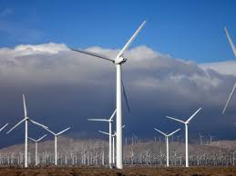
Eternal
Power
By Josie Kim & Alexis Leung

Slide 2
Question of Research
Can we generate eternal power using magnets?

Slide 3
Hypothesis
We think that we can generate eternal power by using the repelling forces of magnets to keep a turbine spinning forever.

Slide 4
What are Magnets?
Magnets are any material capable of producing its own magnetic field. We will explain magnetic fields more clearly in the next slide.
In this experiment, we used neodymium magnets because they are very strong even in low quantity. Due to this property, this type of magnet has been favored by the medical field.

Slide 5
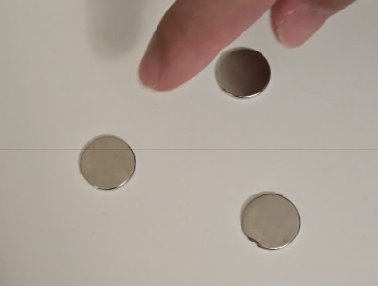
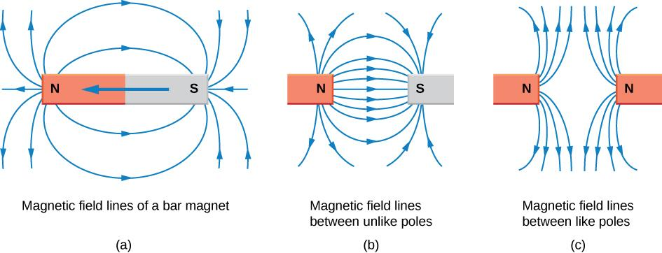
Magnetic Fields
N
Magnet 1
N
A magnetic field is a field produced by either:
A magnet
An electric current or
A changing electric field
Magnets of the same pole repel and magnets of different poles attract
A magnetic field is a field around a magnet which can be observed
Magnetic field lines always flow away from North poles and towards South poles
Magnet 3
Since all three of the magnets are the same pole, Magnet 1 and 2 are repelling Magnet 3, causing it to move forward.
N
Magnet 2

Slide 6
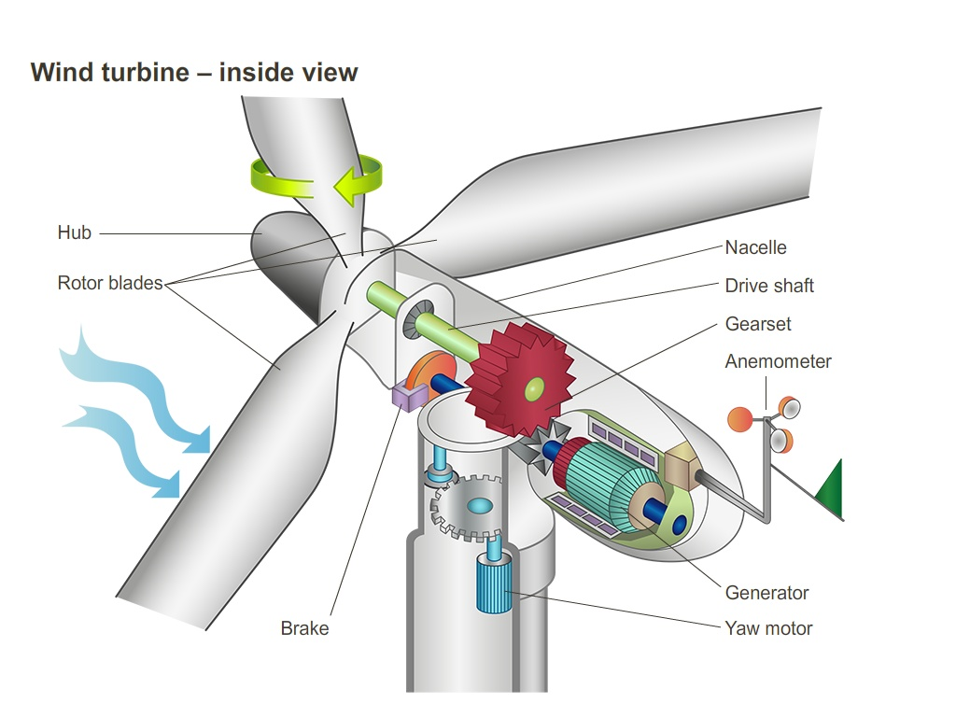
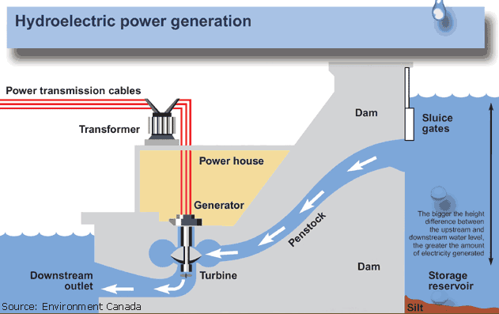
Some Ways to Generate Electricity
Wind power
Uses wind to spin the turbine
Hydroelectricity
Uses flowing water to spin the turbine
Both methods use a spinning turbine to generate electricity.

Slide 7
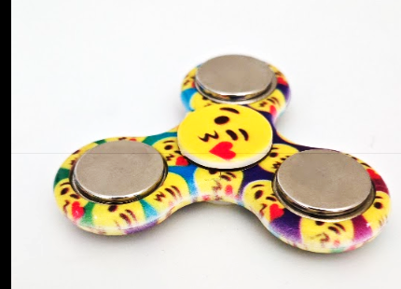
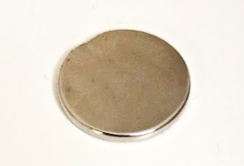
For This Experiment
We will use the repelling forces of magnets to spin the fidget spinner, which is imitating a turbine.
The reason we used a fidget spinner is because we learnt from research conducted by the State University of New York that a fidget spinner has special bearings to reduce friction when spun.
N
REPELS
N
Start here
N
N
So when we bring the magnet in, it should repel and keep the fidget spinner spinning forever.

Slide 8
Variables
Manipulated Variable: Orientation of magnets
Responding Variable: Whether it will spin
Controlled Variable: Type of magnets used, strength of magnets, number of magnets used, type of fidget spinner, size of magnets
Control: Fidget spinner without magnets on arms

Slide 9
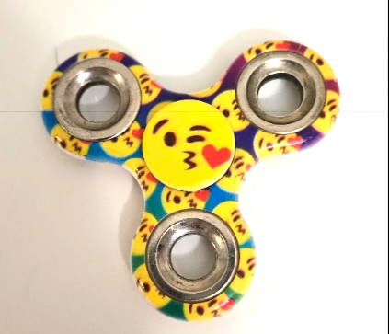
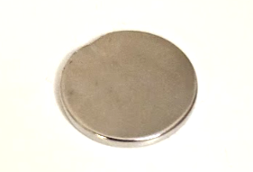
Materials
Fidget spinner (1)
Neodymium magnets (4)
Non-magnetised flat surface (wooden table top)
Magnet
Fidget Spinner

Slide 10
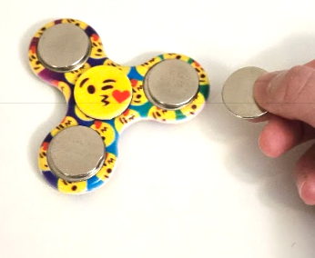
Procedure (Part 1)
We are testing how a fidget spinner with 3 magnets on each of its arms will react when a magnet in a FLAT position is brought near it.
Set up the apparatus from picture attached
Place one magnet per arm of fidget spinner
Slowly move a magnet into range in a flat position
Record results in table 1
Repeat steps 2-4 four more times
Repeat steps 3-5 with the control
Magnet
Start Here
Diagram 1
Fidget Spinner

Slide 11
Procedure (Part 2)
We are testing how a fidget spinner with 3 magnets on each of its arms will react when a magnet in an UPRIGHT position is brought near it.
Set up the apparatus from picture attached
Place one magnet per arm of fidget spinner
Slowly move a magnet into range in an upright position
Record results in table 2
Repeat steps 2-4 four more times
Repeat steps 2-5 with the control

Slide 12
Table 1 - Results for moving magnets toward the fidget spinner at a FLAT position
Trials | 1 | 2 | 3 | 4 | 5
Fidget spinner with 3 magnets | Spun about one third from starting point | Spun about one third from starting point | Spun about one third from starting point | Spun about one third from starting point | Spun about one third from starting point
Fidget spinner with no magnets (control) | Did not spin at all | Did not spin at all | Did not spin at all | Barely spun | Did not spin at all

Slide 13
Table 2 - Results for moving magnets toward the fidget spinner at a UPRIGHT position
Trials | 1 | 2 | 3 | 4 | 5
Fidget spinner with 3 magnets | Spun about one third from starting point | Spun about one third from starting point | Spun about one third from starting point | Spun about one third from starting point | Spun about one third from starting point
Fidget spinner with no magnets (control) | Did not spin at all | Barely spun | Did not spin at all | Did not spin at all | Did not spin at all

Slide 14
Observations
No significant differences observed in Part 1 and Part 2 of the experiment
After spinning around a third of the way, the fidget spinner stopped moving
In both Part 1 and Part 2 of the experiment the fidget spinner spun around the same speed
Unintended Observation
When we repeatedly alternated moving the magnet closer and further from the fidget spinner, it actually spun more
This was not recorded in Table 1 and 2 because this was not the intended experiment

Slide 15
Analysis / Discussion
Initially, after the magnets were pushed away by the repelling forces of magnets, the fidget spinner quickly stopped moving because one magnet was pushing one way and the other was pushing the other way causing it to stabilize.
This is because a magnetic field is actually fan-shaped and pushes more than one direction. Therefore, this prevented it from making a full rotation. So our initial idea of using a magnet to spin a turbine forever won’t work, as we learnt from our experiment.

Slide 16
Analysis / Discussion for Unintended Observation
The reason that the fidget spinner spun longer is by moving the magnet closer and further from the fidget spinner, we generated kinetic energy by changing the magnetic fields. The kinetic energy generated was transferred to the fidget spinner, in the form of magnetic fields. This caused it to spin longer.

Slide 17
First Law of Thermodynamics VS our Experiment
The first law of thermodynamics states that “Energy can neither be created nor destroyed, it can only be transformed from one form to another.”
If our experiment had worked, it would have violated the first law of thermodynamics because we did not put energy into it. This also explains why the Unintended Observation actually worked better because we put more energy into it.
We later discovered for our research that our experiment is referred to as a perpetual machine where it has had a lot of controversial discussions but has generally been classified as does not work.

Slide 18
Errors and Improvements
We were holding the magnet with our hands
Could have caused a change in strength to the magnet that we were holding
Should have very little impact because humans have a weak magnetic field
An improvement could be to use an unmagnetized object (e.g silicon tongs, rubber gloves)

Slide 19
Conclusion
Our hypothesis was incorrect. The fidget spinner did not spin forever. This is because we did not take into account the first law of thermodynamics. We also did not consider that magnetic fields go in a fan shape. From our experiment, we learned that we cannot generate eternal power using magnets with our setup as of today.

Slide 20
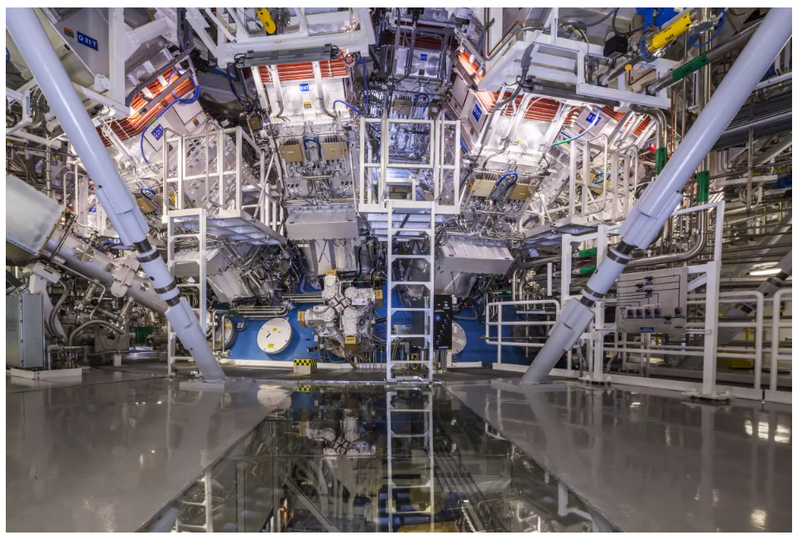
Promising Future
The first law of thermodynamics has already been broken!
It was broken during the nuclear fusion experiment on December 5, 2022 in The National Ignition Facility, located at Lawrence Livermore National Laboratory in Livermore, California, United States.
During this experiment, the scientists generated excess energy for the first time.

Slide 21
How is This Important to our Experiment?
There are upsides and downsides to every way of generating energy. For example, ways like wind power, solar power and hydroelectricity all rely on the environment to work but they are environmentally friendly. Ways like oil and gas can work any time, but heavily impact our environment by generating greenhouse gases and causing global warming.
Our way of generating electricity is environmentally friendly and works any time. The only obstacle we need to overcome is the first law of Thermodynamics. If we can learn from this nuclear fusion experiment, someday we could generate clean energy anytime and anywhere we wanted.

