Slide 1
Log Book for Experiment Projects
Ella and Ellie

Slide 2
Dates we met:
Dec. 5 - Watched this video - https://www.youtube.com/watch?v=xcsIbotRdc4&t=1000s
Dec. 12 - Project and Partner conversation
Jan 9 - Dr. Gorman is coming to talk to us all about Science Fair and the Scientific Method.
Jan 20 - We worked on our hypothesis, procedure, and problem.
Jan 21 - We worked on our materials, trifold layout, and talked about how we were gonna wrap them
Jan 22 - We talked about the letter we were gonna send to on of our experts and wrapped 1 of our variables
Jan 23 - We started cutting stuff for our trifold and emailed some experts
Jan 25 - We got a response from William miller and recorded his response
Jan 26 - We got a response from David Wee and continued printing and cutting

Slide 3
Dates we met:
Jan 27 - We cut out and glued a lot of our steps
Jan 28 - We continued cutting and glueing and finished the layout
Feb 2 - we started our trifold and finished the rest of our steps e.g. conclusion, results, sources of error, etc.
Feb 3 - we continued our trifold
Feb 4 - we continued our trifold and worked on our script.
Feb 6 - we continued our trifold and worked on our script.
Feb 11 - we continued our trifold and worked on our script.
Feb 20 - we finished our script and trifold.
Feb 25 - school shocase
We also worked on it most days after school at home by our selves.

Slide 4
Dates we met:
March 3 - we filled out all of our information on the cysf site.

Slide 5
Why we chose this topic and who would be interested in our research?
We chose this topic because some people can't afford to buy a green house so we want to make an affordable greenhouse for all four seasons because most greenhouses can cost between $1000 for a basic DIY kit or up to $100 000 for a very large and substantial one. Also if you don't have enough room in your house but are still interested in having a greenhouse, hopefully our presentation will give you some ideas. Both of us are very interested in growing plants and the idea of greenhouses so that also gave us some inspiration.

Slide 6
Problem: the specific question you are investigating in your research.
Our problem is greenhouses are very expensive and when people can’t afford one, they set it outside without any protection. Another problem is if you have something like a fruit plant, animals, such as squirrels and bunnies will eat them. Also, it might take a lot of resources to build that greenhouse, package it up, and ship it. Plus, building a greenhouse may not be the best option for some folks physical abilities so hopefully they will be able to get some ideas from our project

Slide 7
Hypothesis:
Our hypothesis is that the grass will grow the best in the plastic bin covered with poly sheeting because greenhouses are often built with plastic or glass covered with poly sheeting so it is very similar to a an official greenhouse. Greenhouses are often made with plastic and wrapped with poly sheeting so it is most like a greenhouse. We also think this will grow the best because it is the largest space which means it can trap the most heat.

Slide 8
Background Research
what is the purpose of a greenhouse?
The purpose of a greenhouse is to protect plants from freezing temperatures. Trapping the sun's rays in your greenhouse can quickly create an oven. Although it is important to trap heat in your greenhouse, it is also very important that you don't trap to much heat or else your plants might get over heated. Maintaining a temperature range is critical to keeping your plants safe, and healthy.
Size
If you want to grow mostly seeds in your greenhouse, a smaller greenhouse is more suitable. But, if you want to grow larger plants, a larger greenhouse or environment is recommended.
Flooring
The choice of flooring will impact a greenhouse more than you think.
1)A bare ground may be the most affordable, but it allows bugs and pests to dig from underneath and enter the interior. When the plants are being watered, it also creates an uneven surface for the plants to grow on which affects their growth. 2)Pea Gravel is very affordable and works quite well. On hot days, spraying the gravel will help keep the space cool, which will also help keep the temperature constant. Animals and bugs prefer not to dig through pea gravel so not as many critters are able to get into the greenhouse. 3)Bark mulch is avoided by most gardeners due to increase of pest issues. Another problem is when the air gets to humid, bark mulch becomes much more challenging to maintain. 4)Even though crushed marble is more expensive than the others, the results are some of the best! With all of the small pieces mushed together, it creates a smooth surface. Much like Pea Gravel, crushed marble reduces pest invasions and diseases . It will also reflect the sunlight to keep your plants warm in the winter.

Slide 9
Background research slide 2
Placement
One of the best spots to put a greenhouse is a very sunny spot. This is because more sun can enter the greenhouse. Even if you've used the best materials out there, its extremely important to set you're greenhouse on a base. The base will provide a more stable position and give the greenhouse a long, healthy life. A tip is to set the end of a greenhouse facing the east. This lets the long side to face the south which allows it to get most direct sunlight. Also, set in on the south or southeast side of a structure or home that may obstruct light.
Must haves
Ventilation - it is vital to have a ventilation system in a greenhouse to keep the air flowing and maintain a good temperature. In every greenhouse, there are inevitably pockets of warmer, and colder air. These will make sure the plants are healthy and keep the air moving. Depending on the size of the greenhouse, each will need two to five different fans for proper ventilation and air flow. Vents do a good job of allowong hot air to escape the greenhouse.
Temperature monitor - These help with keeping track of the temperature in the greenhouse.
Heat - When planning to grow in a greenhouse, heat mats are recommended by many. Even if it is below 0 degrees Celsius, the seedlings will continue to not only survive, but survive. When placed under plants, heating mats can increase surrounding areas by 10 degrees Fahrenheit. When you use these, be careful. You don't want to overheat the plants or that could lead to a setback.
Electricity - most of the items in this section of our research require electricity. So, to let a greenhouse run smoothly, gardeners often hook up an extension cord to let electricity run through. In the past few years, new electricity devices have been introduced to provide solar energy. These would also be a great option.
shade cloth - Shade cloths are commonly used when the light getting into the greenhouse gets too intense. This blocks out all of the light coming into the greenhouse so the plants don't get over heated.

Slide 10
Background research slide 2
Placement
One of the best spots to put a greenhouse is a very sunny spot. This is because more sun can enter the greenhouse. Even if you've used the best materials out there, its extremely important to set you're greenhouse on a base. The base will provide a more stable position and give the greenhouse a long, healthy life. A tip is to set the end of a greenhouse facing the east. This lets the long side to face the south which allows it to get most direct sunlight. Also, set in on the south or southeast side of a structure or home that may obstruct light.
Must haves
Ventilation - it is vital to have a ventilation system in a greenhouse to keep the air flowing and maintain a good temperature. In every greenhouse, there are inevitably pockets of warmer, and colder air. These will make sure the plants are healthy and keep the air moving. Depending on the size of the greenhouse, each will need two to five different fans for proper ventilation and air flow. Vents do a good job of allowong hot air to escape the greenhouse.
Temperature monitor - These help with keeping track of the temperature in the greenhouse.
Heat - When planning to grow in a greenhouse, heat mats are recommended by many. Even if it is below 0 degrees Celsius, the seedlings will continue to not only survive, but survive. When placed under plants, heating mats can increase surrounding areas by 10 degrees Fahrenheit. When you use these, be careful. You don't want to overheat the plants or that could lead to a setback.
Electricity - most of the items in this section of our research require electricity. So, to let a greenhouse run smoothly, gardeners often hook up an extension cord to let electricity run through. In the past few years, new electricity devices have been introduced to provide solar energy. These would also be a great option.
shade cloth - Shade cloths are commonly used when the light getting into the greenhouse gets too intense. This blocks out all of the light coming into the greenhouse so the plants don't get over heated.

Slide 11
Experts we Interviewed:
We sent a total of six emails to six experts across north america and three of them replied: David wees, neil mattson, and william miller. Each of their answers were very different. For example, we asked them how much their greenhouses at their universities costed and their answers ranged between $120-$500 per square foot or $90 000 usd for a substantial greenhouse.
Link for full answers and replies - https://docs.google.com/document/d/1jnzFgQX_aMhyCHj4OrIYKNvjN3qCIhF45SFdTx3MS8E/edit?tab=t.0

Slide 12
Variables: The things that have an effect on experiment are called variables.
Our manipulated variable is our container that we will be storing the grass in.
Controlled Variable:
Our controlled variable is our plant that we were going to be using called grass. We will take this plant and put in our different objects/ habitats to test and see what will be the most practical.
Responding Variable: Our responding variable is the grass being grown with just poly sheeting

Slide 13
Procedure:
1. Gathered all variables
2. We went and bought grass seeds, fertiliser, and jiffy cups.
3. put all the items we bought into variables
4. set each of the variables in a window sill with sunlight
5. let them grow for 11 days
6. water them every morning and evening
7. take pictures of progress every evening
8. record observations and put data in chart

Slide 14
Materials:
6 small plots of grass that are partially grown
1 plastic bucket
1 big glass jar
Metal tin
Wood box
Poly sheeting
Scissors
tape

Slide 15
Results/Observations - What happened during your experiment?
We observed that the grass took a long time to grow if it even did. The results that worked best is just poly sheeting reaching the height 2.4cm . Then in second place was the metal tin experiment growing up to 1 cm. Plastic bin, wood box, glass jar growing 0cm.

Slide 16
Pictures/Graphs/Tables: (take pictures along the way)
Our pictures that we decided to print off are on a google doc as well as our graph and observations.
Link - https://docs.google.com/document/d/1MijX3rOITPj7nROClb2KINtmcL044GVu1uNcDnnWX_E/edit?tab=t.0

Slide 17
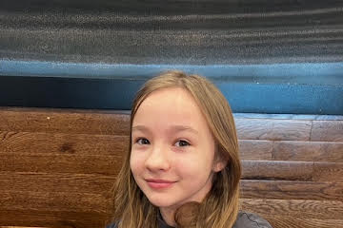

Slide 18
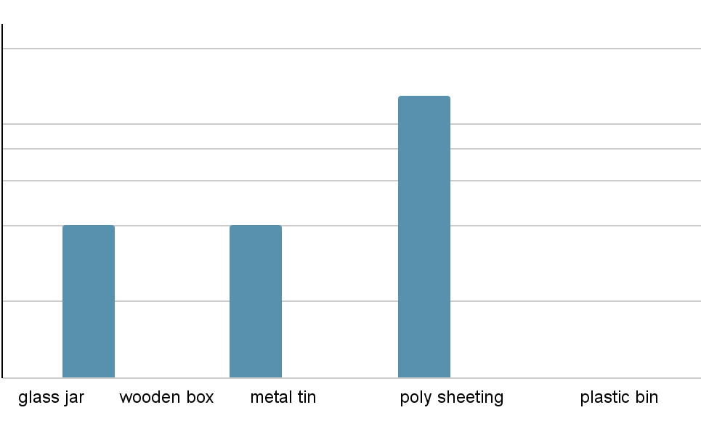
3 cm
2 cm
1 cm
0 cm

Slide 19
Conclusion: - Answers your question or hypothesis.
In conclusion, our hypothesis was wrong we thought the plastic bin would grow the best but it was nothing but polysheting. It grew 2.4 cm in 10 days. In second place is the metal tin growing at 1 cm in last place was plastic bin, glass jar, and wooden box growing at 0 cm. So, the grass growing in with nothing but poly sheeting worked the best.

Slide 20
Sources of Error:
We had trouble figuring out how to water the grass with the poly sheeting on.
We had trouble getting our experts to respond
We had trouble keeping the humidity good inside the plots
We had trouble keeping ellies dog (ken) away from the grass

Slide 21
Bibliography: Where I got my information
https://www.cysf.org/
https://en.wikipedia.org/wiki/Greenhouse
https://kids.kiddle.co/Greenhouse
https://joegardener.com/podcast/hobby-greenhouse-faqs/
https://www.canada-greenhouse-kits.ca/pages/gardening-information

Slide 22
Applications/Extensions:
Our research and experiment benefits us and others because people can use reusable items for around their house to build a environmental friendly greenhouse that is cost effective. Hopefully many people can use our research and experiment in their everyday life.

