Slide 1
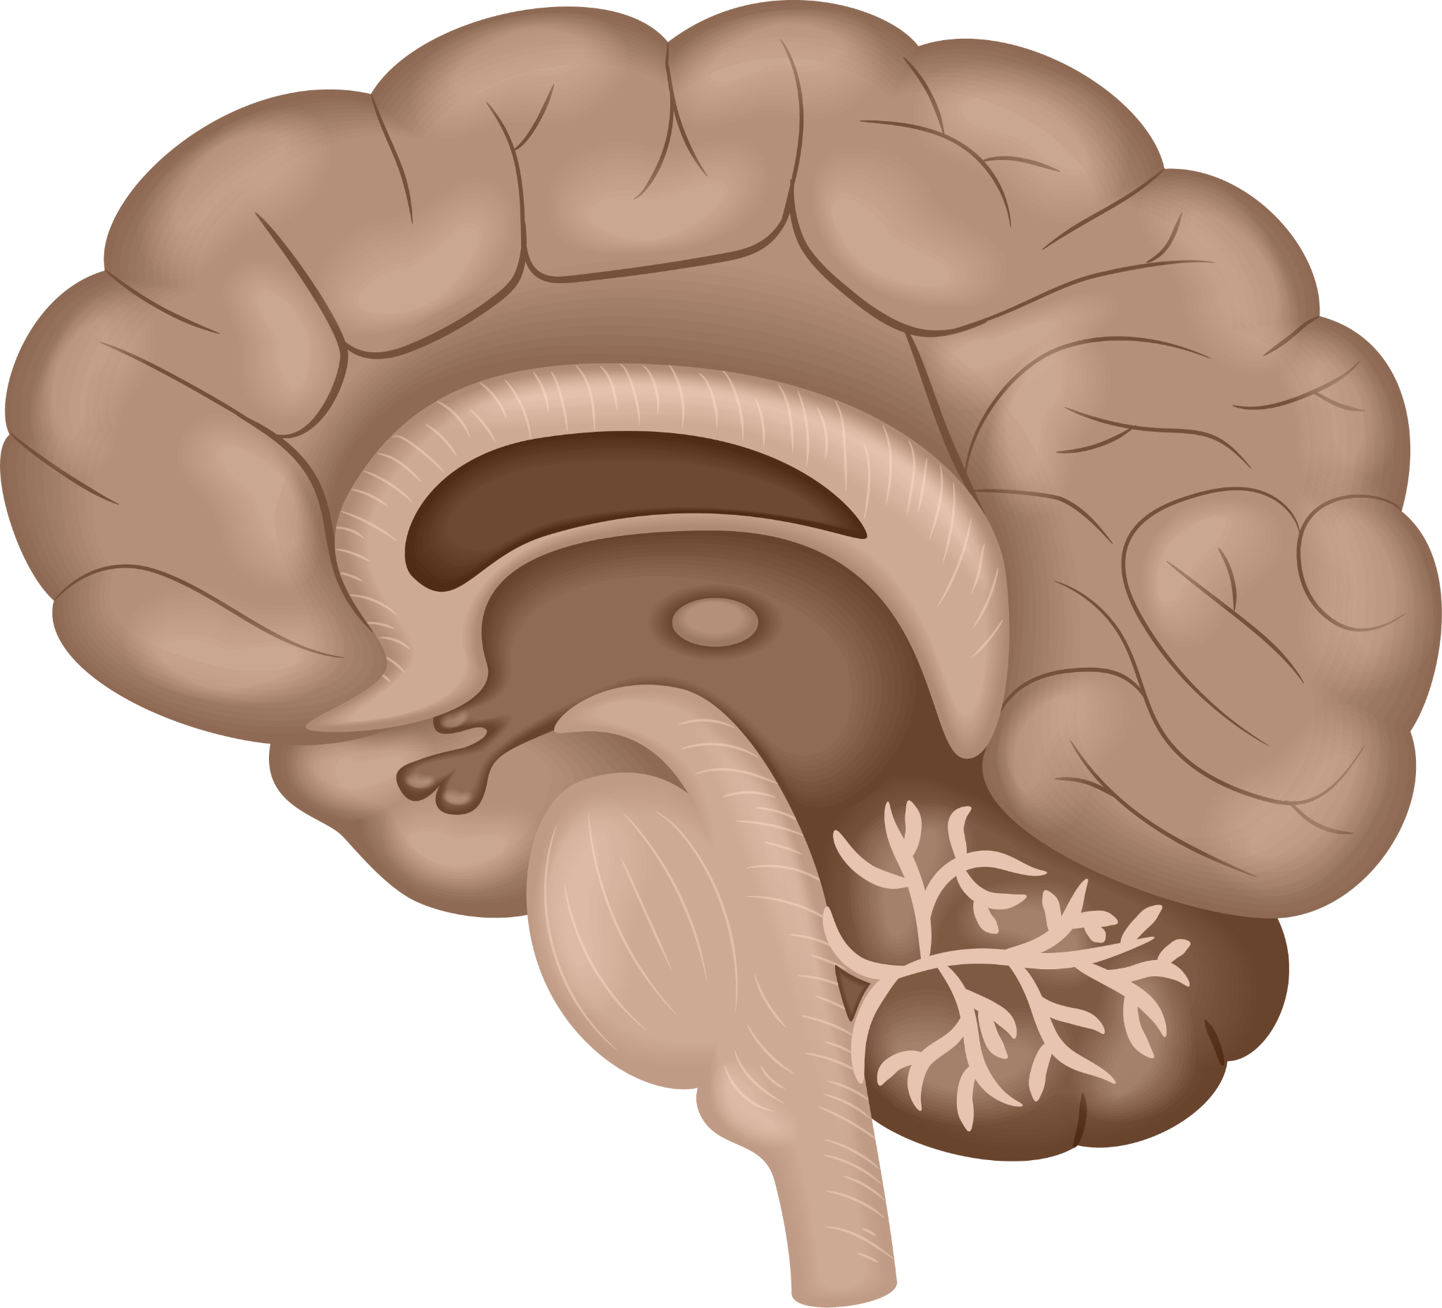
Does Feedback Improve Focus for Individuals with ADHD?
By: Inayah Asif 9B

Slide 2
Table Of Contents
01: Introduction | 07: Why is feedback important for individuals with ADHD?
02: Abstract | 08: The difference between a normal brain vs a brain with ADHD
03: Question | 09: Other ways to improve focus
04: Hypothesis | 11: Conclusion
05: Introduction to ADHD | 12: Sources and logbook
06: What is Feedback and Sustained attention

Slide 3
1
Introduction

Slide 4
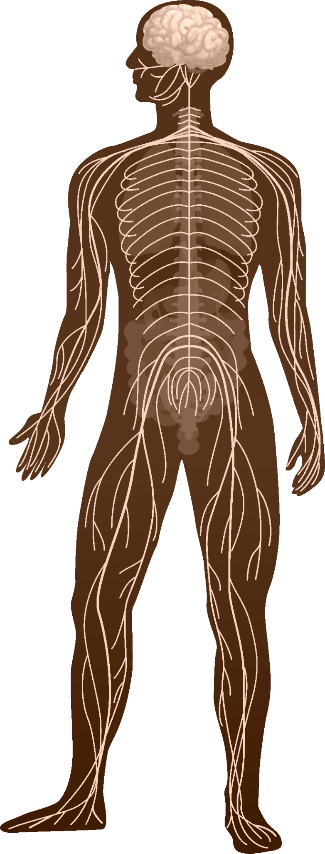
Introduction
ADHD otherwise known as Attention Deficit Hyperactivity Disorder is a condition that deters people focus, organization and leads them to distractions. For people with ADHD it makes it really hard to stay on task especially when there's a lot going around around them. My science fair is about how feedback, like encouraging and giving advice can make a change in how people with ADHD work and overall act. By feedback it could be anything like saying good job or demonstrating how to do something. I researched if getting positive feedback helped people with ADHD improve how they manage their tasks and if it helped them stay focused compared to when they got negative feedback. By researching this my goal is to learn how i can help people who have ADHD staying focused and if their overall work ethic improves. My science fair can also show how even giving a small encouragement can go make a huge difference.

Slide 5
2
Abstract

Slide 6
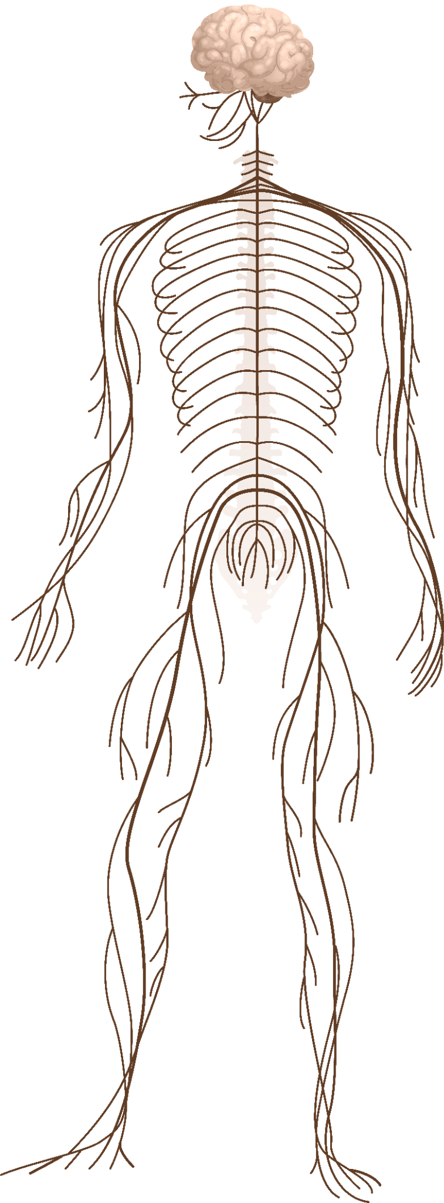
Abstract
My science fair project is about how different types of feedback improves focus for individuals with ADHD (Attention-Deficit/ Hyperactivity disorder).ADHD often causes people to not be able to complete their tasks properly, differs their attention causing them to have challenges in their work life and personal lifes. I reviewed some studies, articles and interviews about the topic. This project is mainly focused on positive and negative feedback and how individuals with ADHD focus are affected by it. Many researchers find that feedback helps people with ADHD by providing guidance, improving their overall working skills. These discoveries find that using positive feedback can help develop important and effective was for people with ADHD which improves the outcome of their work in their personal, school and work life.

Slide 7
3
Question

Slide 8
Does positive feedback improve focus more than negative feedback for individuals with ADHD?

Slide 9
4
Hypothesis

Slide 10
My hypothesis is that if you give positive feedback to an individual with ADHD, then their focus
will improve and overall work ethic as well because positive feedback would probably push them
to do their best.
Hypothesis

Slide 11
5
Introduction to ADHD

Slide 12
What is ADHD?
ADHD stands for Attention deficit hyperactivity disorder. This is now one of the most common disorders found in children nowadays. It's a brain disorder that affects your attention, sitting still and behaviour. Many people take medication and therapy for it but it will never go away but it gets better and less prominent. Some of the best working medications are methylphenidate [mei-thul-fe-nih-dayt] (Ritalin), dextroamphetamine [dek-strow-am-feh-tuh-meen] (Dexedrine), and lisdexamfetamine [lis-DEX-am-FET-a-meen] (Vyvanse). People who don't use any of those medications usually have their ADHD overtake a lot more on their brain rather than people who do use medication. Some effects of untreated ADHD are other mental health disorders like anxiety, depression, substance abuse, fidgeting, academic difficulties, lower self-esteem etc. There are 3 types of ADHD.

Slide 13
What are the different types of ADHD?
1. Inattentive ADHD: This is mainly when people are forgetful, and have trouble doing simple
tasks, or completing things they started. Usually, people with this type of ADHD tend to be
affected neurologically more and physically less.
2. Hyperactive-Impulsive ADHD: This type of ADHD is mainly more socializing. People with
this type of ADHD tend to be more extroverted and talk excessively, need something to keep
busy and usually interrupt others. People with this type of ADHD are affected physically
more and neurologically less.
3. Combined ADHD: This is the most common and is a combo of both types of ADHD.
Sometimes one side is stronger than the other and affected more.
ADHD can affect people with it in many different ways. It can interfere with learning, relationships and emotional health if left untreated.

Slide 14
6
What is feedback and sustained attention?

Slide 15

What is feedback?
Feedback is the information you give someone about something they're doing like a job or a task or even a behavior. It helps them know if their behavior/ task is being done properly and where they need to improve. Feedback is necessary because it helps people as to what they can improve on and it also gives them a sense of accomplishment. There are many different types of feedback but the main ones are positive, negative and constructive feedback.

Slide 16
What is Sustained Attention?
Sustained attention lets a person stay focused on a task or activity for a long period of time without getting distracted or mentally tired. It allows a person to have a consistent performance, such as listening to a lecture, studying for an exam, or driving for a long time. This type of attention is necessary for tasks that require concentration and thinking.

Slide 17
7
Why is feedback important for people with ADHD?

Slide 18
Why is Feedback Important for people with ADHD?
Feedback is important for people with ADHD because it gives clear, immediate and properly formed information that can help them stay focused. It changes their actions and improves their
Performance.
1. Difficulty with Self-Monitoring
People who have ADHD usually struggle with monitoring their own actions.Feedback often acts like a guide, helping them realize if their on the right track or if they need to readjust their approach.
2. Need for immediate reinforcement
Brains of people with ADHD are much more sensitive to immediate consequences or rewards. Feedback can serve as a form of positive reinforcement which motivates them to stay focused and engaged
3. Improves Focus and Task Completion Feedback helps part tasks into easy steps which reduces stress and keeps individuals focused on specific tasks. It can also bring them back to point when they become distracted

Slide 19
Why is Feedback Important for people with ADHD?pt 2
4. Enhances Learning and Skill Development
Clear and constructive feedback can help individuals with ADHD understand what their doing well and where they can work harder. This improves their skills and self confidence over a short period of time.
5. Addresses Working Memory Challenges:
People with ADHD might struggle with their memory which makes it harder to remember instructions or progress. Feedback is like a reminder/ reinforcement which keeps them in touch with their expectations.
6. Supports Emotional Regulation Encouraging feedback can boost their self-esteem and lower their frustration when they “fail”. These feelings are common among people with ADHD when they face challenges.

Slide 20
8
What is the difference between a normal brain vs a ADHD brain?

Slide 21
What's the difference between between a non-ADHD brain versus a ADHD brain?
The biggest difference between a non ADHD brain and a ADHD brain is how they handle focus, impulses and attention. People who have ADHD have less chemicals in their brain like dopamine which helps a person stay focused and motivated. In the brain with ADHD, the prefrontal cortex which is incharge of planning and organizing your tasks or work is less active which makes it harder to focus on things and finishing tasks. It also craves more stimulation which is why sometimes you can catch them fidgeting or losing focus easily. These differences doesn't necessarily mean that someone with ADHD can't be focused or organized it just means that their brain works different then regular non ADHD brains and they might just need some different things or strategies to succeed.

Slide 22
The differences
Non - ADHD brain
ADHD brain
Can focus easily on tasks even when their boring
Can start tasks, switch between tasks or multitask with ease.
Can usually find some motivation to do tasks
Usually know when a deadlines coming and have a sense of time
Emotions happen sure but they can also calm down easier and quicker
Rarely can focus when needed. For them focus turns on and off unpredictably. So they have trouble controlling their attention in certain situations.
Its a impressive achievement to even start the task because its really hard for them.
Need some sort of reward or perk to feel motivated to do something
Usually dont remember due dates or deadlines until the day of
Emotions feel overwhelming and powerful and they dont know how to control them usually.

Slide 23
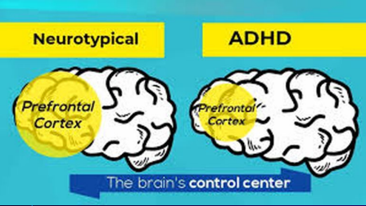
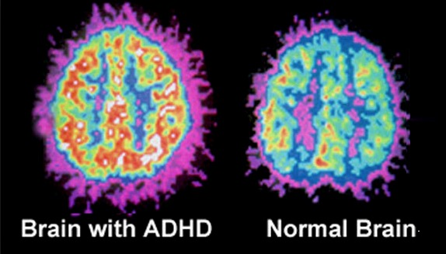
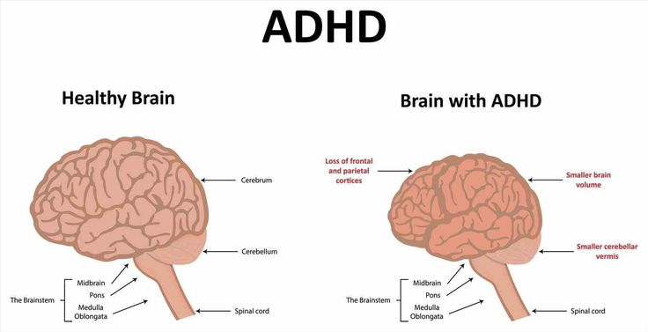
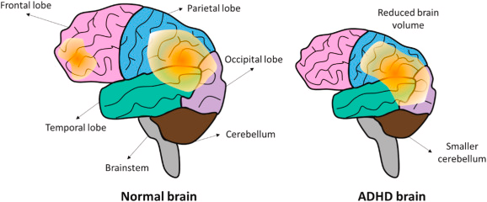
Neurotypical means normal or typical things an individual does and is not affected by any neurological disabilities
The red part is the stimulation they get vs a regular brain stimulation

Slide 24
9
Other ways to improve focus

Slide 25
Some ways and tricks to improve focus
For people with ADHD some ways to improve their focus can be to firstly and obviously get medication for it. Medication can help them in life right now and in the future. Another way to improve their focus and overall way of life is Neurofeedback. Neurofeedback basically stimulates the parts of your brain that are under stimulated and removes stimulation from parts that are too stimulated. This is what happens with brains with ADHD. Some parts are too stimulated and some parts are understimulated. You can also make little timers for your tasks to get a break after a while. Reducing distracting things while doing important tasks and wearing noise cancelling headphones can sort of silence your brain and help you focus more if you have ADHD. Having a fidget toy can also help with keeping your body busy but keeping your mind focused.

Slide 26
10
Conclusion

Slide 27
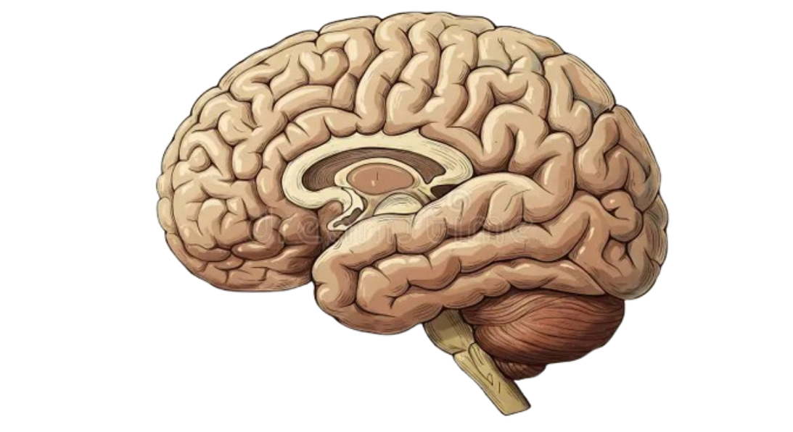
Conclusion
After doing my research my hypothesis was correct, positive feedback does increase their focus and overall the way they work. So to conclude working or interacting with people with ADHD requires patience. They don't understand things like you or others do and they understand it in their own way. Giving them negative feedback will just make them feel bad about themselves and how they work and will have them doubt themselves when in reality it isn't their fault it's just the way their brains work and you should work/ interact with them patiently and kindly.

Slide 28
11
Sources and logbook

Slide 29
Logbook
November 29 - December 1st: Picking my topic
December 2nd - 6th: Introduction,Question, Abstract and Hypothesis
December 6th - 8th: What is ADHD
December 9th - 12th: Introduction to ADHD and What is Feedback
December 13th - 17th: Why is feedback important?
December 19th - 23rd: What's the difference between a regular brain versus a brain with ADHD?
December 24th - 28th: What is Neurofeedback and how does it help with focus?
December 30th - January 2nd: Other ways to improve focus
January 3rd - 7th: Conclusion and making small edits in this
January 8th - 12th: Moving everything to Google slides

Slide 30
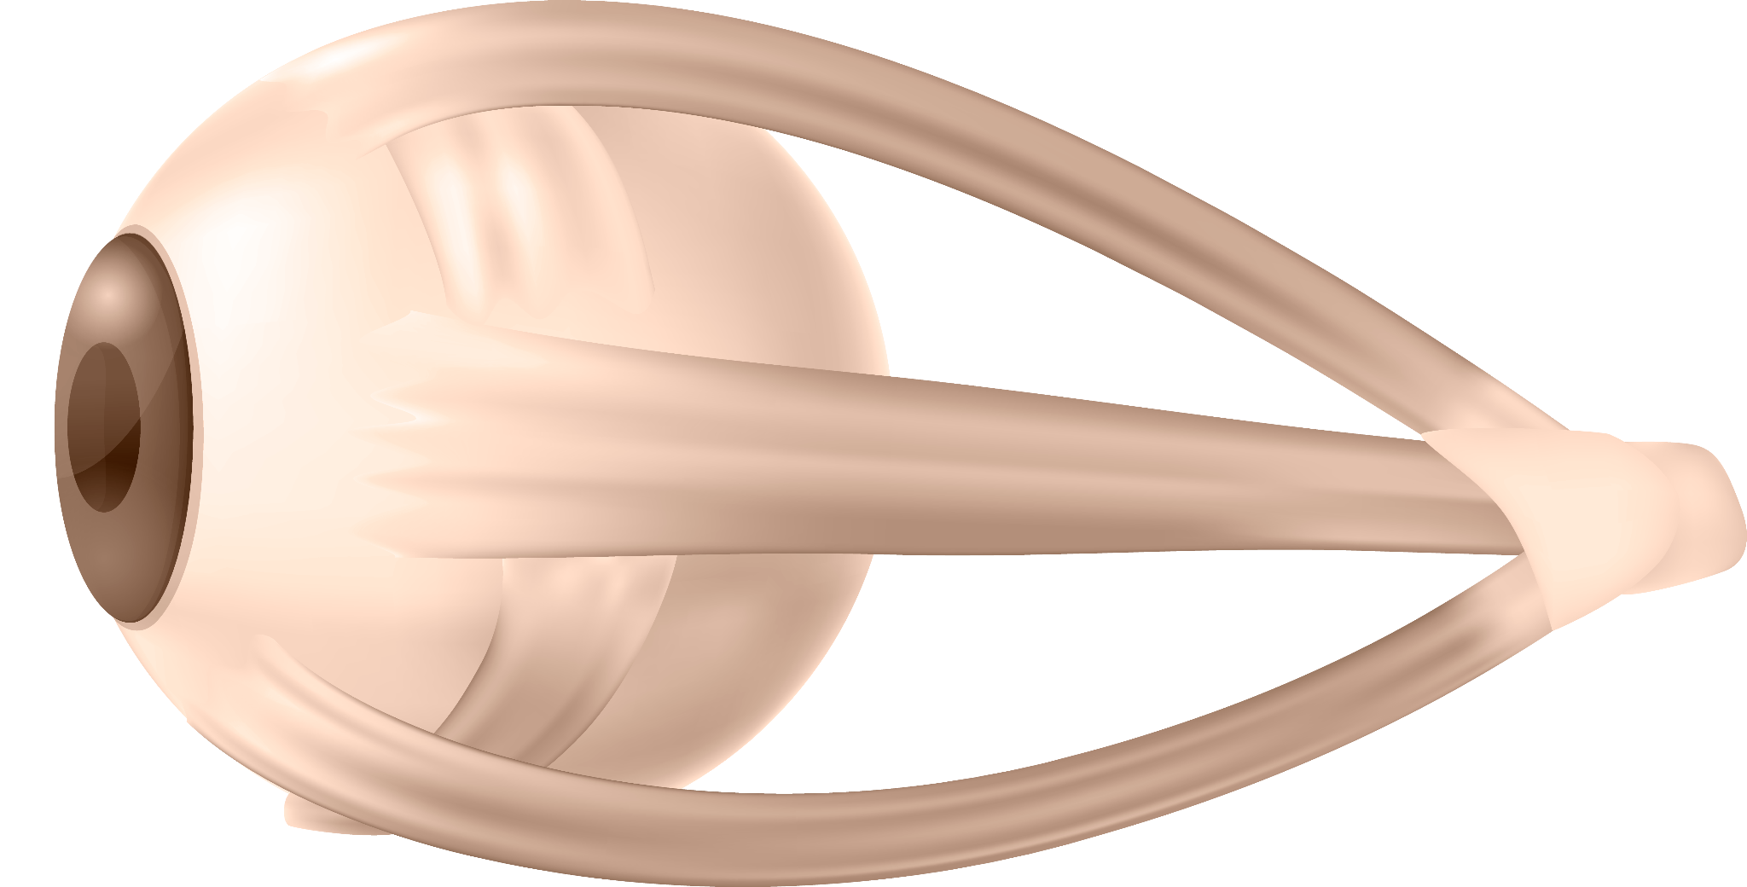
Research resources
Prioritizing giving positive feedback to individuals with ADHD
Evaluation of Neurofeedback Learning in Patients with ADHD
Reducing symptoms of attention deficit/hyperactivity disorder (ADHD) in elementary students: the effectiveness of neurofeedback
The Power of Feedback for the ADHD Brain
Can Neurofeedback Effectively Treat ADHD?

