Slide 1
Masking the Fears of Covid-19
By: Marlea Wang

Slide 2
Scientific Question
I came up with my scientific question because everyone knows what Covid-19 is. It is very serious and that is why we have to take many precautions. Probably the most important one being we have to wear masks to prevent the spread. Now there are many studies showing that the N95 mask is the best mask to wear to protect you through Covid. But this isn’t always the easiest mask that is also available to us. It is very hard for shipments to arrive in a reasonable time frame due to the lack of material and the difficulty of shipping overseas. Which quite often needs to happen. Thus, I wonder which masks that are easily available to people will be the most protective?
Scientific Question: Which mask is least permeable against water and fine powders making it protective against the Covid-19 virus?

Slide 3
Variables
Manipulated Variables
The manipulated variables for my project are the different brands of masks used. (32 Degrees, Sport Chek, Homemade, Surgical, Dust, N95, Gap)
Responding Variable
The responding variable for my project is the durability of my masks and which one is least permeable. I will be measuring the flame for the candle test, the amount of cornstarch for the vacuum test, and the speed of the water passing through for the water test.
Controlled Variable
Candle - same height and brand (President Club) of candle, same initial flame height, same elevation (on counter), same size of candle (20 cm by 6 cm), same wick length (0.8 cm first flame, 1 cm second flame)
Vacuum - same brand (Kings Ford’s), same amount of cornstarch used in each trial (enough to fill my tray with a thin layer)
Water - same amount of water (30 mL)
General - same adult mask for each brand (32 Degrees, Sport Chek, Homemade, Surgical, Dust, N95, Gap masks)
Though, one thing to note is that it is physically impossible for the air flow going through the mask to be the exact same because at different temperatures you could be getting differences in amount of air, temperature of air, and where it goes through your body.

Slide 4
Background Research
experiment = using laser, cardboard box, light sheet make person talk see particles (Bai, 2020)
experiment showed hundreds droplets (ranging 20-500 micrometers) generated saying simple phrase (Bai, 2020)
but nearly all droplets blocked when damp cloth covered mouth (Bai, 2020)
people who = influenza/common cold found wearing surgical mask reduced amount respiratory viruses emitted droplets aerosols (Bai, 2020)
Coronavirus = illness caused by virus spread from person to person (Q&A, 2020)
Covid-19 symptoms range from mild to severe illness (Q&A, 2020)
fever, cough, fatigue, loss taste/ smell, nasal congestion, conjunctivitis (a.k.a. red eyes), sore throat, headache, muscle/ joint pain, skin rash, nausea/ vomiting, diarrhea, chills/ dizziness, shortness breath, loss appetite, confusion, pain/ pressure in chest, high temperature, irritability, reduced consciousness, anxiety, depression, sleep disorder, severe neurological complications (strokes, crain inflammation, delirium, nerve damage) (Q&A, 2020)
become infected close contact about 6 feet (2 arms lengths) with person who has Covid (CDC, 2021)
Infected = respiratory droplets infected person coughs/ sneezes/ talks (CDC, 2021)
Infected = touching surface/ object has virus on it then touch mouth/ nose/ eyes (CDC, 2021)

Slide 5
Background Research
best way protect yourself stay home/ wear mask/ clean, disinfect frequently touched surfaces/ wash hands often soap water at least 20 seconds (CDC, 2021)
older people = higher risk (CDC, 2021)
stay home = sick (CDC, 2021)
avoid public transportation/ carpooling/ taxis (CDC, 2021)
separate from other people/ pets (CDC, 2021)
most protective mask = N95 masks because filter out large, small particles from breath (Ringer, 2020)
32 Degrees masks made of ultra-fine yarns knitted high density performance fabric (single layer) (Peyser, 2020)
Sport Chek masks made of soft 100% cotton jersey knit (soft fabric) (triple layer) (Forzani, 2020)
85% polyester, 15% spandex (Peyser, 2020)
Homemade masks made of fabric, cotton (double layer) (Davis, 2020)
Surgical masks made of non-woven fabric, polypropylene (better bacteria filtration, air permeability) (triple layer) (Hensley, 2020)
Dust masks made of cloth-like filter material (silicone, neoprene, rubber) (triple layer) (Osha Bulletin, 2011)

Slide 6
Background Research
Medical N95 made of multiple layer of nonwoven fabric (polypropylene) (triple layer+woven) (Henneberry, 2020)
made of synthetic plastic fibers (polypropylene) rubber, metal straps/ staples/ nose bar (Talhelm, 2020)
material most commonly polypropylene (Talhelm, 2020)
Gap made of 100% cotton printed poplin (triple layer) (Fisher, 2020)
higher resistance = less flow (air) (CTaylor, 2014)
tighter material interlaced together = not much air flowing through (less chance Covid) (CTaylor, 2014)
tight-knit fabric = feel smooth, loose-knit fabric = bumpy/ ridged (MasterClass, 2021)

Slide 7
Background Research
My manipulated variable in this project will be the different brands of masks used. (32 Degrees, Sport Chek, Homemade, Surgical, Dust, N95, Gap) I will be doing a candle, vacuum, and water test on all 7 of these masks. Based on my research, it has shown that 32 Degrees masks have high-density, performance fabrics. Knitted together are ultra-fine yarns that are only single layered. Whereas, Sport Chek was a triple layered mask that is 100% cotton jersey knit. Similarly, is the Homemade mask which is also made out of cotton but is double layered. Having triple layer is Surgical masks that are made out of non-woven, polypropylene fabric for better bacteria filtration and air permeability. Next, is Dust masks that are made out of cloth-like filtering material some popular ones being, silicone, neoprene, or rubber and is triple layered. Closely, is N95 masks being interesting because it has 3 layers of nonwoven polypropylene fabric. And one woven layer. Also N95 masks have metal straps, some staples, and a nose bar. Lastly, is Gap masks which are 100% made out of cotton printed poplin where there are 3 layers of that. This shows that there are many different types of masks and they all have durabilities for each of them.
I have also learned through my research that the smoother masks have tighter knit fabrics. So using that information I have sensed that between the knit masks. The order would be 32 Degrees smoothest, Homemade, Sport Chek, and Gap least smooth. But that isn’t to say that Gap isn’t smooth. The fabric choice was just very rough.

Slide 8
Background Research
My responding variable in this project is the durability of my mask and which one is most permeable. For the candle test, I will looking at how much the flame moved when I was blowing on it. For the vacuum test, I will be measuring the amount of cornstarch on the sock and the amount of cornstarch on that mask. To measure the cornstarch on the sock I will draw squares on a clear, sheet of plastic and seeing roughly how many are covered in cornstarch. For the water test, I will be calculating the speed of the water flowing through the mask and if there is any drippage. To measure this I will use a device to record my testing then using the clock system in my device I will see how many seconds it takes for the water to empty. In conclusion, for each test I have figured a way to measure the test.

Slide 9
Hypothesis: If a mask is made from tightly woven fabrics, then it has a higher protection rate against air, dust, or water penetration. If a mask has more layers then it will have greater protection against fine powders and human breathe transmission.
32 Degrees smoothest, Homemade, Sport Chek, Gap least smooth (still smooth though)
My order = N95 masks, Dust masks, Surgical masks, 32 Degrees masks, Homemade masks, Sport Chek masks, Gap masks

Slide 10
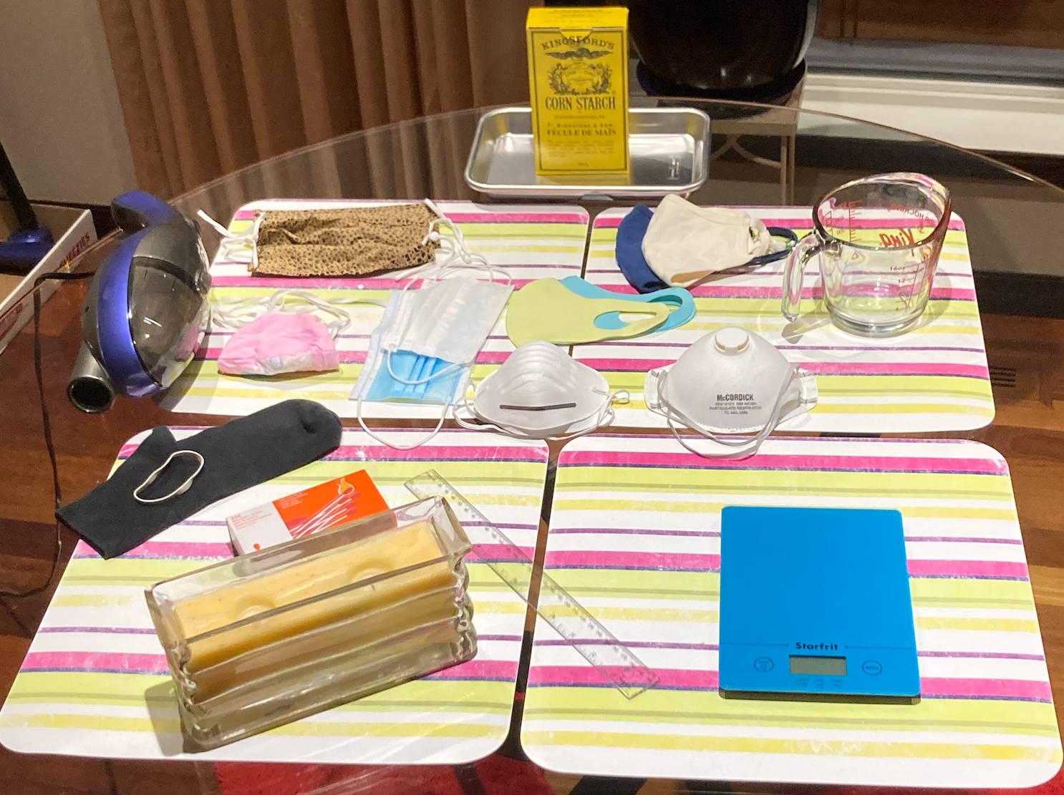
Experimental Design
Materials
Candle
Clear plastic
Corn Starch (Enough to fill tray)
Dust masks
Elastic bands
Fabric
Gap masks
Homemade masks
Matches
Measuring cup
N95 masks
Pillow case
Ruler
Sieve
Sock
Sport Chek masks
Procedure
First Test
Grab candle
Light the candle
Put the masks on one by one
Try to blow out the candle at a 20 cm length
Record whether or not it, any affect on candle
Blow out the flame
Second Test
Put mask around end of vacuum
On a tray, pour corn starch on it
Turn on your vacuum and see how much powder gets through the mask at a 5-8 mm distance off of the cornstarch for 10 seconds
Third Test
Put your mask in a sieve
Pour 30ml water on the mask
Push mask down against sieve, let water drain
See how fast the water went through
Stretchy string
Surgical masks
Thread
Threading needle
Tray
Vacuum
Water (1050 mL)
¼ inch square paper
32 Degree masks

Slide 11
Measured Data
Qualitative Changes
whether or not the candle blew out and how much the flame moved
how much corn starch was on the vacuum
how fast the water streams through the mask
Quantitative Changes
the time
how far the candle was to me
how far off the tray the vacuum was
how much water I was pouring
What recording system will work for each observation
observe whether or not the candle blew out by using my eyes and how much the flame moved
observe how much corn starch was on the vacuum with my eyes
observe how fast the water streams through the mask with my eyes
observe the time with a clock (phone)
observe how far the candle was when blowing using a ruler
observe how far off the tray the vacuum was using a ruler
observe how much water I was pouring using a measuring cup

Slide 12
Candle Testings
Date | Trial | Type | First Flame | Second Flame
21/2 | 1 | 32 Degrees | No movement | No movement
21/2 | 1 | Sport Chek | No movement | No movement
21/2 | 1 | Homemade | A lot | A lot
21/2 | 1 | Surgical | A lot | A lot
21/2 | 1 | Dust | No movement | No movement
21/2 | 1 | N95 | No movement | No movement
21/2 | 1 | Gap | A lot | A lot
Which candle flame moved the most from most to least?
Surgical, Gap 2. Homemade 3. 32 Degrees, Sport Chek, Dust, N95

Slide 13
Candle Testings
Date | Trial | Type | First Flame | Second Flame
21/2 | 2 | 32 Degrees | No movement | No movement
21/2 | 2 | Sport Chek | No movement | No movement
21/2 | 2 | Homemade | Little bit | Little bit
21/2 | 2 | Surgical | A lot | Little bit
21/2 | 2 | Dust | No movement | No movement
21/2 | 2 | N95 | No movement | No movement
21/2 | 2 | Gap | A lot | A lot
Which candle flame moved the most from most to least?
Gap 2. Surgical 3. Homemade 4. 32 Degrees, Sport Chek, Dust, N95

Slide 14
Candle Testings
Date | Trial | Type | First Flame | Second Flame
21/2 | 3 | 32 Degrees | Little bit | No movement
21/2 | 3 | Sport Chek | No movement | No movement
21/2 | 3 | Homemade | Little bit | Little bit
21/2 | 3 | Surgical | A lot | A lot
21/2 | 3 | Dust | No movement | No movement
21/2 | 3 | N95 | No movement | No movement
21/2 | 3 | Gap | A lot | Little bit
Which candle flame moved the most from most to least?
Surgical, Gap 2. Homemade 3. 32 Degrees, Sport Chek, Dust, N95

Slide 15
Candle Testings
Date | Trial | Type | First Flame | Second Flame
21/2 | 4 | 32 Degrees | Little bit | No movement
21/2 | 4 | Sport Chek | Little bit | No movement
21/2 | 4 | Homemade | Little bit | Little bit
21/2 | 4 | Surgical | A lot | Little bit
21/2 | 4 | Dust | No movement | No movement
21/2 | 4 | N95 | No movement | No movement
21/2 | 4 | Gap | A lot | A lot
Which candle flame moved the most from most to least?
Gap 2. Surgical 3. Homemade 4. 32 Degrees, Sport Chek 5. Dust, N95

Slide 16
Candle Testings
Date | Trial | Type | First Flame | Second Flame
21/2 | 5 | 32 Degrees | No movement | No movement
21/2 | 5 | Sport Chek | No movement | No movement
21/2 | 5 | Homemade | No movement | No movement
21/2 | 5 | Surgical | Little bit | No movement
21/2 | 5 | Dust | Very little bit | Very little bit
21/2 | 5 | N95 | No movement | No movement
21/2 | 5 | Gap | A lot | Little bit
Which candle flame moved the most from most to least?
Gap 2. Surgical, Dust 3. 32 Degrees, Sport Chek, Homemade, N95

Slide 17
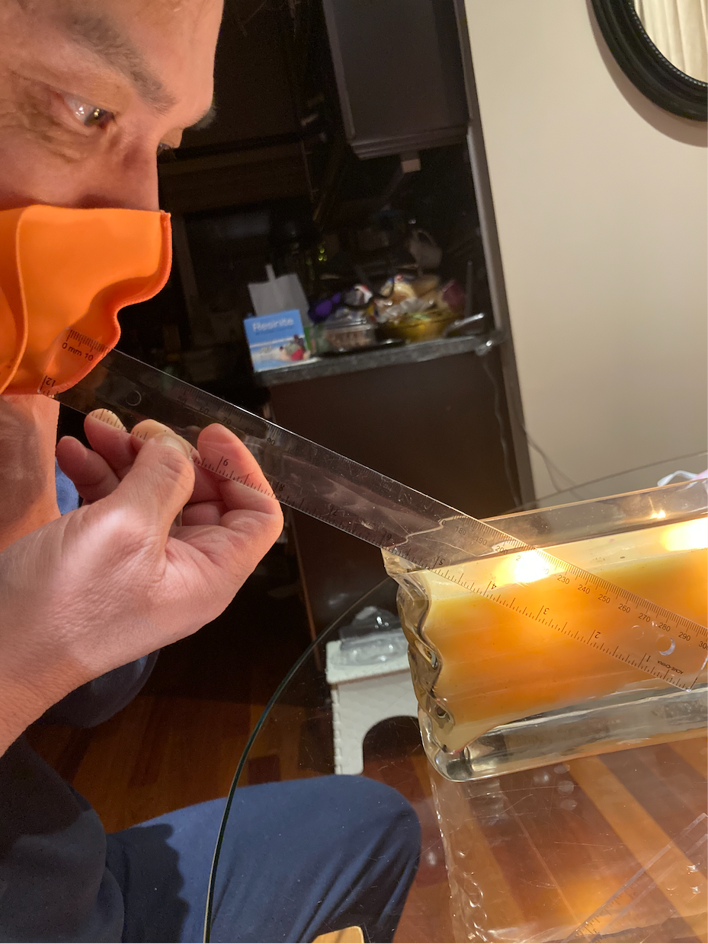
Candle Testings

Slide 18
Vacuum Testings
Date | Trial | Type | On Mask | On Vacuum | Percentage on sock
21/2 | 1 | 32 Degrees | Thin layer, 4 specks | Little bit on side | 13% = 3/24
21/2 | 1 | Sport Chek | Thin layer (inside too) | Thin layer | 33% = 8/24
21/2 | 1 | Homemade | Thin layer, many specks | Nothing | 0% = 0/24
21/2 | 1 | Surgical | 5 specks | Nothing | 0% = 0/24
21/2 | 1 | Dust | 8 specks | Nothing | 0% = 0/24
21/2 | 1 | N95 | Nothing | Nothing | 0% = 0/24
21/2 | 1 | Gap | Very thin layer, 4 specks | Nothing | 0% = 0/24
Which mask had the least amount of flour go through the mask and on the mask? Most to least?
Sport Chek 2. 32 Degrees 3. Homemade, Gap 4. Dust 5. Surgical 6. N95

Slide 19
Vacuum Testings
Date | Trial | Type | On Mask | On Vacuum | Percentage on sock
21/2 | 2 | 32 Degrees | Thin layer | Nothing | 0% = 0/24
21/2 | 2 | Sport Chek | Big layer (inside too) | Thin layer | 54% = 13/24
21/2 | 2 | Homemade | Thin layer, 4 small clumps | Nothing | 0% = 0/24
21/2 | 2 | Surgical | 2 specks | Nothing | 0% = 0/24
21/2 | 2 | Dust | 3 clumps, 4 specks | Nothing | 0% = 0/24
21/2 | 2 | N95 | Nothing | Nothing | 0% = 0/24
21/2 | 2 | Gap | Thin layer, 4 clumps, many specks | Nothing | 0% = 0/24
Which mask had the least amount of flour go through the mask and on the mask? Most to least?
Sport Chek 2. Gap 3. 32 Degrees, Homemade 4. Dust 5. Surgical 6. N95

Slide 20
Vacuum Testings
Date | Trial | Type | On Mask | On Vacuum | Percentage on sock
21/2 | 3 | 32 Degrees | Thin layer, 4 specks | Nothing | 0% = 0/24
21/2 | 3 | Sport Chek | Very thin layer, 2 speck | Small patch | 8% = 2/24
21/2 | 3 | Homemade | Thin layer, 2 small clumps, many specks | Nothing | 0% = 0/24
21/2 | 3 | Surgical | 3 specks | Nothing | 0% = 0/24
21/2 | 3 | Dust | 9 clumps | Nothing | 0% = 0/24
21/2 | 3 | N95 | Nothing | Nothing | 0% = 0/24
21/2 | 3 | Gap | Big layer | Nothing | 0% = 0/24
Which mask had the least amount of flour go through the mask and on the mask? Most to least?
Gap 2. Homemade 3. 32 Degrees 4. Sport Chek 5. Dust 6. Surgical 7. N95

Slide 21
Vacuum Testings
Date | Trial | Type | On Mask | On Vacuum | Percentage on sock
21/2 | 4 | 32 Degrees | Thin layer, 3 specks | Very thin layer | 16% = 4/24
21/2 | 4 | Sport Chek | Big layer (inside too) | Thin layer | 45% = 11/24
21/2 | 4 | Homemade | Thin layer, 4 clumps | Nothing | 0% = 0/24
21/2 | 4 | Surgical | Nothing | Nothing | 0% = 0/24
21/2 | 4 | Dust | 2 clumps, many specks | Nothing | 0% = 0/24
21/2 | 4 | N95 | Nothing | Nothing | 0% = 0/24
21/2 | 4 | Gap | Thin layer, 5 clumps, many specks | Nothing | 0% = 0/24
Which mask had the least amount of flour go through the mask and on the mask? Most to least?
Sport Chek 2. Gap 3. Homemade 4. 32 Degrees 5. Dust 6. Surgical, N95

Slide 22
Vacuum Testings
Date | Trial | Type | On Mask | On Vacuum | Percentage on sock
21/2 | 5 | 32 Degrees | 1 speck | Nothing | 0% = 0/24
21/2 | 5 | Sport Chek | Thin layer, 4 clumps | Small patch | 42% = 10/24
21/2 | 5 | Homemade | Thin layer, 3 clumps | Nothing | 0% = 0/24
21/2 | 5 | Surgical | 3 specks | Nothing | 0% = 0/24
21/2 | 5 | Dust | 1 clumps, many specks | Nothing | 0% = 0/24
21/2 | 5 | N95 | Nothing | Nothing | 0% = 0/24
21/2 | 5 | Gap | Thin layer, many clumps | Nothing | 0% = 0/24
Which mask had the least amount of flour go through the mask and on the mask? Most to least?
Gap 2. Sport Chek 3. Homemade 4. Dust 5. 32 Degrees, Surgical 6. N95

Slide 23
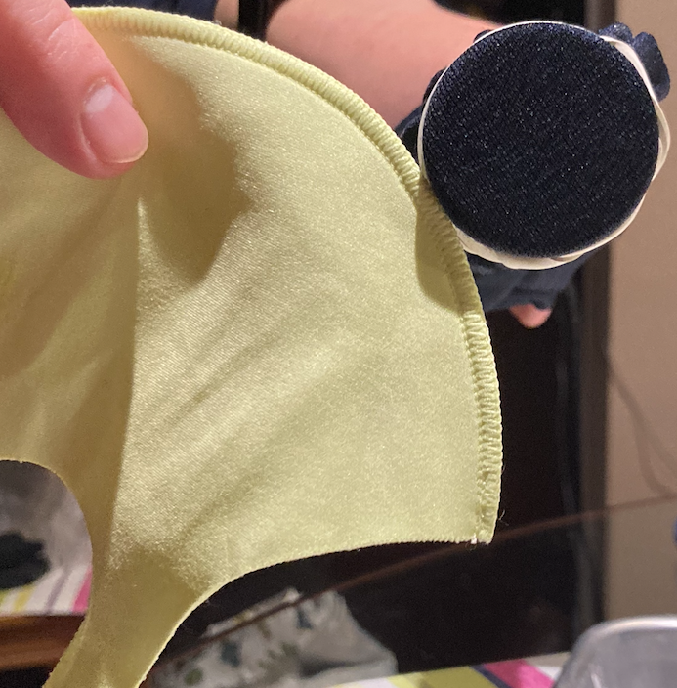
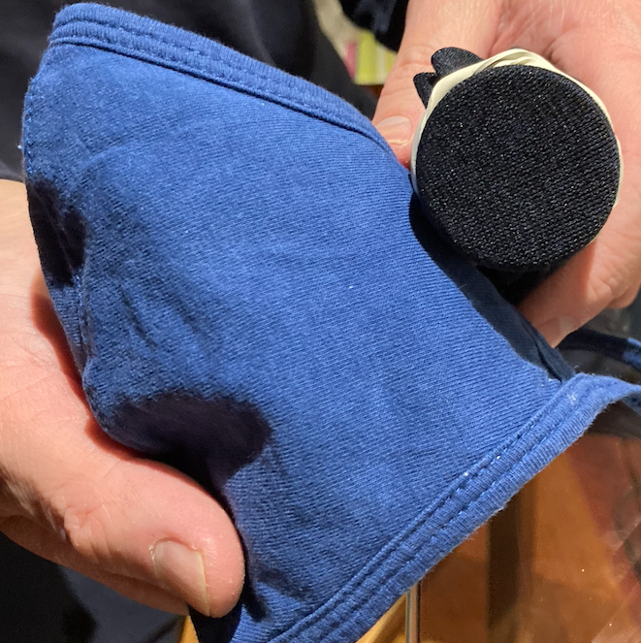
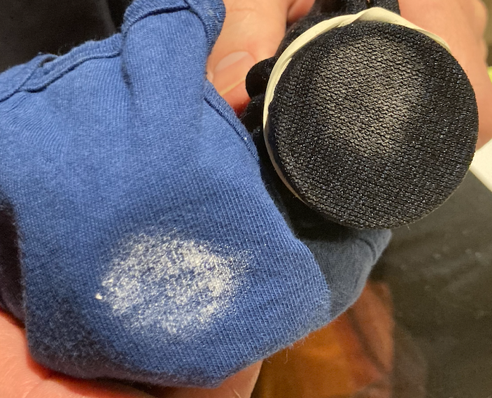
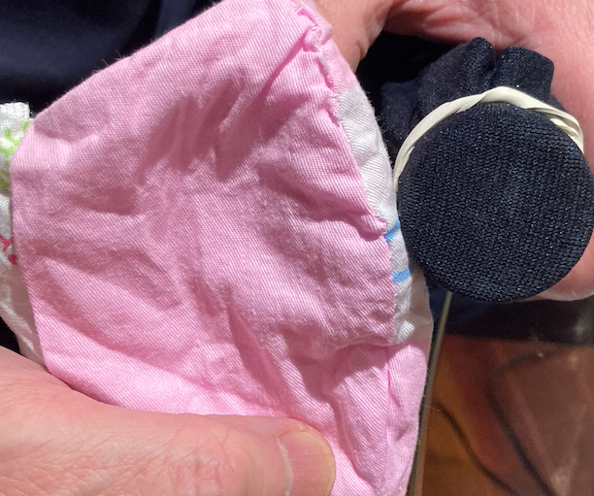
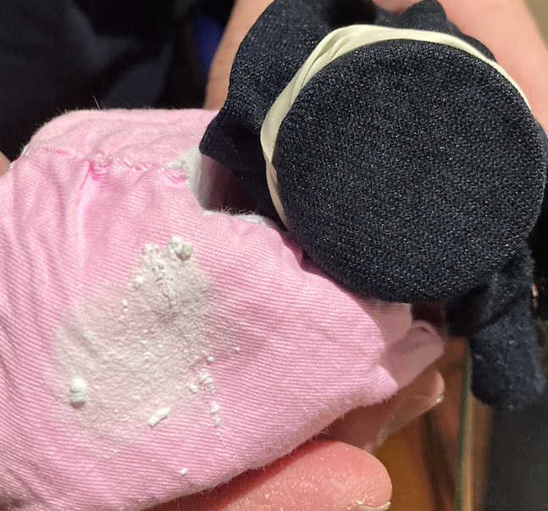
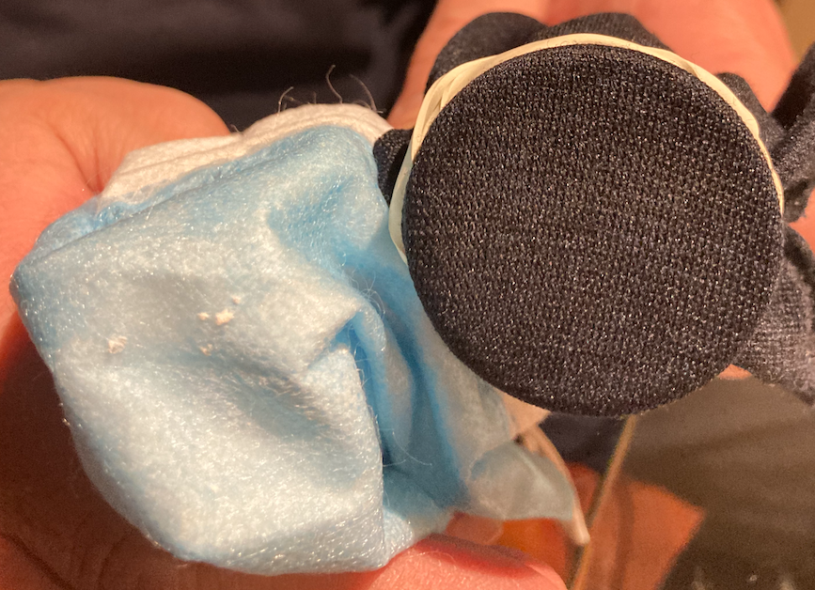
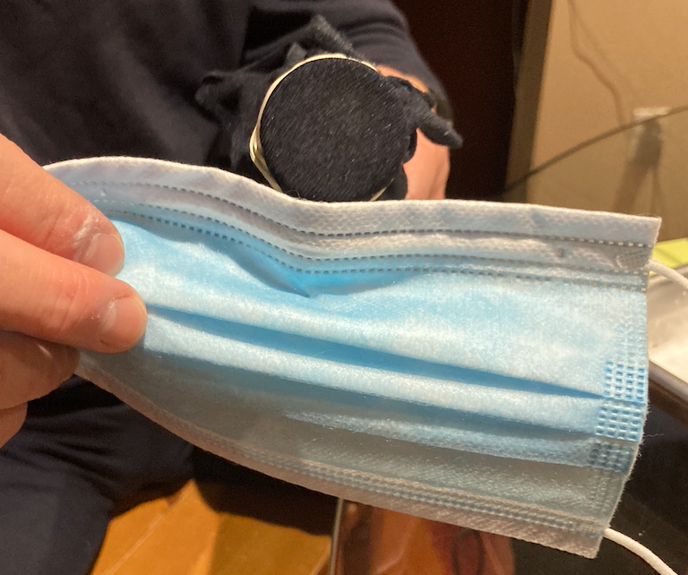
Vacuum Testings

Slide 24
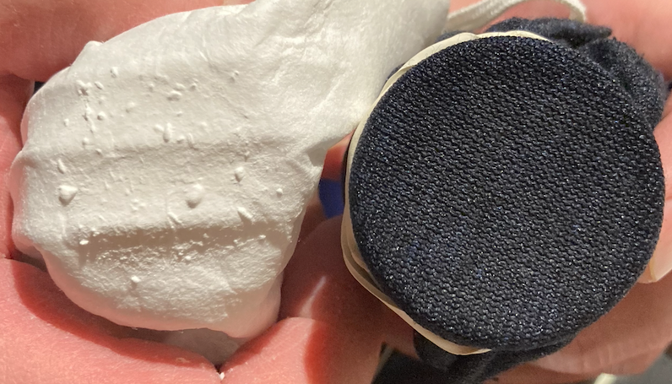
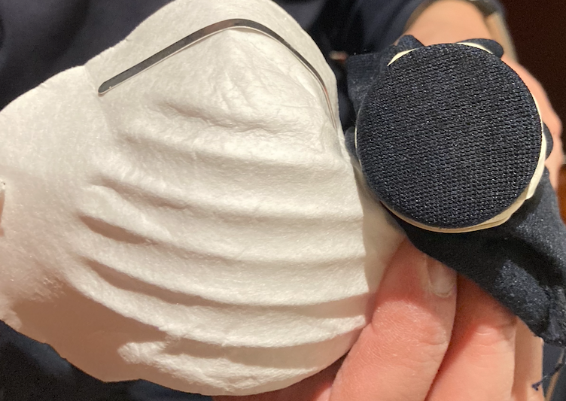
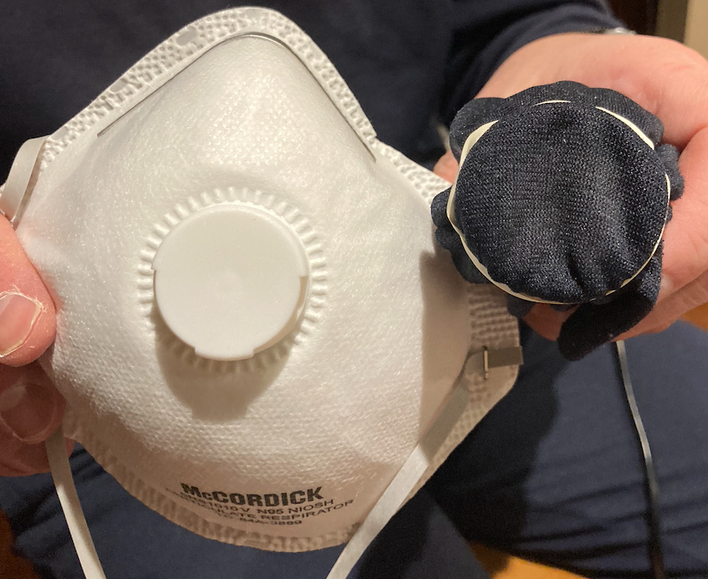
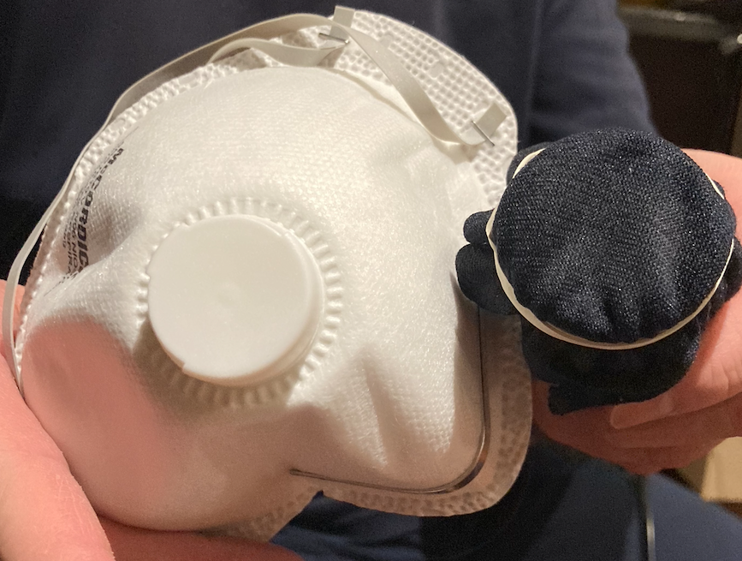
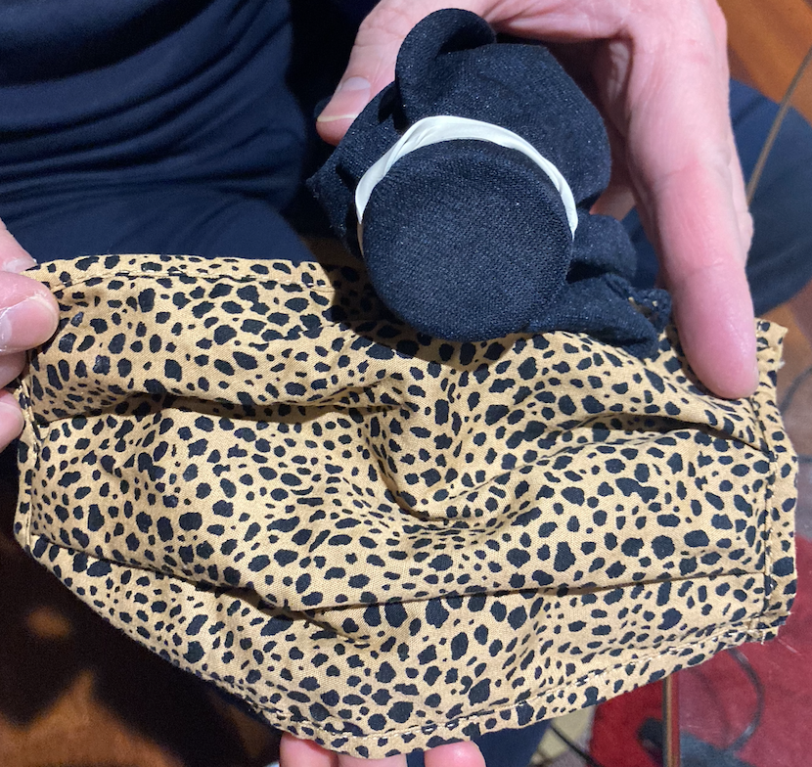
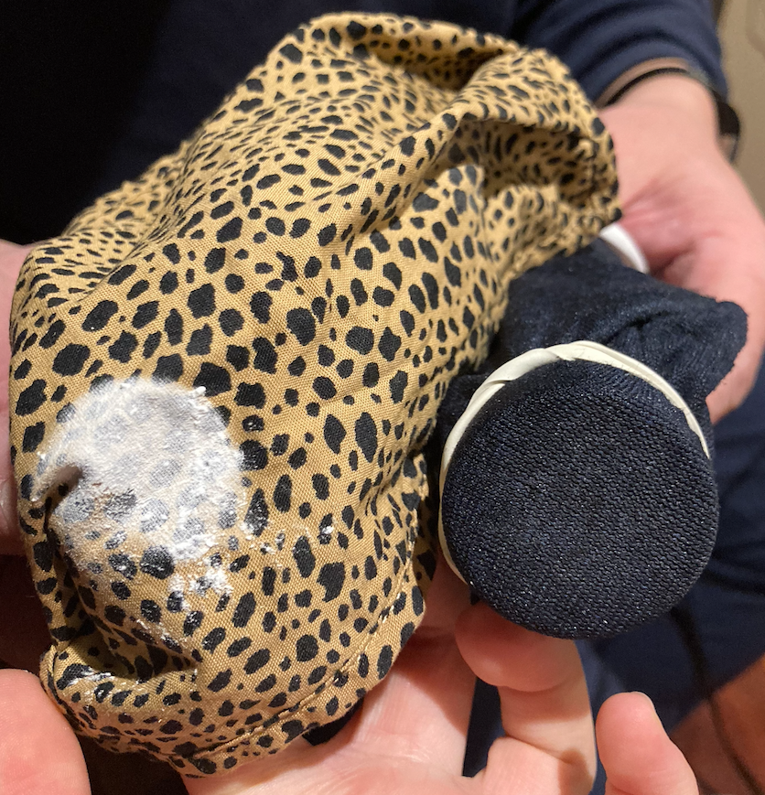
Vacuum Testings
5-8 mm

Slide 25
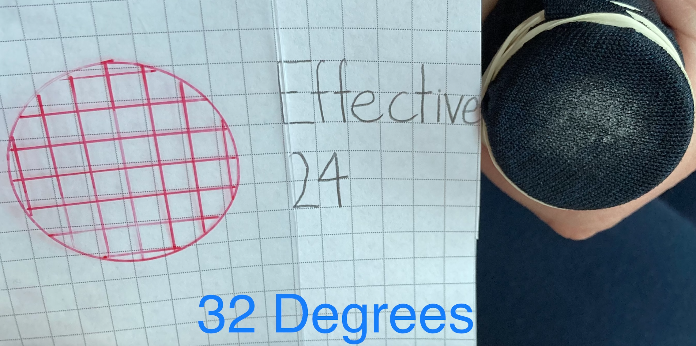
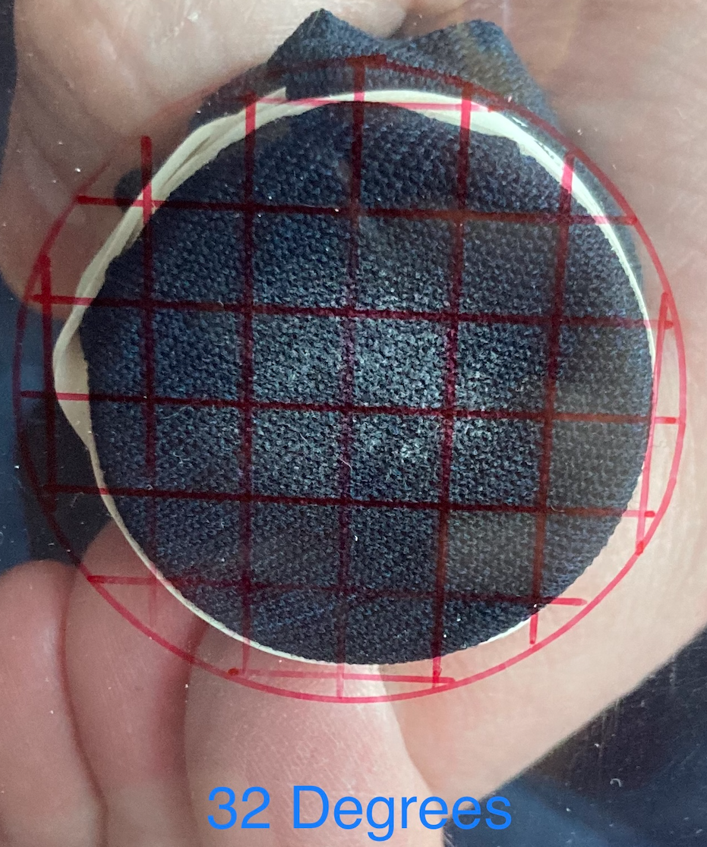
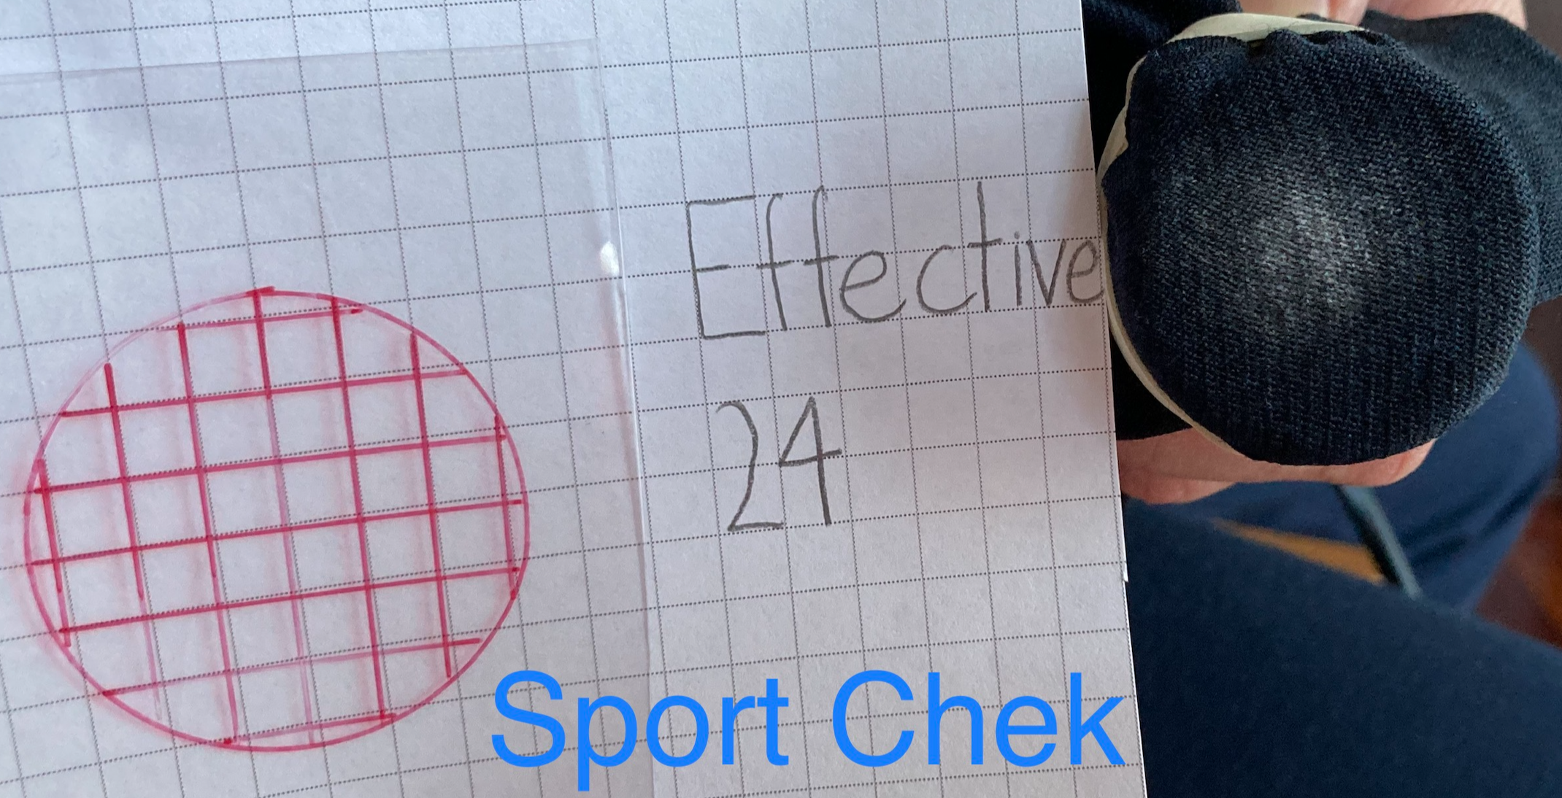
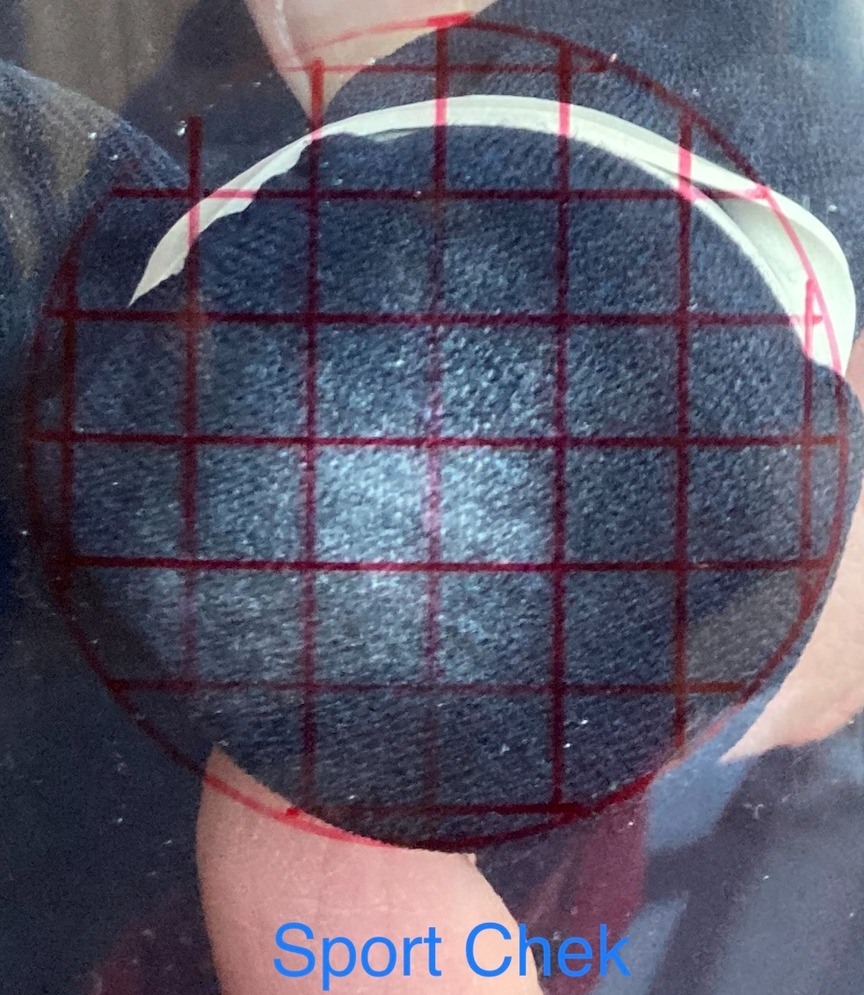
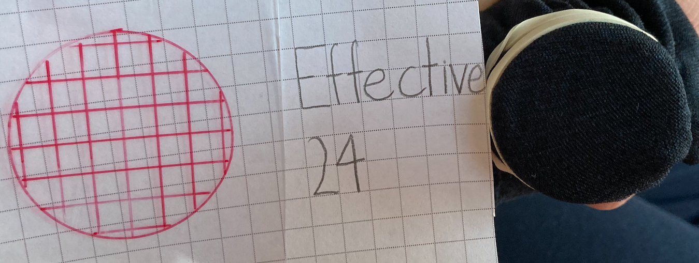
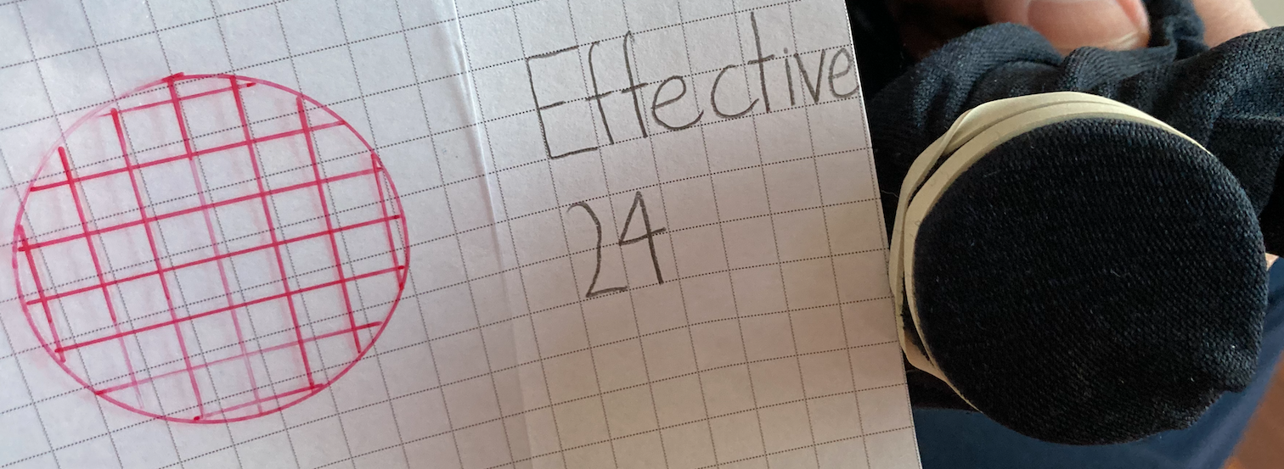
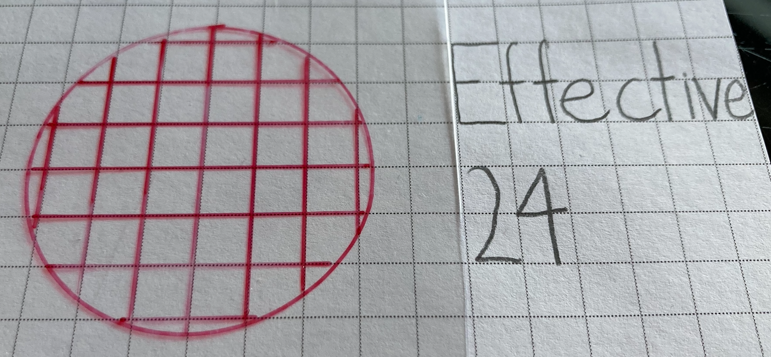
Vacuum Testings

Slide 26
Water Testings
Date | Trial | Type | Speed of Water (Dripping included) (seconds) | Dripping? (seconds)
21/2 | 1 | 32 Degrees | 18 | Yes, 5
21/2 | 1 | Sport Chek | 10 | Yes, 1
21/2 | 1 | Homemade | 23 | Yes, 9
21/2 | 1 | Surgical | 17 | Yes, 8
21/2 | 1 | Dust | Stayed in the mask | No
21/2 | 1 | N95 | 6 | No
21/2 | 1 | Gap | Stayed in the mask | No
Which mask had the slowest speed of water flowing down? Slowest to fastest?
Dust, Gap 2. N95 3. Sport Chek 4. Surgical 5. 32 Degrees 6. Homemade

Slide 27
Water Testings
Date | Trial | Type | Speed of Water (Dripping included) (seconds) | Dripping? (seconds)
21/2 | 2 | 32 Degrees | 19 | Yes, 11
21/2 | 2 | Sport Chek | 20 | Yes, 6
21/2 | 2 | Homemade | 32 | Yes, 15
21/2 | 2 | Surgical | 29 | Yes, 22
21/2 | 2 | Dust | Stayed in the mask | No
21/2 | 2 | N95 | 5 | Yes, 1
21/2 | 2 | Gap | Stayed in the mask | No
Which mask had the slowest speed of water flowing down? Slowest to fastest?
Dust, Gap 2. N95 3. 32 Degrees 4. Sport Chek 5. Surgical 6. Homemade

Slide 28
Water Testings
Date | Trial | Type | Speed of Water (Dripping included) (seconds) | Dripping? (seconds)
21/2 | 3 | 32 Degrees | 17 | Yes, 8
21/2 | 3 | Sport Chek | 14 | Yes, 4
21/2 | 3 | Homemade | 28 | Yes, 12
21/2 | 3 | Surgical | 25 | Yes, 20
21/2 | 3 | Dust | Stayed in the mask | No
21/2 | 3 | N95 | 7 | Yes, 1
21/2 | 3 | Gap | Stayed in the mask | No
Which mask had the slowest speed of water flowing down? Slowest to fastest?
Dust, Gap 2. N95 3. Sport Chek 4. 32 Degrees 5. Surgical 6. Homemade

Slide 29
Water Testings
Date | Trial | Type | Speed of Water (Dripping included) (seconds) | Dripping? (seconds)
21/2 | 4 | 32 Degrees | 20 | Yes, 10
21/2 | 4 | Sport Chek | 14 | Yes, 4
21/2 | 4 | Homemade | 27 | Yes, 11
21/2 | 4 | Surgical | 22 | Yes, 16
21/2 | 4 | Dust | Stayed in the mask | No
21/2 | 4 | N95 | 5 | No
21/2 | 4 | Gap | Stayed in the mask | No
Which mask had the slowest speed of water flowing down? Slowest to fastest?
Dust, Gap 2. N95 3. Sport Chek 4. 32 Degrees 5. Surgical 6. Homemade

Slide 30
Water Testings
Date | Trial | Type | Speed of Water (Dripping included) (seconds) | Dripping? (seconds)
21/2 | 5 | 32 Degrees | 18 | Yes, 6
21/2 | 5 | Sport Chek | 19 | Yes, 5
21/2 | 5 | Homemade | 28 | Yes, 14
21/2 | 5 | Surgical | 20 | Yes, 10
21/2 | 5 | Dust | Stayed in the mask | No
21/2 | 5 | N95 | 4 | No
21/2 | 5 | Gap | Stayed in the mask | No
Which mask had the slowest speed of water flowing down? Slowest to fastest?
Dust, Gap 2. N95 3. 32 Degrees 4. Sport Chek 5. Surgical 6. Homemade

Slide 31
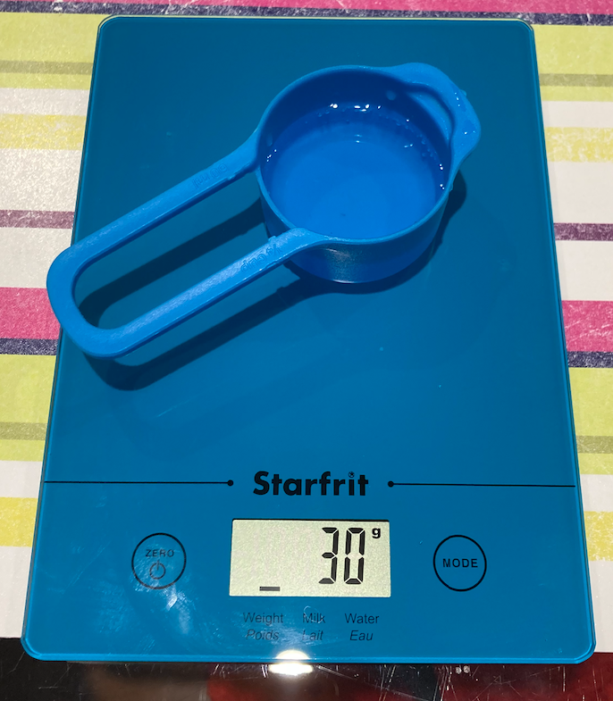
Water Testings

Slide 32
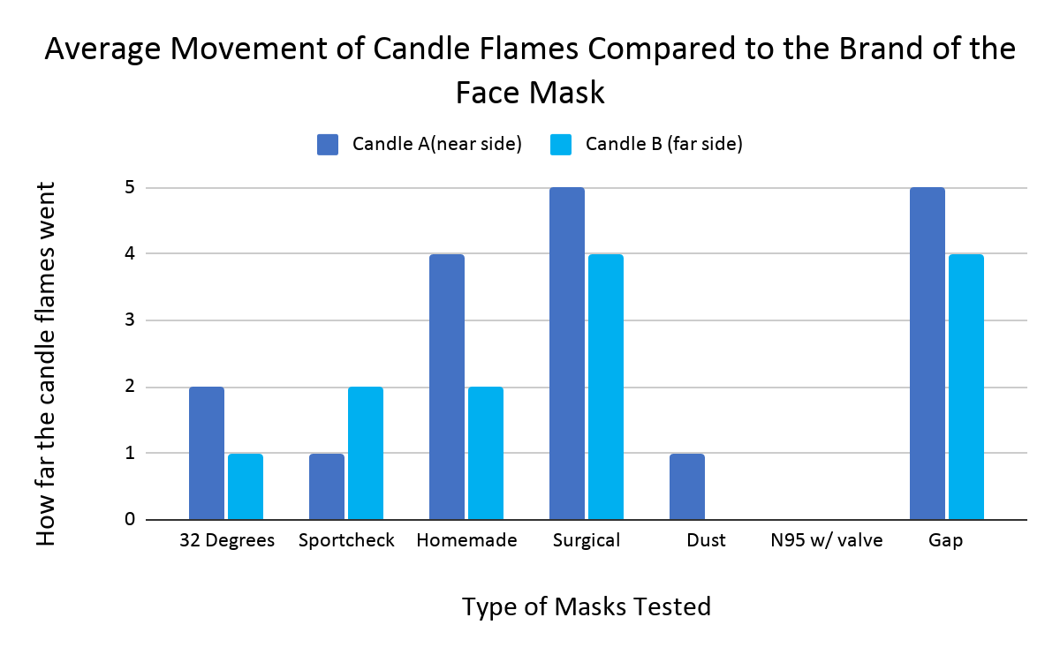
Results
Order for each test and conclusion according to results
Candle Test: 1. N95 2. Dust 3. 32 Degrees, Sport Chek 4. Homemade 5. Surgical, Gap

Slide 33
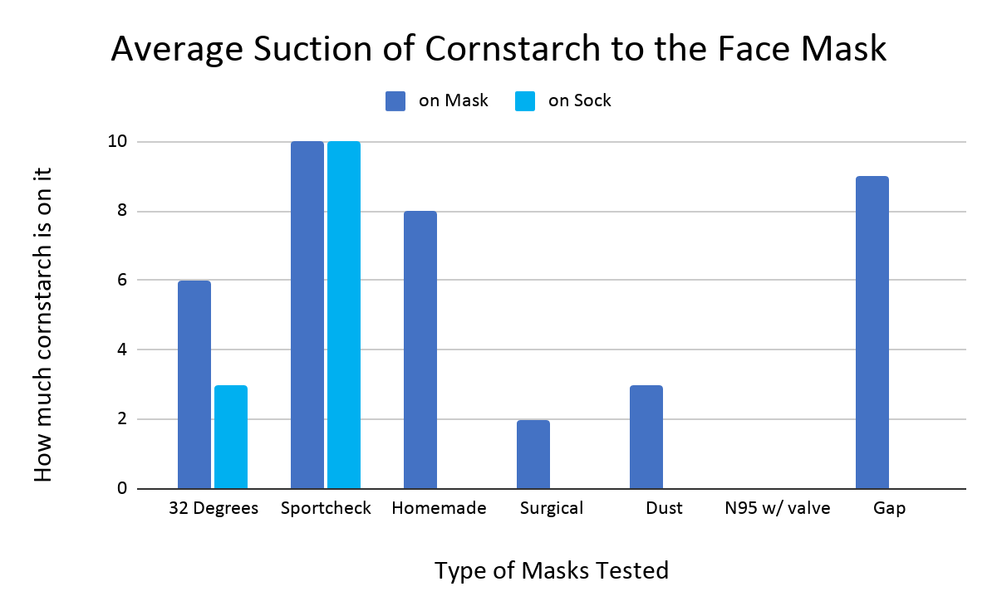
Results
Order for each test and conclusion according to results
Vacuum Test: 1. N95 2. Surgical 3. Dust 4. Homemade 5. 32 Degrees 6. Gap 7. Sport Chek

Slide 34
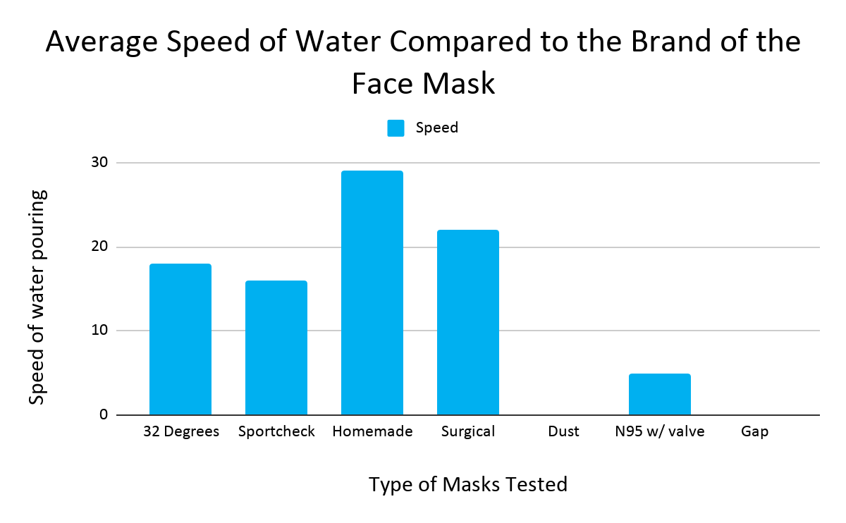
Results
Order for each test and conclusion according to results
Water Test: 1. Dust, Gap 2. N95 3. Sport Chek 4. 32 Degrees 5. Surgical 6. Homemade

Slide 35
Conclusion
Using all this data from all three tests it seems that the N95 had the most successful results comparing it to the others. This is because the N95 placed the highest in all tests successively. I would say the second one is the Dust mask. Unsurprisingly, having results that were very consistent. Following was the Surgical mask having not so well results in the candle test but unbelievable results in the vacuum test. Next, I have placed 32 Degrees for having mediocre results throughout all the tests. Then, I have placed Gap because even though it didn’t have the best results in the candle and the vacuum test. It had the best results having no drippage in the water test. Succeeding, is Sport Chek for having average results for the first and third test. But, not doing so well in the vacuum test having gone through the mask and onto the sock being the only mask that did that. Last but not least is the Homemade mask having done terrible in all three tests.
My hypothesis was partially correct in being that I did think the N95 was the best mask throughout all the tests but if you wanted something much more available do not choose Surgical masks. Better is a Dust mask but that is not to say that Surgical masks should not be worn.

Slide 36
Conclusion
I believe that N95 masks are the best masks to wear because of their materials. Polypropylene is so effective in masks because it is like this, “It holds an electrostatic charge. In other words, it uses the power of static electricity. Think of the static cling that can happen when you rub two pieces of fabric together. That’s basically what’s happening with this fabric: That “cling” effect traps incoming - and outgoing - droplets. “That’s what you want - the cling is what’s important” says Yi Chu, a professor of materials science and engineering at Stanford University. (Godoy, 2020) Similar applies to the Surgical mask which is also made out of polypropylene. (Hensley, 2020) All in all, using my background research and my tests it shows that N95 masks are the least permeable against coronavirus. Also my hypothesized order and my current order the only difference is that Homemade and Gap masks switched positions. I believe that the reason for that is because the Gap and Sport Chek masks both have a triple layer whereas Homemade only has a double layer. (Davis, 2020) (Fisher, 2020) (Forzani, 2020) This also works though because all have the similar category of material, which is cotton.

Slide 37
Real-Life Applications
My experiment really helps and benefits everyone in this world right now because in this time where it is necessary to wear a mask. Depending on how protective you want to be this could help to show you which mask to wear to help prevent Covid the most. This also could help you when you are just shopping and deciding which mask to buy. So that you don’t have to test all of them. So it saves money and time.

Slide 38
Further Questions
Some questions that I still have for my project include:
If I used different materials for the homemade mask, what would happen? What would it affect?
Would different colours of masks that are the same brand affect my results?
What would other masks do to affect this test?
What are some other tests that could maybe be more reliable in showing how permeable a mask is? At home?
How do they prove that the N95 is the most protective mask? Is there a special device?

Slide 39
Improvements
During my experiment I felt that there were many things that I should have changed or clarified. One being that I should have made a more clear way of measuring my water test because I felt that when i was designing it. I could not think of any better way than just the speed of the water and the dripping. Second, to make my candle test more reliable I should have found a way to make the breathing more similar or the same. Next, more types of masks because if I had more types of mask then it could really help support my conclusion that, “N95 is the least permeable mask to fight against Covid-19 but if you wanted something more available you should choose Dust masks.” Another thing to note is that I had to rephrase my controlled variable to make it sound a lot better. From, “But there is also the fact that I cannot keep the force of the breath the same because I do not have a machine blowing into the mask. I just have a human trying their best to breath equally.” To, “Though, one thing to note is that it is physically impossible for the air flow going through the mask to be the exact same because at different temperatures you could be getting differences in amount of air, temperature of air, and where it goes through your body.”

Slide 40
Bibliography
Voltage, Current, Resistance, and Ohm's Law, learn.sparkfun.com/tutorials/voltage-current-resistance-and-ohms-law/all.
“Adult Face Mask (3-Pack).” Gap, www.gapcanada.ca/browse/product.do?pid=668851#pdp-page-content.
“Coronavirus Disease (COVID-19).” World Health Organization, World Health Organization, www.who.int/emergencies/diseases/novel-coronavirus-2019/question-and-answers-hub/q-a-detail/coronavirus-disease-covid-19#:~:text=symptoms.
“Department of Labor Logo UNITED STATESDEPARTMENT OF LABOR.” Safety and Health Information Bulletins (SHIBs) | Occupational Safety and Health Administration, www.osha.gov/shib.
EXP 3-Layåer Reusable Face Mask – Non-Medical S/M 3 Pack- Sport Chek
www.sportchek.ca/categories/shop-by-sport/alpine-skiing/winter-accessories/scarves-masks/product/exp-3-layer-reusable-face-mask-non-medical-s-m-3-pack-color-333297468_90-333297468.html#333297468%5Bcolor%5D=333297468_90
Getty. “Surgical Mask Facts: Why the Blue Side Should Always Face Out.” Healthing.ca, PostMedia, 9 Nov. 2020, www.healthing.ca/diseases-and-conditions/coronavirus/surgical-mask-facts-why-the-pleats-should-point-down#:~:text=While surgical masks are often,is used in some masks.

Slide 41
Bibliography
Godoy, Maria. “A User's Guide To Masks: What's Best At Protecting Others (And Yourself).” NPR, NPR, 1 July 2020, www.npr.org/sections/goatsandsoda/2020/07/01/880621610/a-users-guide-to-masks-what-s-best-at-protecting-others-and-yourself.
Henneberry, Brittany. “How Surgical Masks Are Made, Tested and Used.” , Tested and Used, Thomas, www.thomasnet.com/articles/other/how-surgical-masks-are-made/#:~:text=Surgical face masks are made,meter (gsm) in density.
Henneberry, Brittany. “How to Make N95 Masks.” A Manufacturing Guide, Thomas, www.thomasnet.com/articles/plant-facility-equipment/how-to-make-n95-masks/#:~:text=A medical N95 respirator consists,are created using spun bonding.
“How Many Layers Is Your Face Mask? - MedicineNet Health News.” MedicineNet, MedicineNet, 24 July 2020,
www.medicinenet.com/script/main/art.asp?articlekey=240835.
“Knit vs. Woven: Learn How to Identify the Two Fabric Types - 2021.” MasterClass, www.masterclass.com/articles/knit-vs-woven-learn-how-to-identify-the-two-fabric-types#what-is-a-knit-fabric.
“REUSABLE KID'S 5-PACK FACE COVERING MASK.” 32 Degrees, www.32degrees.com/products/kids-5-pack-face-mask?collection=face-masks&variant=32018485411929.

Slide 42
Bibliography
Laser Light-Scattering Experiment Showing Speech-Generated Droplets. (00:42). “Visualizing Speech-Generated Oral Fluid Droplets with Laser Light Scattering: NEJM.” New England Journal of Medicine, www.nejm.org/doi/full/10.1056/NEJMc2007800.
“Still Confused About Masks? Here's the Science Behind How Face Masks Prevent Coronavirus.” Still Confused About Masks? Here's the Science Behind How Face Masks Prevent Coronavirus | UC San Francisco, 26 Feb. 2021, www.ucsf.edu/news/2020/06/417906/still-confused-about-masks-heres-science-behind-how-face-masks-prevent.
Talhelm, Thomas. “Thomas Talhelm.” Smart Air, 8 Dec. 2020, smartairfilters.com/en/blog/n95-masks-made-from/#:~:text=N95 masks are made from,, staples, and nose bar.
“Things to Know about the COVID-19 Pandemic.” Centers for Disease Control and Prevention, Centers for Disease Control and Prevention, www.cdc.gov/coronavirus/2019-ncov/your-health/need-to-know.html.
“Which Type of Face Mask Is Most Effective against COVID-19?” News, news.llu.edu/health-wellness/which-type-of-face-mask-most-effective-against-covid-19.

