Slide 1
Science Fair Logbook
Name Tegh:

Slide 2
Topic:
Write about the topic you chose. Why did you choose this topic? What do you hope to find out?
I’m doing an experiment to test the acidity of different soda’s. I chose this topic because I wanted know how the food we consume could potentially affect our bodies. In this experiment I hope to find out how the acidity links to how healthy the drink is and how it may be affecting our bodies

Slide 3
Testable Question
How does soda affect marshmallows?
What is the effect of soda on marshmallows?
Which soda is dissolve the marshmallows the fastest ?
I'm doing this experiment to see how acidic soda is to you because if I use marshmallows it will show if it dissolves quick it won’t take a lot of time to do the same to your stomach

Slide 4
Background Information
What questions/information do you need to find out about your topic? What is some important vocabulary?
About crush.
Crush is a soda brand that is owned and operated by Keurig Dr Pepper
Did you know that crush was made by a chemist.
About Coke.
Coke is a soda brand owned and founded Dr.John S, Pemberton he is a pharmacist
Coke was made with the syrup and the recipe was kept for years until was replaced which got lots a lot of backlash so they brought the old recipe back and they had it sense
About Mountain Dew
Mountain Dew was created,owned and founded by Barney and Ally Hartman as a mixer

Slide 5
Background Information
Research your topic and write about what you find out IN YOUR OWN WORDS. Add slides as necessary. Make sure to note your sources of information on the Sources page.
Marshmallow ingredients -sugar -corn syrup -modified corn syrup -gelatin -water -vanilla -blue 1 (artificial color) - dextrose -tetrasodium pyrophosphate extract
may help in the future parts of this experiment
Mountain Dew ingredients -carbonated water -Sugers(sugar glucose-fructose) -Natural flavor -citric acid - sodium benzoate -caffeine -sodium citrate -gum arabic -erythorbic acid -calcium disodium EDTA - Tartrazine
Coca Cola ingredients -carbonated water -sugar/glucose-fructose -caramel color -phosphoric acid -natural flavor -caffeine - secret recipe
Crush ingredients -carbonated water -sugar/glucose-fructose -citric acid -benzoate -Natural flavor -modified corn starch -Ester gum -sunset yellow FCF -salt -allura red
These also may help

Slide 6
Sources of Information
Note all sources used - websites, books, experts, etc. ( *Google is not a website, follow links to find the page information.) Add slides as needed.
Title | Author | Information (web link, publisher, etc) | Year
About crush | Does not show | Soda lovers wiki and bottle https://soda-loverswiki.fandom.com/wiki/Crush | 2025
About Coke | The coca cola company | The Coca Cola Company and bottle https://www.coca-colacompany.com/about-us/history/the-history-of-the-coca-cola-contour-bottle | 2025
About Mountain dew | Does not show | Wikipedia and bottle https://en.wikipedia.org/wiki/Mountain_Dew | 2025

Slide 7
Variables
Manipulated / Independent Variable
ONE thing that you will test/change:
Which soda i put in the jar
Coca Cola
Crush
Mountain Dew
Responding /Dependent Variable
The thing I think will change or be affected: The Marshmallow
How will you measure it? :
How fast will it dissolve in soda

Slide 8
Variables
Controlled Variables
Things we have to be very careful to keep the same every time we test so that they do not affect the results/outcome of the experiment:
Jars ,Stopwatch, tape, amount of soda, size of marshmallow

Slide 9
Hypothesis
Your prediction, or what you think will happen:
If _________________ then _____________ because __________________.
(I do/change this…) (I think this will happen) (Why? )
*use info from your research or background knowledge to help explain)
I think that the mountain dew will be the most acidic than coca cola and the least is crush and that the marshmallow will be quick to be dissolve and will make some of the sodas change there shade when you look at it

Slide 10
Materials
What materials will you use for your experiment? Be specific about amounts whenever possible.
Coca cola
Crush
Mountain Dew
Jars
Marshmallow’
Tape
Timer

Slide 11
Procedure
List the step-by-step procedure you will follow to conduct your experiment. Be as specific as possible and include exact measurements, quantities, times, etc.
Tape marshmallows to a jar
Fill jars with soda (1 cup) and start timer
Turn off timer when it dissolves

Slide 12
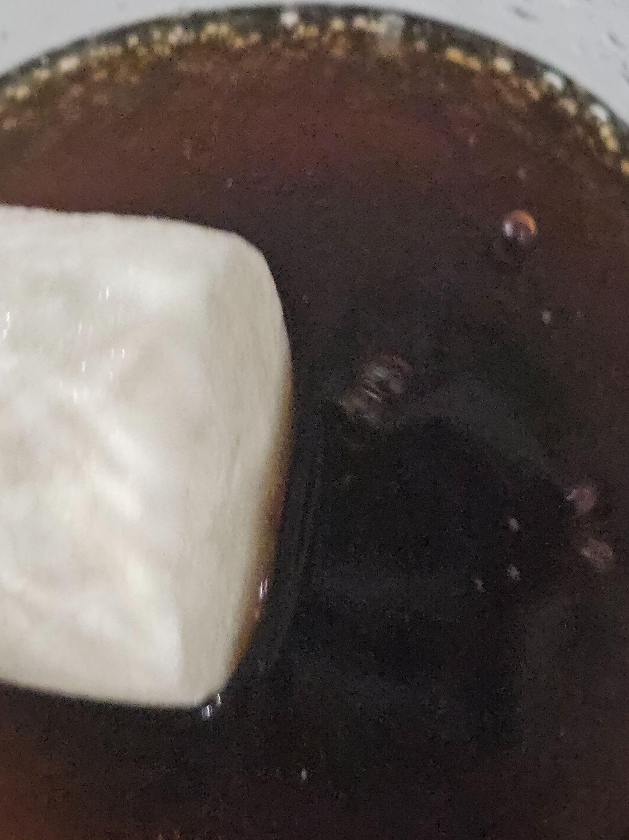
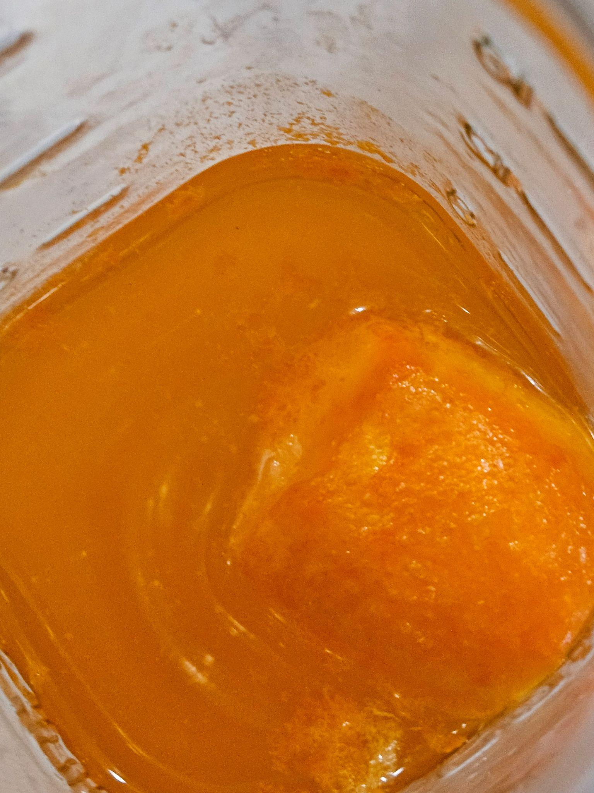
Experiment: Trial 1
Photos:

Slide 13
Experiment: Trial 1
Date:
Data: (measurements)
Observations/Notes: it grew a bit but
There is something in the marshmallows that keep it from dissolving i think in trial 2 I will have to use a different variable to see if it will dissolve unlike the marshmallows.
Coca cola | Would not dissolve
Mountain dew | Would not dissolve
Crush | Would not dissolve

Slide 14
Why did it not work theory
My theory is that the gelatin was the component that stopped it from dissolving because one time when i was at my friends house me and him were eating jello but he dropped some in soda while he was putting it away and then the next day (24 hours later) he called me and said bro i left jello in my soda

Slide 15
The Research Theory
I did my research and the only thing i found was soda fluffs witch use marshmallow fluff so i had to use a mix of the soda with some welch's fruit jelly snacks i had left over from halloween it sat there for days and i now know what happened.the gummies absorbed it and grew just like the marshmallows if you want more proof search up sprite gummy hack. So in conclusion the gelatin was the problem in the experiment

Slide 16
Experiment: Trial 2
Date:
Data: (measurements)
Observations/Notes:
Coca cola
mountain

Slide 17
Experiment: Trial 2
Photos:

Slide 18
Experiment: Trial 3
Date:
Data: (measurements)
Observations/Notes:

Slide 19
Experiment: Trial 3
Photos:

Slide 20
Results: Chart
Put your data together into a chart.
Example: (you can change the chart)
Trial 1
Trial 2
Trial 3

Slide 21
Conclusion
My question was:how fast does a marshmallow dissolve in soda
The answer to my question is: no it won’t even dissolve in soda because of the gelatin inside of the marshmallows
My hypothesis was correct because:
OR
My hypothesis was incorrect because: of the gelatin inside because it won't dissolve in soda

Slide 22
Extensions
If you were to conduct this experiment again, what would you do differently?
I would change the marshmallow to a real tooth

Slide 23
Results: Analyze
Look at your data and observations. Look for patterns and trends. Explain what happened in your experiment and what you found out:
All in all it was a fail because of the gelatin because gelatin will not dissolve it absorbs the soda that was a key component I forgot while doing the experiment that could have helped before so i conclude that this was a big fail

Slide 24
Results: Graph
Graph your data for a visual display of your results.
Use Google Sheets or another website and copy the graph onto this slide, or draw by hand and upload a photo.
Ask your Science Fair teachers for help if you need it!

Slide 25
Applications
In what ways are your findings useful?
Who could benefit from your results and how?
What I was trying to do was to show how acidic soda can be but because of the gelatin in the experiment so i can’t help because it failed

Slide 26
Extensions
Because of the results of this experiment, I wonder…
Describe further experiments that could be conducted to further investigate and understand your topic:
I wonder what could happen if I changed the marshmallow to a jolly rancher or a tooth but that's all for next year to see

Slide 27
CONGRATULATIONS!!
You have completed your experiment!
Make sure that you enter information from this logbook into the CYSF Digital platform.
You are now ready to create your trifold display and practice your presentation.

