Slide 1
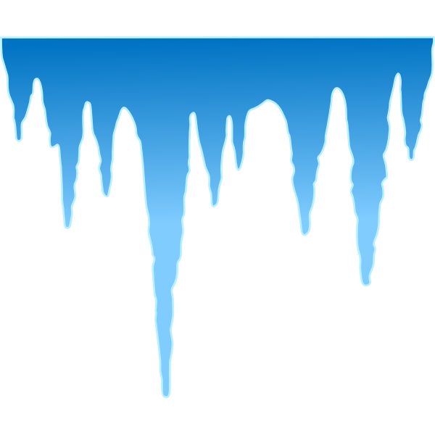
Supercool,
Supercooling
Avery Steinke

Slide 2
Testable Question
Can you Supercool all types of water? Why or Why not?

Slide 3
Hypothesis
If a person supercools different types of water then distilled water will be the only one to maintain liquid form below zero degrees celsius because there is not a nucleus for crystallization.

Slide 4
Background Research
What is supercooling?
Supercooling is the process of cooling a liquid below its freezing point, which in this case is water so we are going to cool water below 0 degrees, without it becoming a solid. A liquid below its freezing point will make crystals/become clear and real in the presence of a seed crystal or center (of a cell or atom) around which a crystal structure can form.

Slide 5
Background Research
Now why does supercooling happen?
Supercooling happens because when the water/liquid cools below its freezing point it freezes but if it has no impurities the atoms will have nothing to grab onto so it will not freeze but the second the water has an impurity like dirt or if it gets shaken it will instantly freeze.Now what is snap freezing? Snap freezing is when supercooled water has an impurity so it freezes before you can snap.

Slide 6
Procedure
Gather materials
Cut a circle from the cardboard to use as a cover for the plastic cup.
Pour a small amount of chosen water into a clean plastic cup (enough to fill about 1/4 of the cup) and place the cup in the center of the bowl.
Cover the cup, then add ice cubes to the bowl, so that the ice is about 2–3 times higher than the level of water in the cup. Be careful not to get any ice inside the cup.

Slide 7
Procedure
Sprinkle two tablespoons of salt over the ice cubes. Be careful not to get any salt inside the cup.
Uncover the cup and put the thermometer inside.
Monitor the temperature of the water. Over the next 30 minutes or so, you should see the temperature slowly decrease. Keep track of the time and temperature in a spreadsheet.
When the temperature of the water reaches −1 to −3 °C or so, carefully remove the cup from the ice bath.
Record observations of water state.

Slide 8
Procedure
Repeat the procedure, testing different types of water to see whether it can be supercooled before freezing. For each type of water, run at least three trials (more is better). Test the following types of water:
bottled distilled water
bottled spring water
plain tap water
boiled and cooled tap water

Slide 9
Variables
Manipulated variable:
type of water
Responding variable:
temperature of water when crystallization occurs
Controlled variables:
cooling method
amount of salt used in cooling bath
amount of ice used in cooling bath
amount of water used in cooling bath
same thermometer used for testing
container used for cooling bath
container used for each of the water types
amount of water in small container for supercooling

Slide 10
Materials
Large bowl
Ice
Salt
Distilled water
Tap water
Kettle
Thermometer. A good range would be -20°C to 110°C,
Transparent plastic cups (tip: a tall, narrow shape works best)
Piece of cardboard (e.g., empty cereal box)
Scissors

Slide 11
Observations
TAP WATER |  |  | DISTILLED WATER |  |  | SPRING WATER |  |  | BOILED TAP WATER
Time (Mins.) | Temp (ºC) | Observations | Time (Mins.) | Temp (ºC) | Observations | Time (Mins.) | Temp (ºC) | Observations | Time (Mins.) | Temp (ºC) | Observations
0 | 19.7 | water | 0 | 19.1 | water | 0 | 18.9 | water | 0 | 19.6 | water
2 | 13.6 | water | 2 | 7.0 | water | 2 | 13.8 | water | 2 | 3.0 | water
4 | 11.5 | water | 4 | 3.2 | water | 4 | 11.3 | water | 4 | 1.6 | water
6 | 9.6 | water | 6 | 2.8 | water | 6 | 9.7 | water | 6 | 1.2 | water
8 | 7.6 | water | 8 | 2.5 | water | 8 | 8.1 | water | 8 | 1.2 | water
10 | 6.1 | water | 10 | 2.5 | water | 10 | 6.1 | water | 10 | 1.2 | water
12 | 4.6 | water | 12 | 2.5 | water | 12 | 4.6 | water | 12 | 1.2 | water
14 | 3.3 | water | 14 | 1.6 | water | 14 | 2.3 | water | 14 | 1.2 | water
16 | 2.4 | water | 16 | 1.2 | water | 16 | 1.7 | water | 16 | 1.2 | water
18 | 2.4 | water | 18 | 0.2 | water | 18 | 1.2 | water | 18 | 0.6 | slush
20 | 2.0 | water | 20 | -0.4 | water | 20 | 1.2 | water | 20 | 0.6 | frozen
22 | 2.0 | water | 22 | -1.2 | water | 22 | 1.2 | water | 22 | 0.1 | frozen
24 | 2.0 | water | 24 | -1.2 | water | 24 | 1.2 | water | 24 | 0.1 | frozen
26 | 2.0 | water | 26 | -2.1 | water | 26 | 1.2 | water | 26 | 0.1 | frozen
28 | 1.7 | water | 28 | -2.1 | water | 28 | 0.7 | water | 28 | -0.1 | frozen
30 | 1.7 | water | 30 | -2.9 | water | 30 | 0.1 | water | 30 | -0.1 | frozen
32 | 1.3 | water | 32 |  |  | 32 | -0.5 | water | 32 | -0.1 | frozen
34 | 0.3 | slush | 34 |  |  | 34 | -1.1 | water | 34 | -0.1 | frozen
36 | -0.7 | ice | 36 |  |  | 36 | -1.8 | water | 36 | -0.1 | frozen
38 | -1.1 | ice | 38 |  |  | 38 | -2.4 | water | 38 | -0.1 | frozen
40 |  |  | 40 |  |  | 40 | -2.7 | water | 40 | -0.1 | frozen

Slide 12
Observations
Tap water froze at 34th minute at zero degrees
Boiled tap water froze at the 18th minute just before hitting zero degrees
Distilled water never froze
Spring water never froze.

Slide 13
Analysis
It can be inferred that spring and distilled water can be supercooled because of the absence of a nucleus.

Slide 14
Conclusion
My hypothesis was partially correct. The distilled water supercooled as expected but spring water also supercooled and that was unexpected.

Slide 15
Sources of Error
A change that I should make next time is using water directly from a spring instead of bottled spring water as one of my manipulated variables. This is because the bottled spring water still goes through a minor distillation process.

Slide 16
Application
Climate Change
Animal Hibernation
Planet Exploration
Most Exciting
Organ Transplant

Slide 17
Bibliography
Science Buddies Staff. (2020, November 20). Supercooling Water and Snap Freezing. Retrieved from https://www.sciencebuddies.org/science-fair-projects/project-ideas/Phys_p033/physics/supercooling-water-and-snap-freezing
Wikipedia contributors. (2021, January 15). Supercooling. In Wikipedia, The Free Encyclopedia. Retrieved 19:06, January 22, 2021, from https://en.wikipedia.org/w/index.php?title=Supercooling&oldid=100047663
Maggie Romuld. (2016, December 21). Cryoproteins and Supercooling: How Some Animals Survive Bitter Winter Temperatures. Retrieved from http://thescienceexplorer.com/nature/cryoproteins-and-supercooling-how-some-animals-survive-bitter-winter-temperatures
DOE/Pacific Northwest National Labratory. (2020, September 17). Supercooled Water is a Stable Liquid, Scientists Show For the First Time. Retrieved from https://www.sciencedaily.com/releases/2020/09/200917180419.htm
Canadian Beverage Association. Retrieved 11:28, March 6, 2021, from https://www.canadianbeverage.ca/beverages/water/

