Slide 1
Conservation of Amino acids through evolution
A Project by: Grace Wang

Slide 2
summary
This project is research on the conservation of amino acids through evolution.
By taking amino acid sequences from a protein called ATM and running them through a program we can see where the conserved regions are.
With this information, we will be able to identify conserved regions that we can later mutate to determine their function.

Slide 3
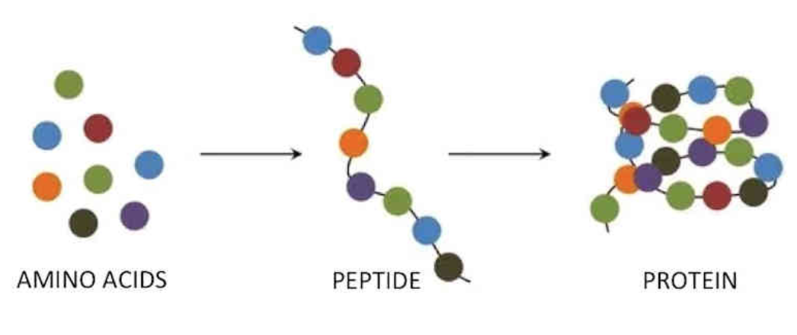
introduction
Amino acids are organic compounds that contain amino and carboxyl functional groups.
We collected different amino acid sequences from various species and ran them through a program to identify conserved regions.

Slide 4
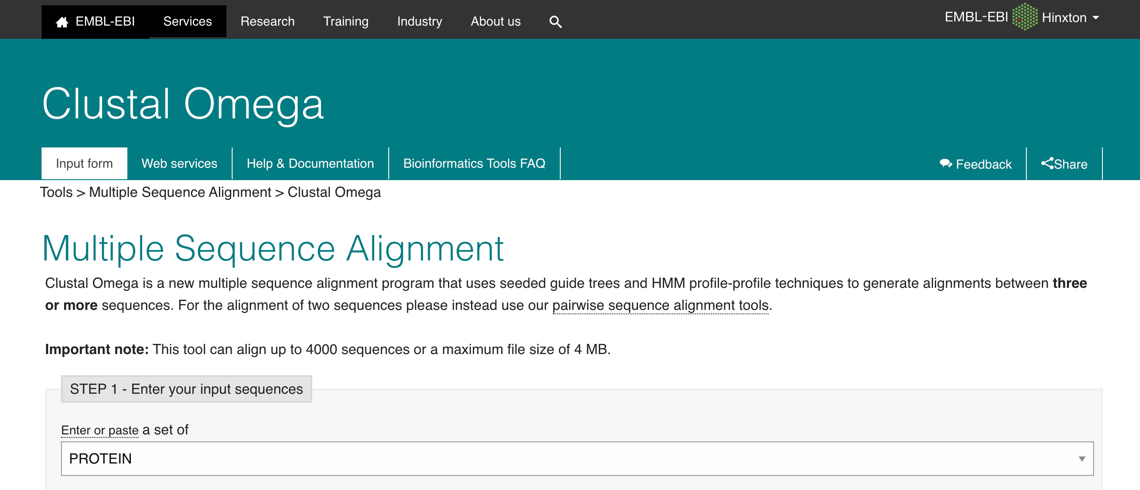
hypothesis
If amino acid sequences are taken from various species and ran through Clustal omega, then the conserved regions will be visible and therefore, we can further mutate these regions.

Slide 5
methods
To start off, we collected different amino acid sequences from the Nation Centre for Biotechnology Information (NCBI)
Human, mouse, rat, horse, chicken, dog, and so on.
Their accession number was taken down and transferred to a master Word document

Slide 6
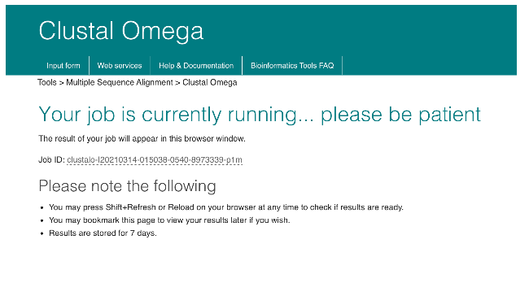
Methods cont.
The amino acid sequences of humans, mice, rats, sharks, frogs, birds, dogs, horses, and fish were all collected and put into a document.
From there, the format was very particular, as Clustal Omega only recognizes the sequences if they are in a certain format.
There would be a “>” symbol, followed by “ATM_ANIMAL_ACCESSIONNUMBER”

Slide 7
results
Once inputted into Clustal Omega, the sequences are processed by the program, and we are given many different formats of the results.
The first one is alignments.
This is a visual representation of where the conserved regions are, and they are marked by certain symbols.
* = completely identical : = minor differences . = some differences

Slide 8
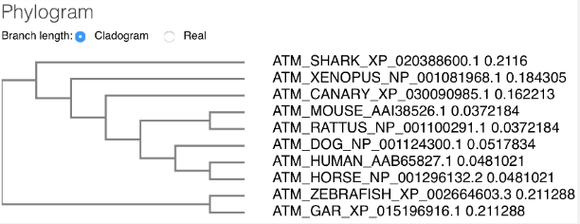
Results cont.
The other formats we looked at were the trees and the percentages.
The trees are a visual representation of how all the ATM sequences align and how they are connected.
The percentages represent how similar the sequences are to the human amino acid sequence.

Slide 9
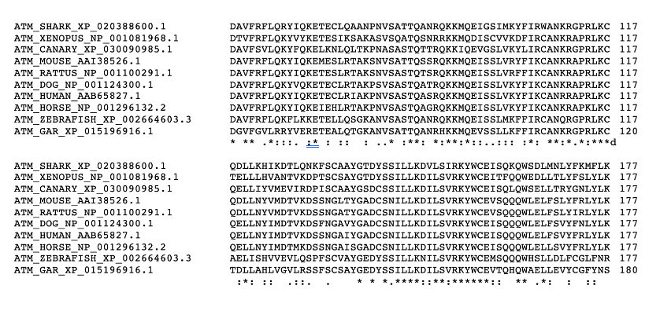
conclusions
We found many alignments in the amino acid sequences that were conserved; therefore, we can use this information in the future to mutate and determine their function.

Slide 10
Resources/acknowledgments
https://www.ncbi.nlm.nih.gov/
https://www.ebi.ac.uk/Tools/msa/clustalo/
I would like to acknowledge Dr. Susan Lees-Miller and her lab for their help with this project. 2020 was a tough year with lots of turmoil for most. I was unable to work in the lab due to COVID-19, as I am still a high school student. However, we tried our best to create a good project working from our computers at home.

