Slide 1
To Bridge or Not to Bridge?
[Civil Engineering]
By: Sabeeh A. and Eyob B.

Slide 2
Which bridge frame is the most effective & sturdy?
Suspension VS Truss Bridges?
؟ Big Question？

Slide 3
Hypothesis & Prediction
Hypothesis
Prediction
We believe that the suspension bridge could possibly tend to be the best frame because of its suspended weight. The reason we believe this is because of its towers, which would support heavy amount of loads. Its towers could support a lot of weight (load). As it doesn’t exceed the weight cap.
If the suspension bridge can handle more weight than the truss bridge than the suspension bridge would conclude the suspension bridge as the most effective bridge out of those two. Meaning that design tends to be better than the truss bridge.

Slide 4
General Topic
Which is the best bridge for heavy loads?
Suspension Bridges
Truss Bridges
Suspension
Suspension bridges use the force of tension to hold lots of load.
The tension forces helps pull and hold the bridge up, keeping it sturdy.
The cable is attached to the tower letting it hold tremendous amount of weight.
Truss
Uses compression force to equally reverse the force that was applied to it.
In triangle shape because triangles can be distorted by stress.
Distributes the stress to help support the weight.

Slide 5
Specific Topic
Which bridge is the sturdiest and most effective to handle massive loads? Suspension OR Truss Bridges?
Suspension
Suspension bridges are mainly used for its support, with its pillars supporting lots of load (weight)
Can cost up to $1B which can be a huge budget margin for bridges.
Can span across wide channels.
Truss
Truss bridges are extremely strong and stiff and with its triangle support structures, helps distribute weight throughout the bridge, without leaving more weight in a specific area.
Don’t span as long as a suspension, but can reach a decent distance.
Truss isn’t as costly, but can tend to be pretty tedious, which doesn’t make it any different from any other bridges.

Slide 6
Truss Bridge
Suspension Bridge
Load: Depending on the type it can range from 100-500 kg/sq ft | Load:Dead Load: 150 to 250 kg/ft² Live Load: 2,400 to 4,800 kg/ft² (Depend if it still or moving)
Cost: $100 - $300/sq ft Average, $200/sq ft | Cost: $200 - $500/sq ft Average, $350/sq ft
Aesthetic: Not very into “Aesthetic appeal” instead meant for efficiency. | Aesthetic: Much more Aesthetically pleasing, and well known as landmarks, for ex: Golden Gate Bridge
Span: 80 - 250 ft Average, 175 ft. | Span: 1000 - 3000 ft Average, 2000 ft (Meant to span a lot, way more than truss)
Material Efficiency: Uses metal materials to create triangles making it very efficient in the materials needed. | Material Efficiency: Aesthetic is a major part for bridges, tend to use less efficient materials but use them as support, need more materials.

Slide 7
How My Topic Solves a Problem
My topic solves…
Which bridge is more effective for handling weight.
Which one can handle more distance without putting more pressure on a specific area.
Which is most sturdy.
Preventing possible future accidents.
Which is worth the time and money spent.

Slide 8
Variables
Independent Variable:
The thing that will change in our experiment will be the type of bridge we are using/testing.
Controlled Variable:
The load of the weights (1kg weights) and material we use to make the bridge.
Dependent Variable:
We are measuring which frame looks the most sturdy, placing 1 kg weights, from 10 g to 500 g.

Slide 9
Step by Step Procedure
Create a blueprint on how we are going to construct the bridge.
2. Make sure we have enough materials and that they are working properly.
3. Plan the bridge frames and how they will be constructed
Materials:
Popsicle sticks
Tape
Wood planks
Cups
Hot Glue
1 kg Weight Set
String or Twine (Suspension)
4. Create the bridge frames singularly (seperate from bridge)
5. Make the bridge so that we can attach the frame.
6. Attach bridge frames on identical bridges (w/ hot glue)
7. Place weights to test out which bridge frame is more sturdy.

Slide 10
Results
Which bridge is able to pass the most research and experimental tests? Suspension vs Truss Bridge
Suspension
The suspension bridge did not pass the 1 kg weight test.
It could only hold 600g with massive bending.
It was more costly do to the fact it takes more material.
Truss
Was able to pass the 1 kg weight test, seemed very steady and withstand with little to no bends.
Much more cost effective for the construction of the bridge.
Less material needed to construct truss.

Slide 11
Bridge Tests | Truss | Suspension
1st test | 500g | 400g
2nd test | 1kg(Added more support) | 500g (Added more support)
3rd test | 1kg | 600g (Maximum capacity)

Slide 12
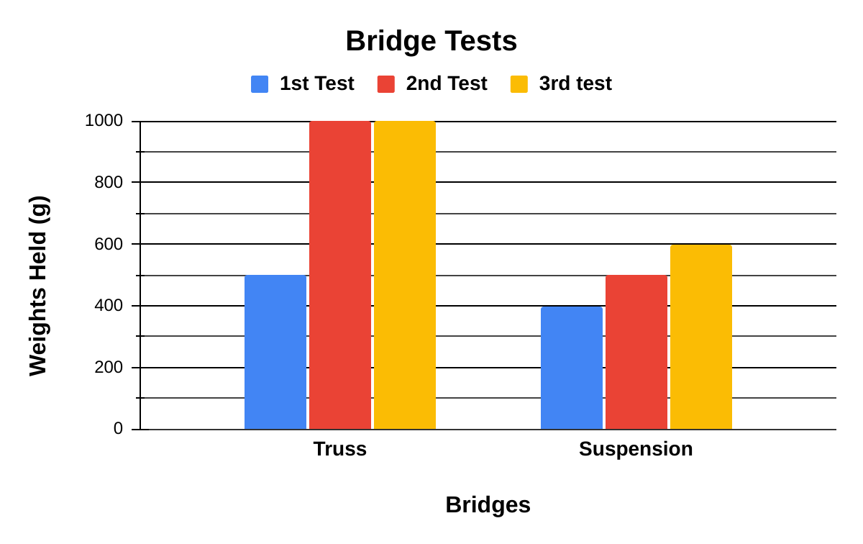

Slide 13
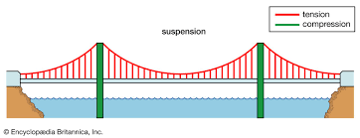
https://www.britannica.com/technology/suspension-bridge

Slide 14
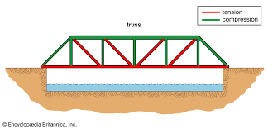
https://www.britannica.com/technology/truss-bridge

Slide 15
Conclusion
Truss bridge seems to be better at handling and controlling the weight held.
Suspension struggled, and had bends when weight were placed on it.
Hypothesis turned out fairly wrong, with our guess being the suspension, and the better bridge frame being the truss.
Most probable reason it could handle more weight because of the shape design (triangle).
Triangles are actually the strongest and most durable shape out of every other single shape there is, this is because when the force is applied to a corner of the 3 vertices of a triangle.
It will then be able to evenly distribute the weight in the triangle. But since there is multiple triangles, then that will only increase the support.

Slide 16
Next Steps (The Future)
What really set us back from getting the answer we wanted was the fact that we didn’t have our materials prepared to have enough material and have more time to do our experiment.
Have our materials prepared in advance
Use more exact measurements to make it perfect and get the best results
Organizing roles for each partner
Plan everything in advance for maximum efficiency
Taking advantage of time(Having the topic and ideas plan beforehand)

Slide 17
Sources
https://byjus.com/physics/tension-force/
https://wsdot.wa.gov/tnbhistory/suspension-bridges.htm
https://www.tn.gov/tdot/structures-/historic-bridges/what-is-a-truss-bridge.html
https://www.tekscan.com/blog/pressure-mapping/what-compression-force
https://www.sciencedirect.com/topics/engineering/suspension-bridges
https://www.ncdot.gov/initiatives-policies/Transportation/bridges/historic-bridges/bridge-types/Pages/truss.aspx
https://dozr.com/blog/suspension-bridges

