Slide 1
Calgary_Youth_Science_Fair@anycomputer:[~]:
run Charlotte_Ambrose_Project.py
Loading .... .... .... .... Complete
Preheating Oven
.... OK
Turning on robots
.... OK
Sharpening Pencils
.... OK

Slide 2
>>>
Welcome to Charlotte Ambrose’s Calgary Youth Science Fair project.
This video will demonstrate my program.
This video will also talk about what I learned and why my program is cool.

Slide 3
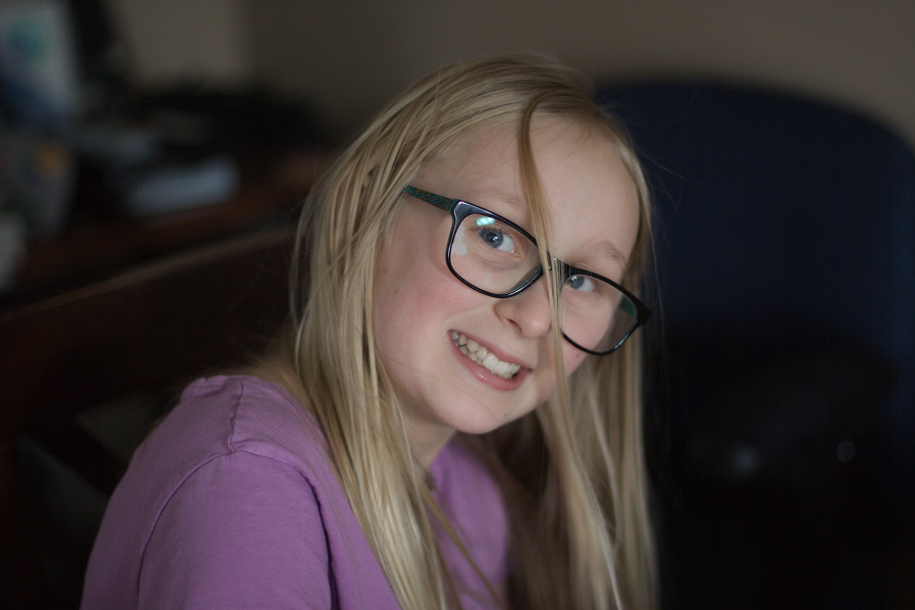
>>>
Load Charlotte.jpg
>>>
This is a picture of me! :)

Slide 4
>>>
My idea is to make a program that can help out in the classroom.
>>>
Some of the things my program does are:
Tells the user a joke.
The user can search for information about a country.
Tests user on math facts.
A simple to do list.
Lets the user search for the definition of a word.
>>>
How my program works...
The program gets input from the user which tells the program what the user wants to do.
The program uses functions I have written which send the answer back. Once the answer is shown to the user the program starts back at step one in a loop.
>>>
Let’s run my program for a demo.
>>>
run python3.8 Charlotteapp.py

Slide 5
How to use this program: the options are to read a joke (type joke), learn about a country (type country), read the definition of a word (type word), practice math facts (type math), and a todo list - to see list type todo, to add type todo add <<item>>, to remove type todo done <<item>>, to clear type todo clear
What do you want to do?
>>>
joke
Why did the barber win the race? He took a short cut
What do you want to do?
word
>>>
What word do you want to know about?
>>>
science
The definition of the word science is knowledge about the natural world that is based on facts learned through experiments and observation -or- an area of study that deals with the natural world (as biology or physics) -or- a subject that is formally studied.
>>>
Let’s clear the screen for a bit more space...

Slide 6
What do you want to do?
>>>
country
What country do you want to know about?
>>>
France
The capital of France is Paris. It has a population of sixty-seven million. It is six hundred and forty thousand square kilometers. It borders Andorra, Belgium, Germany, Italy, Luxembourg, Monaco, Spain, Switzerland.
What do you want to do?
>>>
todo add do homework
item added
>>>
todo
[‘do homework’]
>>>
Let’s get more space...

Slide 7
what do you want to do?
>>>
math
What kind of math do you want to do?
>>>
Division
How many questions do you want to do?
>>>
1
What is 419 divided by 7?
Please enter the whole number
59
>>>
Please enter the remainder. Type in 0 if there is no remainder
>>>
6
You are right. Good job! This is the end of your questions. You got 1 right.

Slide 8
>>>
My program is cool because it uses the internet for looking up information. It uses APIs (application programming interfaces) to talk to websites and get the information we want. A URL (uniform resource locator) is an address on the internet.
>>>
My code also has a special part that gets the remainder when we’re practicing division. It’s called a modulo. In python, the % symbol is used to calculate the remainder of a division problem.
>>>
My code uses functions to do what we want it to. A function is a piece of code that can be used again and again in different places or programs. To use a function we call it. We get functions into our program by importing them at the beginning of the program. In my program, to call the joke function it says “from joke import joke”
>>>
Next we’re going to talk about loops...
Next we’re going to talk about loops...
Next we’re going to talk about loops...
Next we’re going to talk about loops...
Next we’re going to talk about loops...
>>>
STOP IT NOW!
>>>
Sorry :(

Slide 9
>>>
No seriously, now we’re going to talk about loops.
>>>
A loop is a piece of code that runs over and over again.
There are ‘while’ and ‘for’ loops.
A while loop is a loop that lets us run the code in the loop until the condition we want is met. Let’s say we want to print “Stop it seagulls” 2 times. We can do that by making a loop that runs until a counter reaches our goal number.
Let’s run this python code and see what happens...
counter = 1
while counter <3:
print('stop it seagulls’)
print(counter)
counter += 1
>>>
Run stop_it_now.py
stop it seagulls
1
stop it seagulls
2
>>>
Notice how it printed ‘stop it seagulls’ twice and then stopped once the counter reached the biggest whole number under three?

Slide 10
>>>
A ‘for’ loop steps through each item in a list and runs the code until there are no more items.
>>>
Another cool thing my program does is use ‘conditionals’. My program uses ‘if’, ‘elif’, and ‘else’ statements.
>>>
An ‘if’ statement lets us test a condition and if that condition is met, then the code in the block below the ‘if’ runs.
>>>
‘elif’ stands for ‘else if’ and lets us have multiple choices – my code has 8 elif statements.
>>>
Last but not least, ‘else’ statements let us tell the program what to do in all other conditions. Let’s clear the screen and you can see some of the conditionals in my program...

Slide 11
>>>
This is my code.
if intent == "joke":
joke_out = joke()
print(joke_out)
elif intent == "math":
math = math_facts()
else:
print(help) #prints the instructions again
>>>
The hashtag is a comment.
Comments are writing in our code that the computer ignores. We use them to tell people who are looking at the code what it does.
The ‘==’ sign means ‘is the same as’.
We call the function joke with the variable “joke_out”.
We show the user the joke by printing the variable “joke_out”.

Slide 12
>>>
Now we will talk about Python.
Python is a general purpose programming language. It was put out for others to use in 1991 by a man named Guido Van Rossum. As of 2021 it will be 30 years old. Python can be used for almost any kind of programming.

Slide 13
>>>
Load Python.svg
>>>
This is the python logo :)
I got it from: https://commons.wikimedia.org/wiki/File:Python_logo_and_wordmark.svg
Use permissions are here: https://www.python.org/psf/trademarks/

Slide 14
>>>
Lastly we will talk about Pythonanywhere.com
Pythonanywhere is a website that lets anyone write, run, and share python code. Pythonanywhere can be used on a computer, an iPad, cell phones, and on other mobile devices. Pythonanywhere can be used by: students, teachers, work places, or people just coding for fun.
>>>
Load python_anywhere.svg
>>>
Learn more about pythonanywhere at:
https://www.pythonanywhere.com/

Slide 15
>>>
You can actually use my program by sending me an email requesting access. I will have pythonanywhere send you a link for secure access.
My email is charlottea11@educbe.ca
>>>
Thank you for watching this video.
A plain copy of this powerpoint is available in the report section of my CYSF submission.
Music courtesy of bensound.com
>>>

