Slide 1
AI Enabled Smart Walking Stick
By: Yugam Bansal

Slide 2
Problem
Everyday, visually impaired people have to manage difficulties regarding navigation. Visually impaired people have to navigate around obstacles, uneven surfaces, stairs and more. This is where traditional walking sticks come in use. They allow the user to move around as the user can tap the stick in front of them allowing them to gain information on their surroundings.
Though, multiple problems arise. A traditional walking stick can not give the user more detailed information, and it can not detect everything. For instance, a traditional walking stick can not tell the user about oncoming people, animals or other objects. This poses a significant risk to the visually impaired user and can be a threat to their life. This is why I have created a model that can fix most of these problems.

Slide 3
Background Research
What is AI recognition and how does it work?:
AI recognition lets computers see and understand visual information
Requires large datasets to train the AI model
Uses Machine Learning (ML) to learn patterns in data
AI identifies features that belong to specific objects
Makes probability-based decisions
Classifies objects into categories (e.g. cat, dog)
Humans use classifications to organize, sort, or analyze images

Slide 4
How do different sensors help detect obstacles, and what are their limitations?
Sensors detect obstacles in different ways, each with limitations
Four main sensor types:
Camera LiDAR | Radar Ultrasonic
Camera sensors Capture visual data AI/algorithms process images Affected by weather (rain, fog, snow) | Radar sensors Emit radio waves Measure return time of waves Lower resolution Can cause false positives
LiDAR sensors Emit laser pulses Measure time for light to reflect back Very expensive Performance reduced by weather scattering light | Ultrasonic sensors Emit high-frequency sound waves Measure time for waves to return Short range (only a few meters) Affected by ambient noise, temperature, and soft materials

Slide 5
Are there existing smart canes, and what problems or errors do they have?
Many existing smart canes help users navigate more easily but they have some errors and limitations
Users lack a semantic experience (no understanding of what objects are), hampering decision-making
Missing object recognition, knowing what is ahead can helps users react appropriately
Many canes use only one sensor to detect surroundings
Navigation can feel like moving within invisible boundaries
Most commercial canes cannot detect water on the ground causing users to accidentally step into puddles, causing injuries
Commercial smart canes are very expensive, typically ranging between $500–$1200 making it unaffordable for many visually impaired users

Slide 6
Hypothesis
If object recognition using AI is added to a walking stick with a camera and an ultrasonic sensor, then I think it will provide more accurate and useful feedback than a traditional walking stick because the user can navigate in a much better and safer way, and can do more things with the feedback they receive from the AI enabled walking stick
If obstacle detection is added along with object recognition using an ultrasonic and water level sensor, then I think it will allow the user to react quickly against danger because the user will get instant feedback from the buzzer.

Slide 7
Innovative Solution
Designed and built an AI-enabled walking stick that:
Uses multiple sensors like the Ultrasonic sensor and the Raspberry Pi camera 2 to give accurate information
Uses a pre-built AI model called YOLO to analyze the surroundings and classify objects into different categories
Gives feedback to the user through buzzers and speakers
Allows users to give an appropriate reaction to their surroundings
Isn’t as expensive as many other commercial smart walking sticks
Detects water on the ground through the water level sensor
Saves some battery by splitting the components between the Raspberry Pi 5 and the Arduino Nano

Slide 8
Innovation:
Project is innovative because it goes beyond simple distance detection
Helps visually impaired users better understand their environment by providing meaningful feedback about what objects are present, tells the user what is there and not just that something is there
Allows users to react more appropriately to their surroundings
System uses two main circuit boards - Raspberry Pi 5 & Arduino Nano
Raspberry Pi 5 with camera for object recognition using AI model
Arduino Nano for object and water detection
Raspberry Pi 5 consumes too much power to handle everything alone, power bank cannot support power needs for all attached components
Arduino handles most components with low power usage
Arduino Nano cannot run AI recognition models

Slide 9
Components Used
Components list:
2 x Ultrasonic Sensor - ($4): For object detection - one for the Arduino Nano and the other for the Raspberry Pi 5
Raspberry Pi 5 - ($120): For YOLO AI model processing for object recognition, connects the camera and the ultrasonic sensor
Raspberry Pi Camera 2 - ($35): To collect visual info
Mini Speaker - ($12): It will alert the user about what type of object is in front of them
2 x Resistors - ($0.18): are used to create a voltage divider for ultrasonic sensor as echo pin outputs 5V while the raspberry pi 5 can only take 3.3V
Power Bank - ($30): Used to power all of the Raspberry Pi components
2 x Breadboard - ($5): Used to complete the circuits - one for Raspberry Pi 5 circuit and the other for Arduino Nano circuit - is used for the voltage divider on Raspberry Pi 5

Slide 10
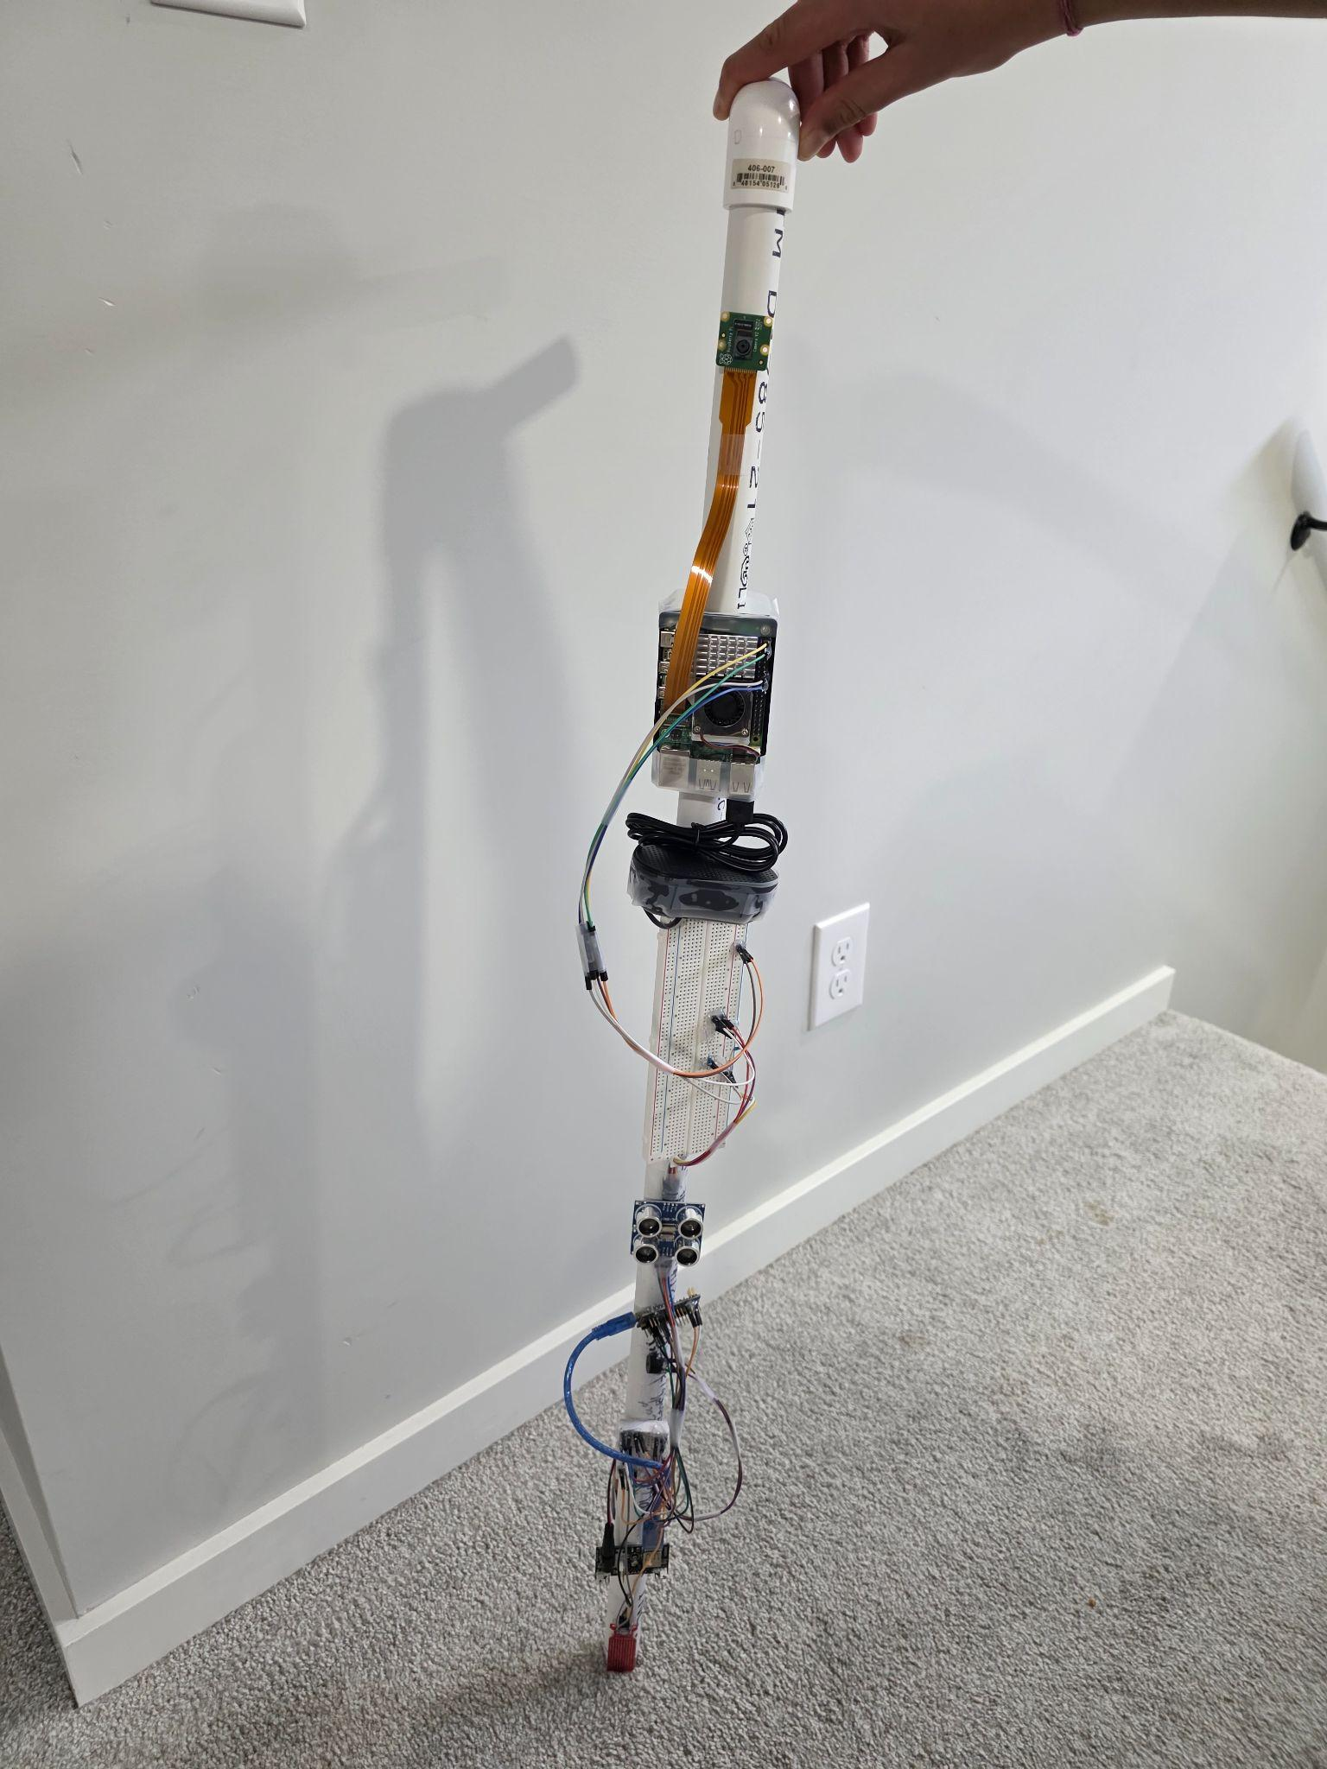
Arduino Nano - ($30): For object detection and processing - will control the second ultrasonic sensor, the water level sensor and the passive buzzer
Passive Buzzer - ($2.5): It will buzz in a certain tone if the ultrasonic sensor detects something and it will buzz in a different tone if the water level sensor detects something
Water Level Sensor - ($4): Detects if there is water on the ground
Arduino Power Supply - ($0.5): Used to power all components connected to arduino
9V battery - ($1): Battery to power all arduino components
PVC Coated Wires - ($5): To connect all the components together and for completing the circuit
PVC Pipes and PVC Connectors - ($20): Creates the main physical stick that the user will hold - will carry all the components
Total Cost: $242.68

Slide 11
Design and Method
Raspberry Pi 5:
Design focuses on timely and meaningful feedback using multiple sensors and AI
Feedback is processed through a multi-step system on the Raspberry Pi 5
Ultrasonic sensor remains active to detect obstacles
If an object is detected within 1.75 metres, a signal is sent to the Raspberry Pi 5
YOLO AI model is activated on the Raspberry Pi 5
Camera sends visual data to the Raspberry Pi 5
AI classifies the object into one of 80 categories
Classification result is output to the user through a speaker

Slide 12
Arduino Nano:
Arduino Nano provides instant danger feedback
Uses an ultrasonic sensor and a water level sensor
If an obstacle is detected within one metre, buzzer sounds at 320 Hz
If water is detected, buzzer sounds at 500 Hz
Combined Raspberry Pi and Arduino processes create a semantic experience
User can decide to use one system only as well based on their needs
System helps visually impaired users better understand their surrounding

Slide 13
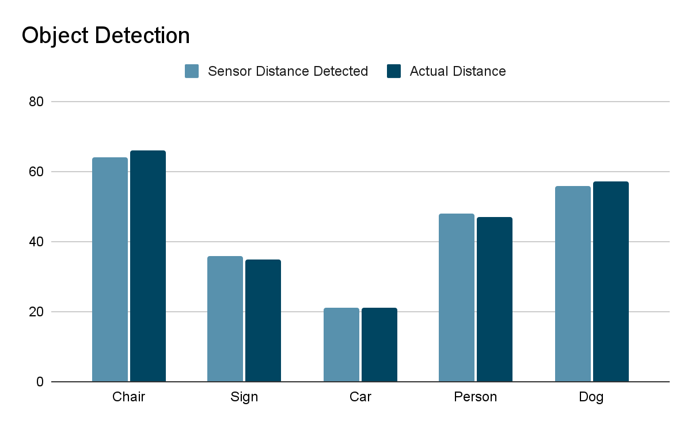
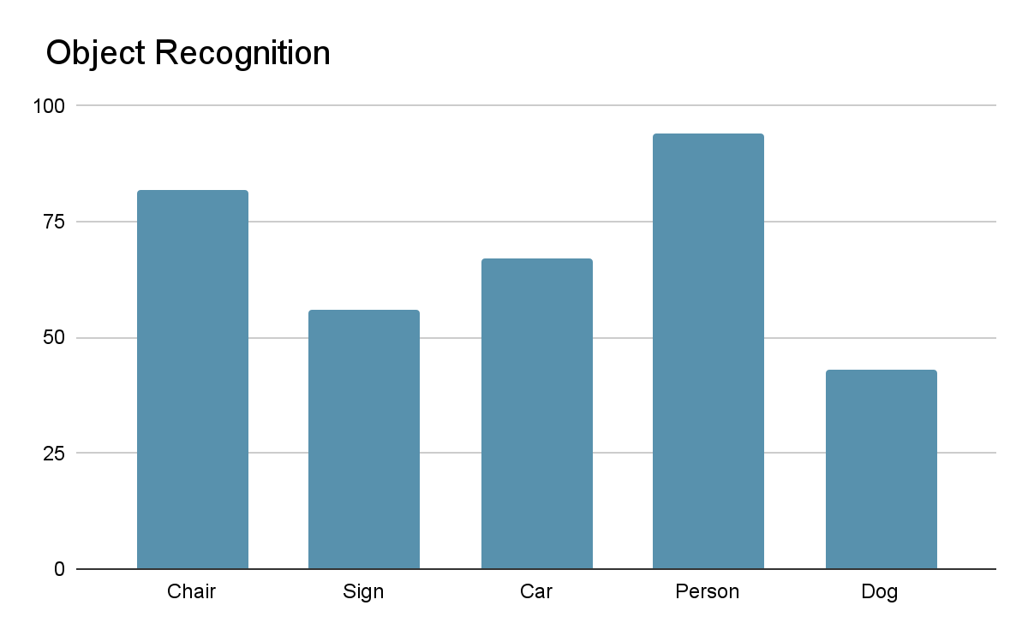
Testing
(Probability)
(cm)

Slide 14
I tested my model in my house, a park and pathway.
House: Aimed at furniture and other miscellaneous objects
Park and Pathway: Aimed at benches, signs, stopped vehicles and volunteer participants
Analysis
System Results
 | Arduino System Results | Raspberry Pi System Results
House | Ultrasonic Sensor worked almost perfectly; accurate object detection and correct buzzer frequency with quick feedback | AI recognition activated within 1.75 m; performed well in detecting people; Limited to 80 objects; misclassification of unknown objects
Pathway | Reliable obstacle detection; water sensor retained moisture after puddles, causing continuous buzzing and interference | Battery shutdown every 10–15 minutes; performed well in detecting animals
Park | Generally reliable; residual moisture caused occasional buzzing; buzzer failed in extreme cold | Cold conditions reduced recognition accuracy; frequent shutdowns requiring manual restart
Test Locations

Slide 15
Improvements and
Future Work
After analysing the testing data, the following are some improvement ideas:
Add more inbuilt recognizable objects or use adaptive learning on the AI model: This will fix the confusion of some unidentifiable object.
Use a more energy efficient CPU (not the one on Raspberry Pi 5) or use a higher voltage battery source: This will fix the problem in which the Raspberry Pi would keep turning off due to low voltage issues.
Adding extra insulation to the components to allow usage in colder temperatures
Future enhancements:
I could make the walking stick durable as PVC pipes are generally really flexible and not a good long term solution. Some alternatives to PVC pipes could be carbon fibre rods, wood sticks, or even hollow aluminum rods which are more durable and allow sturdy long term solutions.
Some more higher tech advancements could be the usage of GPS navigation. This would allow the visually impaired user to get to where they are going without needing their phone or other devices like that.
Voice directions would also be a good feature to add as it can allow the user to simply turn on their walking stick by a single sentence prompt rather than having to find the button amongst all the components.

Slide 16
Impacts and
Applications
The real-world impact and applications of this walking stick are numerous; here are some in both categories:
Impacts:
Helps visually impaired people walk more safely and independently
Gives users more confidence while walking in new places
Water sensor alerts users about puddles or wet areas using a buzzer which reduces chances of slipping or accidents
Encourages people to use technology to help with real world issues
Applications:
AI object recognition can be used in other helpful technologies
Similar AI can be used in healthcare (ex: finding diseases in images or blood samples)
Shows how two systems (AI + sensors) can work together in one project
Multiprocessing can be used in robotics, smart devices, and automation
Idea can be expanded into smart glasses or other assistive devices

Slide 17
Conclusion
Based on all my testing and analysis; these are my conclusion:
My hypothesis was supported: adding AI obstacle recognition to a walking stick with multiple sensors provided more accurate and useful feedback than a traditional cane.
Also, my hypothesis for adding obstacle detection to a walking stick along with AI recognition provided instant feedback which helps the user to react quicker than a traditional cane.
The AI-enabled smart walking stick used a Raspberry Pi 5 running a YOLO model and an Arduino Nano to provide semantic feedback.
The system successfully delivered information about detected objects and obstacles.
There were some issues related to power and sensor performance, but the device still produced sufficient feedback.
The added intelligence allowed visually impaired users to navigate more safely and with more awareness compared to a traditional cane.

Slide 18
Citations and
Acknowledgements
How does AI image recognition work? - IONOS CA
What is Image Recognition? | IBM
What is AI Image Recognition? How It Works & Examples | Shaip
Smart Cane: A Machine Learning-Powered Assistive Device
WeWALK Smart Cane
Smart Canes as Multifunctional Aids: Enhancing Navigation, Gaming, and Social Connectivity for the Visually Impaired
How Does a Self-Driving Car See? | NVIDIA Blog
Guide to Obstacle Detection for Robots with MRDVS S Series
How to Choose the Right Sensors for Autonomous Vehicles
I would like to acknowledge Gaurav Bansal, a software engineer, who is my expert, and who helped me with some code integration and gave me advice during my time working on the project.
I would also like to acknowledge Mrs. Fourie, Mrs. Tanner, and Mrs. Turner who are some of the teachers at Louis Riel School that helped me set up and get a start on my project.

Slide 19
Thank You

