Slide 1

Burning Candles
Sasha Schweitzer-Elsen
Kate Desjardins
East Lake School
Grade 6

Slide 2
The Big Question (Problem):
Kate & Sasha
Which type of candle burns the fastest?
If you want a candle to last all through supper or to use if the power goes out, you want a long lasting candle.

Slide 3
Variables
Independent Variables
Dependent Variable
Type of wax - paraffin or beeswax
Amount of candle that is melted

Slide 4
Variables
Controlled Variables
Size of candle
Start at the same time
Same lighter used every time
Same phone used for the stopwatch
All candles set up in holders at the same time the same way
Same people measuring every time
Experiment done at one time in one place
Indoors so that the wind could not blow them out

Slide 5
Hypothesis
We think that paraffin will burn faster than beeswax because beeswax comes from bees and it needs to be strong to protect the hive so it will take longer to melt.

Slide 6
Research
Testing which candles to include in the experiment:
We did a test with a paraffin candle to see how long to make the time.
From the weight of wax burned, we learned that the candle shape and container changes the amount of melting. The soy candle was in a jar and there was less weight change, so we did not include it.
25 minute test:
Wax | Weight before (g) | Weight after (g) | Melted (g)
Paraffin | 9.3 | 6.6 (average) | 2.7
Beeswax | 11.8 | 9.7 (average) | 2.1
Soy | 322.3 | 320.7 | 1.6

Slide 7
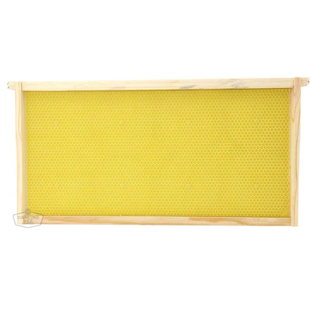
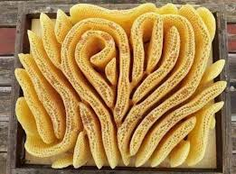
Research Interview with Mrs Rita Clyde
1. When you had hives, what happens to the beeswax normally? Do you have to take it out over time if there is too much?
When we had bees, we took out beeswax along with the honey. We had frames and foundation, which looked like this:
The bees built their honeycomb on the foundation. It looked like little hexagon shaped cups sitting on the frames. When it was time to take some honey from the hive, we pulled out the frame, cut open the beeswax cups and the honey poured out. Then, we put the frame back into the hive. The bees would clean up and fix up the honeycomb and use it for more honey.
If we didn't take any honey from the bees, they would cover all the frames with beeswax cups or honeycomb. Once all the frames were full, they would stop making honeycomb. They would take care of the honeycomb by cleaning out any old honey or dirt and putting new honey in. Bees also use the honeycomb spaces to hold their eggs and babies. Once the babies grow up, they also clean out the honeycomb to use again. Bees are so very tidy and so very good at reusing things!
So we don't have to worry about taking out the wax to make space. The bees will fill the hive with their honeycomb and stop when it's full.
Fun fact: If there is no foundation in the beehive, the bees build their honeycomb in crazy, curvy shapes like this:

Slide 8
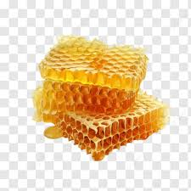
Research Interview with Mrs Rita Clyde
2. When people are selling beeswax candles, when we looked at pictures it looked like sometimes they just used pieces of beeswax rolled up. Is that how beeswax looked in your hives? Or do you think maybe they are melting it into flat pieces that they roll up?
The beeswax in our hives was not flat. It looked like this:
It was like little cups of honey sitting beside each other. My guess is that the wax used for beeswax candles is made by melting down the honeycomb, after taking out the honey, and pouring it into a flat mold, just like you guessed.
3. How much honey do bees make in a week?
A bee lives about six weeks. During their lifetime, a bee makes 0.8 grams of honey. That is like, a single drop of honey.
4. How much beeswax do bees make in a week?
A bee makes wax a flake at a time. It can make 8 little flakes in about 12 hours. It takes about 1000 flakes to make 1 gram of wax. That is a tiny, tiny, amount.
5. How much beeswax do all the bees have to make to protect the hive?
It depends on how big the hive is and how many bees there are. Bees need enough honeycomb to hold their eggs, their babies, and their honey. So as long as they have enough space to do this, they will stop making beeswax and focus on other things. That said, my beekeeping books say that most hives have about 70 - 90 kg of wax in them.

Slide 9
Procedure
Cut the candles to be the same length.
Weigh the candles starting weight.
Trim the candle wicks to 0.5 cm.
Mark centimetre lines on the candles to help see progress.
Put candles in melted wax from a different candle to hold them in candle holders.
Light the candles (1 paraffin and 1 beeswax) at the same time and start the stopwatch.
Every 5 minutes record the amount burned or melted.
After 25 minutes put out the candles CAREFULLY.
Record the final burned or melted length.
Record the final weight.
Clean up.

Slide 10
Procedure - Safety
Fire safety: have an adult light the candles and stay in the room.
Fire safety: put out the candles by stopping the flame, not by blowing them and making wax blow off the candles.
Fire safety: put the candles in candle holders and on a heat-proof tile, not just on the table.
We had a bowl of water so if needed we could dump the candles in.

Slide 11
Equipment
Paraffin candles
Beeswax candles
Candle holders
Metal ruler with 1mm lines
Stopwatch
Kitchen scale
Sharpie to mark candles
Heat-proof surface

Slide 12
Sources of error
Air movements make the flames flicker and not burn steady if people move around.
Candle wicks did not seem to be identical.
Candles were hot so measuring was hard, used a metal ruler to not burn
Forgot how to use the stopwatch the first trial so we stopped it too early and had to restart

Slide 13
Observations/Results
 | Paraffin (cm) |  |  |  | Beeswax (cm)
Time (minutes) | Trial 1 | Trial 2 | Trial 3 | Paraffin Average | Trial 1 | Trial 2 | Trial 3 | Beeswax Average
0 | 0.0 | 0.0 | 0.0 | 0.0 | 0.0 | 0.0 | 0.0 | 0.0
5 | 1.0 | 1.1 | 1.2 | 1.1 | 0.7 | 0.7 | 0.9 | 0.8
10 | 1.8 | 1.8 | 1.8 | 1.8 | 1.0 | 1.0 | 1.1 | 1.0
15 | 2.5 | 2.2 | 2.1 | 2.3 | 1.5 | 1.2 | 1.4 | 1.4
20 | 3.0 | 3.0 | 2.8 | 2.9 | 1.8 | 1.7 | 1.7 | 1.7
25 | 3.7 | 3.4 | 3.3 | 3.5 | 2.2 | 2.0 | 2.0 | 2.1

Slide 14
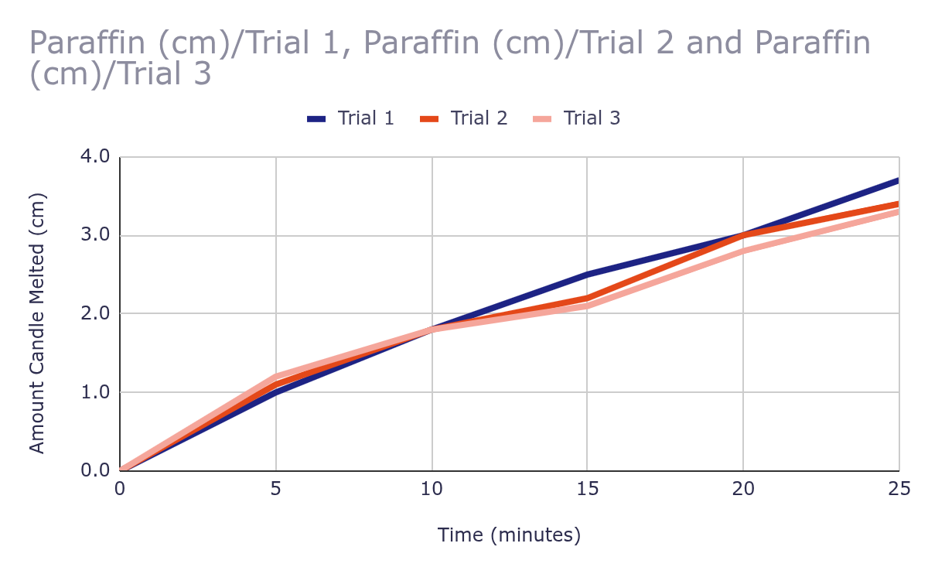
Observations/Results

Slide 15
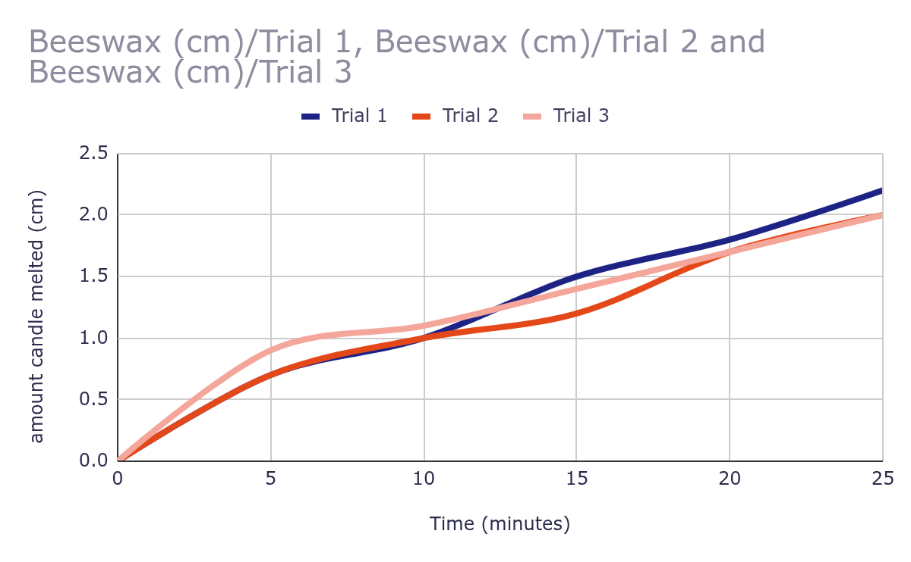
Observations/Results

Slide 16
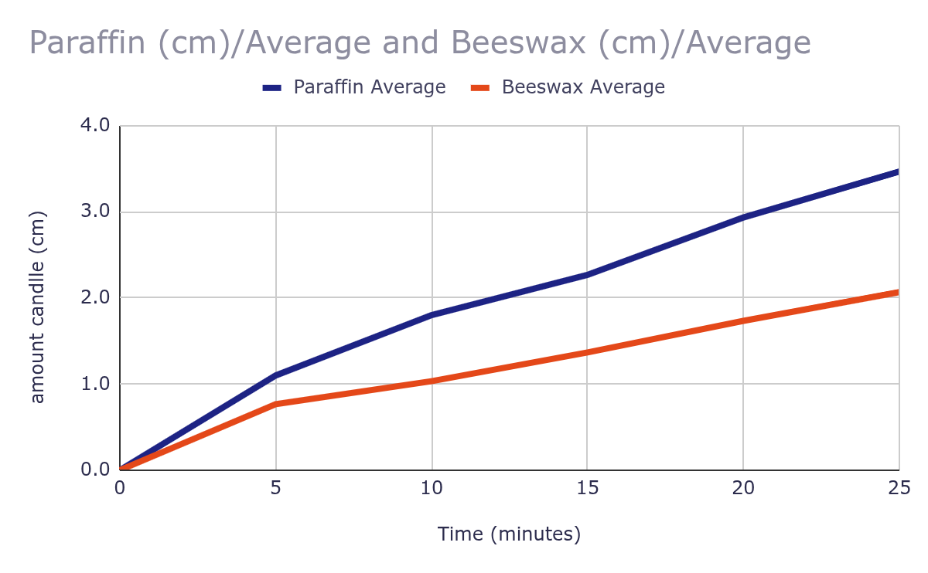
Observations/Results

Slide 17
Analysis
The graph for paraffin and beeswax shows that over the 25 minutes much more paraffin candle melted.
In the results the lines of the different trials are close together that means the experiment can be repeated and have the same results and we were surprised that the lines were so close together.

Slide 18
Conclusion
Our conclusion is that paraffin melts faster than beeswax so our hypothesis was correct.

Slide 19
Application
Our application is that if there is a power outage or you’re eating dinner you can use a beeswax candle because they last longer.

Slide 20
Citations (sources)
CandleScience
https://www.candlescience.com › paraffin-wax-how-it-s… and,
What Exactly is Paraffin wax?
Blended Waxes Https://blendedwaxes.com › Blog & Resources
Interview with Mrs Rita Clyde
What is beeswax? https://www.motherearthnews.com/natural-health/what-is-beeswax-ze0z1511zcwil/
How tall was the tallest candle?
https://www.guinnessworldrecords.com/world-records/67215-tallest-candle
How does a candle work?
HowStuffWorks
https://home.howstuffworks.com question 267
How does a candle work?
History of Candles
National Candle Association
https://candles.org › history-of-candles
The History of Candles: From Ancient Times to Modern Day
Beelight Candle
https://beelightcandles.net › benefits-of-beeswax-candles
What are the parts of a candle?
https://www.britannica.com/technology/candle#ref429599
Why do people use candles today? https://generalwax.com/blogs/news/9-reasons-why-people-are-lighting-candles#:~:text=March%2018%2C%202023,the%20light%
What were early candles like?
https://salcombecandlecompany.com/pages/candle-making-history#:~:text=Middle%20Age,to%20product%20of%20its%20time.

Slide 21
Acknowledgement:
We would like to thank Joanne {Kate’s mom}, Mark {Sasha’s dad}, Mrs Rita Clyde.

Slide 22
Research questions
By Kate and Sasha
Company Name
Month Year

Slide 23
What is paraffin?
1
Paraffin wax is know as a petroleum wax It comes from petroleum, coal and oil shale. Paraffin wax is separated from the oil. Although paraffin wax comes from a natural source, it usually isn’t considered a natural wax.
CandleScience What Exactly is Paraffin wax?
https://www.candlescience.com › paraffin-wax-how-it-s… and, Blended Waxes Https://blendedwaxes.com › Blog & Resources

Slide 24
What is beeswax?
2
Beeswax is long-chain alkanes, acids, esters, polyesters and hydroxy and it comes from a worker bee’s abdomen.
What is beeswax? https://www.motherearthnews.com/natural-health/what-is-beeswax-ze0z1511zcwil/

Slide 25
How tall was the tallest candle?
3
The tallest candle was 24.38 meters [80 feet] high and 2.59 meters [8 feet and 6 inches] in diameter. The overall height including the brick base was 38.7 meters [127 feet].
How tall was the longest candle?
https://www.guinnessworldrecords.com/world-records/67215-tallest-candle

Slide 26
How do candles work?
4
There are two parts of the candle that work together:
The fuel, made of some sort of wax
The wick, made of some sort of absorbent twine
The wick needs to be naturally absorbent. If you buy an unwaxed wick at a store, you will find that it feels soft and absorbs water quickly. This absorbency is important in a candle because the wick needs to absorb liquid in the wax and move it upward through the candle while the candle is burning.
How does a candle work?
HowStuffWorks
https://home.howstuffworks.com question 267

Slide 27
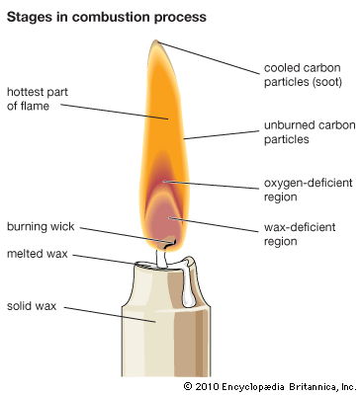
What are the parts of a candle?
5
When a candle is lit, heat melts the wax near the wick. This hot wax rises through the wick by capillary action, vaporizes, and breaks down into hydrogen and carbon. These elements then combust to produce light, heat, carbon dioxide, and water vapor.
What are the parts of a candle?
https://www.britannica.com/technology/candle#ref429599

Slide 28
When did humans start to use candles?
6
Candles have been used as a source of light for more than 5,000 years, yet little is known about their origin.
The earliest candles were used by Ancient Egyptians, who made rushlights and torches by soaking the pithy core of reeds in melted animal fat. However, the rushlights had no wick like a true candle.
History of Candles
National Candle Association
https://candles.org › history-of-candles

Slide 29
What did people use candles for in ancient/history times?
7
Ancient Greece and Rome adopted candle-making techniques, but with an important difference: the Romans began making candles from beeswax, a cleaner and more efficient alternative to tallow. Candles became common in Roman homes, public spaces, and religious rituals, and were later adopted by the early Christian Church as a representation of the "light of Christ.
Due to the cost of beeswax, these candles were considered a luxury item and were often reserved for churches, monasteries, and in households. The ancient Egyptians believed that light symbolizes life and the afterlife, which is why candles were often used during funerals and placed in tombs.
The History of Candles: From Ancient Times to Modern Day
Beelight Candle
https://beelightcandles.net › benefits-of-beeswax-candles

Slide 30
Why do people use candles today?
8
People use candles for power outages, dinner, lights and festivals. And sometimes just to make the house nicer.
Why do people use candles today? https://generalwax.com/blogs/news/9-reasons-why-people-are-lighting-candles#:~:text=March%2018%2C%202023,the%20light%

Slide 31
What were early candles like?
9
Early candles were made from sperm whale wax and beeswax until 1879 when light bulbs were invented.
What were early candles like?
https://salcombecandlecompany.com/pages/candle-making-history#:~:text=Middle%20Age,to%20product%20of%20its%20time.

