Slide 1
What is Artificial Rain?
By: Haniel Helton Fernandez

Slide 2
Objective
To understand the concept of artificial rain and the science behind cloud seeding.
Investigate the methods and materials used in cloud seeding.
Evaluate the effectiveness and environmental effects of cloud seeding.

Slide 3
Hypothesis
My hypothesis is that cloud seeding is a process when you pour some chemicals into a cloud, then after a couple hours the chemicals will absorb the water vapor that's already inside of the cloud to make big water droplets, leading the cloud to get heavier until it starts to rain.

Slide 4
Introduction
Artificial rain / Cloud Seeding is a type of weather modification technique. It artificially changes the weather by Cloud seeding and produces artificial rain or snow, which can help to meet the precipitation needs of a particular region.

Slide 5
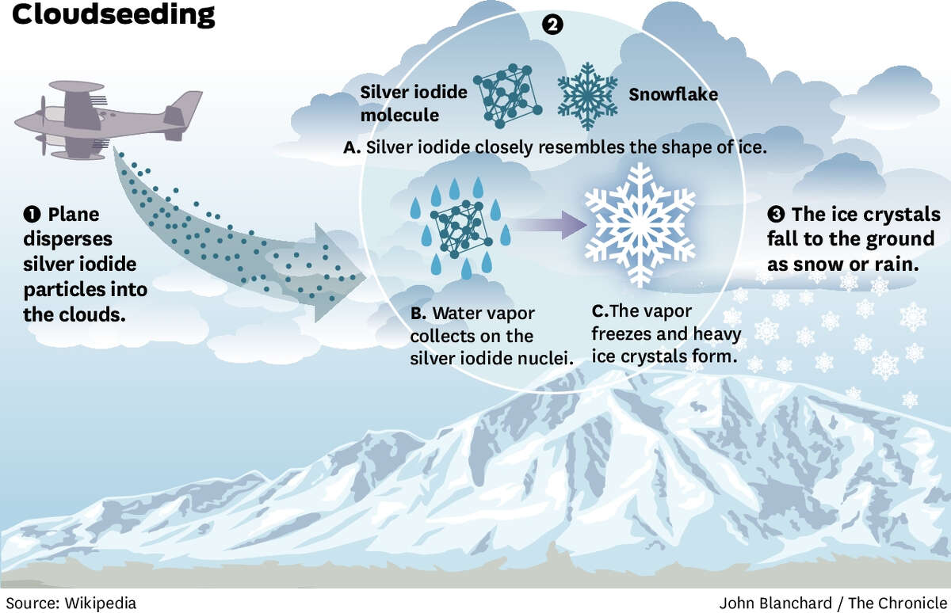

Slide 7
Dr. Vincent Schaefer
Dr. Vincent Schaefer was an American chemist and meteorologist. He was researching aircraft icing and precipitation. In 1964, he used a cold box(cooler) for his research. While testing something else, during his experiments, he often breathed out in the cold box. As you know, when we breathe out of our mouth it contains water vapor if it’s cold outside, it will condense like how clouds are formed. So he noticed this while doing the experiment. But then he thought about what will happen if he cooled the box down further, to do that he used dry ice

Slide 8
Dry ice is basically a solid form of carbon dioxide. So he placed some dry ice in the cold box, and then when he breathed out in the box, he saw something amazing, the air he blew out turned into millions of microscopic ice crystals. Then he realized that if the temperature suddenly reduces, the water vapor will instantly turn into ice crystals. This is the same thing that happens at the last stage of clouds. He saw that using dry ice has sped up this process. He immediately conducted more experiments to exactly understand what was happening. Finally when he understood it, he realized that it could be helpful in real life as well. So he thought if he could instantly cool the clouds in the sky by using dry ice, we can get instant snow fall or rain.

Slide 9
November 13th 1946, Dr Vincent Shaefer took a plane from New York with 2.5 kg of dry ice, and conducted his test on a cloud near mount Greylock. He threw crushed ice out of the planes, on the clouds and the result was amazing. He saw instant heavy snowfall, and this lead to the invention of Cloud Seeding.

Slide 10
Dr. Bernard Vonnegut
Dr. Bernard Vonnegut was a scientist who wanted to cool the clouds without using dry ice, so he used a chemical that had the same affect as dry ice. But for water vapor to turn into water droplets in condensation you need a surface, so he thought that if he provided a better surface for the tiny water vapor it would speed up the process.

Slide 11
He did an experiment with chemicals like silver and iodide. He found out that by using silver iodide, it provides a better surface for the water vapor because silver iodide has a property to absorb a lot of moisture so the water vapor gets attracted to the silver iodide and gets converted into water droplets.

Slide 12
Cloud formation
Clouds are formed from water vapor that rises into the air. As the water vapor moves to higher altitude it cools down just like how it gets colder at the top of a mountain. When the water vapor is at a higher altitude it condenses due to the cold, called condensation. Then the water vapor turns into extremely small water droplets, which are so small that the diameter is one–hundredth’s of a millimeter.

Slide 13
If a cloud goes to a higher altitude, the atmosphere is even colder, this means not only does it condense, but it also freezes. These water droplets turn into tiny ice crystals and these crystals form the clouds.
There are 2 types of clouds, one made of water droplets and another one made out of ice crystals. The one made out of water droplets are closer to the ground but the ones made out of ice crystals are at higher altitude.

Slide 14
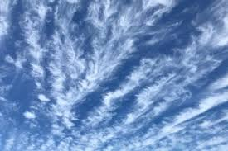
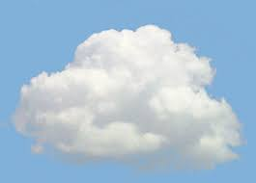
Clouds formed from ice crystals
(Higher altitude)
Clouds formed from water droplets
(Lower altitude)

Slide 15
Natural precipitation process
Natural precipitation begins when all the small water droplets in the atmosphere collide and combine to form larger droplets. These bigger droplets can then rise into the colder parts of the atmosphere, where they freeze and turn into ice crystals. As the ice crystals collide with one another, they grow bigger and heavier. This process continues until the ice crystals become so large and heavy that they fall to the ground. If the air temperature is cold, the ice crystals remain frozen and result in snowfall. On the other hand, if the air is warmer, the ice crystals melt and turn into raindrops.

Slide 16
What is Cloud seeding and how does it work?
Cloud seeding is a process of adding artificial substances to clouds to make them rain or snow.
The clouds must have some moisture in them.
Special substances like silver iodide or salt are introduced to the clouds.

Slide 17
Cloud seeding procedure

Slide 18
Materials used for cloud seeding
The materials in cloud seeding include
Silver iodide
Potassium iodide
Salt
Dry ice (solid carbon dioxide)

Slide 19
Methods of Cloud seeding
There are three cloud seeding methods
Hygroscopic cloud seeding: In this method disperse salts through flares in the lower portion of clouds. The salt grow in size as water joints with them.
Static cloud seeding: Involves spreading a chemical like silver iodide into clouds. The silver iodide provides a crystal around which moisture can condense.
Dynamic cloud seeding: aims to boost vertical air currents, which encourages more water to pass through the clouds, translating into more rain.

Slide 20
Techniques of cloud seeding
The following are the equipment's and techniques used to disperse the artificial substances to the clouds which helps for artificial rain.
Static cloud seeding method: In this method the army planes or aircrafts are used for cloud seeding.
Ground generator seeding: This method is same as static cloud seeding, but aircrafts are replaced by ground generators. There are 2 types of ground-based generators which are remote controlled generators and manual generators.
Rocket cloud seeding: In this method rockets are used to aim the rain-bearing clouds.

Slide 21
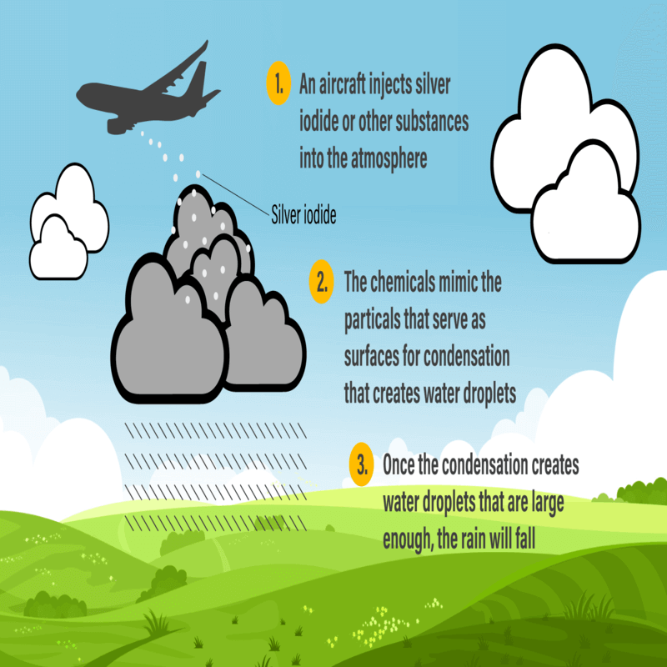
Static cloud seeding method

Slide 22
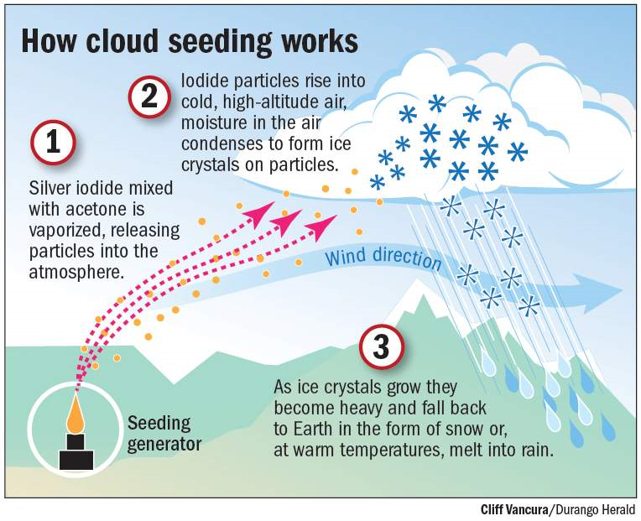
Ground generator seeding

Slide 23
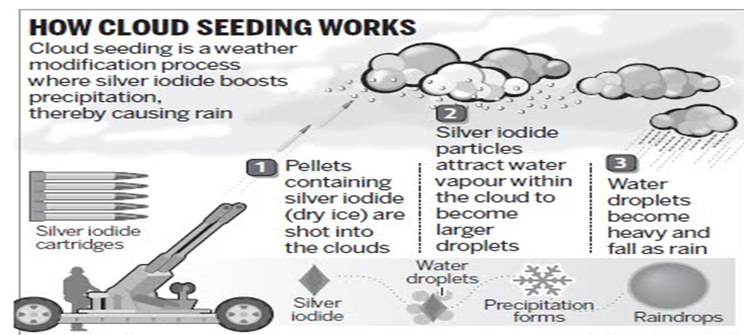
Rocket cloud seeding

Slide 24
Advantages of cloud seeding
Cloud seeding can be used in many ways like:
Increase precipitation.
Decrease the time of condensation.
Reduces the size of hail.
Reduces the amount of fog.
Reduce pollution.

Slide 25
Disadvantages of cloud seeding
There are a couple of disadvantages about cloud seeding like
Potential environmental impact due to the chemicals used during cloud seeding.
Mistakes while operating could lead to natural disasters like Hurricanes, floods and intense thunderstorms.
High cost depending on how much area you want to cover and for how long (For example, in USA they spend around millions of dollars annually. Where as Canada spends approximately 3 million dollars but it is covered by insurance companies).

Slide 26
Countries that used cloud seeding early
In the early days, cloud seeding was tested to increase rainfall and reduce hail damage. The countries that used it earlier are,
USA(United States of America)
Russia
Switzerland

Slide 27
Which countries have used Cloud seeding?
There are many countries that are using cloud seeding, here are a couple examples,
Canada: Alberta has been using cloudseeding technologies since the 1980s to increase snowfall in the Rocky mountains. This helps to improve water supplies, especially in the Bow river, also they are using cloud seeding to suppress hailstorms and drought managements. Alberta is the only province in Canada that has used cloud seeding technologies.
India: India also uses cloud seeding for droughts and they think that cloud seeding will help improve the air quality.

Slide 28
UAE (United Arab Emirates): UAE use’s cloud seeding for agriculture, increase water supplies, and to battle against the heat.
China: China has the biggest cloud seeding system in the world, they even used it during the Beijing Olympics in 2008 in order to have a dry Olympics. China also uses cloud seeing for agriculture and to also prevent natural disasters like droughts or floods.
USA(United States of America): USA has used cloud seeding in Wyoming, Utah, Texas, North Dakota, New Mexico, Nevada, Idaho, Colorado, California. They mainly use cloud seeding for agriculture.

Slide 29
Conclusion
My hypothesis was half correct because I thought that there was a chemical that would absorb all the water in the cloud. But silver iodide acts as a surface for the water vapor to mix together to form big water droplets. And I also thought that it would take several hours but it only takes a couple minutes for it to start raining.
Cloud seeding is a new technology that can help improve weather conditions in dry areas, by increasing rainfall or snowfall, it provides water for agriculture, reduces hail damage, and supports water supplies in regions that need it. However, scientists are still studying it’s effectiveness and environmental impacts.

Slide 30
After doing the research on this topic I have a wider knowledge of artificial rain, learnt useful information about different methods to produce rainfall.
I think that in the future this technology will be a very important because global warming is a major issue also it helps to control hailstorms, pollution, fog and droughts. So cloud seeding will be a solution to these problems.

Slide 31
Citations
https://en.wikipedia.org/wiki/Cloud_seeding
https://www.scribd.com/presentation/438687568/Artificial-Rainfall-Cloud-Seeding
https://studylib.net/doc/27031120/637998079270703452-cloudseedingresearchpaper
https://youtu.be/Jz4b3AJmZ5o?si=STTee7viWWVMabDf

