Slide 1

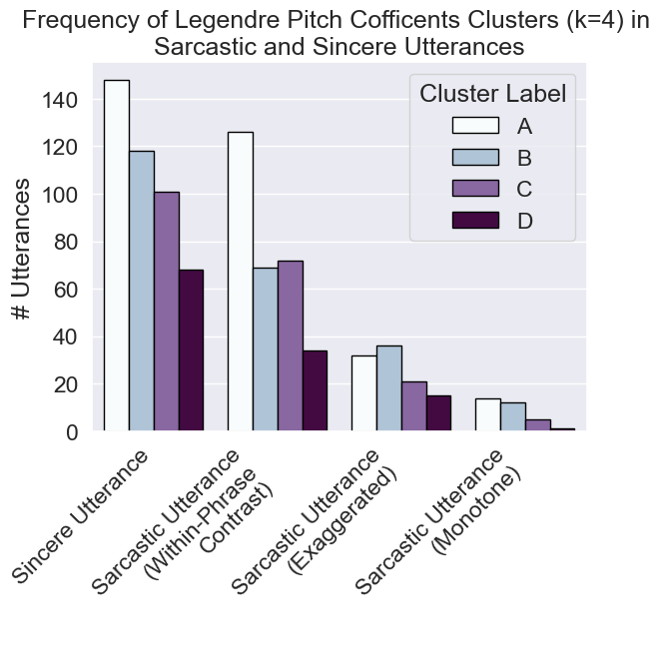
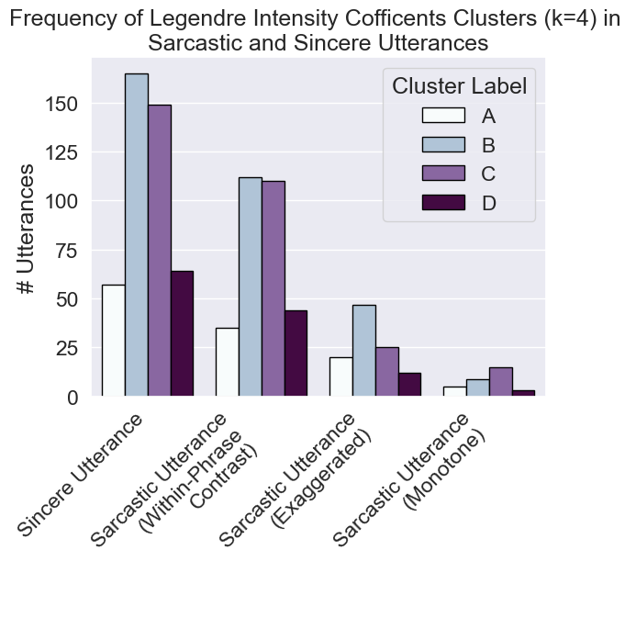
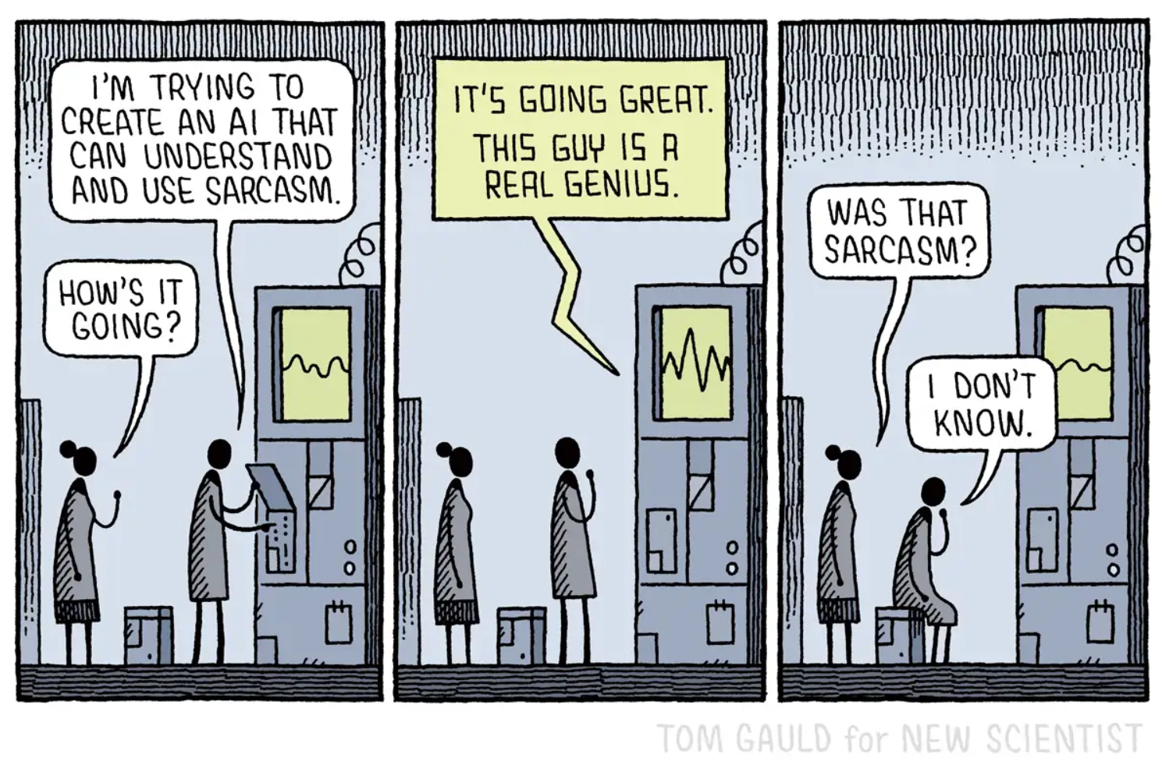
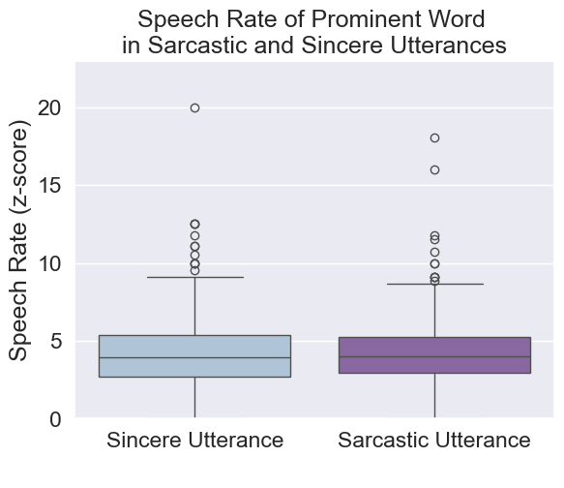
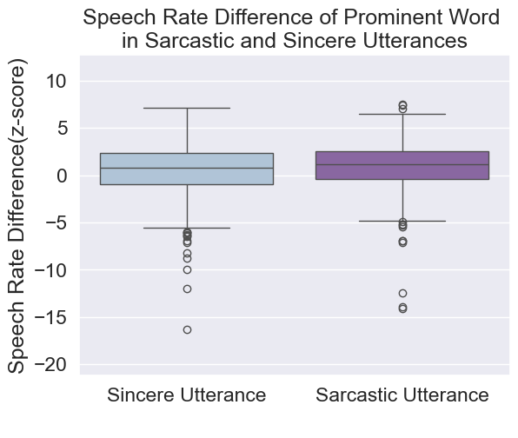
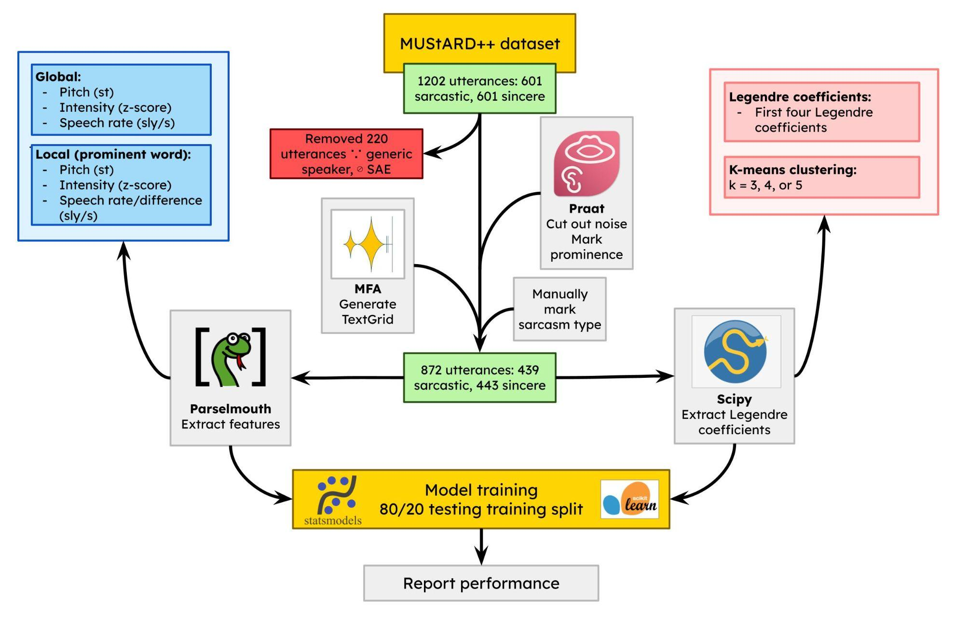
Automatic Sarcasm Detection from Prosodic Features Andi Liu (Webber Academy)
Supervised by Brooklyn Sheppard and Angeliki Athanasopoulou (University of Calgary)
BACKGROUND
RESULTS: SIGNIFICANT PREDICTORS
DISCUSSION
Sarcasm: Utterance that means the opposite of what is said
Prosody:
Global features (eg. pitch, speech rate) → mixed findings
Local features (eg. elongation) → understudied in sarcasm prosody
(Attardo et al., 2022) found 3 sarcasm types with differing prosody: within-phrase contrast, exaggerated, monotone
Legendre coefficients
Not predictive or sarcasm types → pitch + intensity contours not distinct enough/difference not on prominent word
(Sheppard & Winters, 2022) found contribution of contour shape on sarcasm perception, not production
(Chen & Boves, 2018) found FPC of contours to be predictive in detection of British English → possible impact of dialect + representation method
Speech rate
Difference in speech rate predictor in noisier models only → weak predictor
Speech rate of prominent word slower in exaggerated sarcasm → possibly adds additional emphasis
Sarcasm type
Performance differs substantially by sarcasm type
Monotone Sarcasm not different from Sincere → prosodically similar, importance of meaning
Within-phrase Sarcasm model low performance→ type characterized by “sincere” part + “sarcastic” part
Comparison to other models
Performance of best model comparable to other models trained on MUStARD
Orange = multimodal (audio + text), Red = audio only
Automatic sarcasm detection → applications in sentiment analysis, ASR, sarcasm recognition apps
Most systems use NN → low interpretability + computationally expensive + doesn’t account for sarcasm types
Objective:
Develop a logistic regression model to distinguish sarcastic and sincere utterances using local features, characterize sarcasm types
♥
✷
RQ: Can a simple logistic regression model perform at an equal level as neural networks when detecting sarcasm from speech?
Model name |  | Precision | Recall | F1
Global only |  | 0.64 | 0.64 | 0.64
Global+Local (k=3) |  | 0.65 | 0.65 | 0.64
Type specific (exaggerated) |  | 0.71 | 0.71 | 0.71
(Wang et al., 2024) | LR | 0.55 | 0.67 | 0.61
 | LSTM | 0.80 | 0.54 | 0.64
(Shi, 2024) |  | 0.62 | 0.61 | 0.61
(Xue et al., 2024) |  | 0.73 | 0.72 | 0.71
(Gao et al., 2024) |  | 0.81 | 0.81 | 0.81
METHODOLOGY
♥
Global+Local (coefs) | Global+Local (k=5) | Type specific (exaggerated)
𝛽 = -0.17, p = 0.1 | 𝛽 = -0.18, p = 0.1 | 𝛽 = -0.32, p = 0.5
✷
Global+Local (coefs) | Global+Local (k=5)
𝛽 = -0.12, p = 0.4 | 𝛽 = -0.13, p = 0.3
RESULTS: MODEL PERFORMANCE
Little improvement in performance with addition of local features
Decline with raw Legendre coefficients and with k=5
Sarcasm Types:
Best model → classifying Exaggerated Sarcasm
No significant predictors for Monotone Sarcasm classification
CONCLUSION
Best performing model comparable to others in field → Yes to RQ
Sarcasm type influences system performance → need of type sensitive systems (eg. multimodal with text in monotone type)
Potential of LR to be effective in sarcasm detection → prosody based features useful in sarcasm detection
Future direction: FPC, Wavelet for automatic prominence detection, comparison to conversational sarcasm, include text to improve performance on monotone type
Sources of error: speakers “acting sarcastic” → prosodic differences bigger; noise in audio
Model name | Accuracy | Precision | Recall | F1
Global only | 0.64 | 0.64 | 0.64 | 0.64
Global+Local (coefficients) | 0.63 | 0.64 | 0.63 | 0.63
Global+Local (k=3) | 0.65 | 0.65 | 0.65 | 0.64
Global+Local (k=4) | 0.65 | 0.65 | 0.65 | 0.64
Global+Local (k=5) | 0.63 | 0.64 | 0.63 | 0.63
Type specific (exaggerated) | 0.71 | 0.71 | 0.71 | 0.71
Type specific (phrase contrast) | 0.61 | 0.61 | 0.61 | 0.61
Type specific (monotone) | NA
Feature inclusion: features with p < 0.05 in training set
Legendre Coefficient → simplification of pitch/intensity contour
K-means Clustering → reduction of Legendre coefficients to discrete values
Model name | Global | Local | Legendre Clustering | Legendre Coefficients
Global only | X
Global+Local (Legendre coefficients) | X | X |  | X
Global+Local (clustering: k=3, 4, 5) | X | X | X
Type specific | X | X | X
ACKNOWLEDGMENTS
Special thanks goes to Dr Garcia and Ms Kale

