Slide 1
This Presentation is dedicated to my Mother Institute CIS and all the Teachers
https://calgary.ctvnews.ca/mobile/school-fee-dispute-hits-calgary-islamic-school-1.5813268

Slide 2
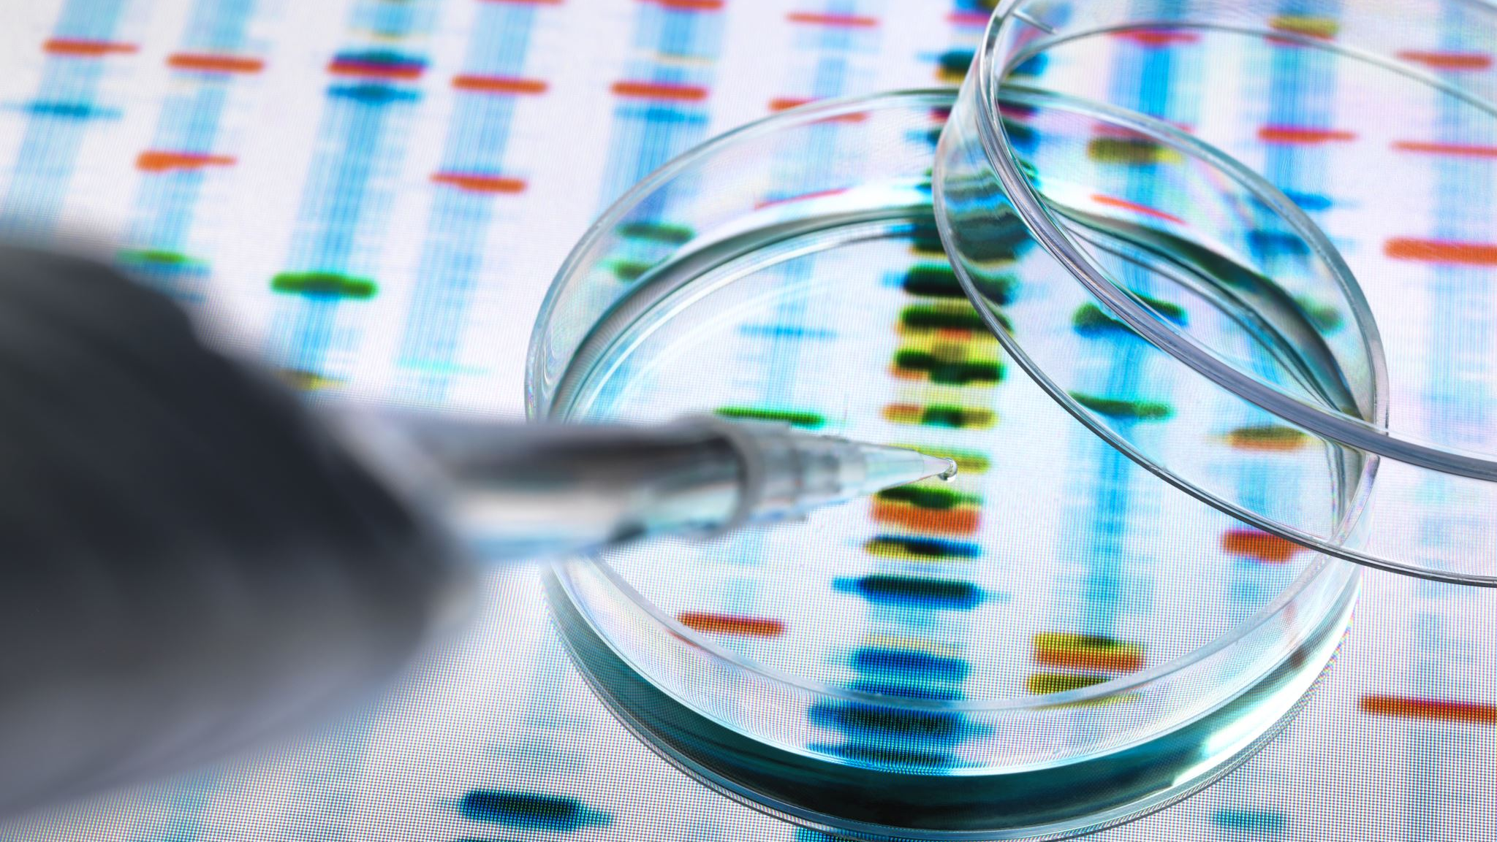
Alzheimer’s Disease and Advanced Research Therapy
Presented by:
Muhammad Usman Mirza
Grade. 8B

Slide 3
Outline
What is Alzheimer's ?
Symptoms of Alzheimer's
Causes
Neurodevelopmental Basis of Alzheimer's
Treatments
Advanced Research Techniques
References

Slide 4
My Motivation! What motivated me to choose this topic?
I became interested in this topic through my previous experience in the 2024 Science Fair, where I worked on a project about epilepsy. That project earned me the First Place Gold Medal and gave me the opportunity to collaborate with the Neuroscience Lab at the University of Calgary.
During my time in the lab, I observed a Ph.D. student conducting research on Alzheimer’s disease. Hearing their discussions about its impact on the brain and the ongoing challenges in finding effective treatments sparked my curiosity. Even though it was a new topic for me, I was fascinated and immediately decided to explore it for my next project. With the lab’s approval, I started my research journey to learn about Alzheimer’s and share the latest findings through this project.”

Slide 5
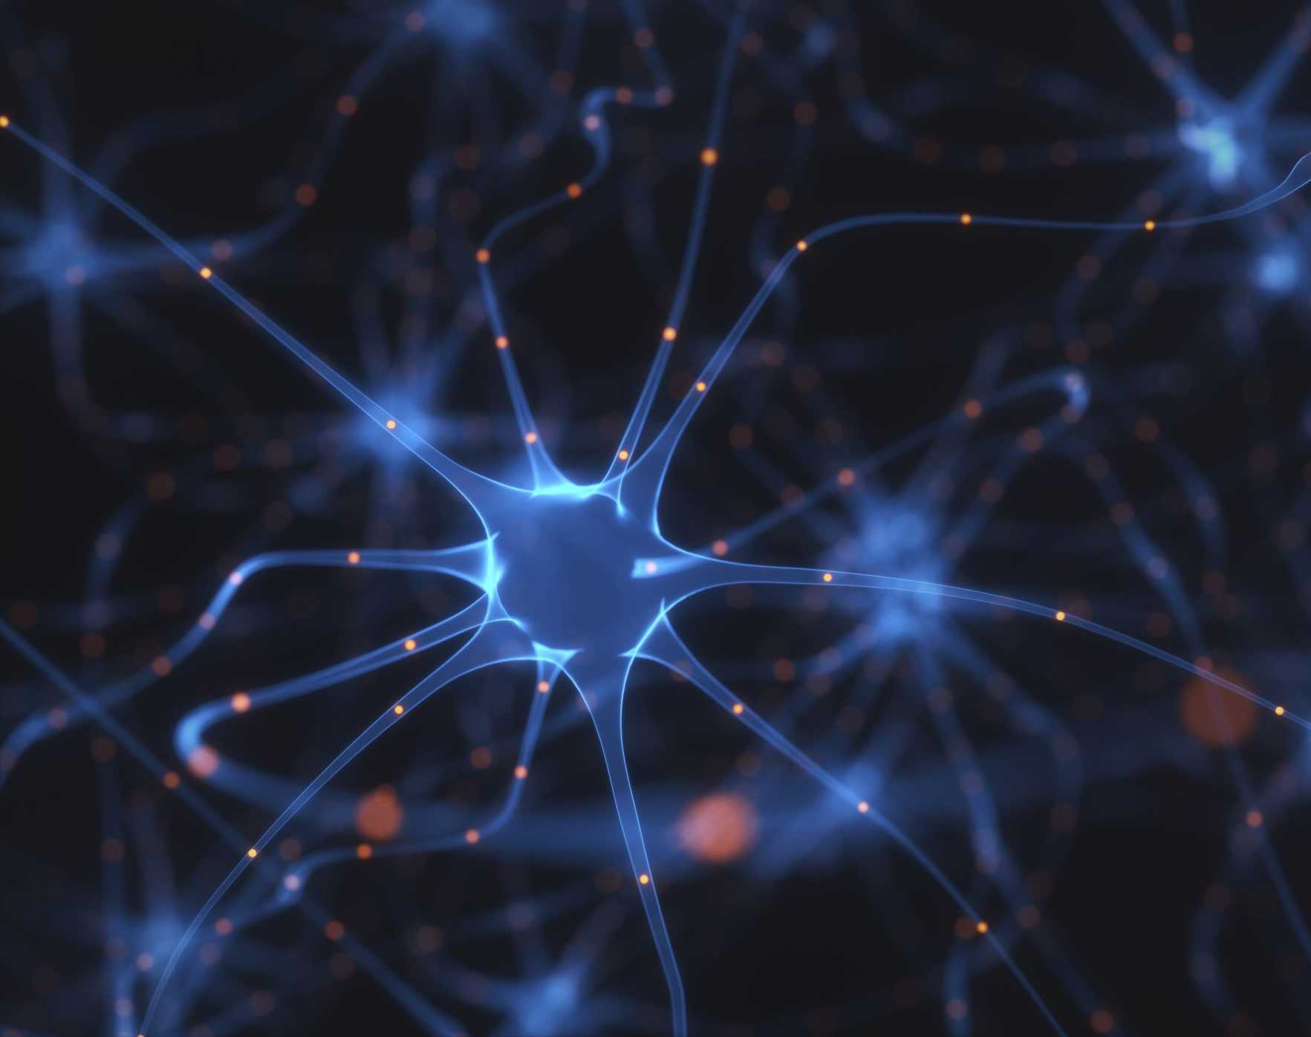
Alzheimer’s: What is it?
Alzheimer’s disease is a Neuro degenerative progressive Brain disorder that affects memory, thinking, and behavior.
The language of the Brain is Electrical Signals between Neurons (Brain Cells)
When there are Abnormal Changes in Brain’s Electrical Activity and Nerve Cells Degenerate, this may Alzheimer's.
Biologically, it is caused by build-up of beta-amyloid plaques and tau tangles in the brain, leading to neuron damage, and inflammation.

Slide 6
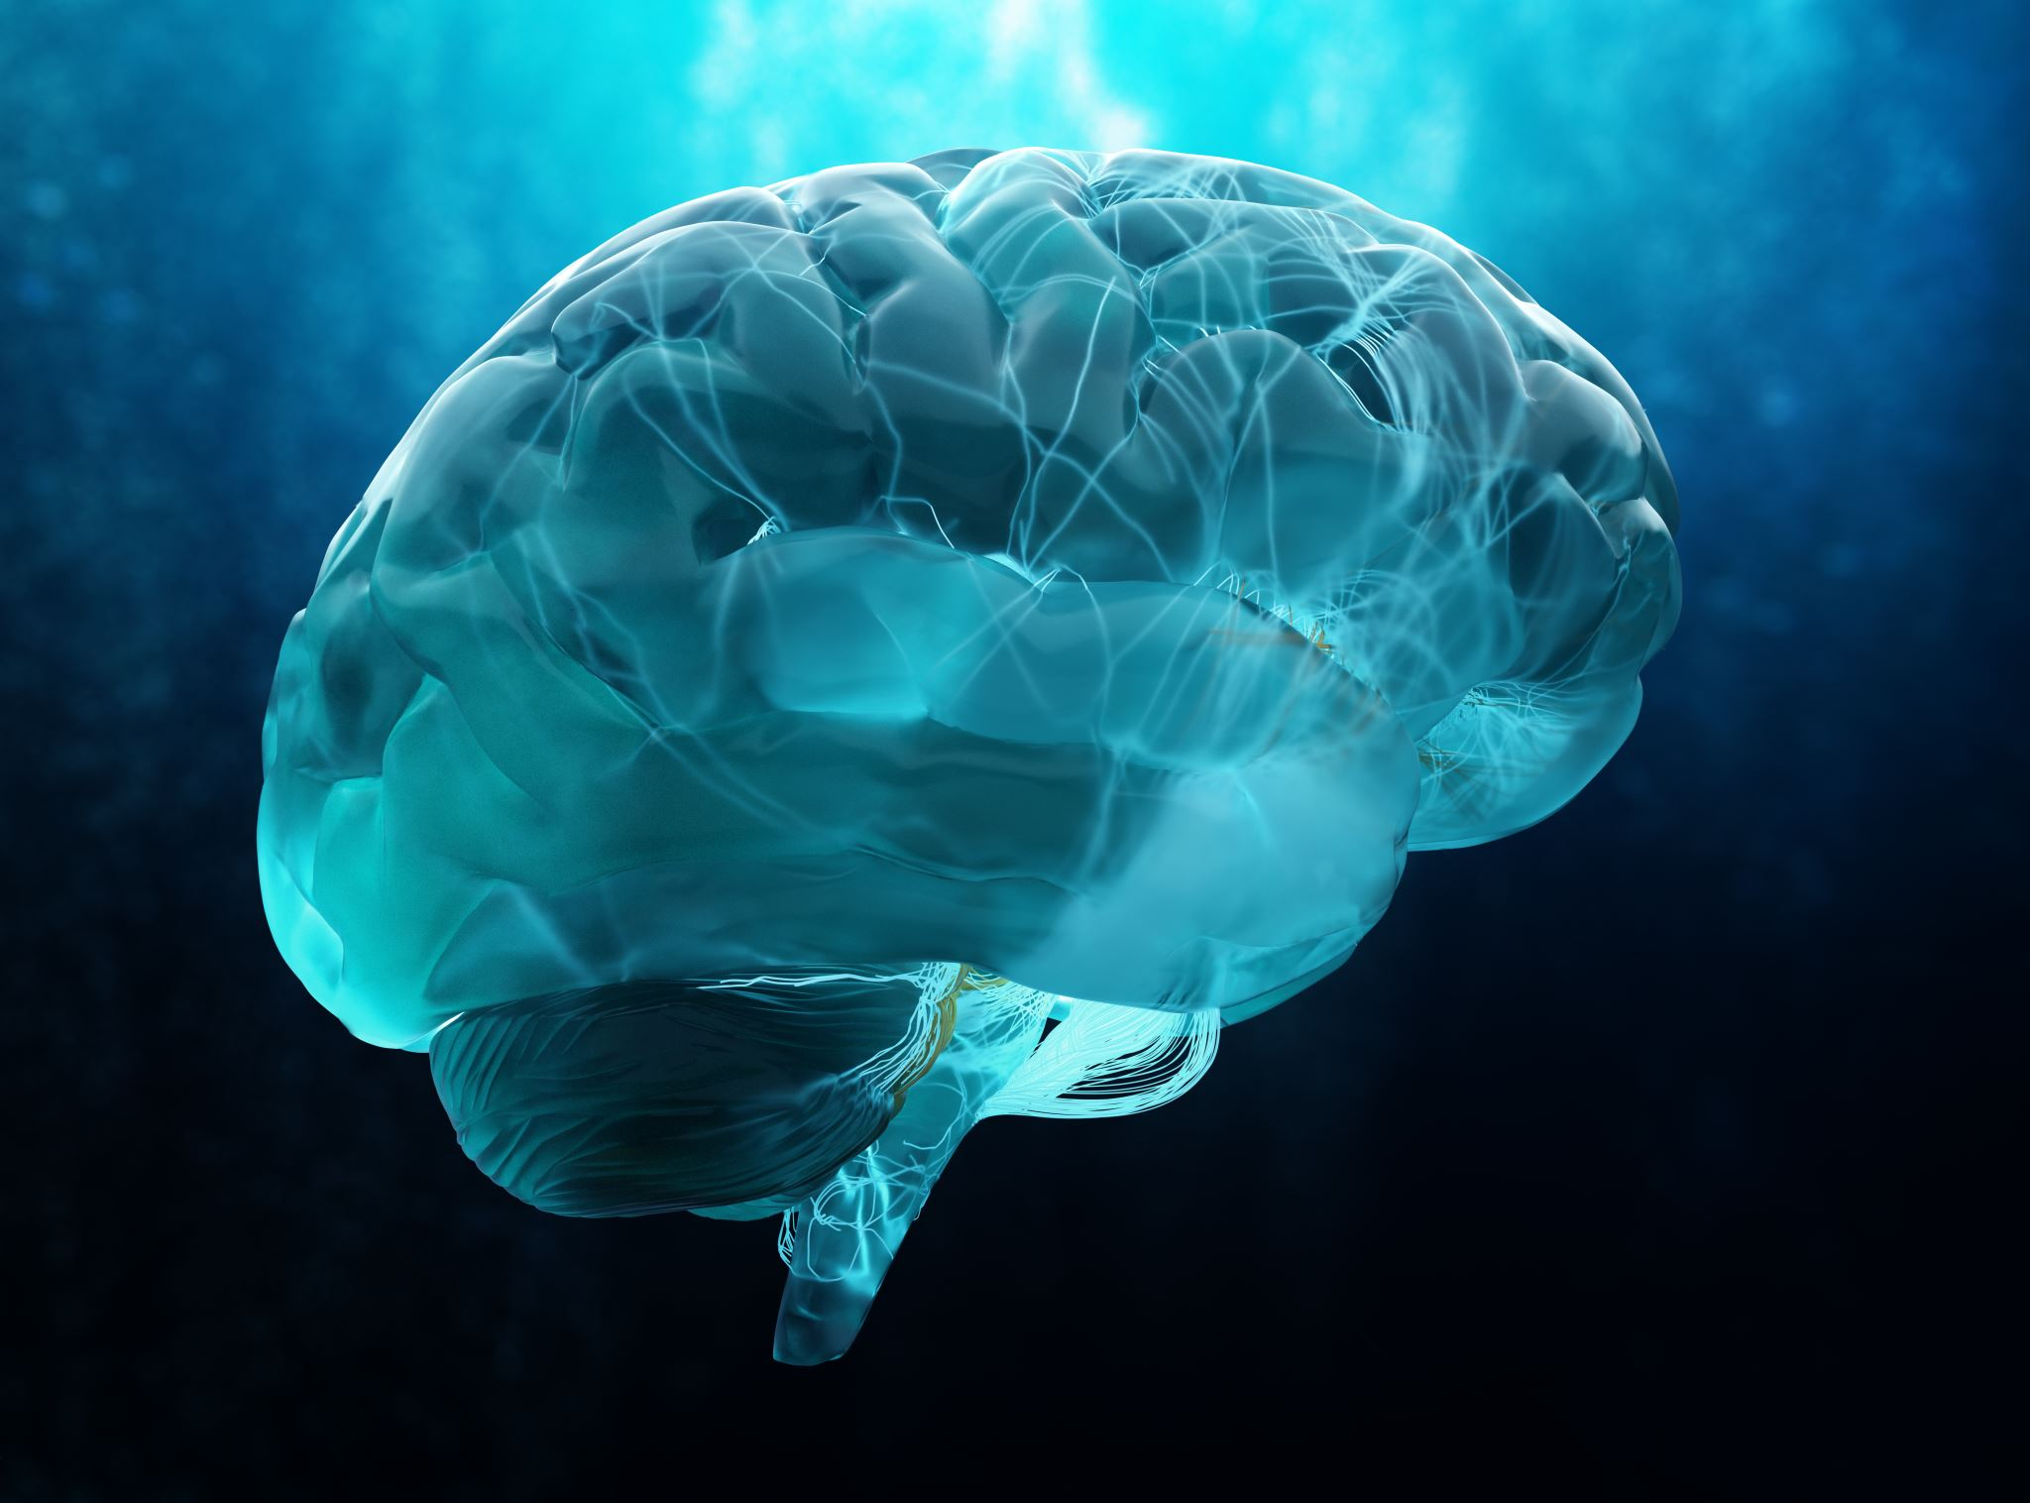
Alzheimer’s: What is it? Continued..
Difference between Alzheimer’s and Dementia:
Alzheimer’s: Alzheimer's is a chronic Brain-based Disease, which is non-communicable (Non-Spreadable). It is not like Viral disease.
Dementia:
It is the Primary Symptom of Alzheimer’s.
The Brain works by processing and transmitting Information through Neurons.
Damage or Death of Neurons can disrupt brain activity, leading to memory loss, confusion, and impaired thinking.

Slide 7
Alzheimer’: What is it? Continued.
Alzheimer’s disease can affect people of all genders, ethnicities, and backgrounds, though it primarily affects older adults. (ARE)
Approximately 55 million people worldwide live with Alzheimer’s disease and other forms of dementia.
Over 60% of people with dementia live in low- and middle-income countries.
Neuroscientists estimate that with early diagnosis and proper care, the progression of Alzheimer’s can be slowed in many cases, improving quality of life.
Some people with Alzheimer’s and their families often face stigma and discrimination due to misunderstandings about the condition.
Key Facts

Slide 8
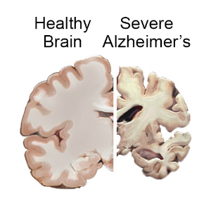
Symptoms of Alzheimer’s
There are several symptoms of Alzheimer's which could range from Mild to Severe.
The most Common Symptoms of Alzheimer's are the following:
Memory Loss.
Confusion with Time or Place.
Age.
Loss of Consciousness or Awareness. (PPS)
Cognitive (Thoughts) or Emotional (Feelings) Changes.
Difficulty with Problem-Solving.

Slide 9
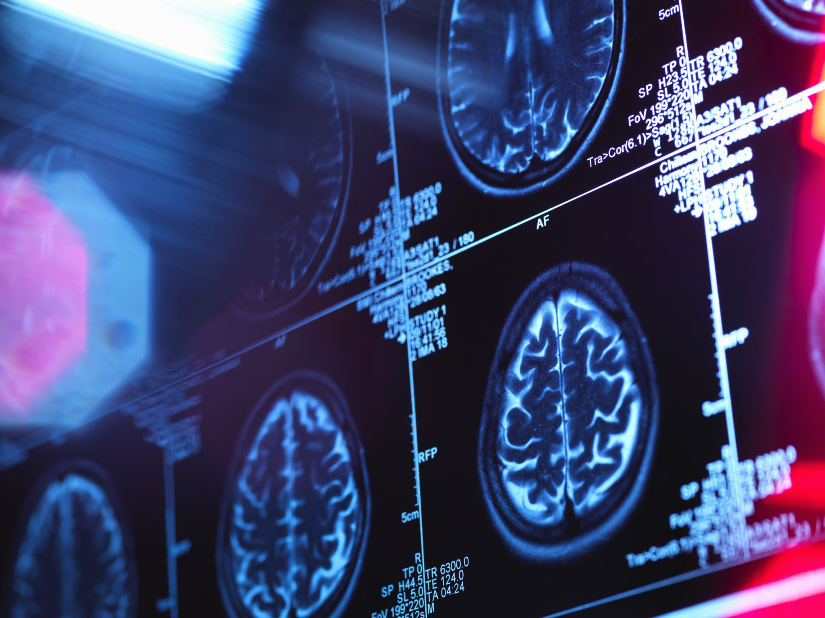
Causes of Alzheimer’s

Slide 10
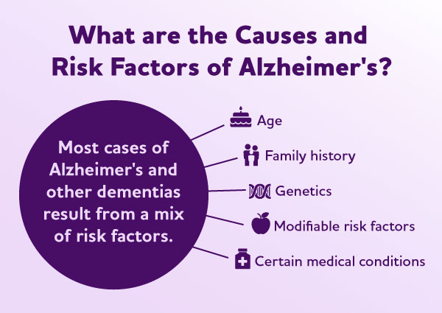
Causes of Alzheimer’s
There are many causes of Alzheirm’s.
Genetics: If Alzheimer’s is in the Family, there is a higher risk it can happen to the other family members.
Plaques and Tangles: Abnormal protein clumps (amyloid plaques) and twisted tangles of protein (tau tangles) in the brain are hallmarks of the disease.
Age: The risk increases with age, especially after 65.
Family History: Having a close relative with Alzheimer’s increases the risk.
Other Risk Factors: High blood pressure, diabetes, smoking, and a lack of exercise can increase the risk.
Diet: Poor dietary habits, such as high consumption of processed foods and sugar, can negatively affect brain health.
Social Isolation: Lack of regular social interactions may contribute to cognitive decline.
https://www.alz.org/alzheimers-what-is-alzheimers/causes-and-risk-factors

Slide 11
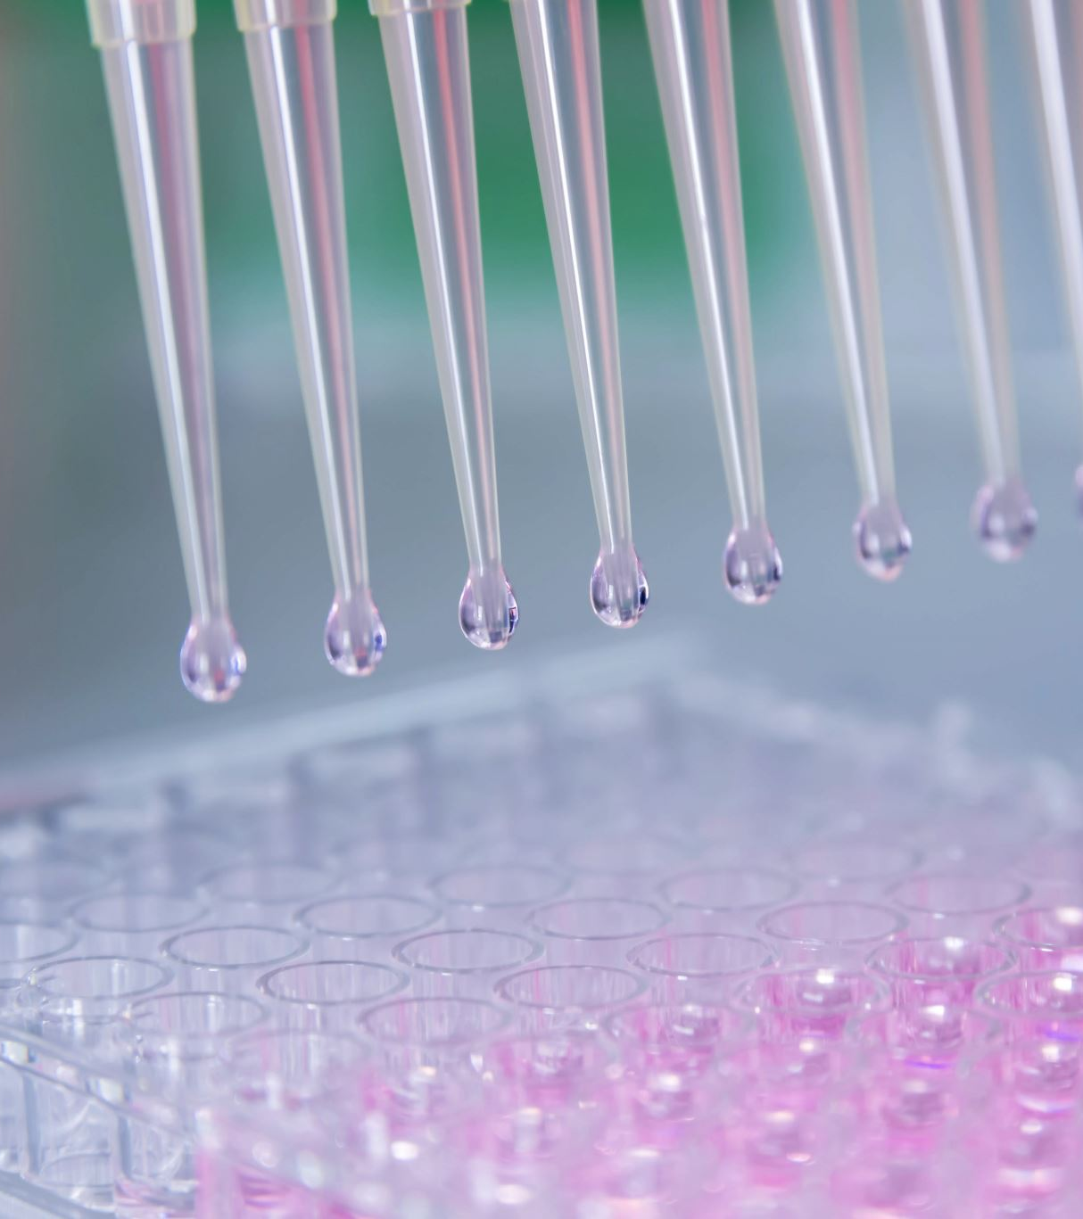
Types of Alzheimer’s
Alzheimer's is divided into Three Types.
Early-Onset Alzheimer's Disease
Late-Onset Alzheimer's Disease
Familial Alzheimer's Disease (FAD)

Slide 12
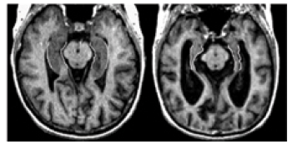
1:Early-Onset Alzheimer’s
In Early-Onset Alzheimer’s Disease, Occurs before the age of 65, and in some cases, it can happen in people as young as their 40s or 50s. Only around 5% of all Alzheimer’s cases are early-onset.
Genetic Mutations:
Mutations in the APP, PSEN1, or PSEN2 genes are common causes of early-onset Alzheimer's.
Family History:
A strong family history of the disease increases the likelihood of developing it.
Early Symptoms: Difficulty in remembering recent events or conversations. Challenges in finding the right words to express thoughts. Trouble concentrating, solving problems, or planning daily activities. Mood swings, irritability, or mild personality changes.
Progression:
Initially affects memory and language areas of the brain. Over time, it impacts decision-making, movement, and social interactions.
AD Society of Canada

Slide 13
2:Late-Onset Alzheimer’s
In this type, the brain is affected by age-related changes, such as the buildup of harmful proteins and nerve cell damage. This form of Alzheimer’s generally occurs after the age of 65 and is the most common type.
Causes and Risk Factors:
Age: The risk increases significantly with aging. Genetic Factors: Having the APOE-e4 gene raises the chances but does not guarantee the disease. Lifestyle Choices: Conditions like high blood pressure, smoking, poor diet, and inactivity increase the risk.
Symptoms:
Trouble remembering recent events or conversations. Confusion about time, place, or familiar tasks. Behavioral changes like mood swings, apathy, or irritability. Difficulty solving problems or following a plan.
Progression
Starts with mild memory lapses and confusion. Gradually leads to challenges in decision-making and motor skills. Severe stages result in the need for full-time care and assistance.
AD Society of Canada

Slide 14
3: Familial Alzheimer’s Disease (FAD):
A rare form of Alzheimer’s, inherited in families across multiple generations.
Caused by genetic mutations that are passed from one generation to the next.
Symptoms typically begin earlier in life, between 30 and 60 years of age.
They can experience a mixture of the symptoms as discussed in the previous slide.

Slide 15
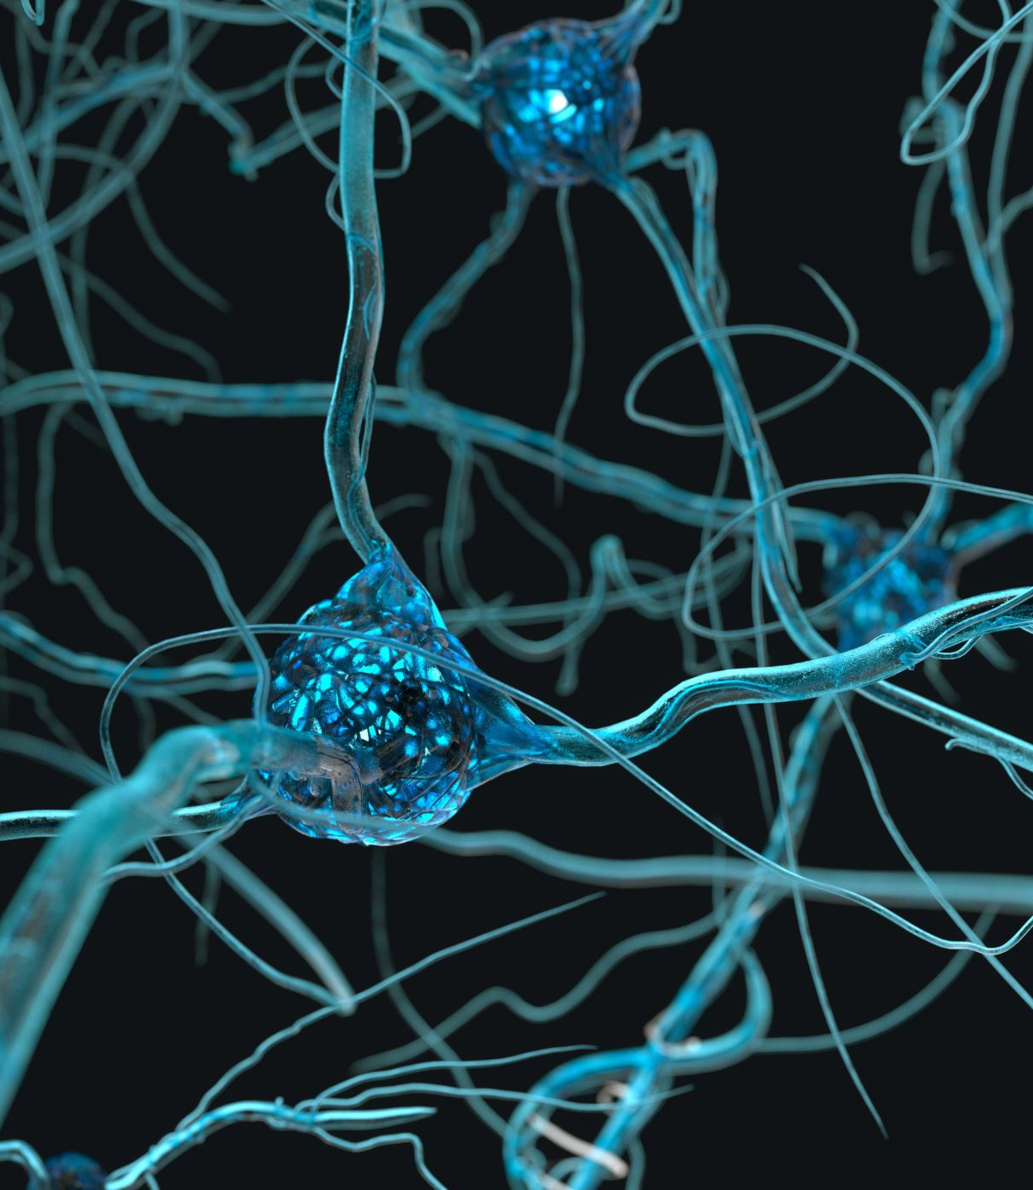
Neurodevelopmental Basis of Alzheimer’s.
The Brain and Alzheimer’s:
Your brain is like a supercomputer made of billions of tiny cells called neurons. These neurons communicate with each other to help you think, remember, and learn. In Alzheimer’s disease, these cells get damaged and stop working properly.
What Does Neurodevelopment Mean?
Neurodevelopment is how the brain grows and forms connections during childhood. It’s like building the brain’s “wiring system.” The way your brain develops when you’re young can affect how strong or weak these connections are when you get older. Scientists now believe that these early brain-building processes might influence who develops Alzheimer’s later in life.

Slide 16
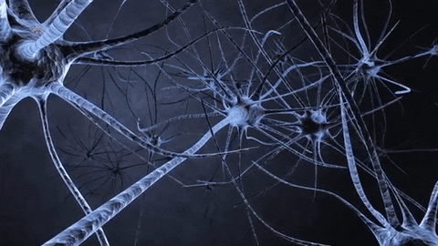
Neurodevelopmental Basis of Alzheimer’s.
https://mcgovern.mit.edu/2019/02/28/ask-the-brain-how-do-neurons-communicate/
https://giphy.com/explore/brain-neurons

Slide 17
Treatment

Slide 18
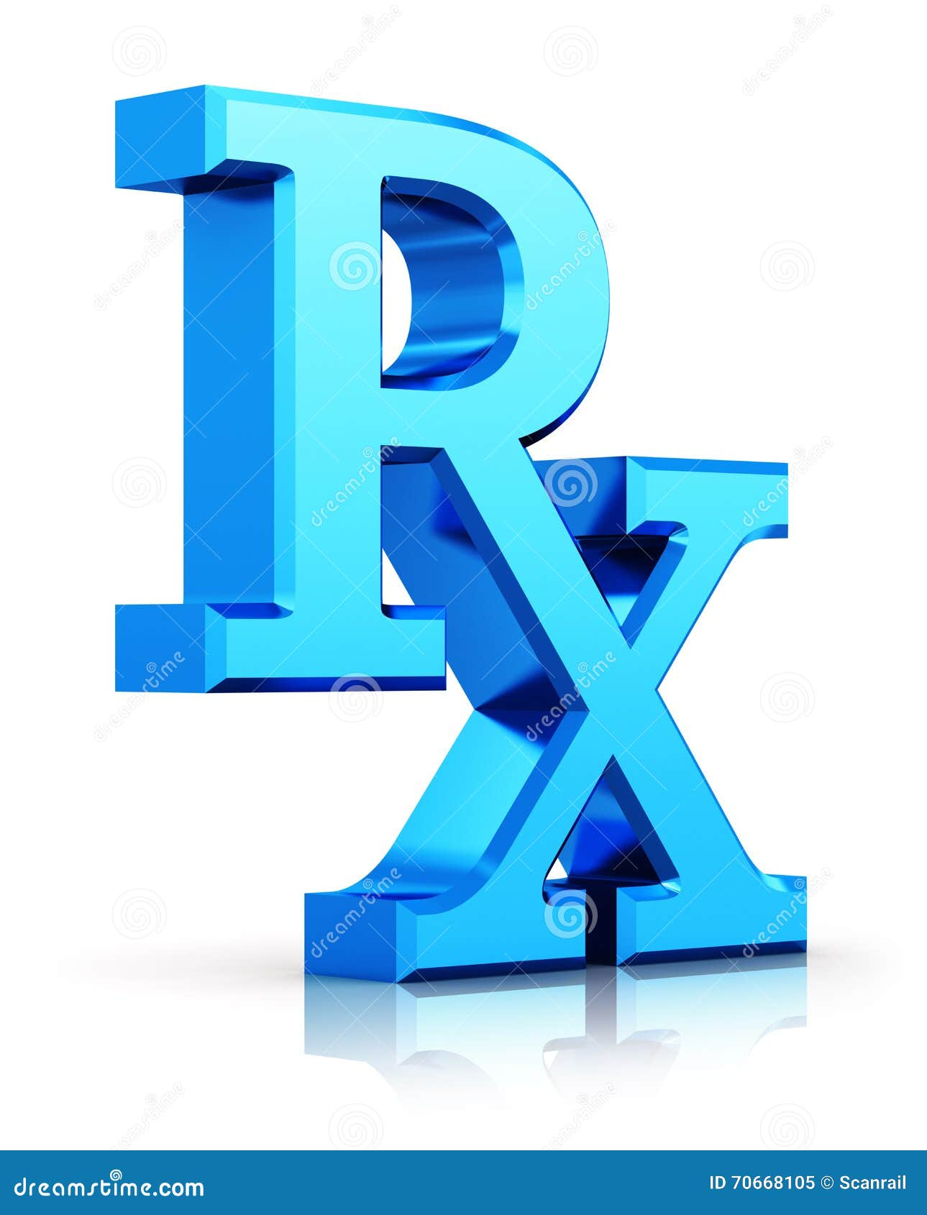
Treatments…
There are Several Clinical Treatment Options.
However, my centre of attention will be on Current Advanced Treatment and understanding the Mechanisms of Neurodevelopment, Degeneration, and Alzherim’s Disease .
1: Medications.
These drugs target memory, thinking, and behavior:
Cholinesterase Inhibitors
Examples: Donepezil (Aricept), Rivastigmine (Exelon), Galantamine (Razadyne).
How they help: Boost levels of acetylcholine, a chemical important for memory and learning.
Memantine (Namenda):
Helps regulate glutamate, a chemical involved in learning and memory.
Often used for moderate to severe stages of Alzheimer’s.

Slide 19
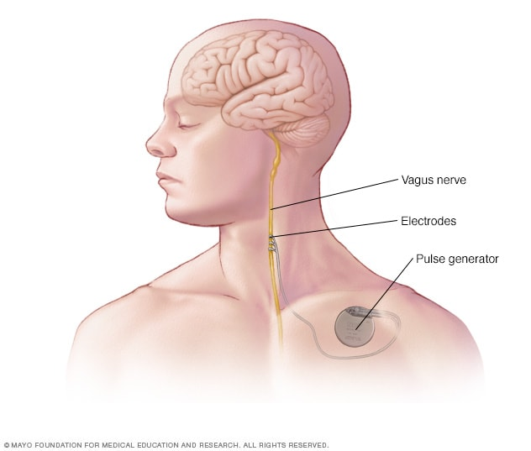
Treatments…
2: Vagus Nerve Stimulator
Let’s talk about Vagus Nerves first. There is one vagus nerve on each side of the body.
The vagus nerve runs from the lower part of the brain which goes to the neck to the chest and stomach.
It regulates our Heart Rate, Blood Pressure and Breathing by sending Signals between your Brain, Heart and Lungs.
It can also affect your Mood, Memory and Cognition by sending Electrical Signals between Brain and Limbic System.
(www.mayoclinic.orgvagus-nerve-stimulation/about/).1

Slide 20
Treatments…
2 : Vagus Nerve Stimulator
This is a experimental approach being studied for its potential to help with Alzheimer’s disease and Depression,
This Device Stimulates the Vagus Nerve with Electrical Impulses.
FDA-approved, VNS: Uses a device (like a small pacemaker) to send mild electrical signals to the vagus nerve, either through an implant or a non-invasive device.
Side-effects:
Voice changes,
Throat Pain,
Cough,
Headaches,
Shortness of Breath,
Difficulty Swallowing,
and Skin itching.
(www.mayoclinic.org/vagus-nerve-stimulation)1

Slide 21
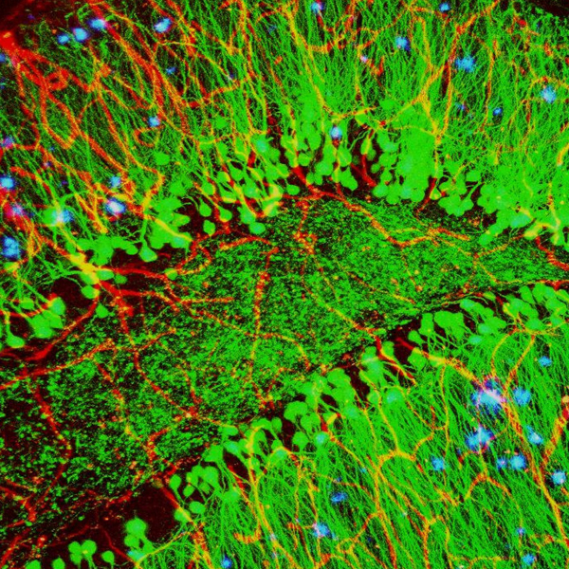
Treatments…
3 : Antiepileptic Drugs. These drugs help to reduce some. There are around 30 approved drugs for the treatment of Alzheimer’s.
4: Ketogenic Diet. Another Treatment for Alzheirm’s which works on to Change in Diet.
Credit: Alvin Gogineni, Genentech

Slide 22
Introduction of the MEN1 Gene
Menin

Slide 23
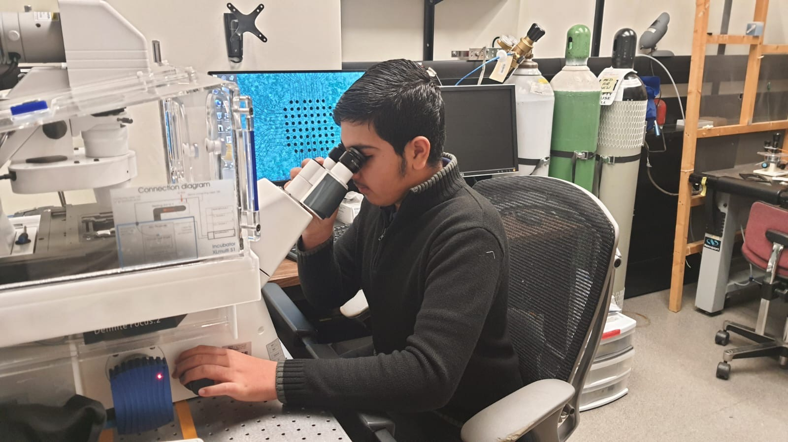
Introduction of MEN1
MEN1 (Multiple endocrine neoplasia type 1)
Encodes menin protein
Nuclear protein
Tumour suppressor
Plays a role in cholinergic transmission, Induce synapse formation and plasticity
Evidence for the presence of menin in humans and its relationship with tau protein
Two Question: 1-Is Menin present in Human Brain?
2- Does Menin have to anything to do with
Tau, a protein that causes Bain damage?

Slide 24
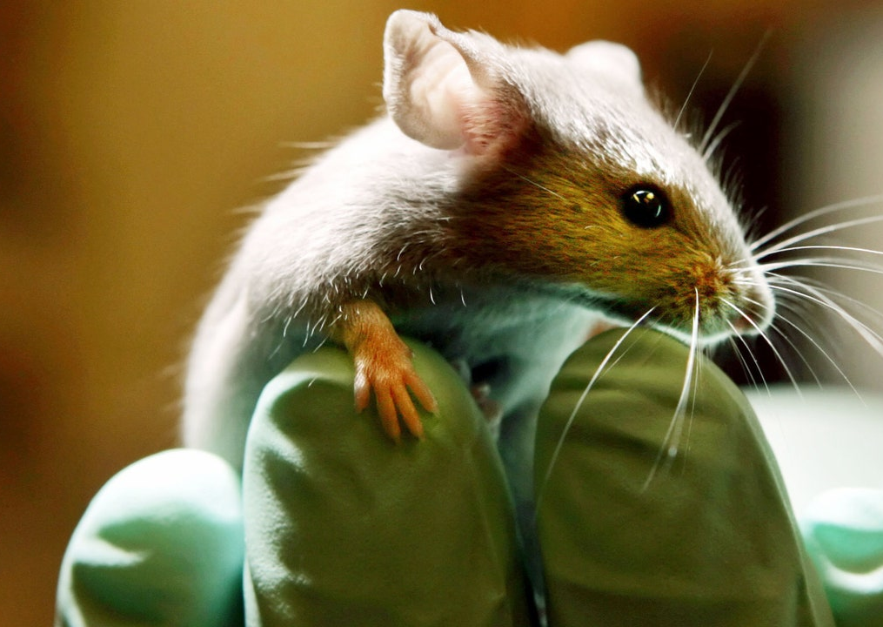
Menin and learning and memory
Gene knockout of MEN1 gene in the CA1 region of the hippocampus
Contextual fear conditioning test
Learning and memory deficits
Reintroduction of MEN1 recovered these deficits
Notes:
Mice injected with AVV9 viral vector to induce gene knockout of MEN1 gene in the CA1 region of the hippocampus
Contextual fear conditioning test
Day 2: decreased freezing time in the conditional knockout mice
Not able to retain fear conditioning memory
Reintroduction of MEN1 recovered these deficits

Slide 25
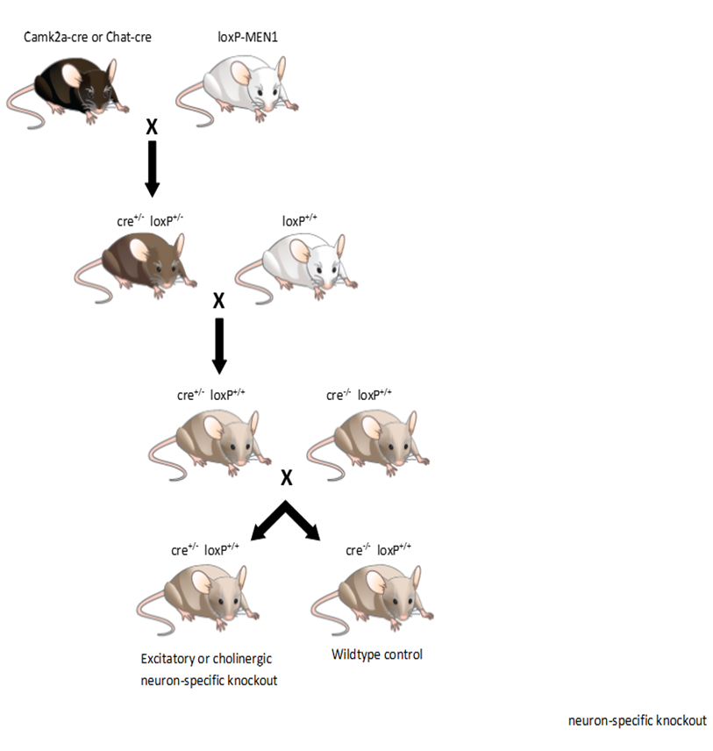
MEN1 Role in Learning & Memory
In vitro MEN1 knockdown in Lymnaea blocks synapse formation
MEN1 knockdown specifically in the hippocampus results in learning and memory deficit
Rescue following the re-introduction of MEN1 in the intact animals
Decreased nAChR α5 subunit expression, the clustering of α7 subunit containing nAChRs at glutamatergic synaptic terminal

Slide 26
(Both males and females were included, with diagnoses confirmed for Alzheimer’s early-onset (ADEO) or late-onset (ADLO). This approach allowed us to study differences between early and late stages of the disease while considering individual variability.“)

Slide 27
Cholinergic Hypothesis
Earliest Hypothesis
Loss of Acetylcholine or Impairments in Cholinergic Synapses
Cholinesterase inhibitors- Currently one of the best AD treatments

Slide 28
Observations/Analysis
I had the opportunity to go to the Neurosciences Research Centre at Cumming School of Medicine, at the University of Calgary and participated in cutting-edge experiments to discover new Gene Mutions for Alzheirm’s treatment. I spent in the lab 15-20 hours in-person. I learned how Beta Amyloid (Aβ)Tau protein, Neuroinflammation and the Cholinergic hypotheses can be cause of Alzheirm’s
Vagus Nerves Stimulator (VNS)
Inhibbitors
Lifestyle
https://educationalresearchtechniques.com/2015/09/30/observation-in-qualitative-research/

Slide 29
Conclusion
Alzheimer’s is a devastating and incurable disease.
But symptoms can be treated with several techniques
I observed that we can record Brain activity from Interface Neuron chip.

Slide 30
Future Directions/Areas of Improvement
When we devolve new devices and Implants in developing countries
We need to make new implantable devices that have less corrosion
We need more safer, reliable, and effective Treatments
Build more accurate algorithms to model Alzheimer’s Disease in the brain.

Slide 31
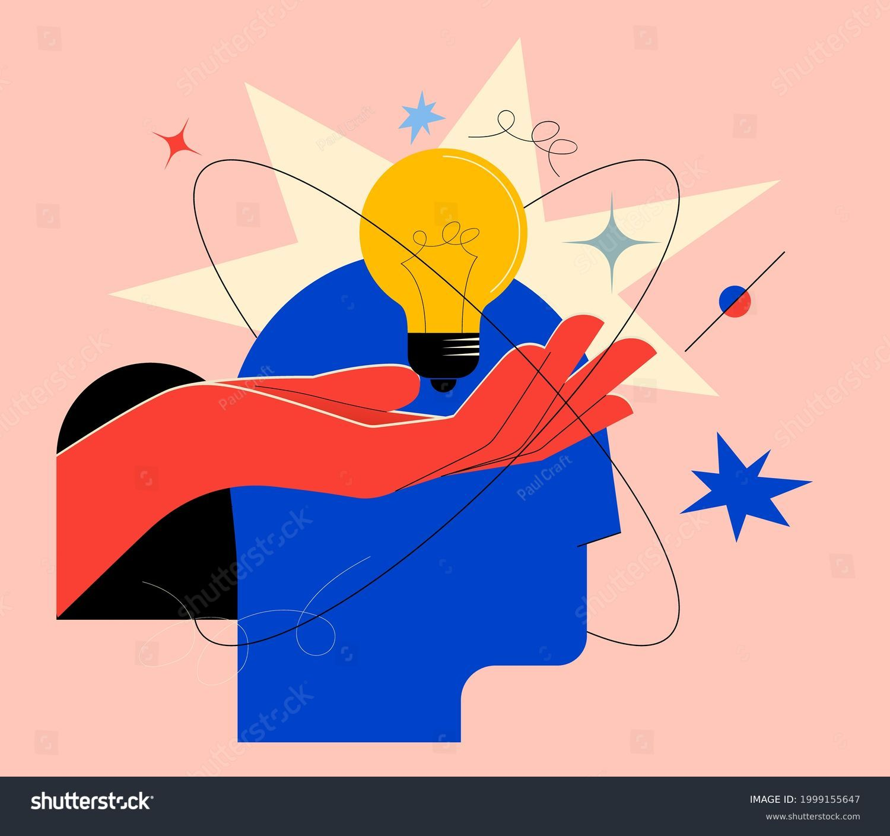
My Experience
I had a great experience in the Neurosciences Lab at Cumming School of Medicine, the University of Calgary.
I observed Neuroscience Research, including Human Brain Cells, Snail Neurons, Rat cells, and Men1 Gene
Interacting with Neuroscientists, Ph.D. and graduate students, I gained insights into the advanced research and treatment options against Alzheimer's.
This experience was educational, and inspiring and motivated me to pursue my interest in neurosciences and to become a Neurosurgeon as a career in future.

Slide 32
Special Thanks!
Firstly, I would like to pay my Special Thanks to ALLAH whose Blessings made everything possible.
And to everyone who helped me to complete this Project on Alzheimer’s.
Special Thanks to Respectable Teachers Mrs. Jyoti, Bennacer, Khalil and Dr. Naweed Imam Syed, Neuroscientist, Professor of Medicine and their Ph.D. students, Mrs. Zainab Khan from Cumming School of Medicine, University of Calgary.
Lastly, I would like to thank my father as well.

Slide 33
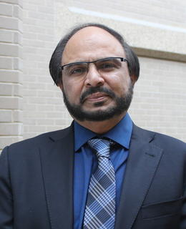
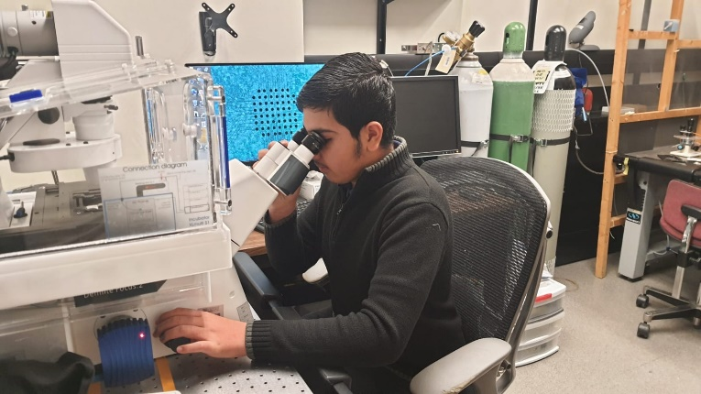
My Mentors…..

Slide 34
Ref:
https://www. alzheimer.com/what-is-Alzheimer’s
https://www.mayoclinic.org/diseases-conditions//symptoms-causes/syc-20365711
https://www.mayoclinic.org/diseases-conditions/petit-mal-/symptoms-causes/syc-20359683
https://www.medicalnewstoday.com/articles/types-of-alzheimer#types
https://www.who.int/news-room/fact-sheets/detail/alzheimer
https://www.ninds.nih.gov/health-information/disorders/alzheimer
https://facty.com/conditions/10-treatments-of-alzheirm’s/2/
https://anatomyinfo.com/parts-of-the-brain/
https://www.google.com/search?q=what+is+the+role+of+limbis+system&rlz=1C1UEAD_enCA1080CA1088&oq=what+is+the+role+of+limbis+system&gs_lcrp=EgZjaHJvbWUyBggAEEUYOTIJCAEQABgNGIAEMggIAhAAGBYYHjIICAMQABgWGB4yCAgEEAAYFhgeMgoIBRAAGAoYFhgeMggIBhAAGBYYHjIICAcQABgWGB4yCAgIEAAYFhgeMggICRAAGBYYHtIBCjI0NTY2ajFqMTWoAgCwAgA&sourceid=chrome&ie=UTF-8
https://www.google.com/search?q=simple+Difference+between+alzheimer+%26+Alzheirms%3A&tbm=isch&ved=2ahUKEwiIm4GSpduDAxX_OUQIHU2MCKoQ2-cCegQIABAA&oq=simple+Difference+between+Epilepsy+%26+Seizure+Attacks%3A&gs_lcp=CgNpbWcQA1CZBliJFmDaGGgAcAB4AIABbYgBnQaSAQMzLjWYAQCgAQGqAQtnd3Mtd2l6LWltZ8ABAQ&sclient=img&ei=If6iZciGNf_zkPIPzZii0Ao&bih=712&biw=1511&rlz=1C1RXQR_enCA1059CA1059#imgrc=eCpi1v_Tz7UrmM
https://www.google.com/search?q=creative+pictures+of+Brain+and+k&tbm=isch&rlz=1C1RXQR_enCA1059CA1059&hl=en&sa=X&ved=2ahUKEwjphY7qs9uDAxViJzQIHRJZB1oQBXoECAEQPg&biw=1492&bih=712#imgrc=ytq6aowmQq-_OM
https://www.cureAlzheimers.org/for-patients/understanding/basics/classification/

