Slide 1
The Basel Problem: A New Way to think about Numbers
A Science Fair Project
By Ignacio G.L
Grade 8

Slide 2
Problem/Objective
What are limits in math?
What are their applications with solving the Basel Problem?

Slide 3
Method

Slide 4
What are Limits?
A limit is the value a function approaches as the input gets nearer to a value.
One example of a problem that we can apply limits to is:
$\frac{(x^{2}−1)}{(x−1)}$
If x=1 we can work out the equation to be $\frac{0}{0}$, which is indeterminate. (mathisfun)

Slide 5
What are Limits? Cont.
x |  | $$\frac{\text{(}\text{x}\text{2}\text{ − 1)}}{\text{(}\text{x}\text{ − 1)}}$$
0,5 |  | 1,50000
0,9 |  | 1,90000
0,99 |  | 1,99000
0,999 |  | 1,99900
0,9999 |  | 1,99990
0,99999 |  | 1,99999
Therefore, the limit of $\frac{\text{(}\text{x}\text{2}\text{ − 1)}}{\text{(}\text{x}\text{ − 1)}}$ as x approaches 1 is 2

Slide 6
Limits to Infinity
What is $\frac{1}{∞}$?
Infinity is a concept.
Let’s convert that equation into $\frac{1}{x}$.
We can see that as x increases in value, $\frac{1}{x}$ decreases in value; therefore, the limit of $\frac{1}{x}$ as x approaches infinity is 0.
This can be written as $\lim_{x→∞}\frac{1}{x}=0$.
x | 1 /x
1 | 1.00000
2 | 0.50000
4 | 0.25000
10 | 0.10000

Slide 7
Infinite Series
Convergent series are finite, and have a limit.
$\frac{1}{1}$ , $\frac{1}{2}$ , $\frac{1}{4}$ , $\frac{1}{8}$ , $\frac{1}{16}$ … is an Convergent series, and has a limit of 2.
Divergent series are infinite, and do not have a limit.
$1+1+1+1$… is a Divergent series, as it surpasses any finite number. (mathisfun)

Slide 8
The Basel Problem
The Basel Problem is an infinite series that was proved to be Convergent, but the exact limit could not be found.
The problem was $\frac{1}{1^{2}} , \frac{1}{2^{2}} , \frac{1}{3^{2}}$ , $\frac{1}{4^{2}}$ , $\frac{1}{5^{2}}$ … = ?
The limit was $\frac{π^{2}}{6}$

Slide 9
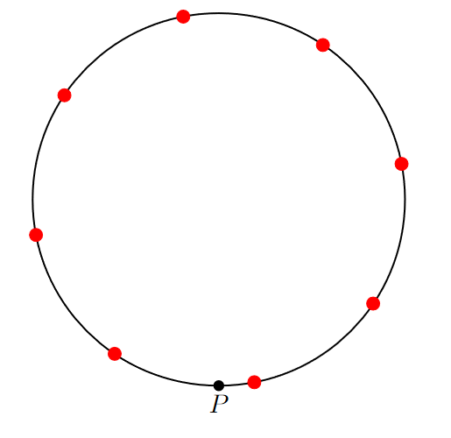
But wait, there’s more!

Slide 10
The Infinite Number Circle
As we approach the limit, as mathematician Ben Hambrecht says, the circle becomes a straight line, with all real odd numbers on that line.
This implies that the number line is a circle.

Slide 11
Combining this conjecture with Imaginary Numbers
Riemann Sphere

Slide 12
Conclusion
From the aforementioned conjecture, it can be deduced that the number line is an infinitely large circle.
Furthermore, one could say that the number line is a projection of a Riemann sphere, marrying the above conjecture with complex analysis.

