Slide 1



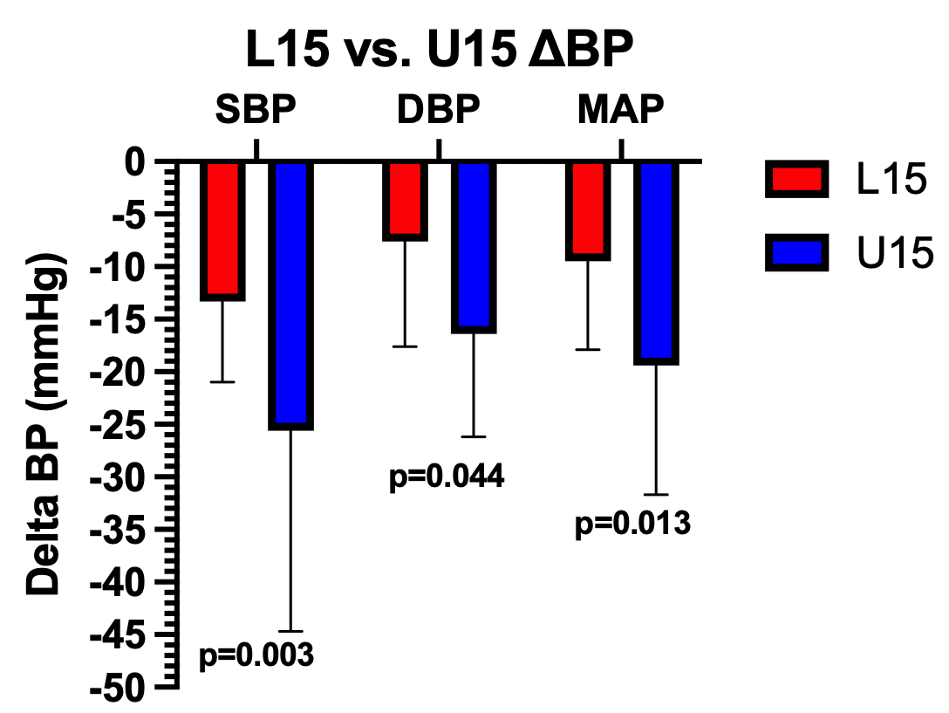
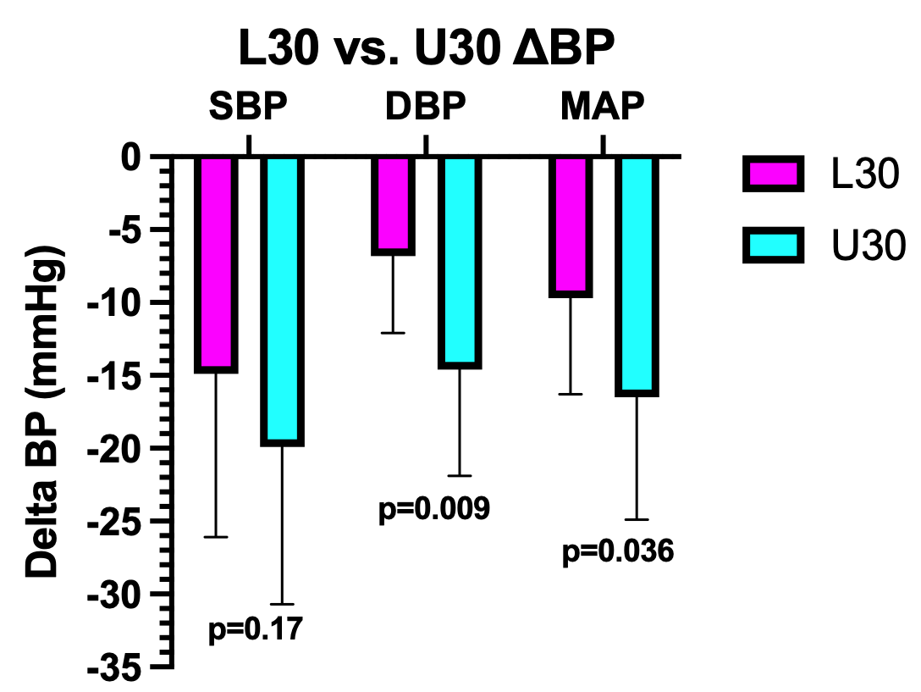
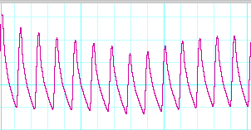
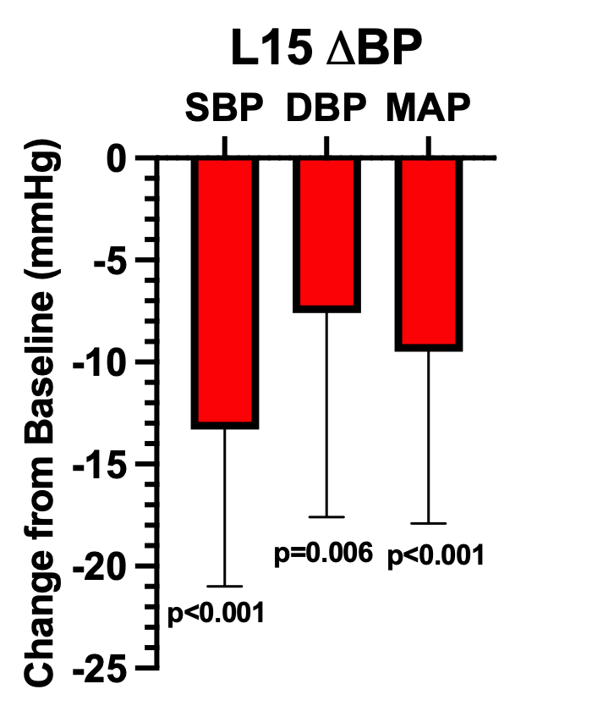
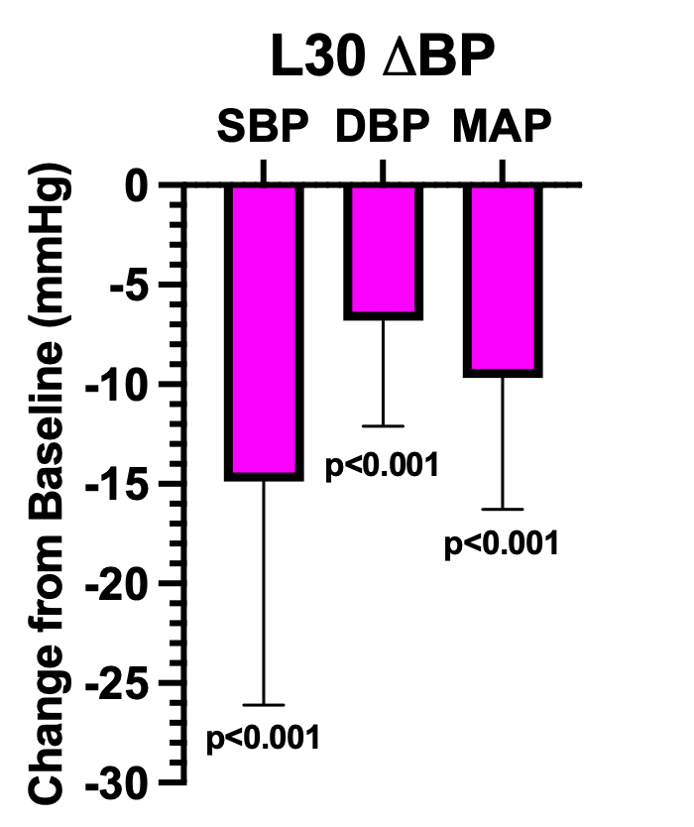


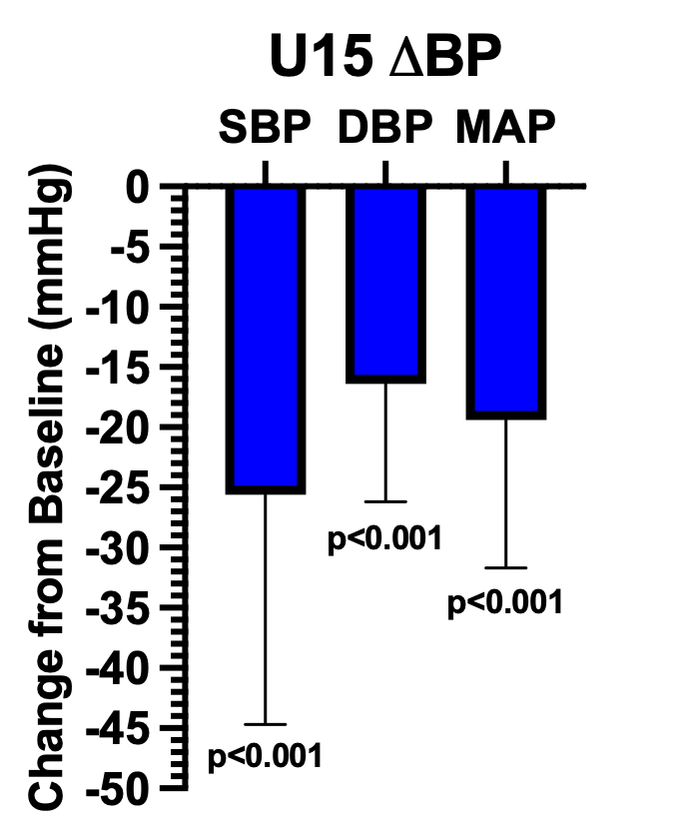
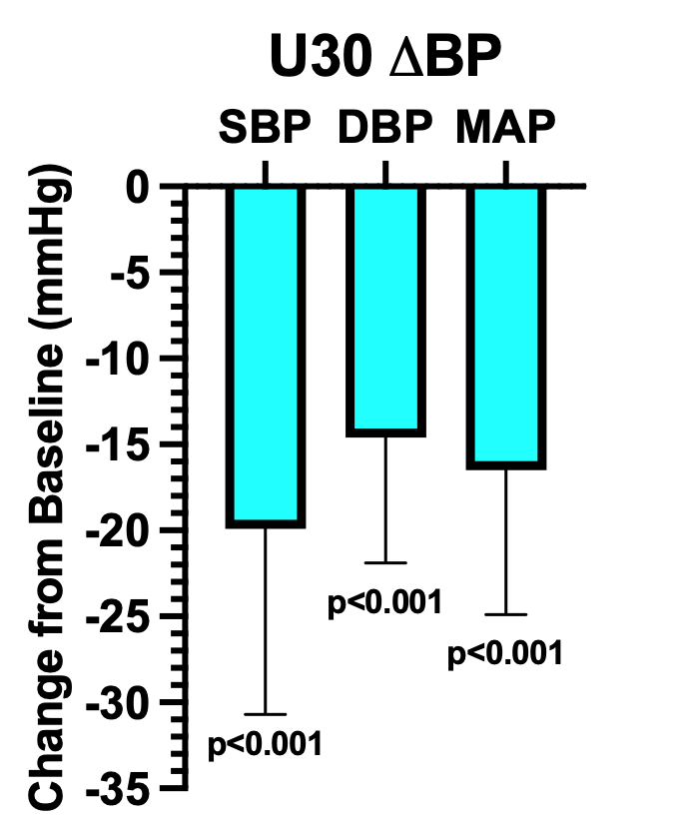
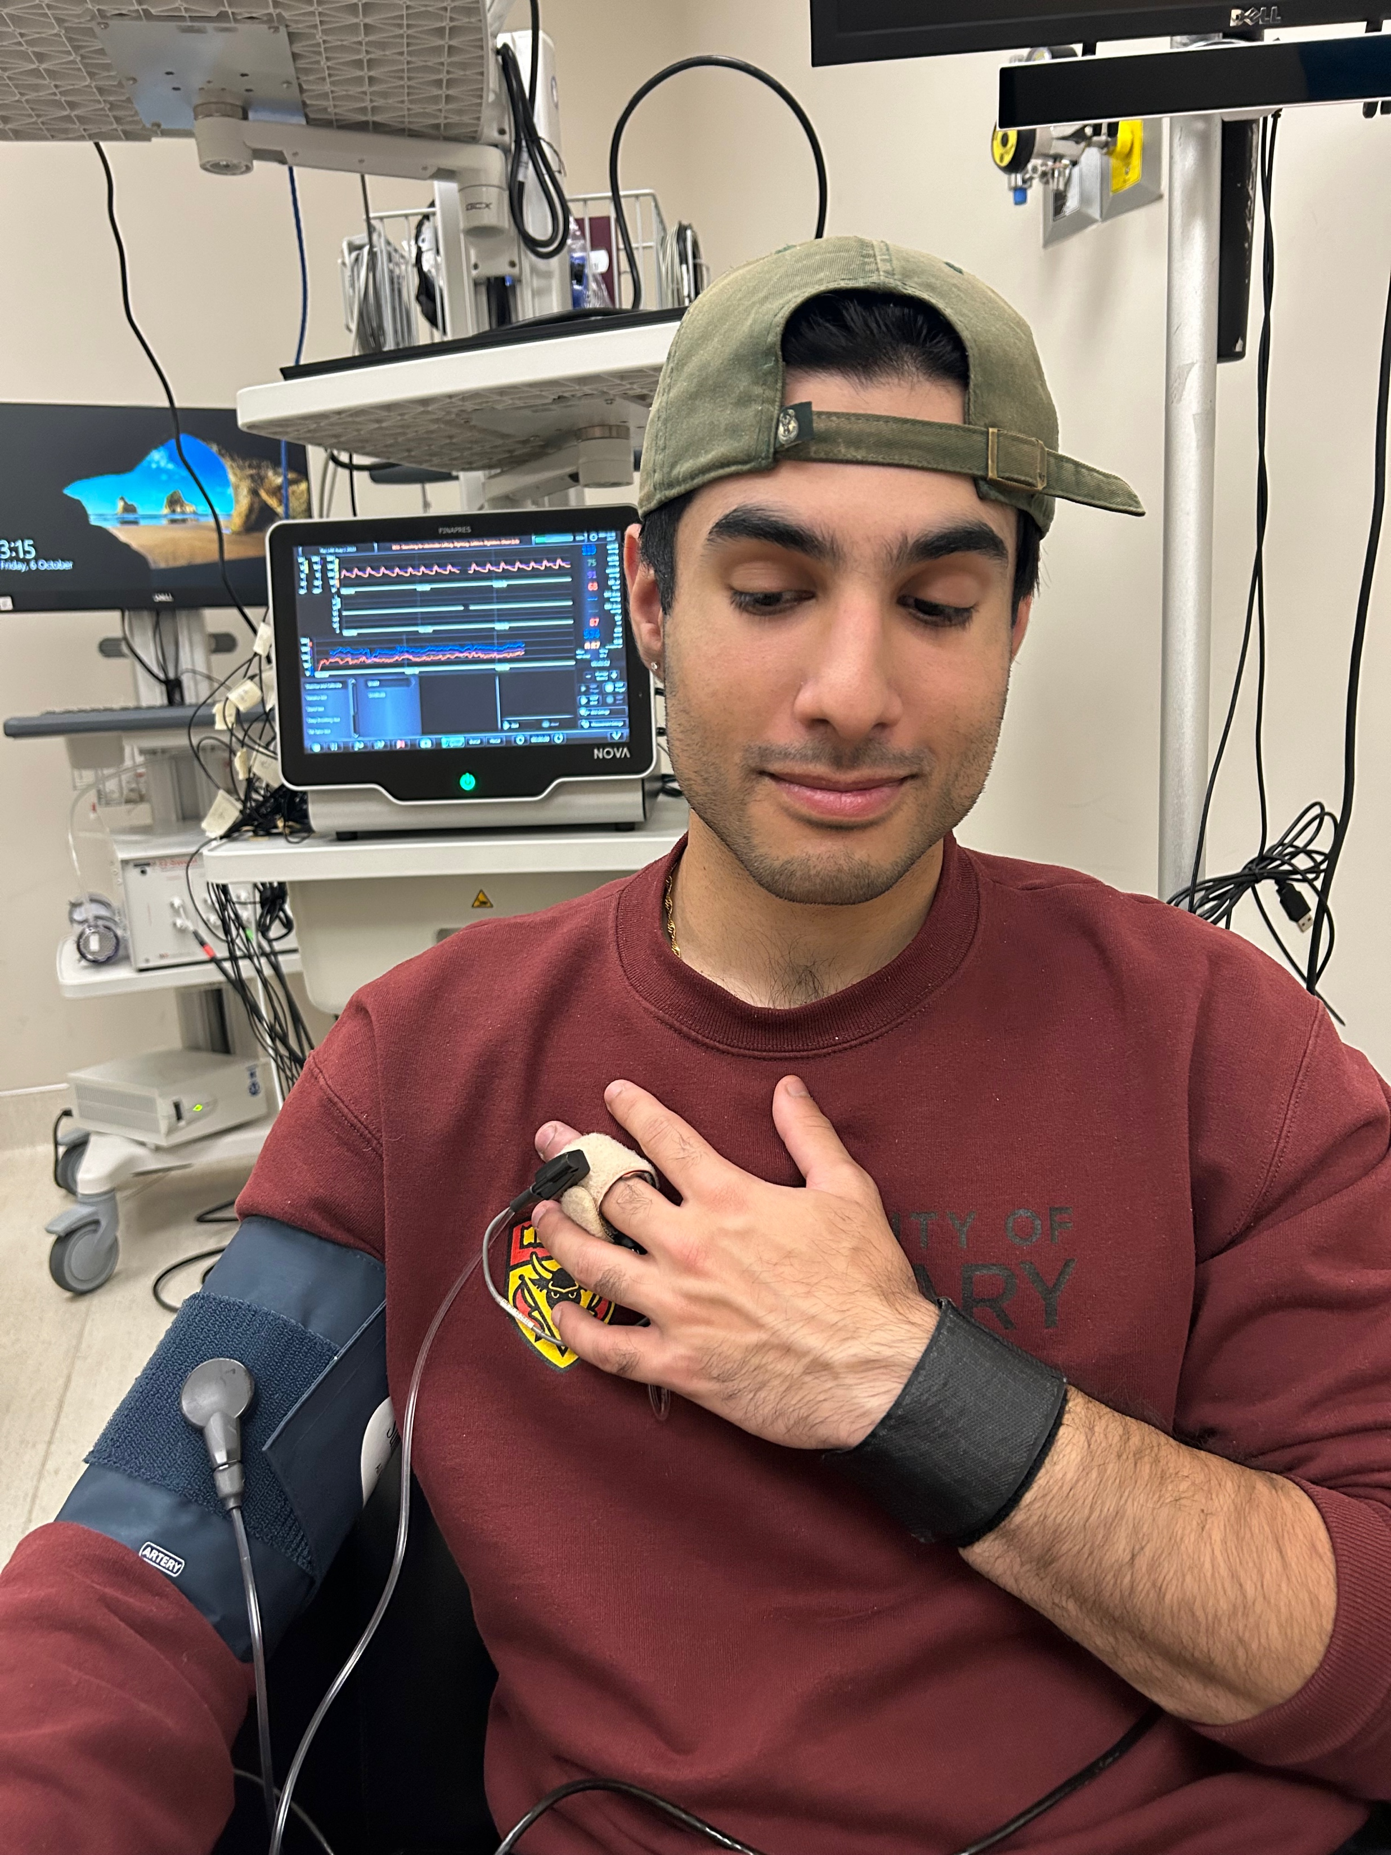
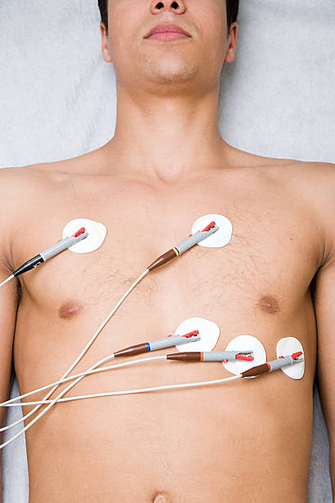
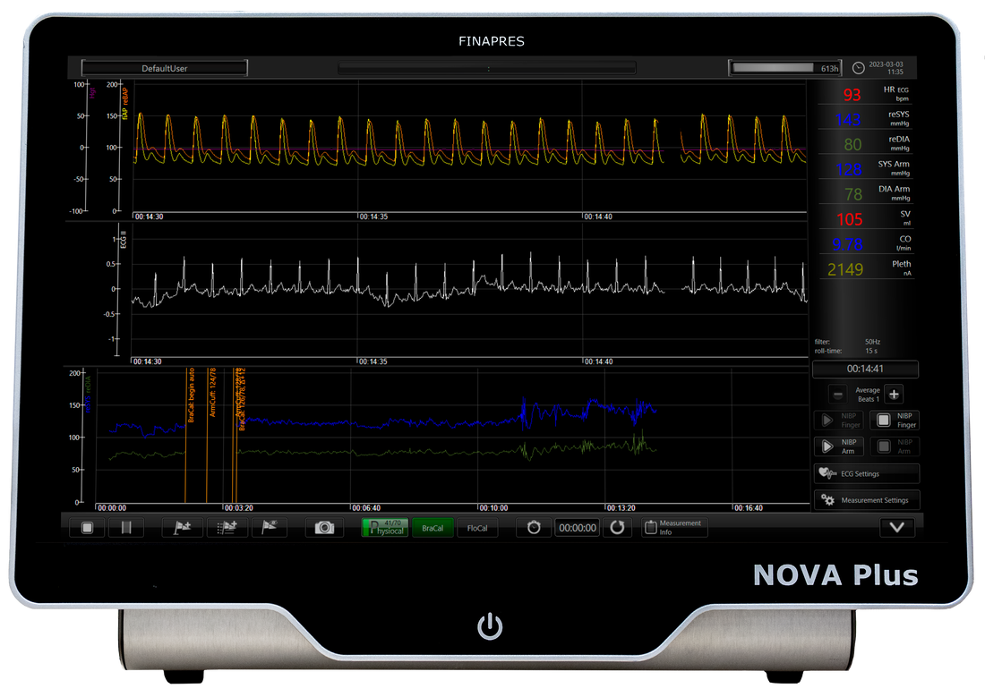
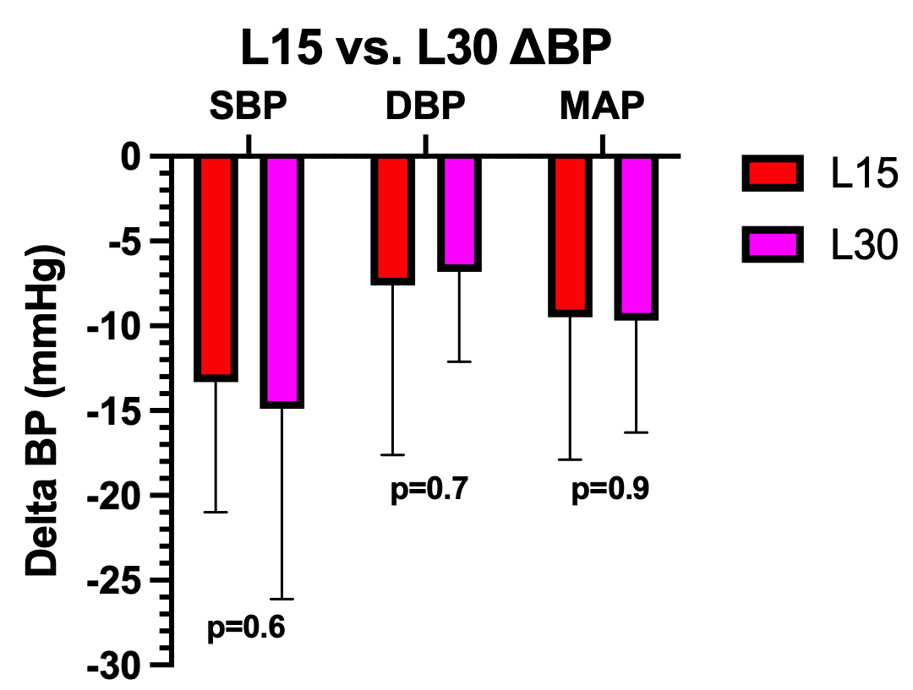
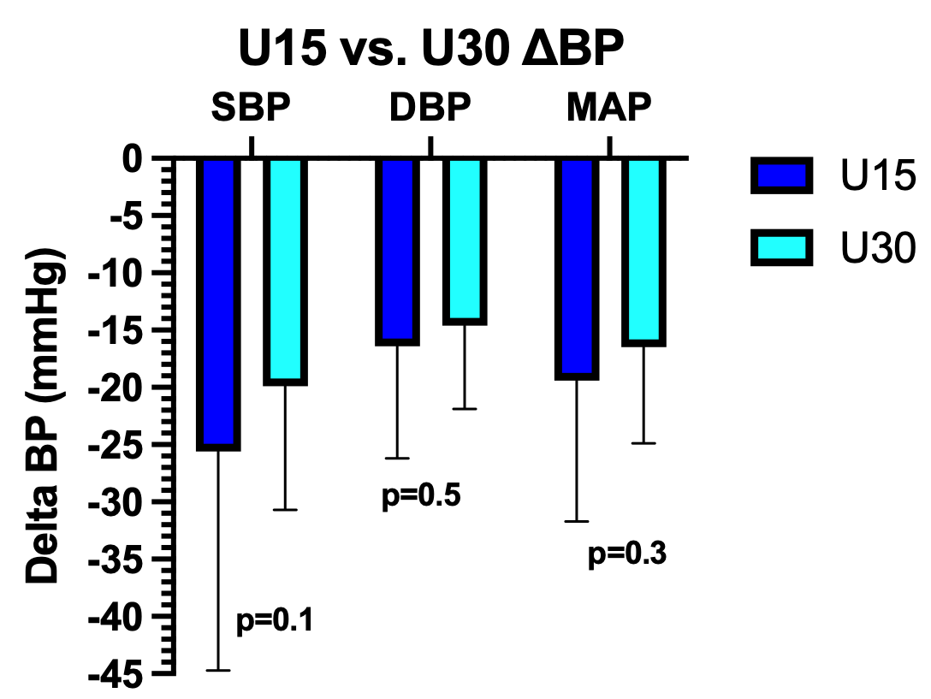
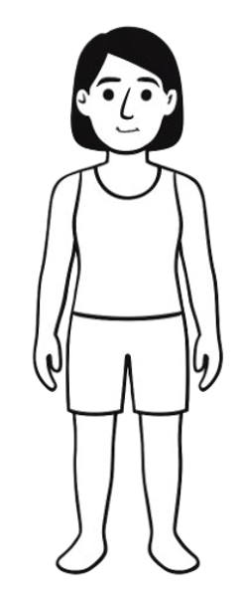
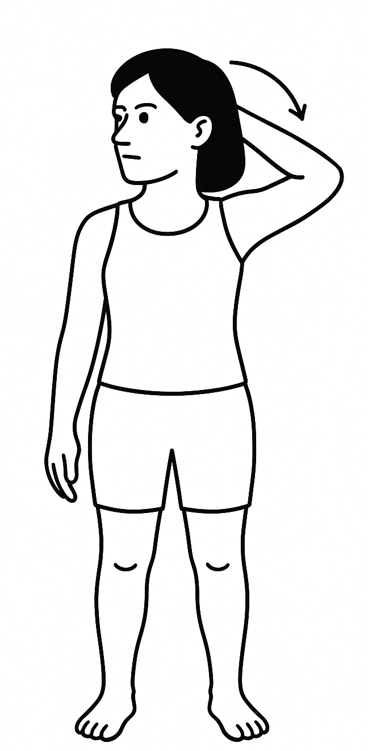
Addressing the Underlying Cardiovascular Hemodynamic Physiology of Upper-Body Stretching in Healthy Adults
Arvind R Raj, Priyanshu Giri, Rashmin Hira BA BSc, Martin Miranda Hurtado RN PhD, and Robert S. Sheldon MD PhD FRCPC.
University of Calgary, Calgary, AB, Canada.
Background & Objective:
z
Participant Demographics
Results:
Qu#3: Does Orthostatic Stress (Standing vs. Lying) Impact the Magnitude of Upper Body Stretch Induced Hypotension
Upper-body stretching (“stretch”) is a universal maneuver …but the cardiovascular physiology of stretching remains scarcely studied
Recent research:
Stretch can cause lightheadedness and syncope
Stretch may induce transient, significant blood pressure (BP) drop (hypotension)
Rare -> “Stretch Induced Syncope”
Enrolled | n=17
Female | N=15 (88%)
Age (years) | 38±17
Height (cm) | 168±7
Weight (kg) | 70±21
Blood Pressure Trace with Stretch
Pathology or Physiology?
Is this a pathological response seen only in the rare syncope patients?
Or is this broader physiological phenomenon in the general population?
Continuous BP Trace with Upper Body Stretch While Lying down for 15 sec (L15)
Qu#1: Does Upper Body Stretch Induce Hypotension?
YES! Upper body stretch DOES induce greater hypotension when upright than when lying down
Results Summary:
Primary Research Questions:
L15
= Supine, 15s
Question #1
Significant Hypotension
Does upper body stretch cause a significant BP drop in healthy (without syncope) volunteers?
Does the duration of upper body stretch matter?
Does orthostatic stress increase the induced hypotension with upper body stress?
L30
= Supine, 30s
Question #2
Duration of Stretch
Question #3
Effect of Upright Posture
Methods:
U15
= Standing, 15s
Male and female healthy participants age 18-60y, were enrolled in this UCalgary Conjoint Health Research Ethics Board approved study
U30
= Standing, 30s
Limitations:
Instrumentation:
Sample size is fairly small (n=17); we are still recruiting
Predominantly female sample (n=15, 88%); limits conclusions about effects of upper body stretch in males
Children (<18y) & elderly (>60y) were not studied
Electrocardiogram (ECG) electrodes
Continuous HR
Brachial Arm BP Cuff
Calibrate BP
Finapres NOVA
Modelflow software
Continuous finger BP monitor
YES! Upper body stretch DOES induce hypotension in each test condition (seen for systolic, diastolic & mean BP)
Qu#2: Does Stretch Duration Affect Hypotension Magnitude
Conclusions & Future Directions:
Stretch-induced hypotension can explain lightheadedness & syncope
While the duration (of stretch) does not appear to have a significant effect on the degree of induced hypotension, orthostatic stress likely makes a major contribution toward lightheadedness & syncope
In the FUTURE, we plan to:
Study this stretch response across the lifespan and to look for sex-differences
Compare results between healthy volunteers and patients with stretch syncope
Testing Protocol:
Data Analysis:
Neck Twist
(Hyperextension)
Physiological Signals were analyzed using custom software in MATLAB
SPSS statistical software
Single-Arm T-Test (Q1)
Paired T-Test (Q2 & Q3)
Tests were two-tailed
Mean ± standard deviation
p≤0.05 was significant
2x Supine (L)
(15s & 30s)
Shoulder Abduction
STRETCH
2x Standing (U) (15s & 30s)
Still Torso
NO! Prolonged upper body stretch DOES NOT induce greater hypotension (both when lying down or when upright)
References:
Back
Hyperextension
Acknowledgements: I want to thank my mentors, Dr. Robert Sheldon, Dr. Beatriz Garcia-Diaz, Mrs. Madhavi Kale, and Priyanshu Giri for giving me the opportunity to be involved in this research project and providing me advice whenever necessary.
Kosmopoulos M, et al. Stretch syncope in humans: Evidence for symptomatic neural reflex hypotension triggered by stretching of shoulder and upper back muscles. Heart Rhythm. 2025;22(6):1464-1471. doi:10.1016/j.hrthm.2025.03.166
Pelekanos JT, Dooley JM, Camfield PR, Finley J. Stretch syncope in adolescence. Neurology. 1990;40(4):705-707. doi:10.1212/wnl.40.4.705
Sturzenegger M, Newell DW, Douville CM, Byrd S, Schoonover KD, Nicholls SC. Transcranial Doppler and angiographic findings in adolescent stretch syncope. J Neurol Neurosurg Psychiatry. 1995;58(3):367-370. doi:10.1136/jnnp.58.3.367

