Slide 1
KHALSA SCHOOL CALGARY Science Fair
AJEET SINGH 5A
TEACHER: Mrs. PARHAR

Slide 2
TITLE
Which cup will keep a hot drink warm longer: Paper, Plastic, Styrofoam, or Glass?

Slide 3
Background Research
Bad conductors of heat
Styrofoam
Paper
Thermal conduction happens when heat moves from a source at a higher temperature (liquid) to a source at a lower temperature (cup) until temperature becomes equal.
Not so good conductors of heat
Plastic
Thermal conductivity of a material determines how good an insulator it is. Materials that are not good at conducting heat are called insulators. So the best materials for insulation are the ones with the lowest thermal conductivity.
Good conductors of heat
Silver
Aluminium
Copper
Glass
While some materials are better than others at conducting heat. Materials that are good at conducting heat are called conductors.
To keep the liquid warmer, heat transfer needs to be reduced. To lower the speed of heat transfer, a good thermal insulator is needed. In this experiment we will try to determine which material insulates heat the best.

Slide 4
Key Words
Insulator- An insulator is a material that doesn’t easily allow heat to pass through it.
Thermal conductivity- Thermal conductivity of a material determines how good an insulator it is. It is the ability of a material to conduct/transfer heat.
Temperature- Temperature is the measure of hotness or coldness measured in terms of Fahrenheit or Celsius.

Slide 5
Science behind the project
The purpose of this experiment is to figure out which material insulates heat the best. We will look into the science of thermal insulation and how it varies with change in the material.

Slide 6
Hypothesis
Based on my research, I think the Styrofoam will keep the hot drink warm longer because it has lower thermal conductivity so the speed of heat transfer will be slow.

Slide 7
Materials
4 Different type of cups: Glass, Plastic, Paper and Styrofoam
Measuring cup
Food thermometer
Water
Pan
Stove
Watch/Timer

Slide 8
Variables
Manipulated (test) variable
Different cup material
Responding Variable
Change in temperature in each cup at different time intervals
Controlled (constant) variable
Starting temperature
Amount of water
Time

Slide 9
Procedure
Gather all materials.
Boil water in a pan up to 196 F.
Line up all the cups and for the first trial put same amount of water (150 ml) into each cup using the measuring cup.
Measure the temperature of each cup after every 30 seconds until 300 seconds.
Repeat experiment 2 more times using the same amount of water (150 ml) and starting with the same water temperature.

Slide 10
Conduct Experiment
Heat water in a pan until it reaches 196 F. Take a measuring cup and pour 150 ml into each cup. Record temperature of each cup after every 30 seconds up to 300 seconds. Repeat the experiment 2 more times keeping the same quantity of water at the same initial temperature. Take average of each temperature at different time intervals.

Slide 11
Observations TRIAL 1
Temperature (Fahrenheit)
Time (sec) | Styrofoam | Paper | Plastic | Glass
0 | 196 | 196 | 196 | 196
30 | 187 | 187 | 177 | 167
60 | 179 | 176 | 168 | 163
90 | 173 | 169 | 160 | 150
120 | 167 | 163 | 154 | 151
150 | 163 | 157 | 150 | 144
180 | 158 | 154 | 145 | 139
210 | 155 | 149 | 140 | 136
240 | 151 | 146 | 136 | 132
270 | 148 | 143 | 133 | 132
300 | 145 | 140 | 129 | 126

Slide 12
Observations TRIAL 2
Temperature (Fahrenheit)
Time (sec) | Styrofoam | Paper | Plastic | Glass
0 | 196 | 196 | 196 | 196
30 | 183 | 174 | 170 | 165
60 | 177 | 168 | 160 | 160
90 | 170 | 162 | 159 | 155
120 | 165 | 158 | 154 | 150
150 | 161 | 154 | 146 | 140
180 | 158 | 150 | 143 | 139
210 | 153 | 147 | 138 | 137
240 | 150 | 143 | 135 | 129
270 | 147 | 140 | 132 | 125
300 | 144 | 137 | 130 | 122

Slide 13
Observations TRIAL 3
Temperature (Fahrenheit)
Time (sec) | Styrofoam | Paper | Plastic | Glass
0 | 196 | 196 | 196 | 196
30 | 181 | 178 | 177 | 165
60 | 175 | 172 | 161 | 159
90 | 169 | 167 | 153 | 152
120 | 164 | 160 | 150 | 146
150 | 159 | 157 | 143 | 141
180 | 155 | 153 | 139 | 137
210 | 152 | 150 | 135 | 133
240 | 149 | 147 | 134 | 132
270 | 146 | 143 | 131 | 129
300 | 142 | 139 | 129 | 125

Slide 14
Results
In each trial, temperature readings were taken at 30 seconds intervals up to 300 seconds. Styrofoam always showed the highest temperature amongst all 4 different cups. Three trials were performed. In the end, average of temperature reading at each interval for every cup was taken. Graph has been plotted using the average readings.

Slide 15
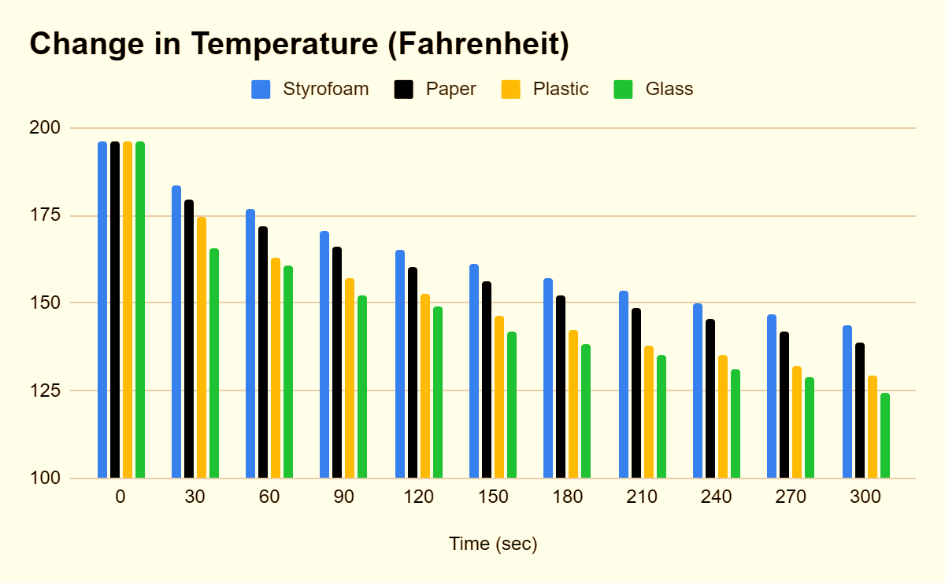
Graph

Slide 16
Conclusion
So as per the 3 trials, Styrofoam keeps the hot liquid warmer for longer time. Followed by paper and then plastic. Glass doesn’t fare well as compared to other cups and recorded the lowest temperature at the end of each trial. So, Styrofoam is the best cup in keeping hot liquid warmer for longer time.

Slide 17
Abstract
I was intrigued as to why cafe’s use paper cups and if there are other better alternatives. So I chose the topic ‘Which cup will keep a hot drink warm longer: paper, plastic, styrofoam, or glass?’
To conduct the experiment, heat water in a pan until it reaches 196 F. Take a measuring cup and pour 150 ml into each cup. Record temperature of each cup after every 30 seconds upto 300 seconds. Repeat experiment 2 more times keeping the same quantity of water at the same initial temperature. Average of each temperature reading at different time intervals was taken. This showed that the styrofoam cup keeps the liquid warm for a longer time, followed by paper, plastic, and lastly glass.
So this raised another question, that why aren’t the cafe’s using styrofoam instead. Then I did some further research and found that styrofoam is more harmful to the environment. Also, heat can cause chemicals to release from the foam and into the food. Repeated use of these cups can be a health risk.

Slide 18
Bibliography
www.stemmaterials.org
www.thermtest.com
www.sciencing.com

Slide 19
Thank you
AJEET SINGH
KHALSA SCHOOL CALGARY
ajeet.singh@khalsaschoolcalgary.ca

