Slide 1
Log Book
3D printers: started NOV. 26, 2023, 3:54 PM
2nd time: Jan. 10, 2024
3rd time: Jan 11, 2024
4th time: Jan 19, 2024

Slide 2
Partners:
Matthew, Emmet

Slide 3
Ideas for project
Past, present, future of 3D printers, pictures, 3D printer effortlessly and efficiently printing homes

Slide 4
Question?
How can 3D printers change the world and make things more efficient?

Slide 5
Hypothesis
With a BECAUSE
I think using 3D printers can make making buildings more efficient because they take less time, money and material.

Slide 6
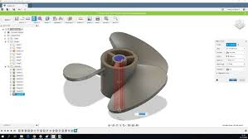
Research
“It starts with a design that is fed into the machine as a 3D file. The 3D printer then creates the product using what materials have been put into the machine, usually concrete and other substances. It works by adding layer upon layer of the material that is inside the machine to form the designed structure.” said the website “Buttonwood property management”. “The 3D printer uses a converted blueprint or CAD drawing to create a physical structure by gradually printing the material in layers” Said the website COBOD.
CAD

Slide 7
Controlled Variables:
Printer filament, printer, design software, colour of filament, heat of nozzle, heat of bed.

Slide 8
Manipulated Variables:
House design (shape), print speed.

Slide 9
Responding Variables:
Responding to design: time & resources. Responding to print speed: detail, time.

Slide 10
Materials
3D printer (of course), Tri-fold (also of course), Paper (also) DO-NOT-TOUCH-sign, computer (TINKERCAD), 3D printer filament.

Slide 11
Procedure
Turn on 3D printer, enter CAD into printing software, make adjustments, print.

Slide 12
Observations
-Needs to be leveled every 3 or 4 prints

Slide 13
Application
Mobile 3D printers can be applied in the real world to create quick and affordable housing.

Slide 14
Analysis
It is quite fast, and doesn't use much filament.

Slide 15
Conclusion
They are much quicker and efficient, and can be used for green housing anywhere.

Slide 16
Websites
Websites:Buttonwood property management, COBOD, Tencom, https://www.archdaily.com/1005043/infographic-the-evolution-of-3d-printing-in-architecture-since-1939, TINKERCAD.com, Creality print slicer (Program, not website),

Slide 17
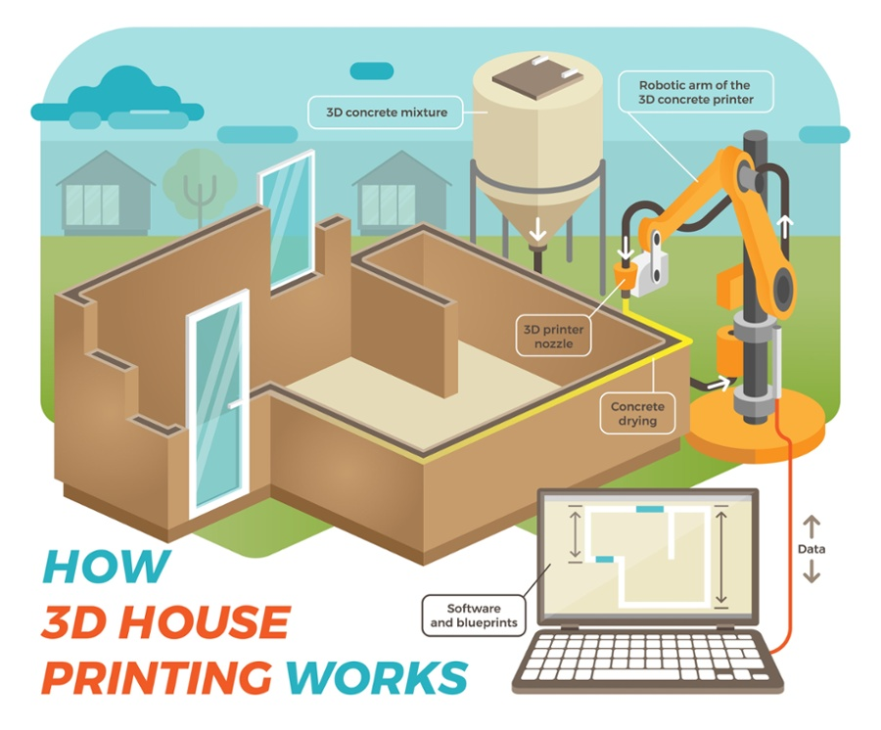
Courtesy of Tencom

