Slide 1



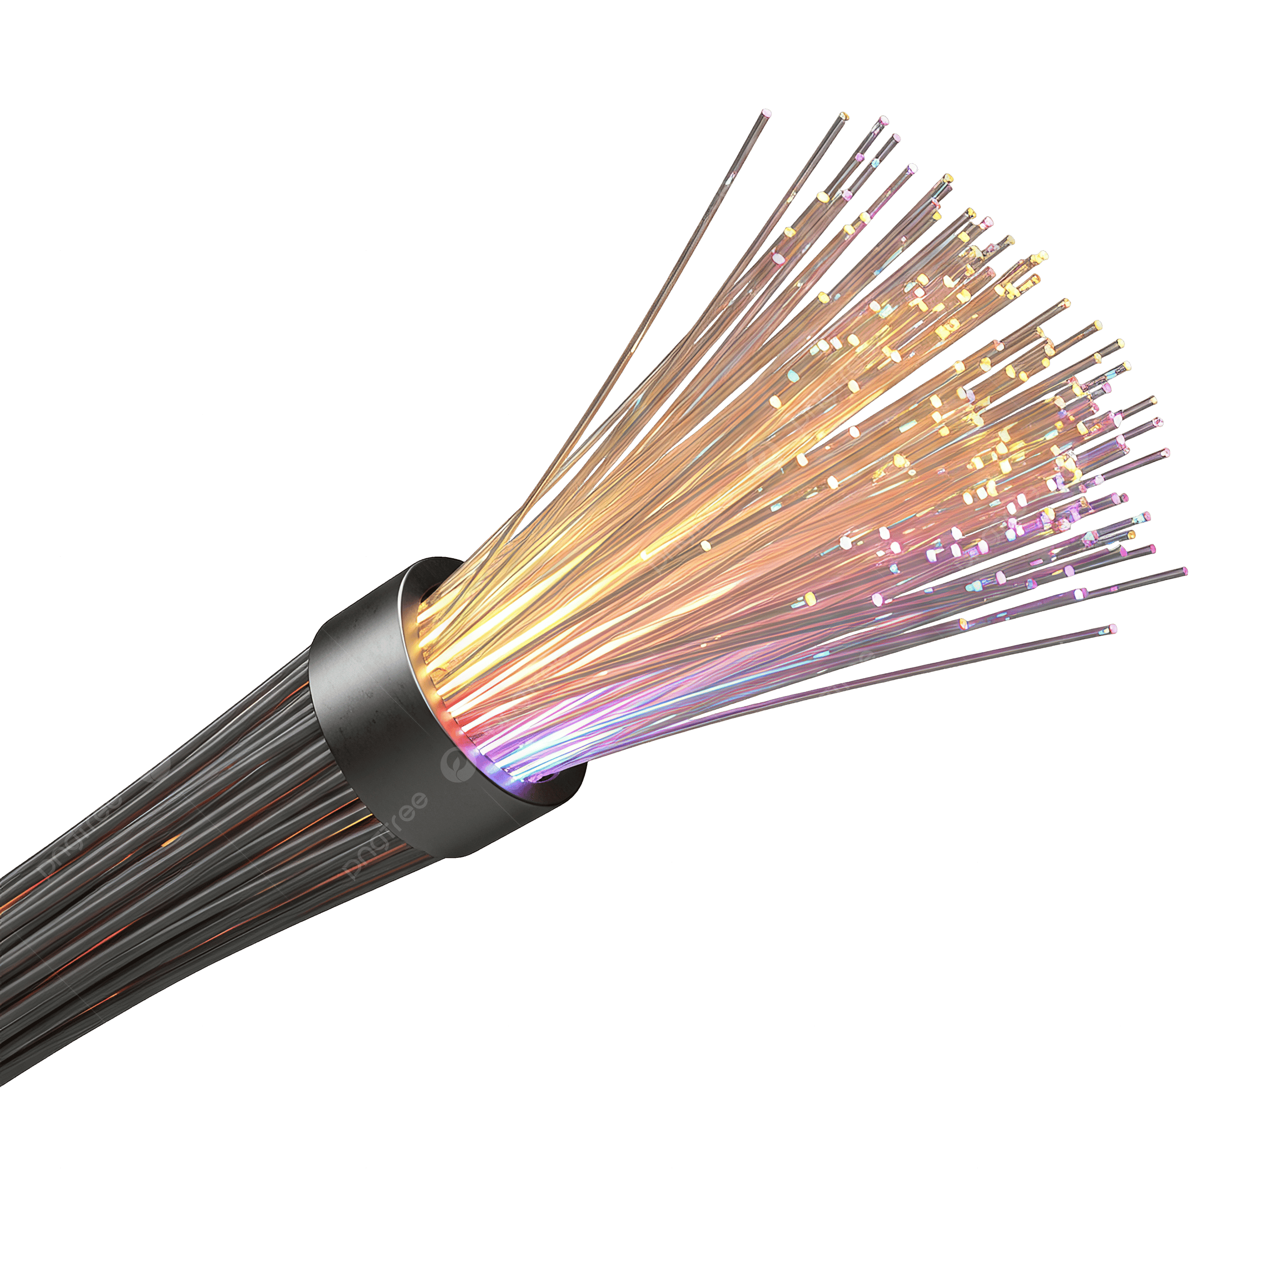

Project Title
24/7 Sunlight
Prepared by
Param Panchal (Grade 6)
‘24/7 Sunlight’ by Param Panchal (Feb 2026)
School
Glamorgan School,
Calgary
School Coordinator
Mr. Patrick Howey
Supporter
Mother, Father
Prerana Archit

Slide 2
Question, Hypothesis, Prediction
Question:
Can we maximize the use of natural sunlight for illumination in homes and workplaces?
How can we harness 24/7 Sunlight for illumination and reduce dependence on artificial lighting, even during nighttime?
‘24/7 Sunlight’ by Param Panchal (Feb 2026)

Slide 3
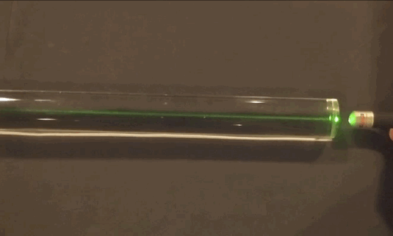
Question, Hypothesis, Prediction .. (Cont.)
Hypothesis:
I think, when we install the fiber optic cables on a house/building roof, it can transmit enough direct sunlight for illumination inside the house/building. Also, I believe that the fiber optic cable can transmit sunlight from the daytime location to the nighttime location on the other side of the world for illumination.
‘24/7 Sunlight’ by Param Panchal (Feb 2026)
Photo Sources: https://www.thefoa.org/tech/sciproj.htm

Slide 4
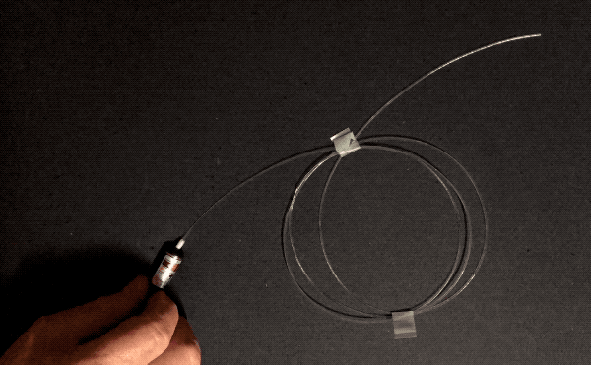
Question, Hypothesis, Prediction .. (Cont.)
Prediction:
If I install the fiber optic cables on a house/building roof, it will transmit direct sunlight inside the house/building for illumination.
Besides if we install the fiber optic cable at one location (such as Calgary, Canada) and connect it to its antipodal or another location (like Perth, Australia), we will transmit sunlight for illumination from the daytime location to the nighttime antipodal, location and vice versa.
‘24/7 Sunlight’ by Param Panchal (Feb 2026)
Photo Sources: https://www.thefoa.org/tech/sciproj.htm

Slide 5
Background Research
Big Topic: Light energy (electromagnetic energy)
Why is this important for society:
Light energy is very important in our daily life.
Sunlight is very useful for giving us light and it helps to make Vitamin D cells in our body.
Artificial light energy is used in our houses and other buildings such as workplaces etc.
Light can be used for both nighttime and even daytime too.
What do we already know about the topic:
Sunlight gives energy, light and it helps to make Vitamin D to our body
Fiber optic cable helps to transfer the light quickly from one place to the other
about 1.48 million kilometers of fiber optic cables under the ocean to transmit data (includes Internet and communication) in the form of light all across the world
‘24/7 Sunlight’ by Param Panchal (Feb 2026)

Slide 6
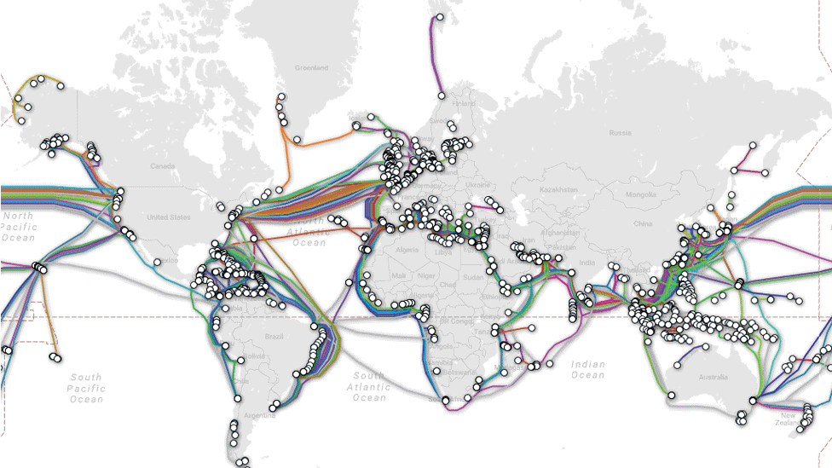
Background Research .. (Cont.)
Map of undersea cables
‘24/7 Sunlight’ by Param Panchal (Feb 2026)
Photo Sources:
https://www.bbc.com/news/technology-17340700

Slide 7
Background Research .. (Cont.)
What are we missing?
How do we get 24/7 Sunlight for illumination with the help of Fiber Optic cables in homes and workplaces, even during the nighttime?
How my topic solves a problem
We can get Sunlight by transmitting it into the fiber optic cable.
When one place in the world has Sunlight (Daytime), we can transmit it to other places which have no Sunlight (at the same time - Nighttime) and a dusk.
‘24/7 Sunlight’ by Param Panchal (Feb 2026)

Slide 8

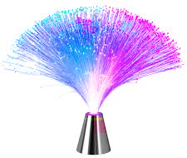
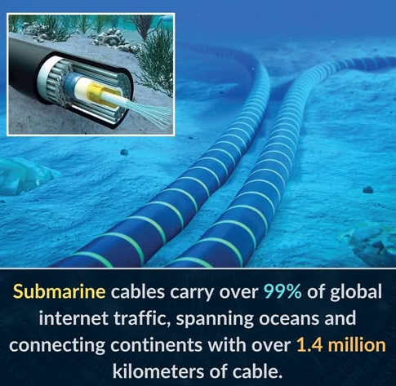

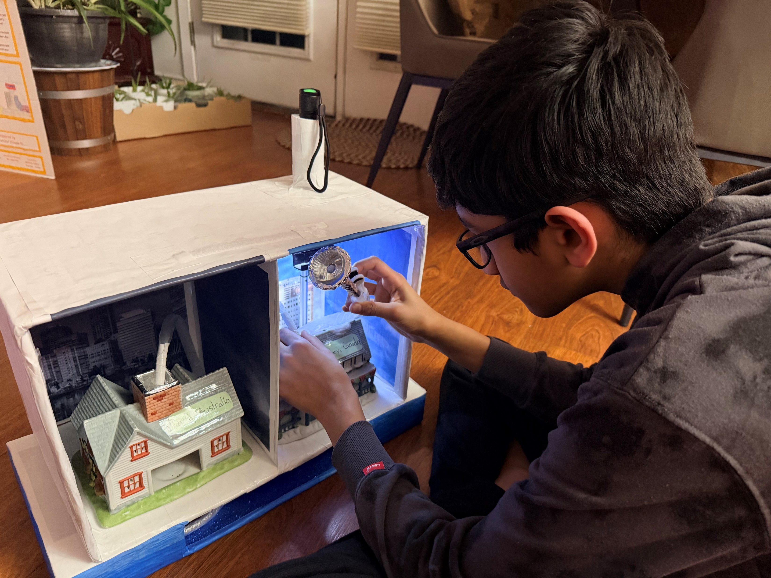
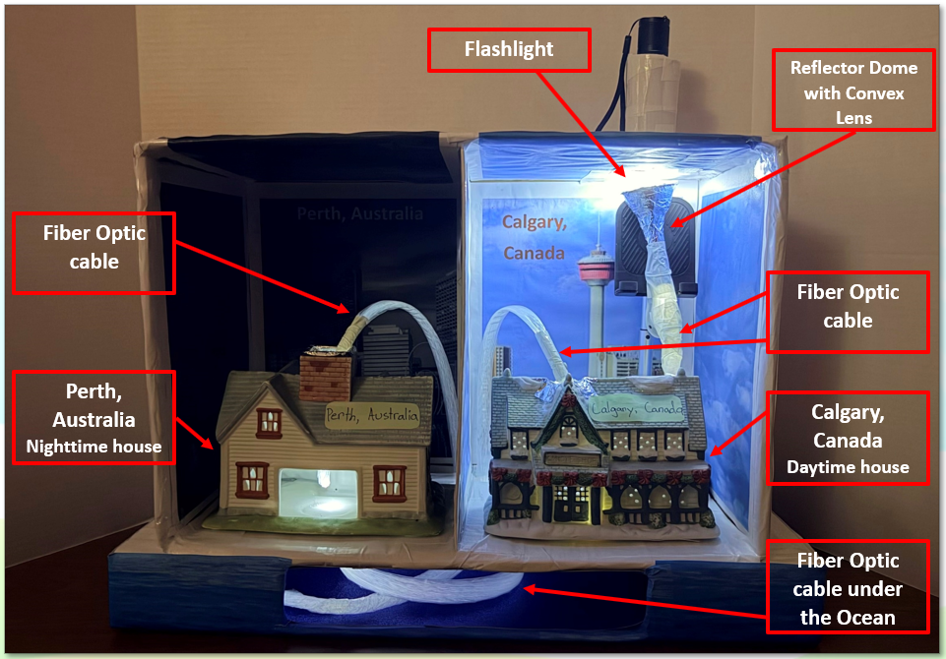
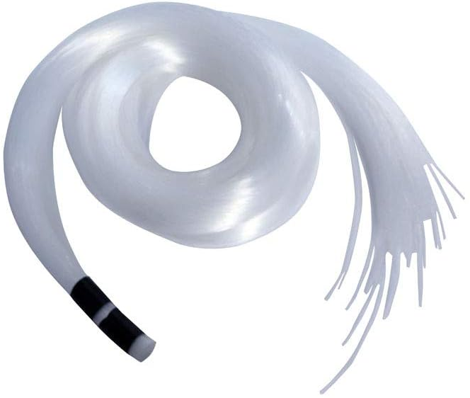
My Science Project Ideas
Information / Advertising flyers in our community
‘24/7 Sunlight’ by Param Panchal (Feb 2026)

Slide 9
Variables
Independent Variable (What I change) | Dependent Variables (What I observe) | Controlled Variables (What I keep the same)
- Installing fiber optic cables with a reflector dome and convex lens on a house/building roof - Passing fiber optic cables inside the house/building from the roof Measured in numbers of Fiber Optic cables and number of reflector domes and a convex lens | - Illumination/Sunlight inside the house/building Measured in Lux (Lumen per square meter) - Temperature inside the house/building Measured in Celsius | - Same Sunlight - Same house/building - Same roof of the house/building
‘24/7 Sunlight’ by Param Panchal (Feb 2026)

Slide 10
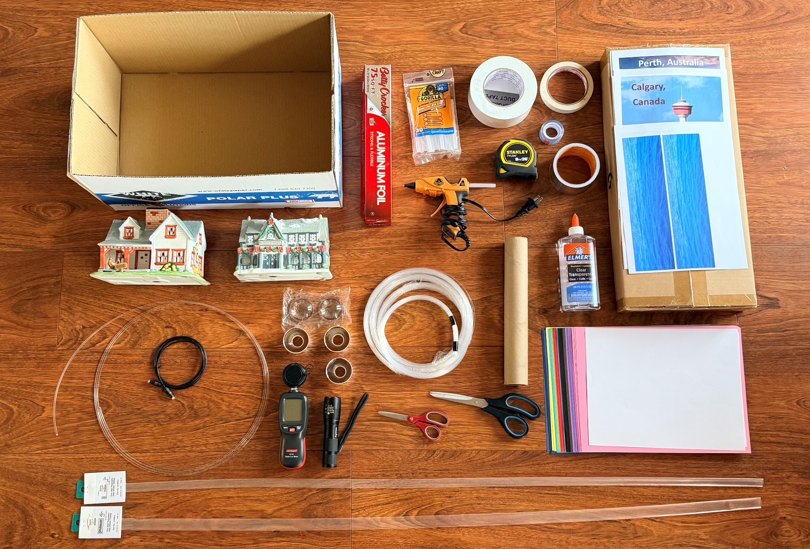
Material used for Working Model
‘24/7 Sunlight’ by Param Panchal (Feb 2026)

Slide 11
Material used for Working Model .. (Cont.)
Fiber Optic cable (approx. 6.5ft)
Shrink tube (to protect fiber optic cables)
Flashlight
Light Meter, Temperature Meter
Small toy houses (tealight houses) (2), Reflector Dome (3)
Convex Lens (1), Aluminum Foil
Hot Glue Gun and Sticks, & Glue (1 small bottle 266ml)
Duct Tape (1-2 roll), Clear Tape (1-2 roll)
Masking tape (1 roll), Aluminum Tap (1 roll)
Measuring Tape, Paper, Cardboard box
Cardboard, Scissors, Other Craft items
‘24/7 Sunlight’ by Param Panchal (Feb 2026)

Slide 12
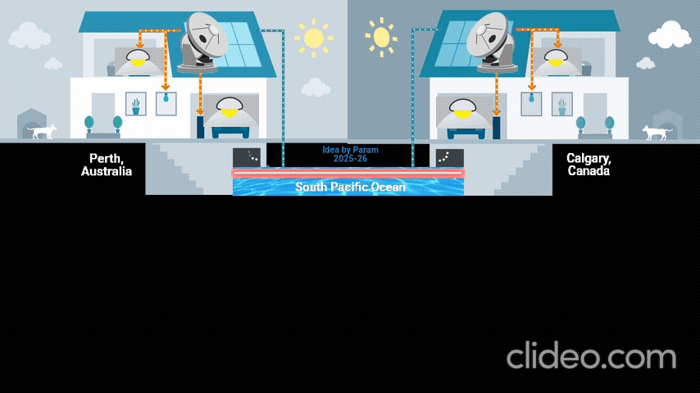
Procedures (Experiment - Working Model)
‘24/7 Sunlight’ by Param Panchal (Feb 2026)
Fiber Optic cable
Photo Sources:
https://www.core7.co.uk/solar-battery-storage-installer-swindon/
https://gifs.alphacoders.com/gifs/view/19518
https://www.atlast.uio.no/
https://infogram.com/energisol-colombia-1hd12yxez37rw6k

Slide 13
Procedures (Experiment - Working Model) .. (Cont.)
First, I set up two toy houses (tealight houses) inside a cardboard box – one representing daytime and the other nighttime.
Next, I installed fiber optic cables (about 6.5 ft long) along with a reflector dome and a convex lens near the roof of the daytime house to collect sunlight and transmit it through the cables.
Then, half of the fiber optic cables are connected inside the daytime house, ending in a reflector dome to distribute light throughout the house. The other half connect to the nighttime house, also ending with a reflector dome for light distribution.
We can test the model using a flashlight by shining light into the dome near the roof of the daytime house. The light will travel through the fiber optic cables and reach the reflector dome inside the house. The same setup applies to the nighttime house. The illumination inside both houses can be observed with a light meter, measured in Lux (lumens per square meter).
Finally, we can test the model under sunlight and measure the illumination inside both houses with the light meter.
‘24/7 Sunlight’ by Param Panchal (Feb 2026)

Slide 14
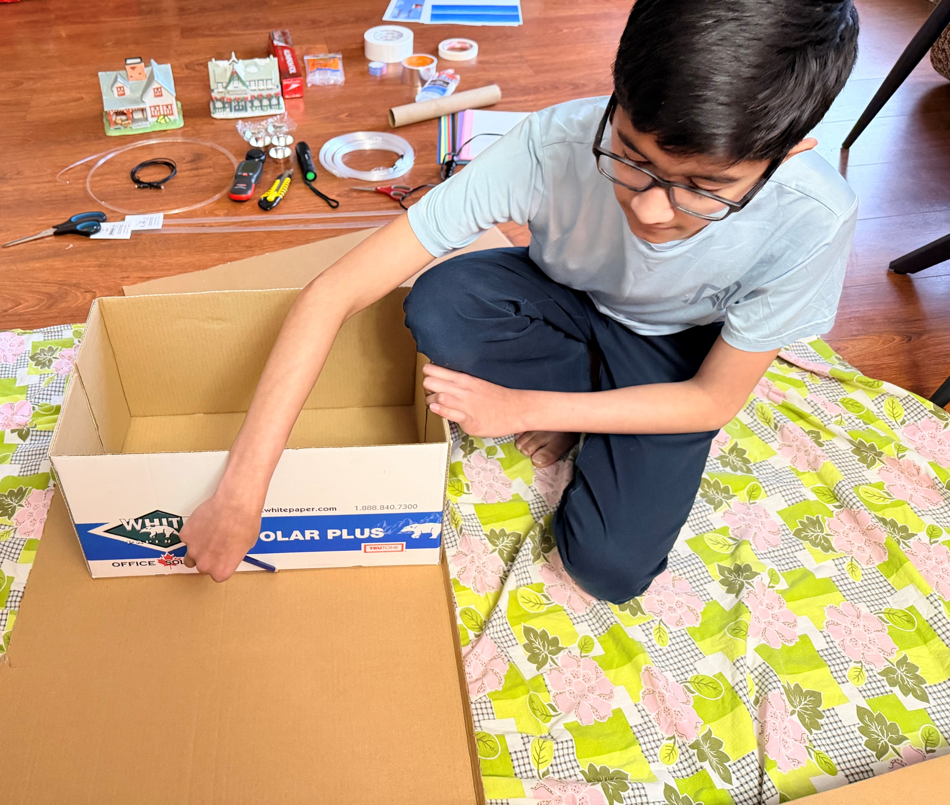
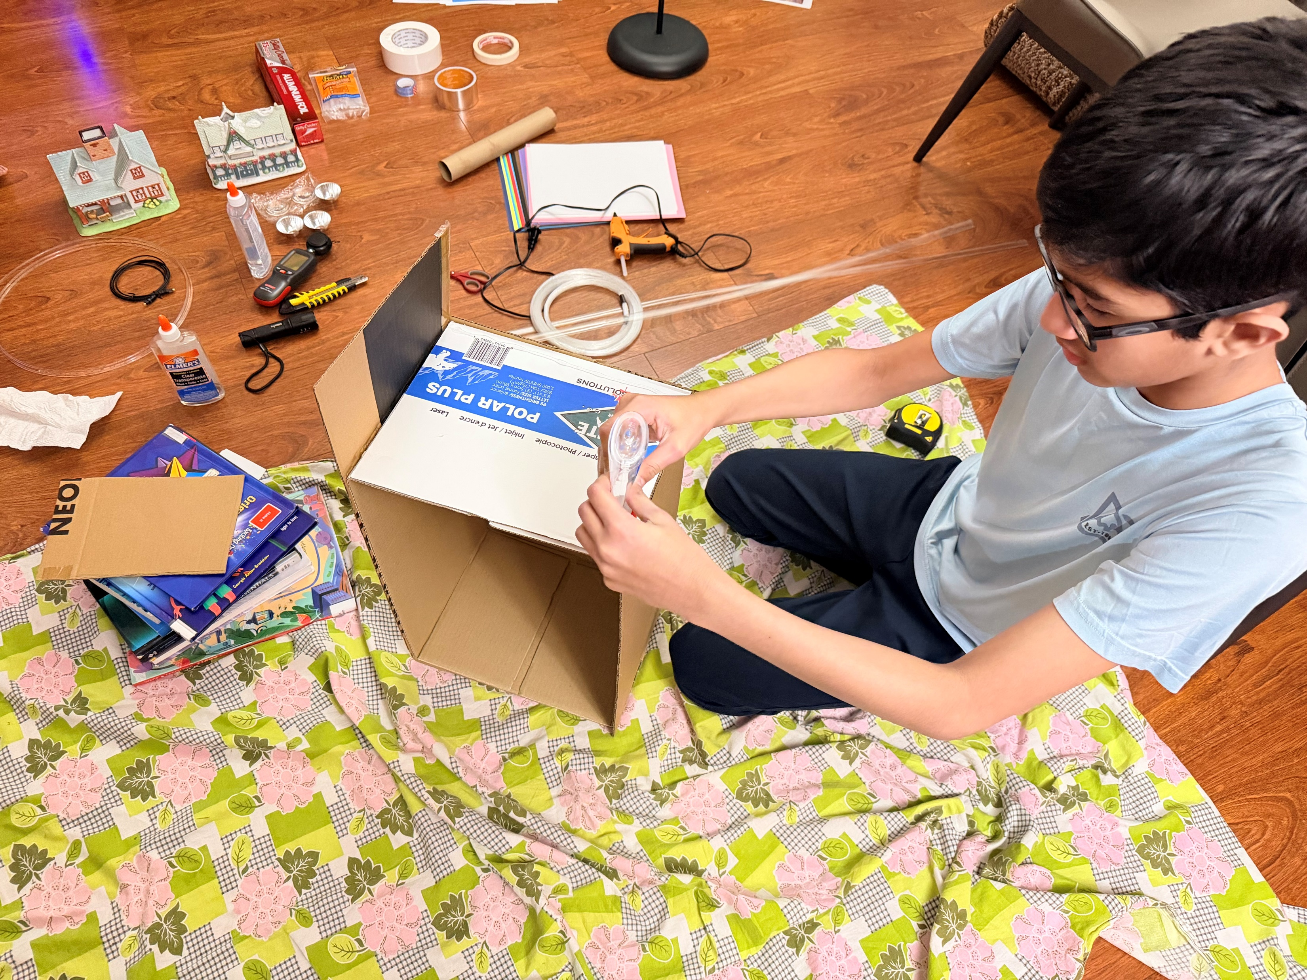
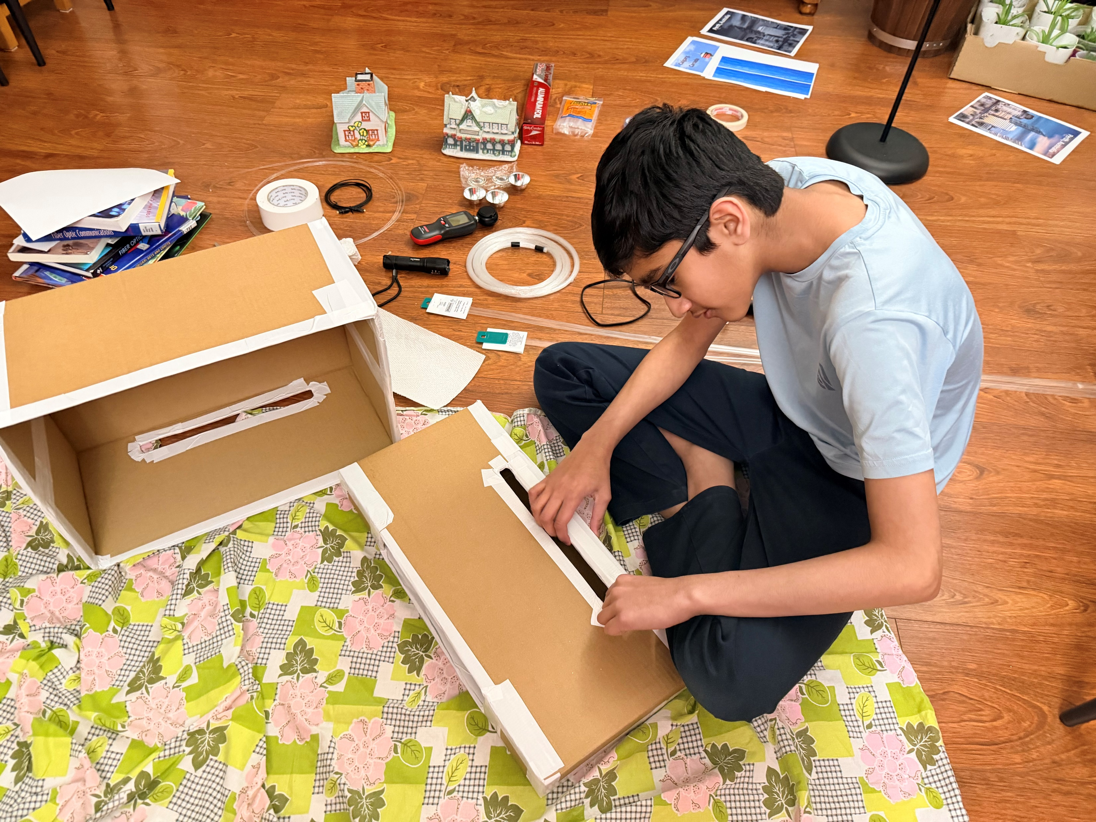
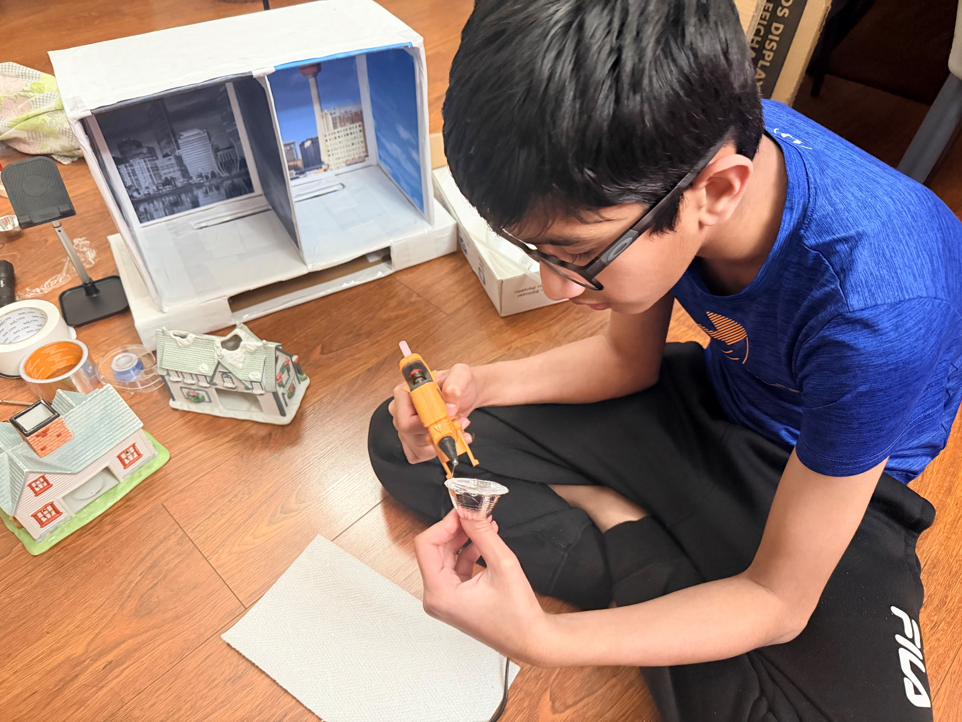
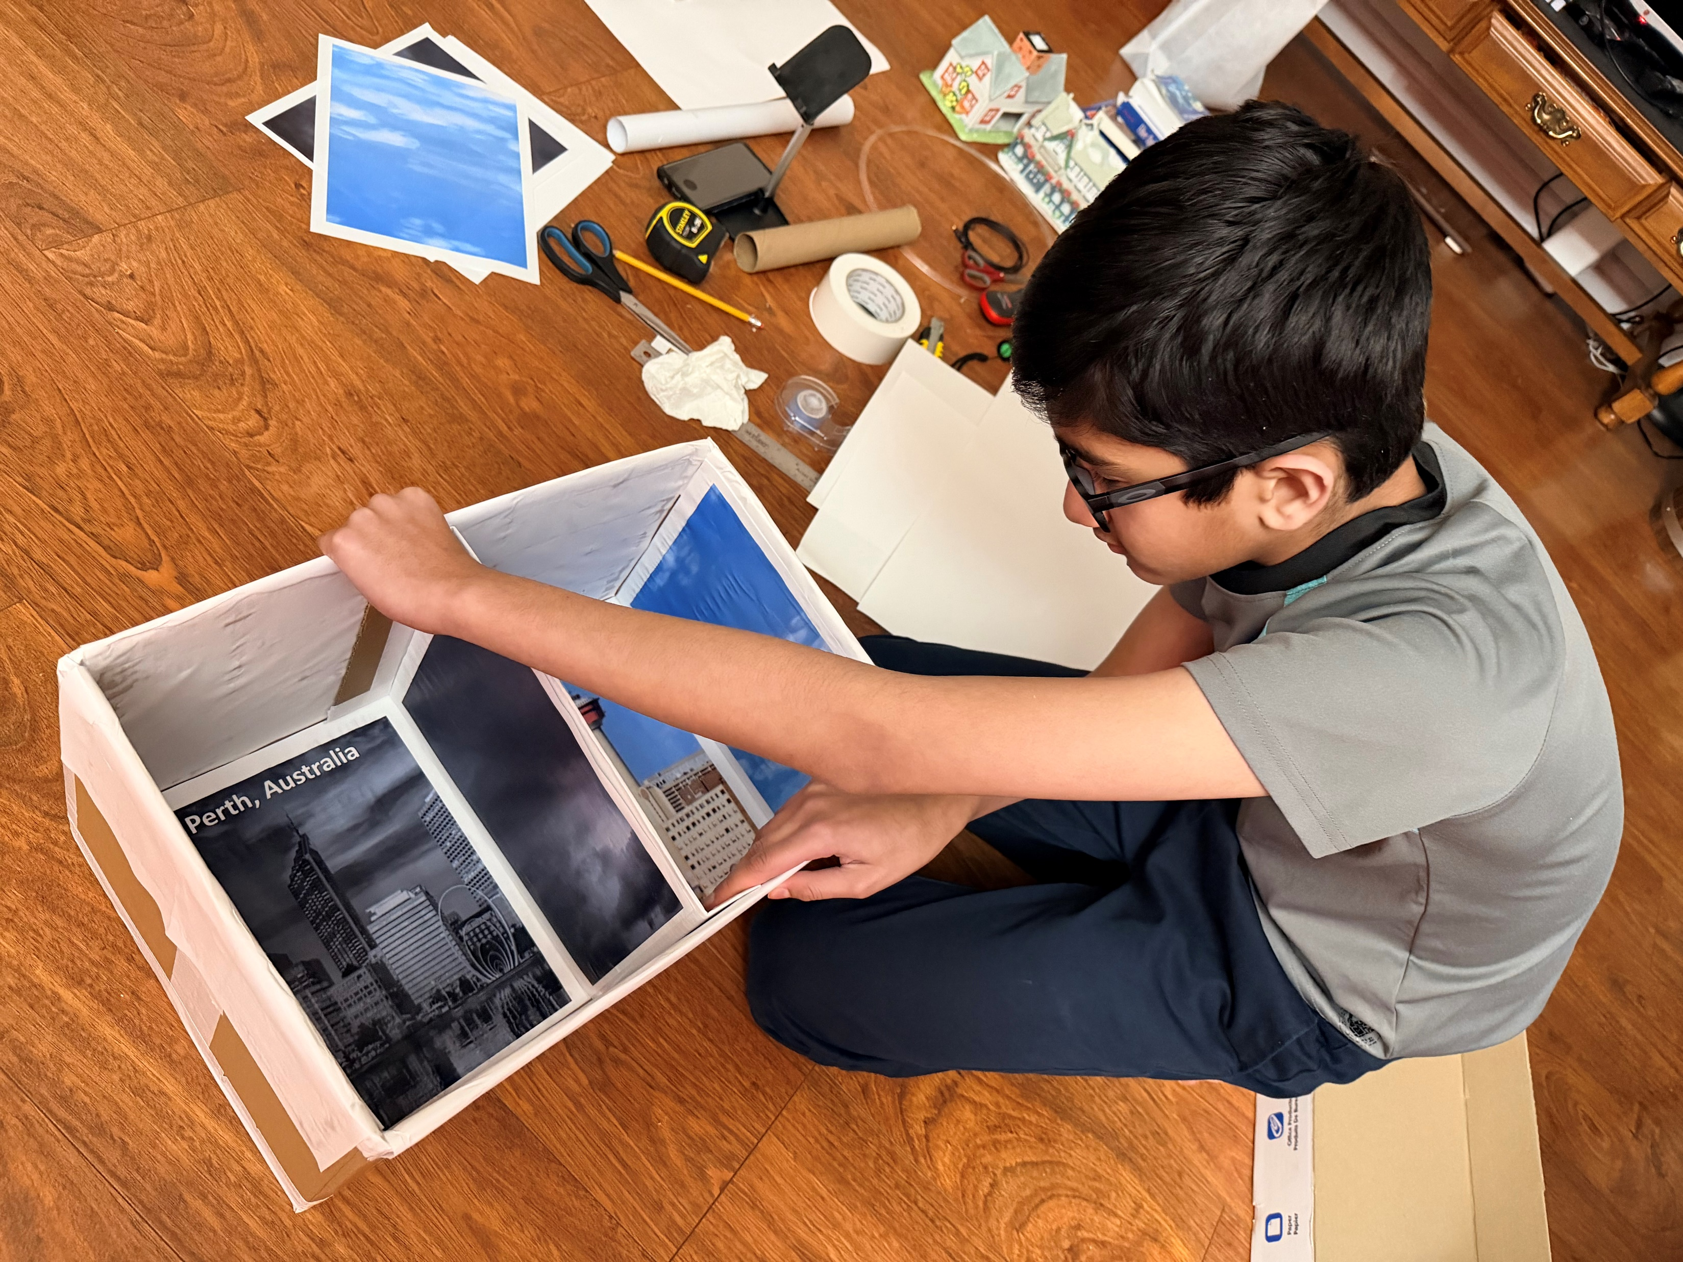
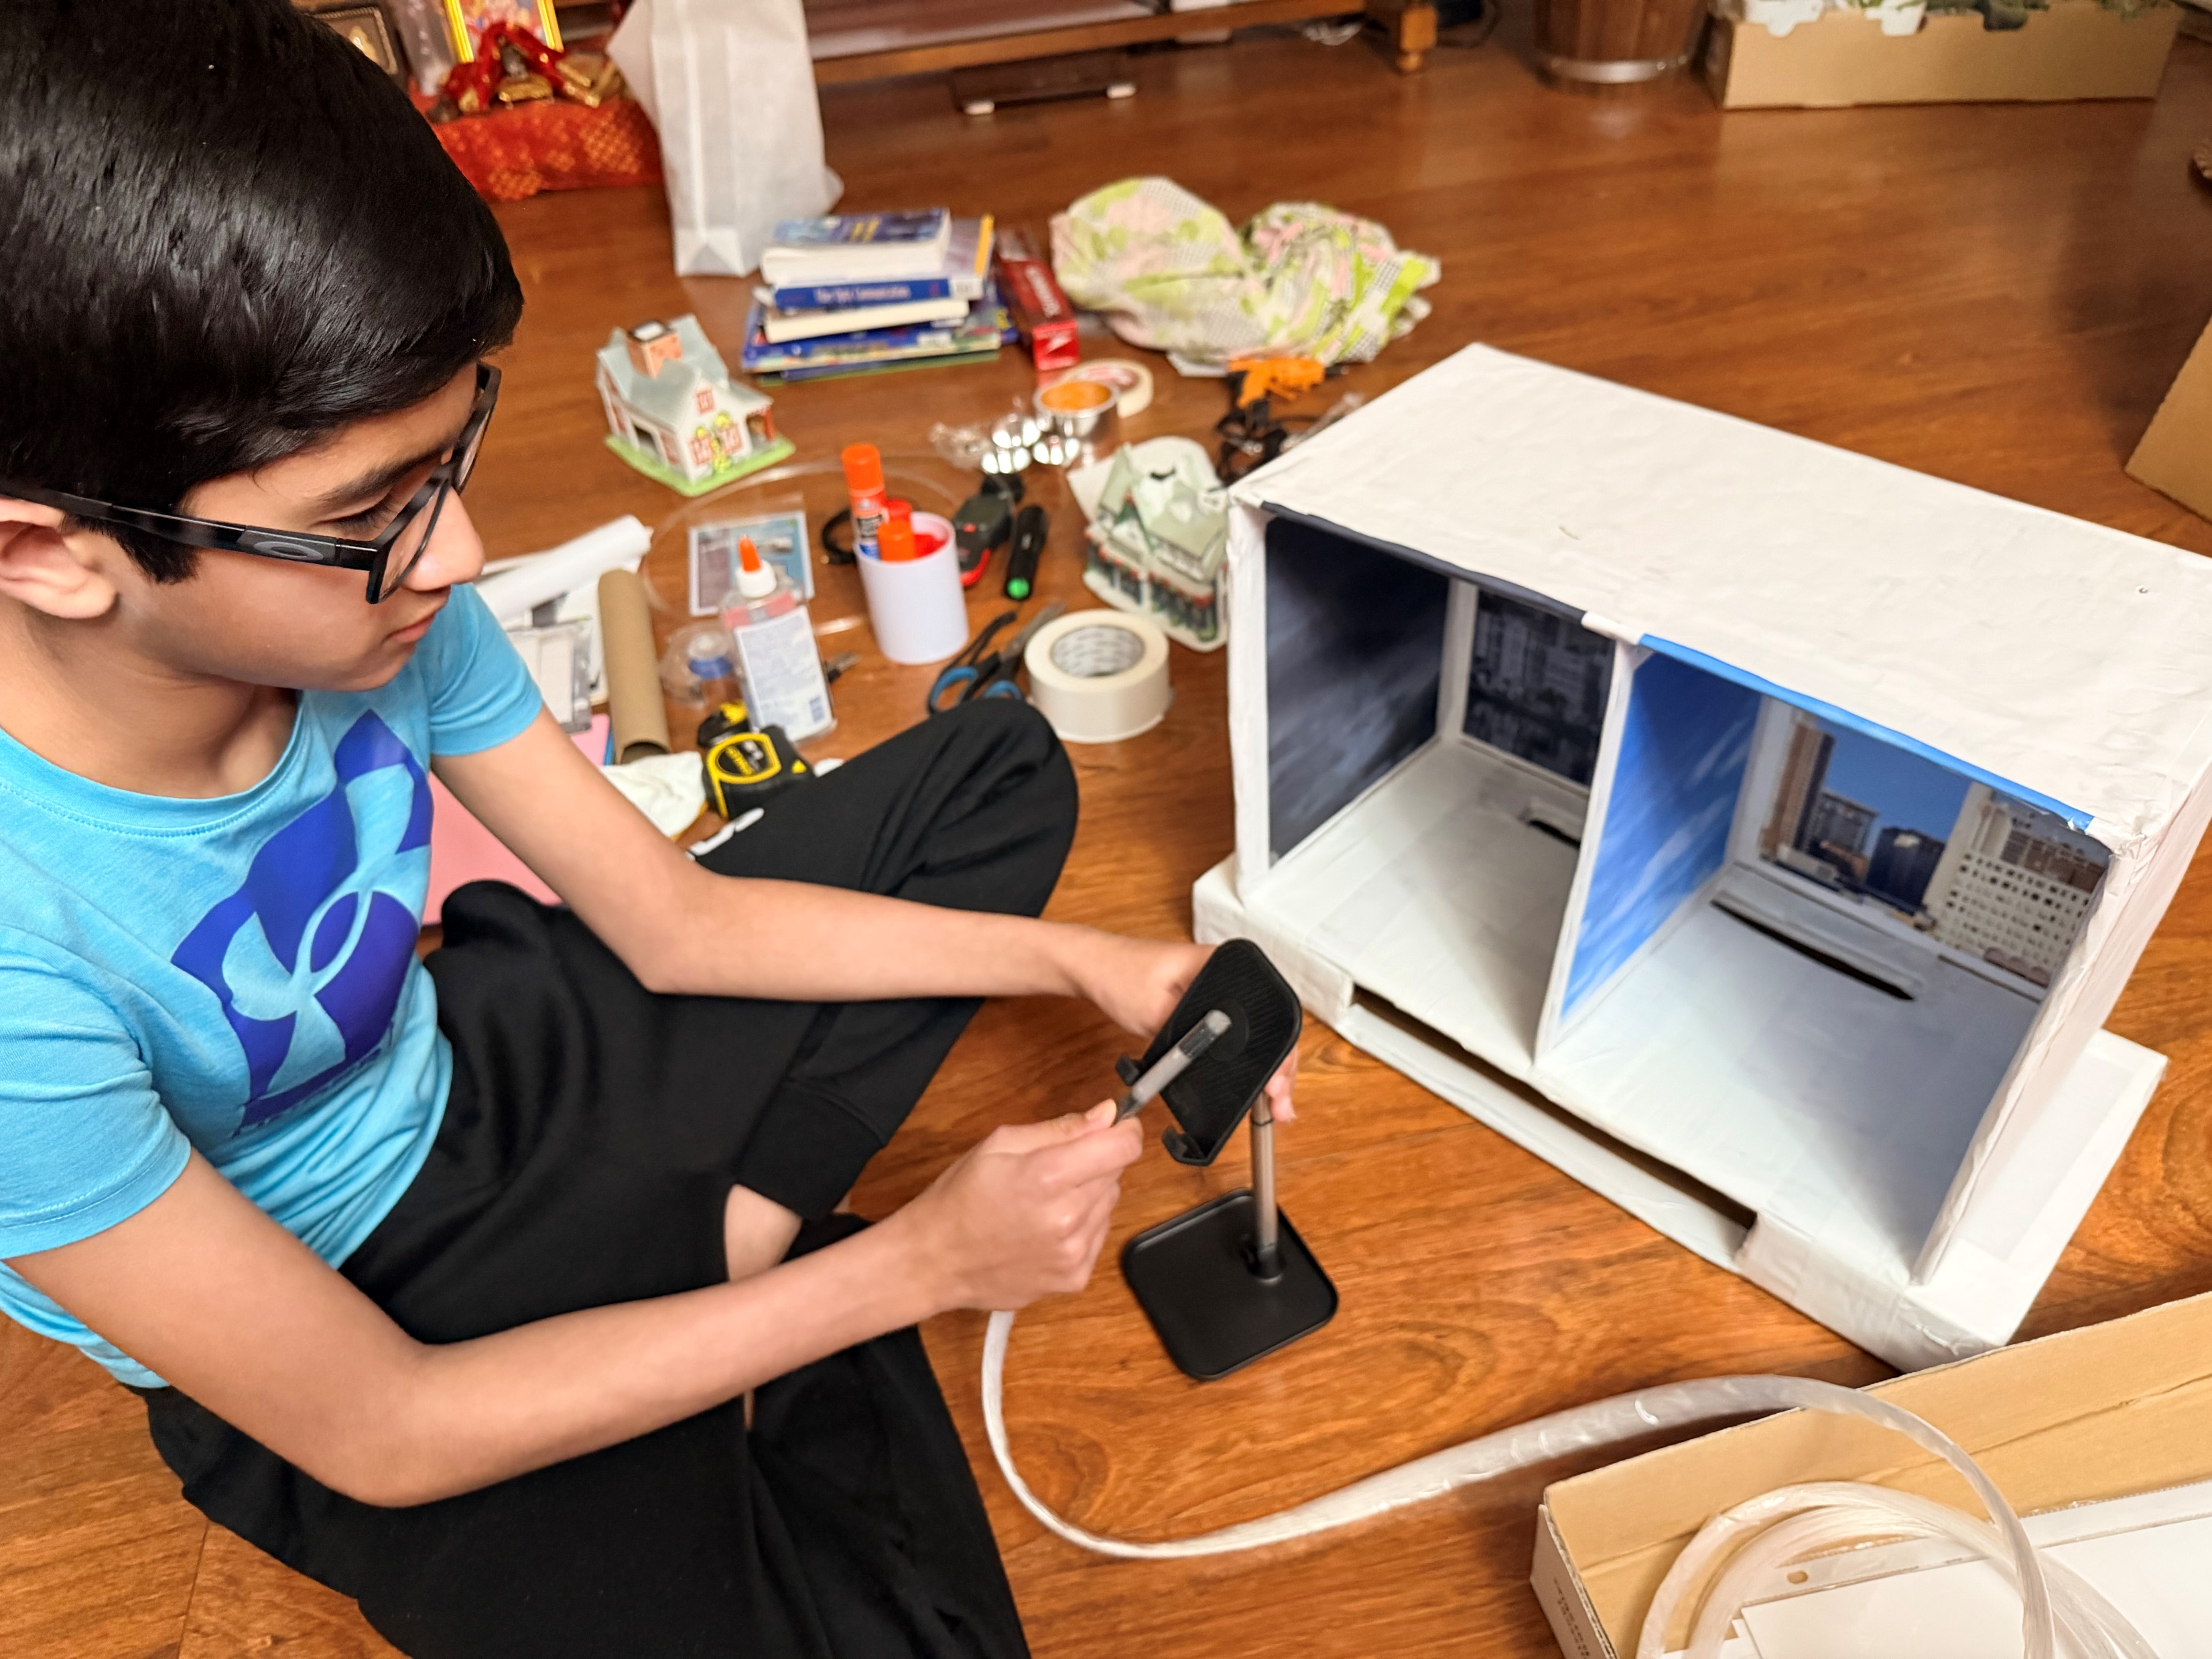
Procedures (Experiment - Working Model) .. (Cont.)
‘24/7 Sunlight’ by Param Panchal (Feb 2026)

Slide 15
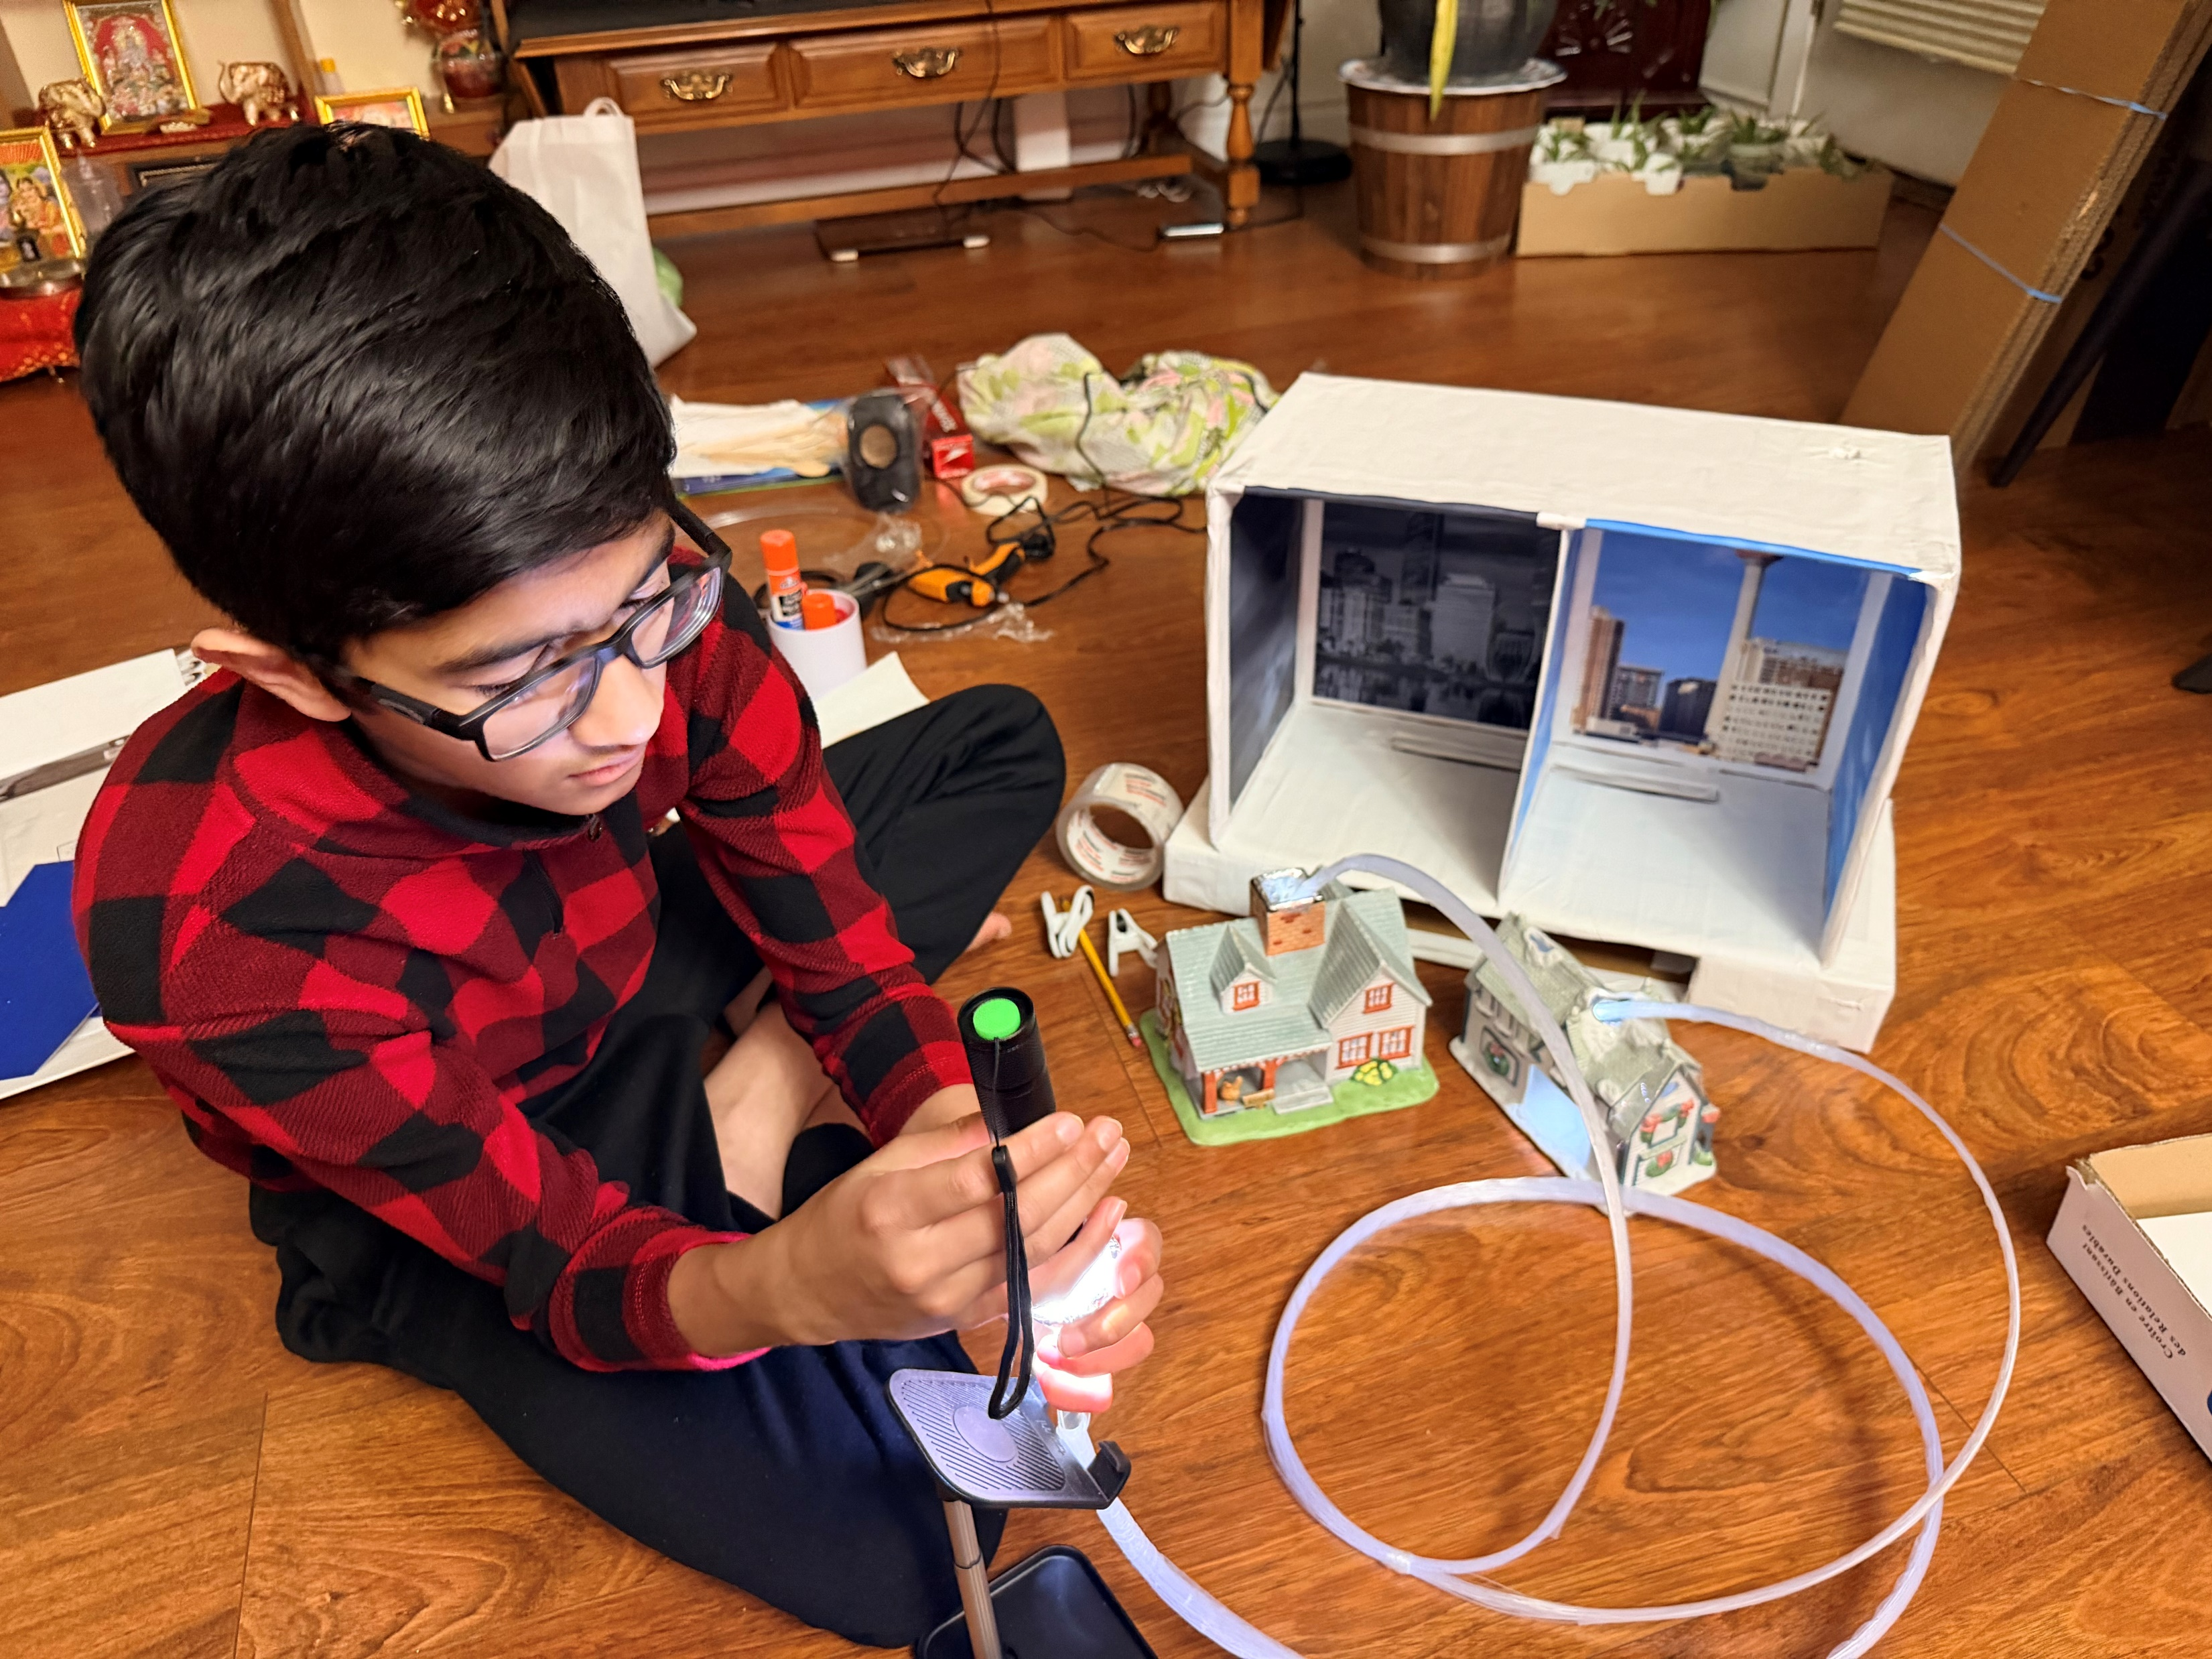
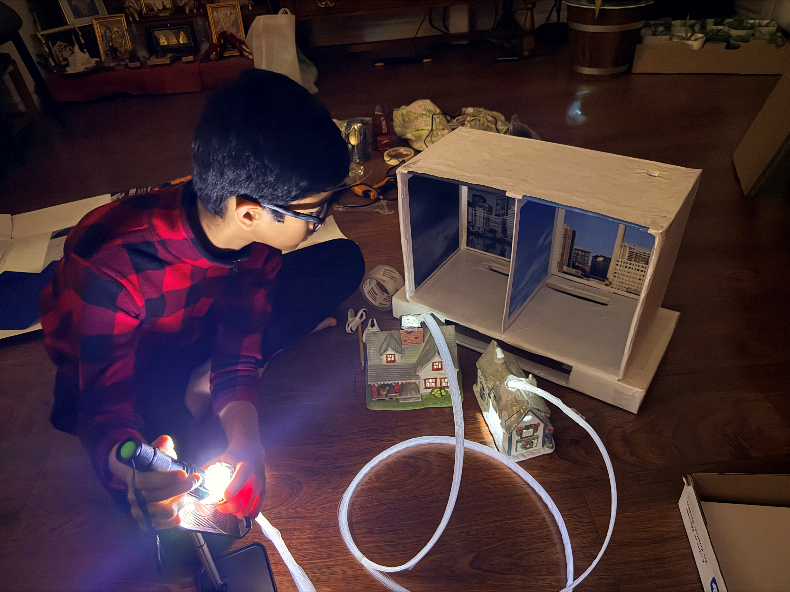
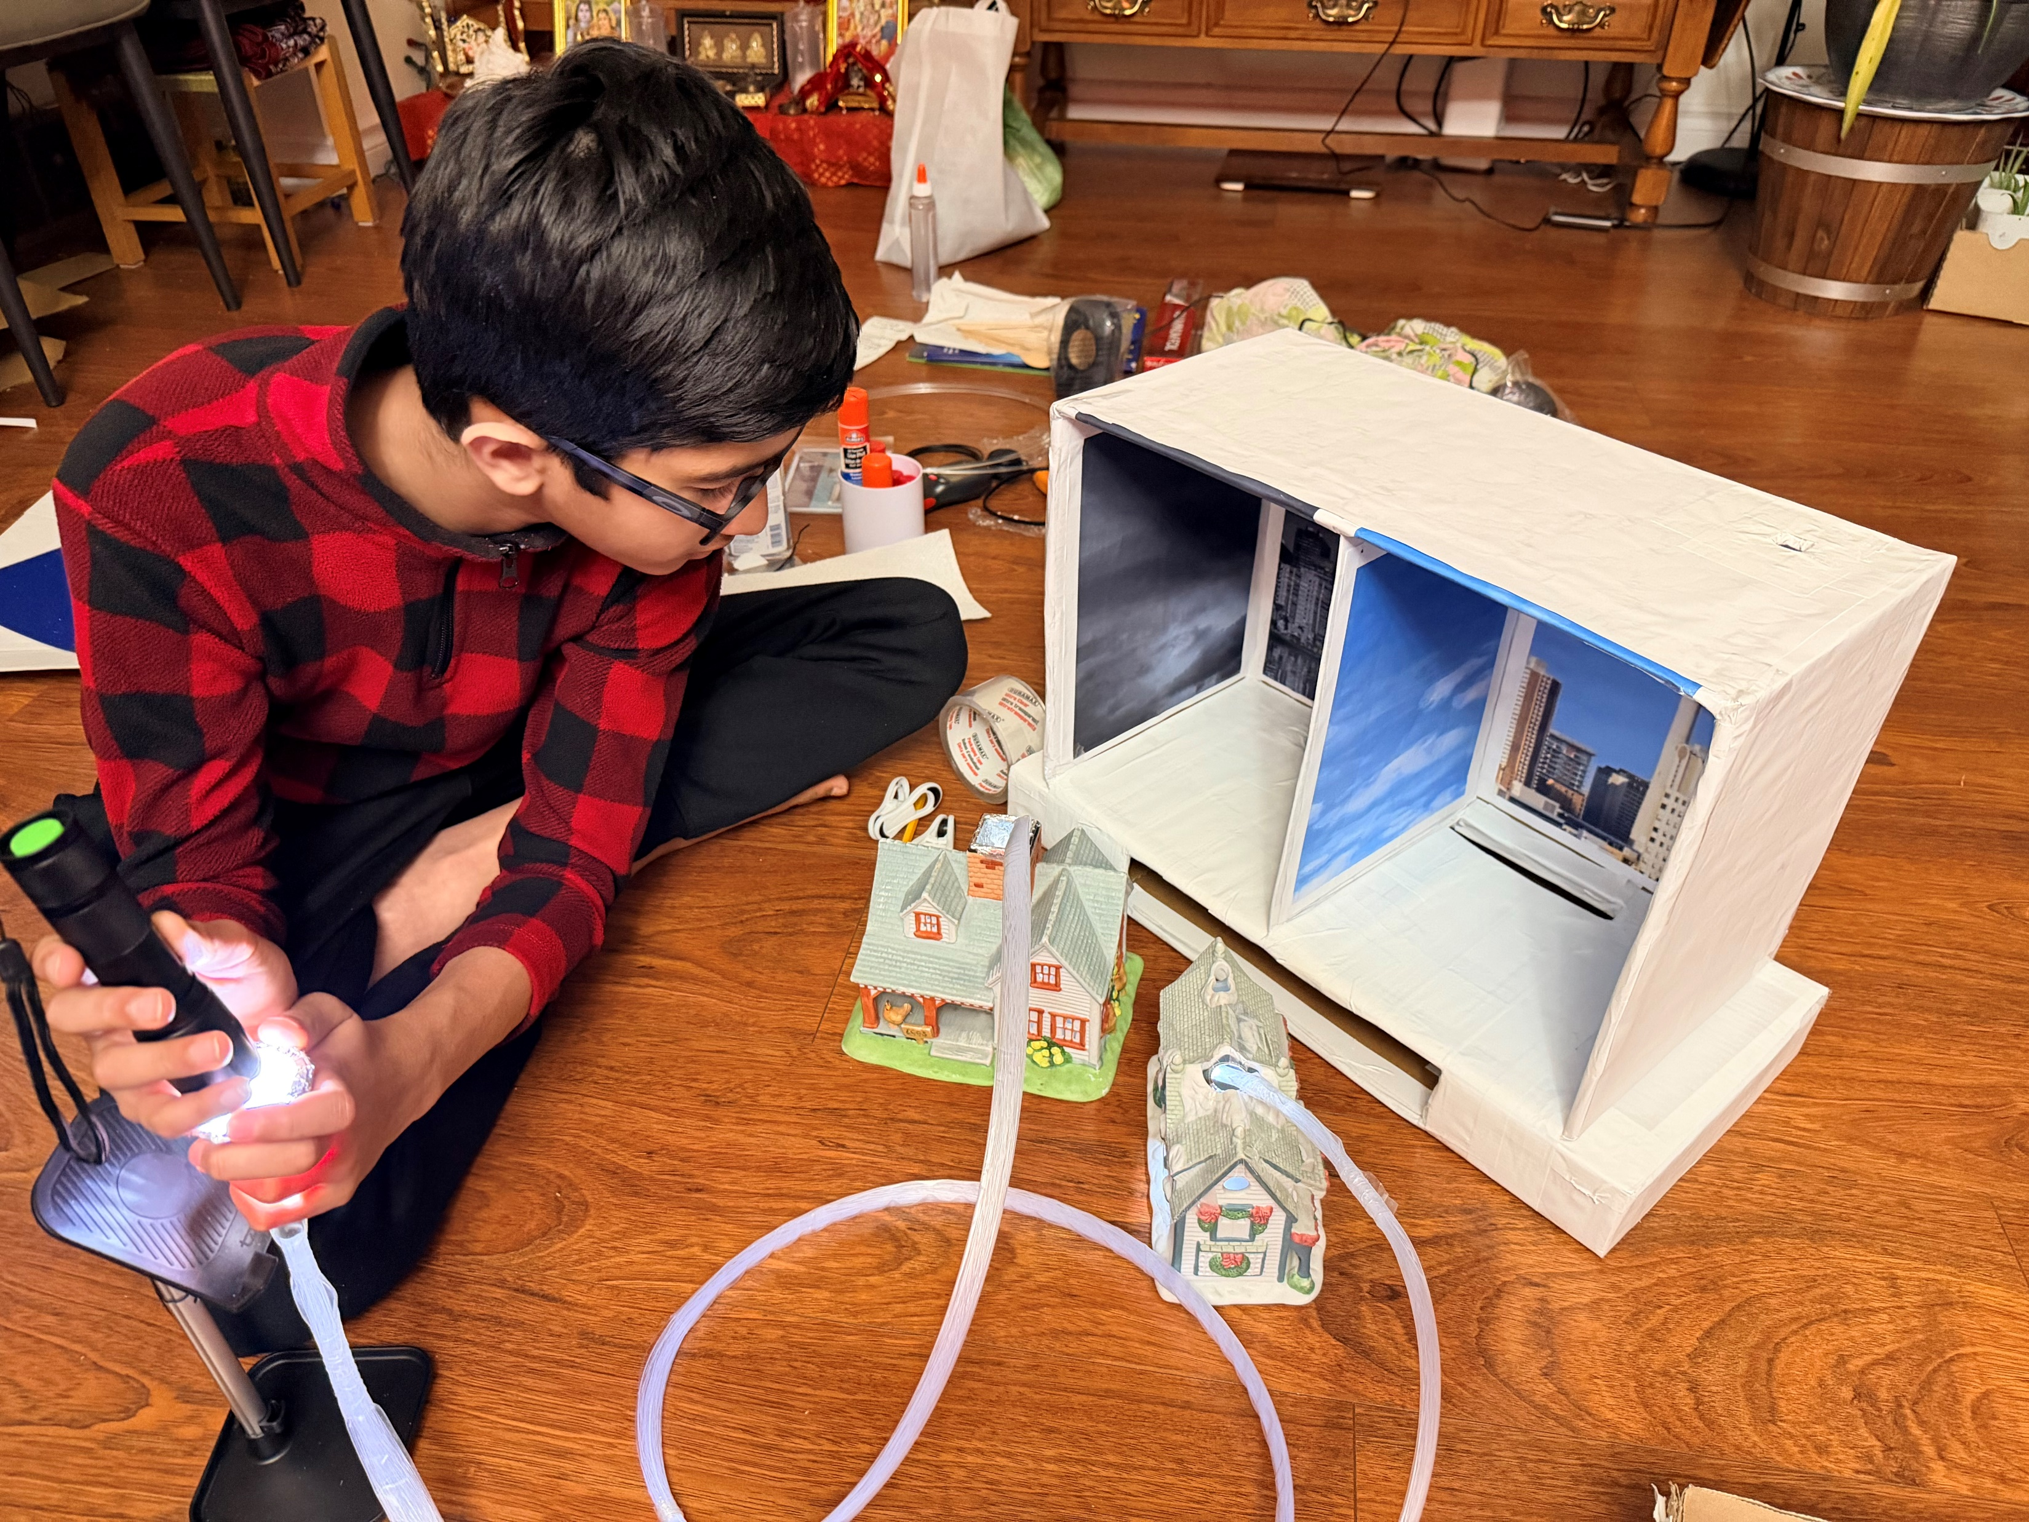
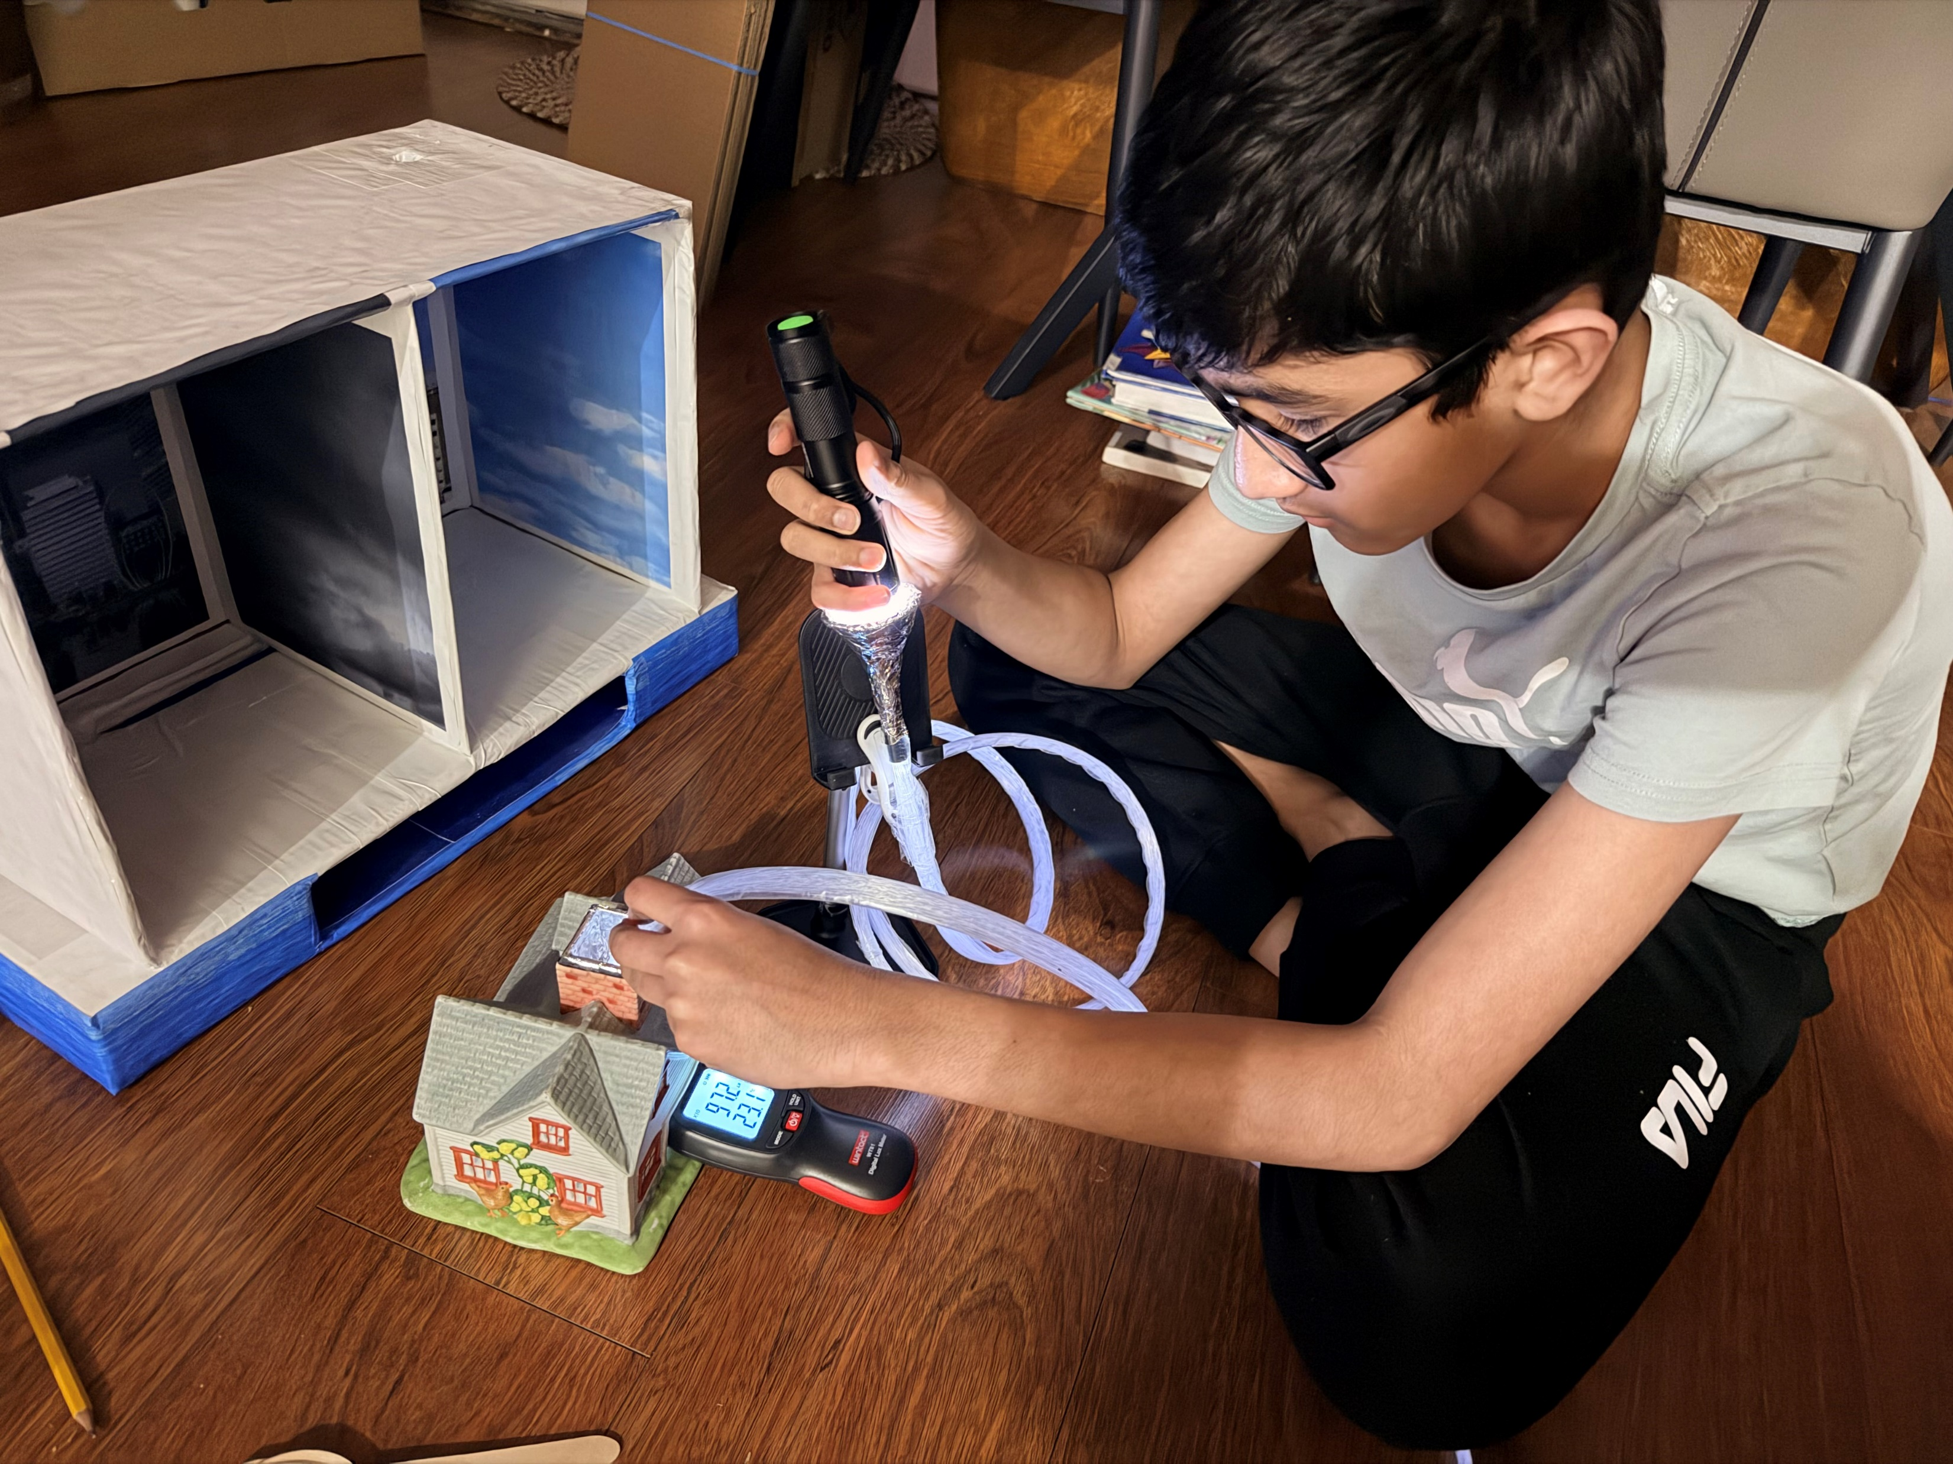
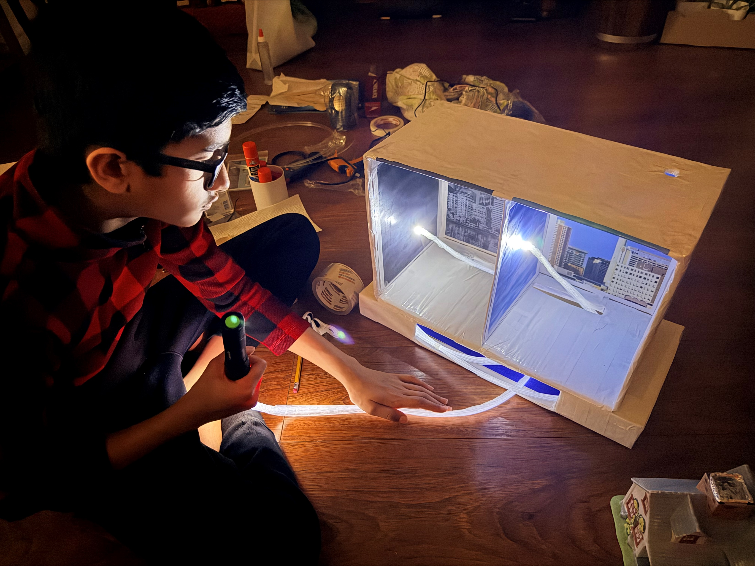

Procedures (Experiment - Working Model) .. (Cont.)
‘24/7 Sunlight’ by Param Panchal (Feb 2026)

Slide 16
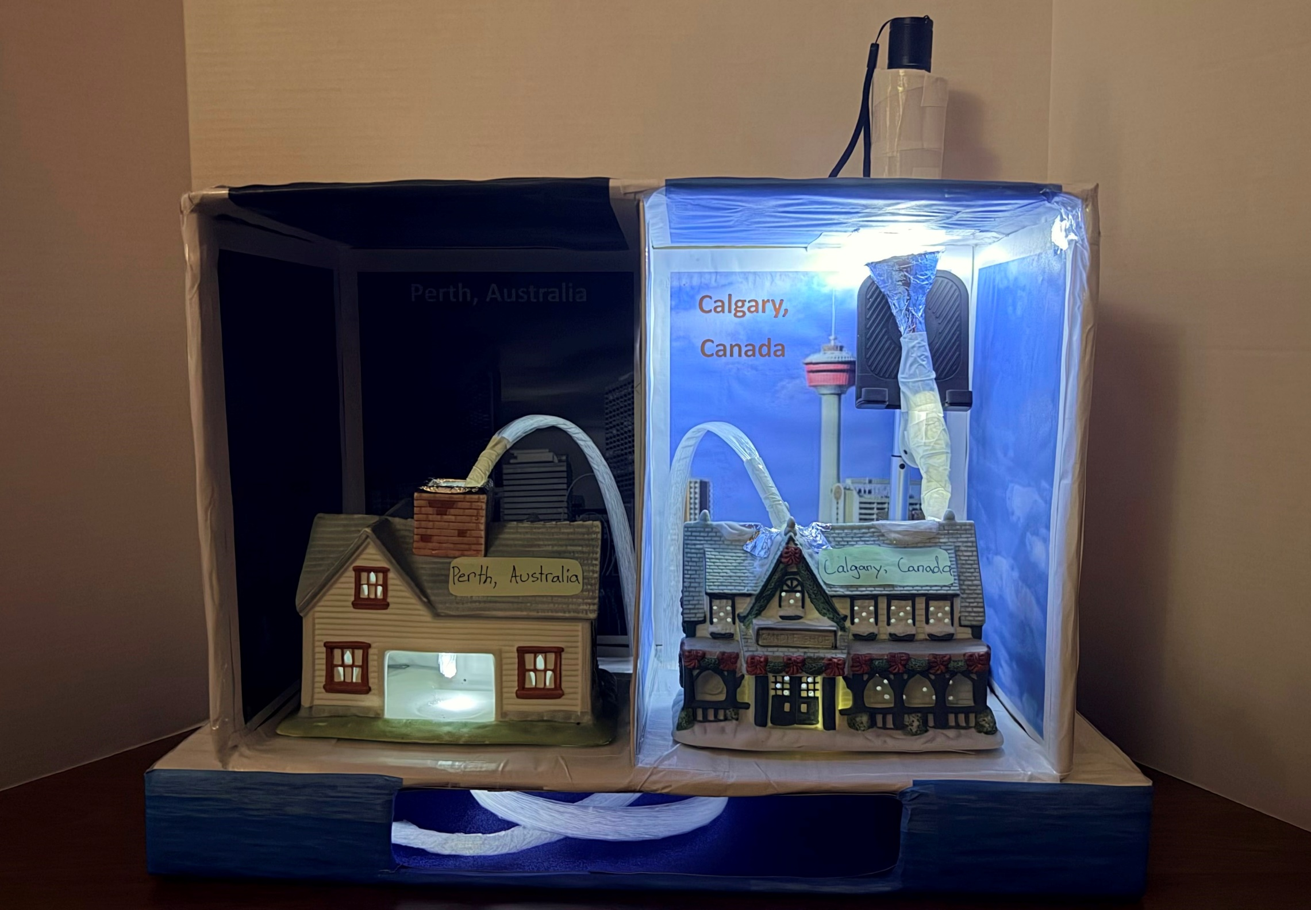
Procedures (Experiment - Working Model) .. (Cont.)
Flashlight
Reflector Dome with Convex Lens
Fiber Optic cable
Fiber Optic cable
‘24/7 Sunlight’ by Param Panchal (Feb 2026)
Perth, Australia Nighttime house
Calgary, Canada Daytime house
Fiber Optic cable under the Ocean

Slide 17
Results
I shined the flashlight into the dome a few times near the roof of the house.
The light went into the fiber optic cables.
The light continued going through the cables and ended in the house with a reflector dome.
First, I used a light meter to measure the light in Lux (Lumen per square meter) directly from the flashlight.
I have done the same thing for measuring the light inside the house at the end of the reflector dome.
Lastly, I used the same light meter to measure the temperature in Celsius from at the start of my experiment to after 5 minutes, to check if the fiber optic also transfers heat with the light.
‘24/7 Sunlight’ by Param Panchal (Feb 2026)

Slide 18
Results .. (Cont.)
I have also tested it under sunlight, and went through the same procedure.
We can transfer light through the fiber optic cables inside the house with the help of speed of light.
All my observations (in a table form) are recorded to show how much light is being transferred through the fiber optic cables.
‘24/7 Sunlight’ by Param Panchal (Feb 2026)

Slide 19
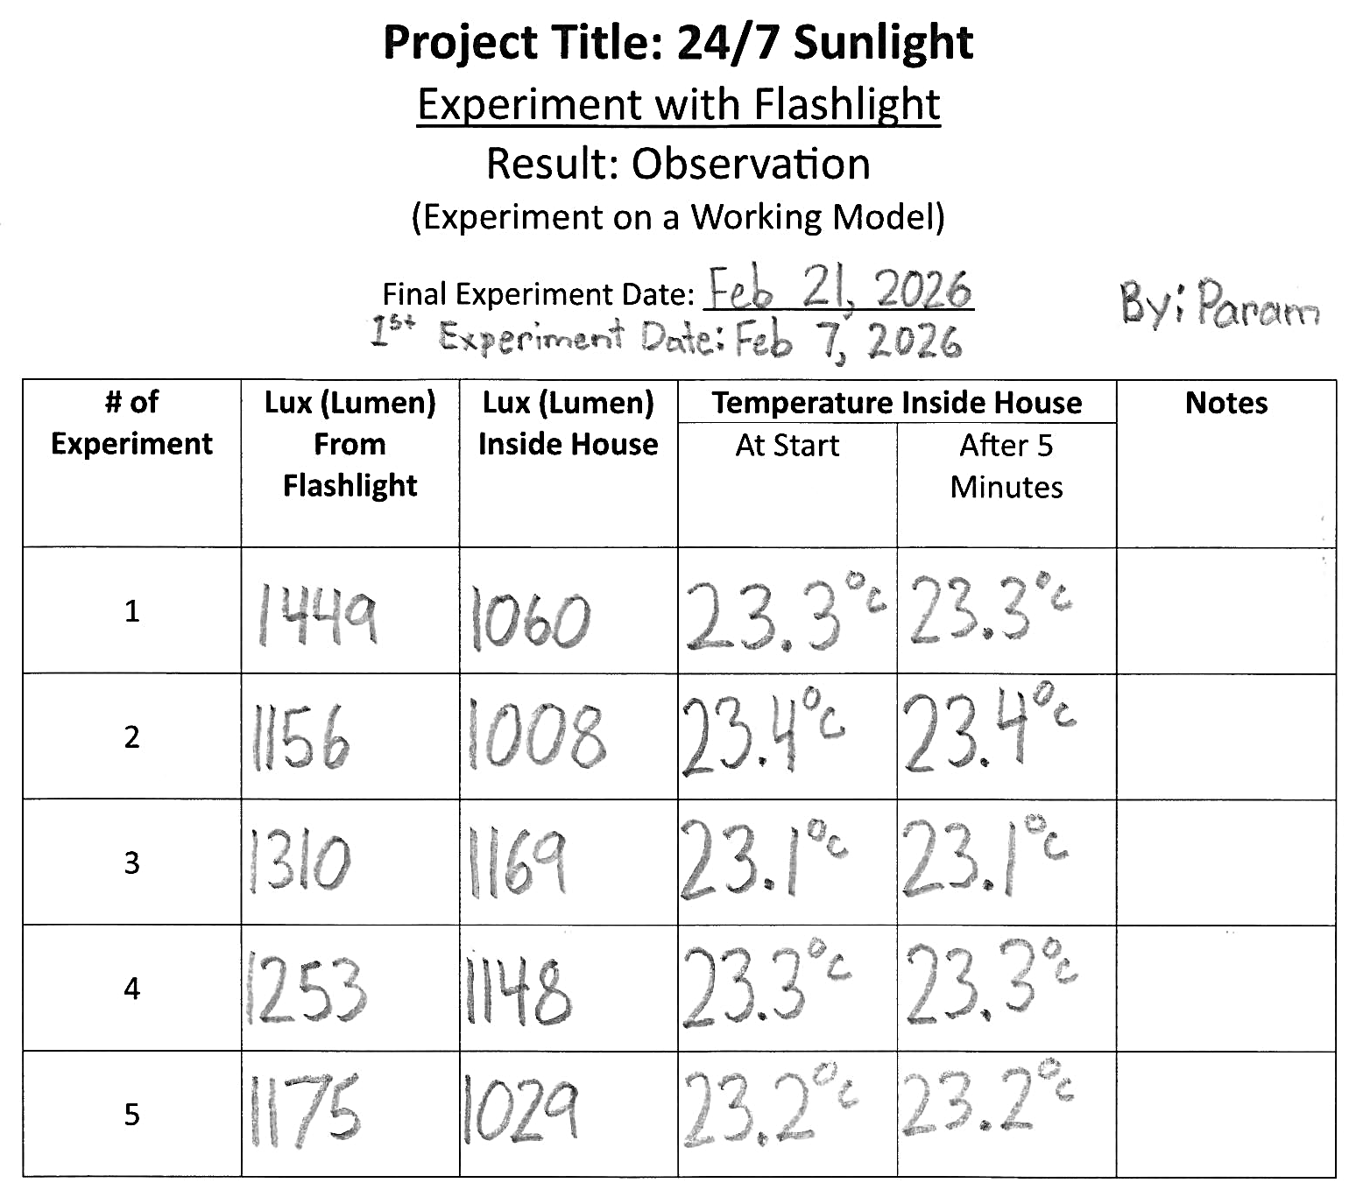
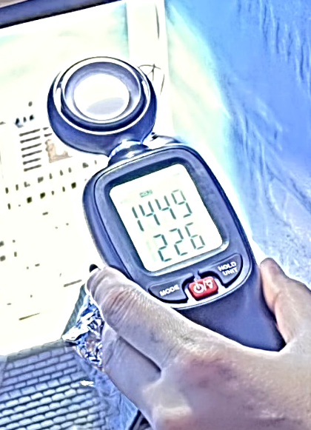
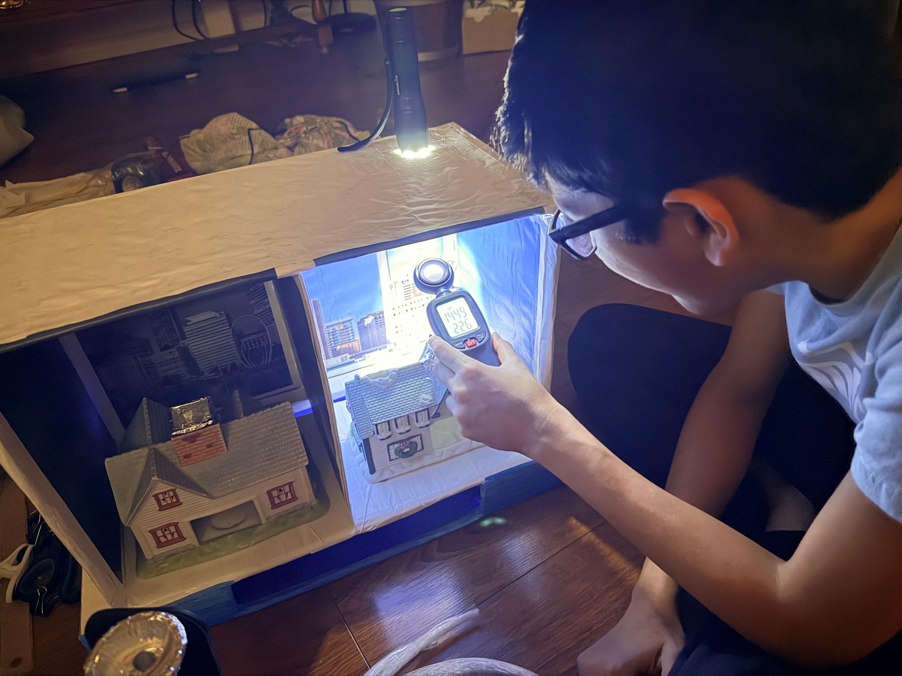
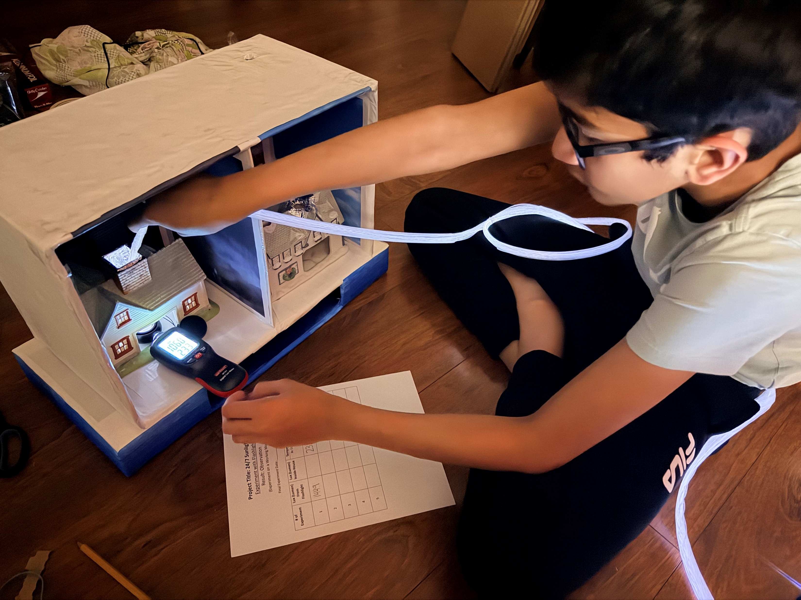

Results .. (Cont.)
‘24/7 Sunlight’ by Param Panchal (Feb 2026)

Slide 20
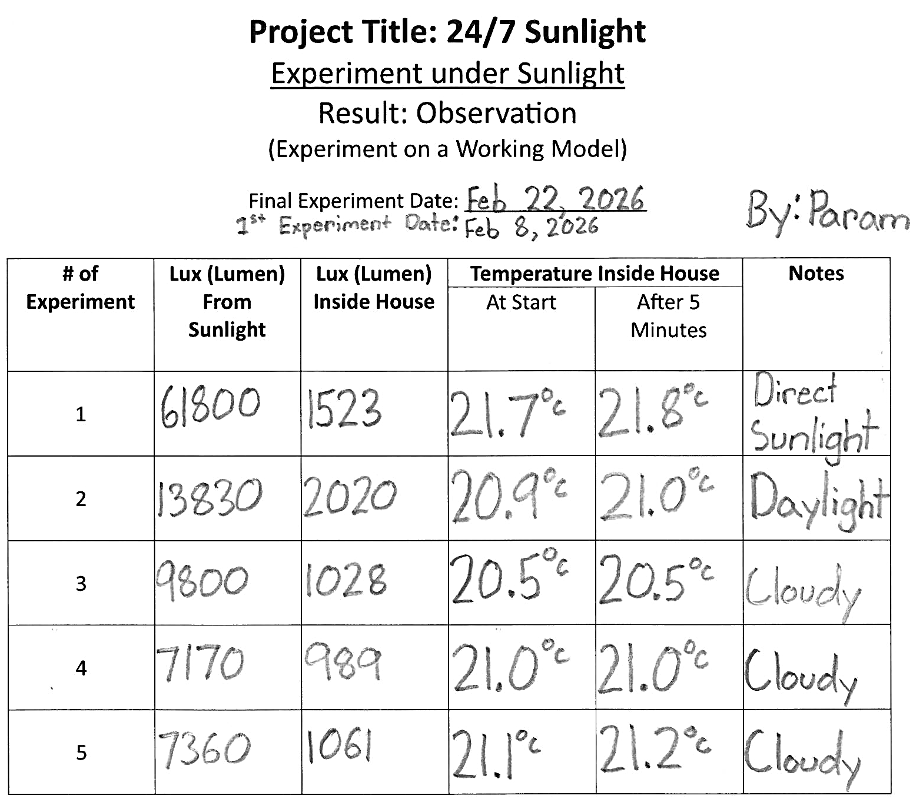
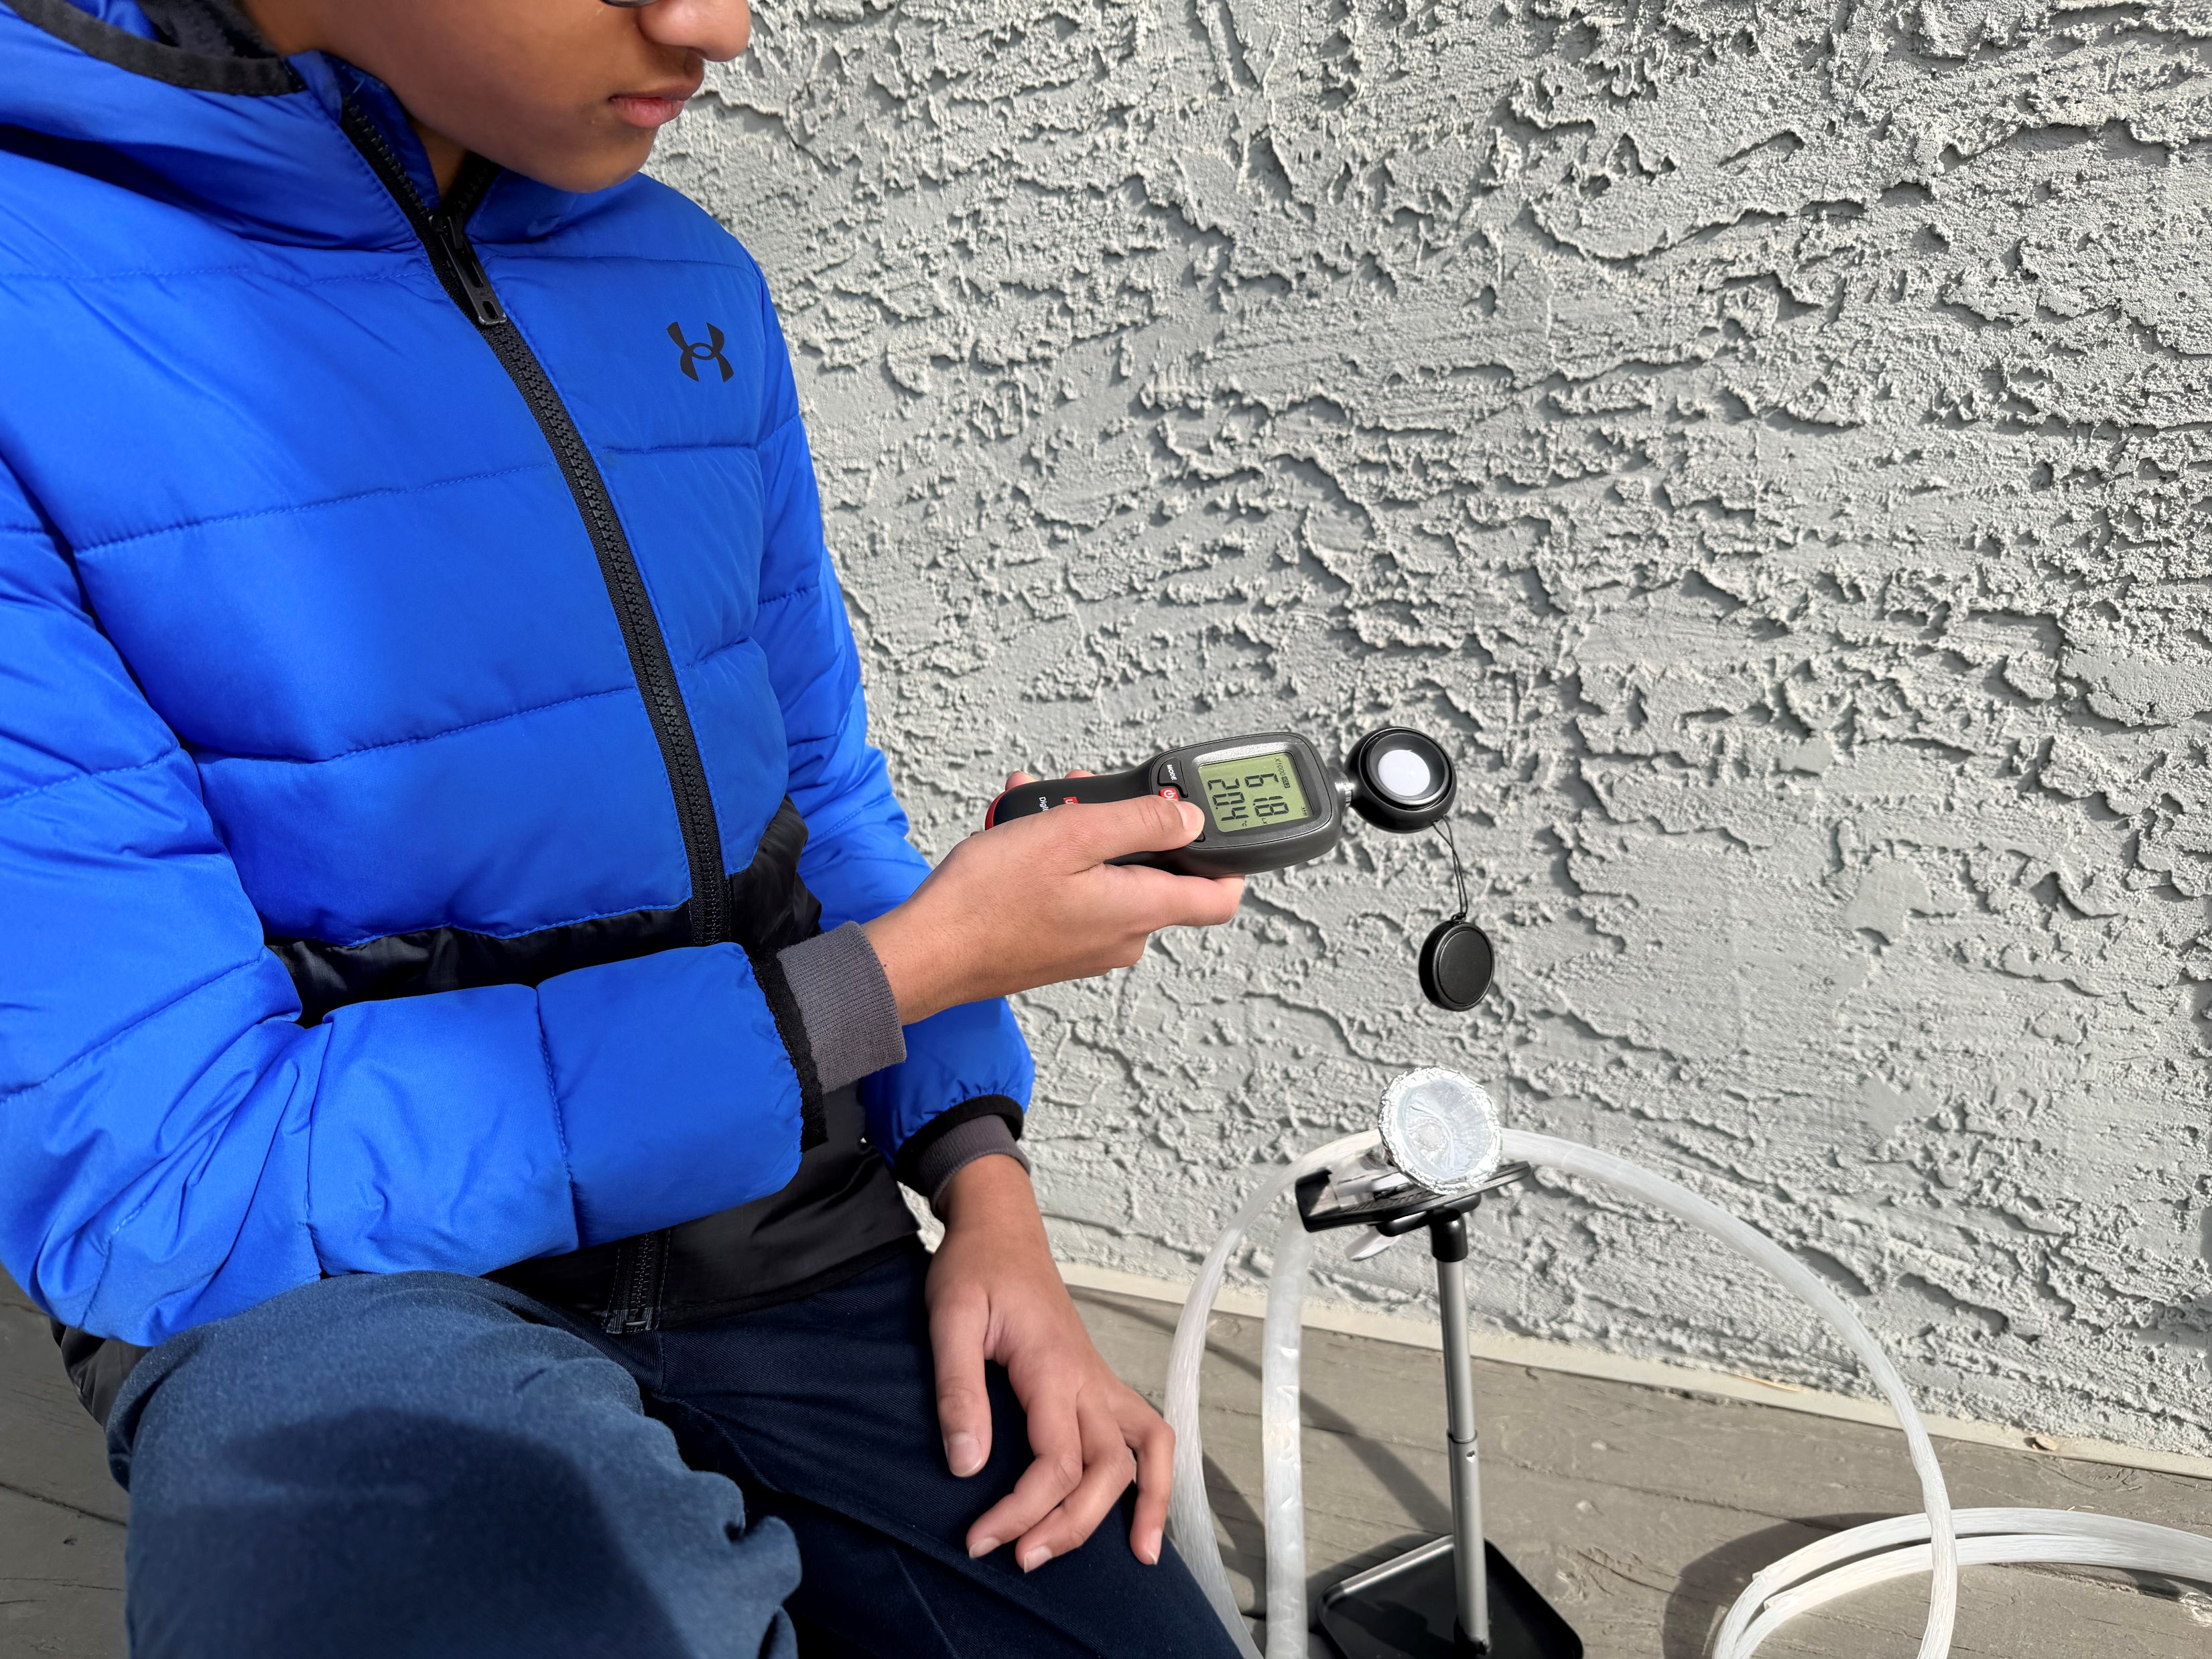

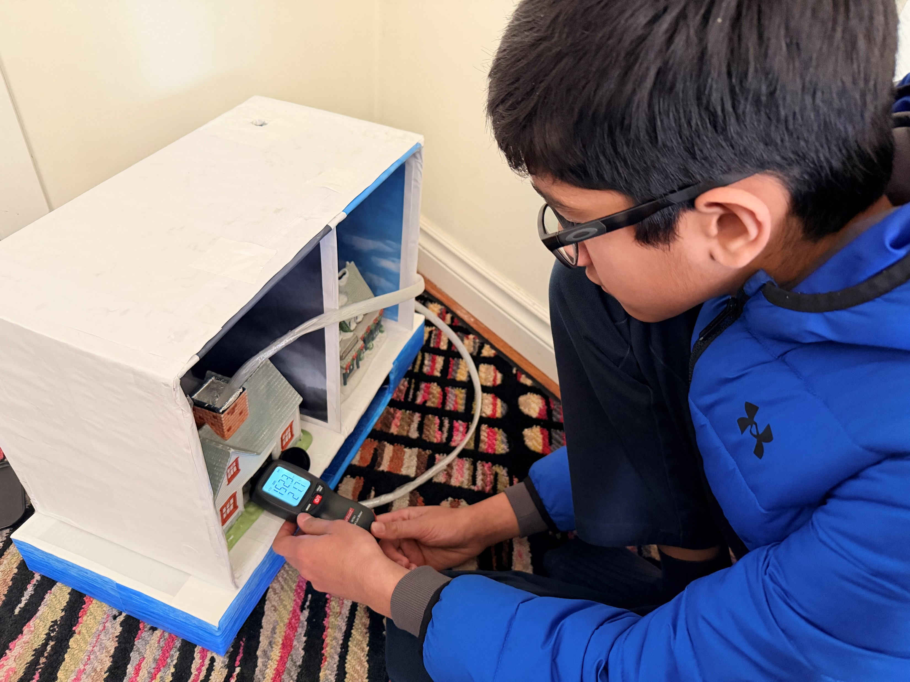

Results .. (Cont.)
‘24/7 Sunlight’ by Param Panchal (Feb 2026)

Slide 21
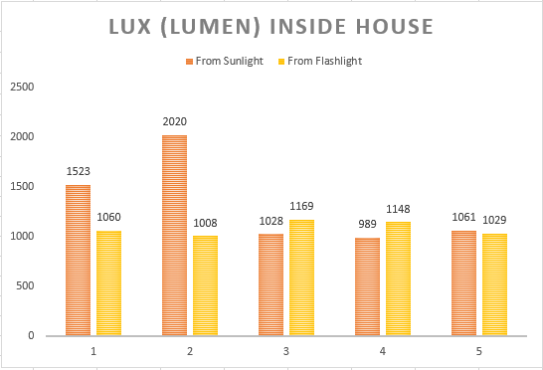
Results .. (Cont.)
‘24/7 Sunlight’ by Param Panchal (Feb 2026)

Slide 22
Analysis 1
From direct sunlight, we can get between 32,000 to 100,000 Lux (Lumen per square meter)
For daylight (in case sun is hiding behind the clouds), it provides 10,000 to 25,000 Lux (Lumen per square meter)
In our house, normally we need about 100 to 500 Lux (Lumen per square meter) for our daily usage
The maximum we would need is for small and detailed task, such as on Kitchen worktops. It would need to be between 500 to 700 Lux (Lumen per square meter)
As per my experiment under Sunlight and with a Flashlight, I found that the light illuminates above 1,000 Lux (Lumen per square meter)
1,000 Lux (Lumen per square meter) is more than enough for all our daily illumination usage
‘24/7 Sunlight’ by Param Panchal (Feb 2026)

Slide 23
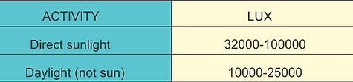
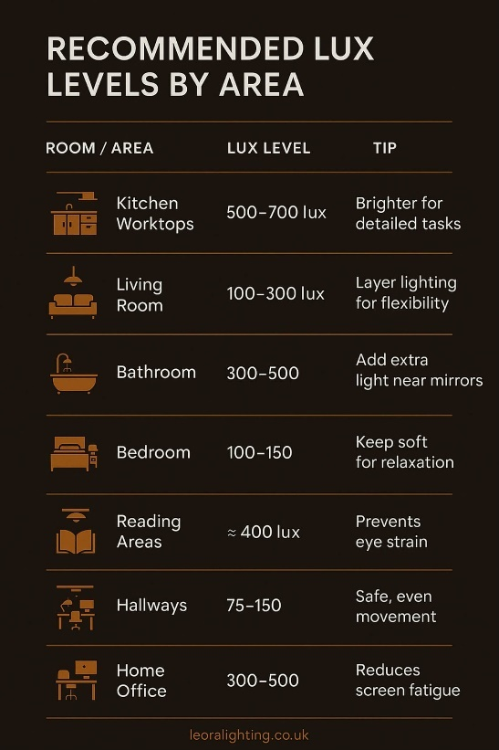
Analysis 1 .. (Cont.)
‘24/7 Sunlight’ by Param Panchal (Feb 2026)
Photo Sources: https://www.lumenarts.net/manuals
Photo Sources:
https://leoralighting.co.uk/blogs/the-glow-guide/how-bright-your-light-should-be?srsltid=AfmBOopktNcmz8mZdfp-5qbIt_xmUPbP4EE2xGyYyHqhM3zc60o5KUJq

Slide 24
Analysis 2
The speed of light
The speed of light is very fast and efficient because it travels at 300,000,000 meters per second (300,000 km/s) in a vacuum
In fiber optic cables (made with silica glass), the speed of light will be slower by 30%. The speed of light will be approximately 200,000 km/s in a fiber optic cable
‘24/7 Sunlight’ by Param Panchal (Feb 2026)

Slide 25
Analysis 2 .. (Cont.)
Calculation:
n = c / v
  n = Light refraction index / Electromagnetic waves
  c = Speed of Light in a vacuum (300,000 km/s)
  v = Speed of light in a material/medium
The refractive index of fiber optic cables (made with silica glass) n = 1.5
  v = c / 1.5
  v = 300,000 / 1.5
  v = 200,000 km/s in a fiber optic cables
So, the speed of light is 200,000 km/s in a fiber optic cable.
As per my project, the fiber optic cable can transfer the light quickly from one place to the other without losing that much light.
‘24/7 Sunlight’ by Param Panchal (Feb 2026)

Slide 26
Conclusion
My hypothesis is true:
We can maximize the use of natural sunlight (Controlled Variables) and transmit direct sunlight inside the house/ building (Controlled Variables) for illumination (Dependent Variables) from the roof of the house (Controlled Variables) through the fiber optic cable (Independent Variables).
Likewise, we can transmit sunlight from the daytime location to the nighttime antipodal location through the fiber optic cable (Independent Variables).
My experiment answers the missing piece of my background research:
Fiber optic cable is very efficient to transfer light very quickly and we can transmit the Sunlight in homes and workplaces, even from daytime location to the nighttime location.
Importance of energy to the world:
We found another way to harness 24/7 sunlight for illumination and reduce dependence on artificial lighting, even during nighttime.
‘24/7 Sunlight’ by Param Panchal (Feb 2026)

Slide 27
Next Steps
Daytime Location
We can install the dome on the roof of the house and the big building with the fiber optic cable and end inside the house with the reflector dome for illumination during the daytime.
Daytime to Nighttime Location
The distance between Calgary and Vancouver is 972 Kilometers by road, and Vancouver to Perth, Australia by cargo ship (by sea) distance is 16,862 kilometers
In total, the distance is 17,834 kilometers between Calgary, Canada and Perth, Australia
As per current undersea cable network, the cost for installing the cables under the sea is really high, from $6,000 to $20,000 per kilometer
  The cost depends on number of cables and the distance or amount of fiber optic cables
‘24/7 Sunlight’ by Param Panchal (Feb 2026)

Slide 28
Next Steps .. (Cont.)
The approximate cost for the real-life big scale project (From Calgary, CA to Perth, AU)
  Total cost may be: $10,000.00/kilometer for 18,000.00 km = $180 million
Population of Canada is 41,549,366 currently (as on February 11, 2026)
If each residence of Canada donates or gives $4.34, it will cover the whole cost of installing the fiber optic cable
We can transmit sunlight for illumination from the daytime location to the nighttime antipodal location
After installing the fiber optic cable network for illumination, there will not be No electricity bills for lighting
Need more research and experiment for the real-life large-scale project and the expert engineers would study for the practicability of my project for the real-life large-scale project.
‘24/7 Sunlight’ by Param Panchal (Feb 2026)

Slide 29
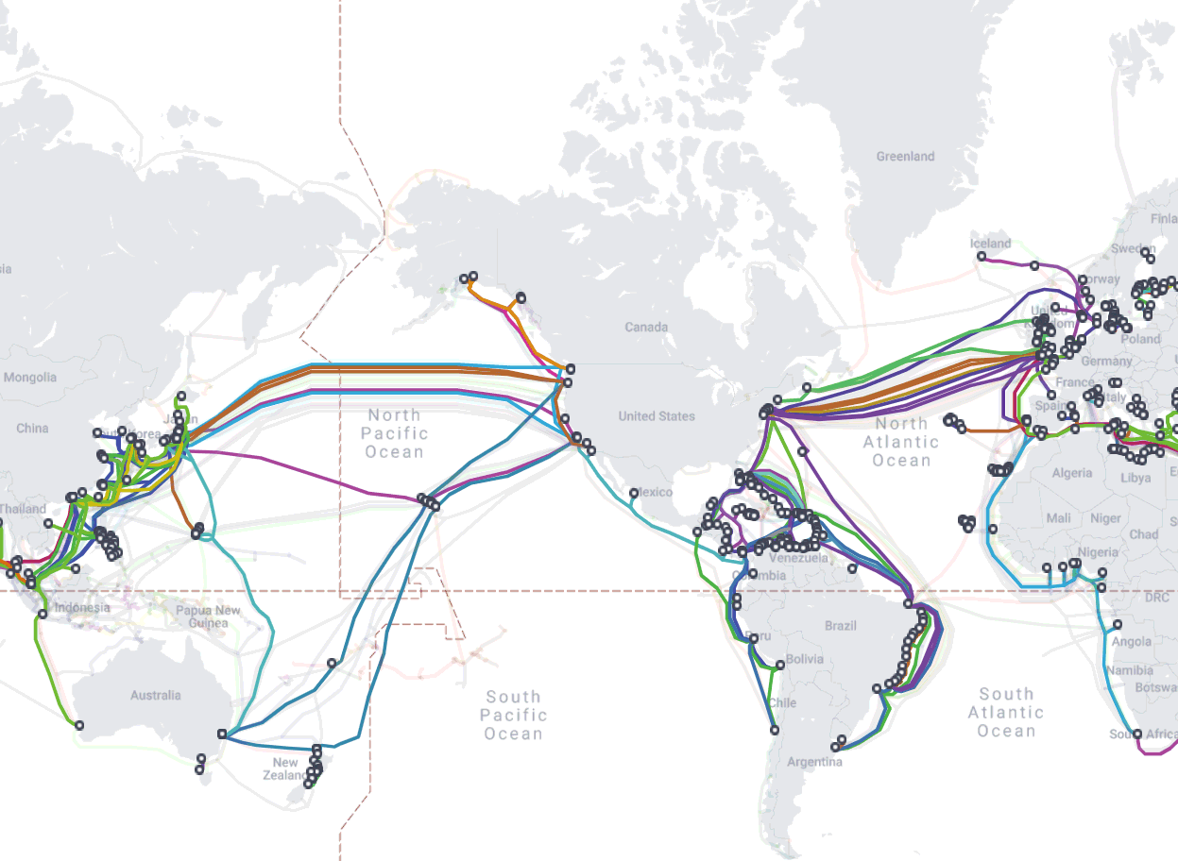
Next Steps .. (Cont.)
‘24/7 Sunlight’ by Param Panchal (Feb 2026)
Photo Sources:
https://www.theigc.org/blogs/can-internet-access-lead-improved-economic-outcomes

Slide 30
Sources of Error
Measurement Errors: (during conducting experiments):
During the observation of my working model, Sunlight strength is not constant during the day because of the clouds.
Machine / Mechanism errors:
Light Meter is more sensitive and the readings to hit their maximum limit under direct sunlight
Illuminance accuracy +/- 1000 Lux as per Light Meter description
Temperature accuracy +/- 1 Celsius as per Light Meter description
Fiber optic cable:
Plastic fiber optic cable with good quality (not the best quality) is used for my working model. The cable helps to reduce heat while transmitting light.
There are different types of high-quality optic cable that can be used for real-life project and for underwater usage.
‘24/7 Sunlight’ by Param Panchal (Feb 2026)

Slide 31
Sources: Citations
Websites: For Project Research
Fiber Optic Cable
  https://www2.telegeography.com/submarine-cable-faqs-frequently-asked-questions#:~:text=As%20of%20early%202025%2C%20we,kilometer%20Asia%20America%20Gateway%20cable.
  https://www2.telegeography.com/submarine-cable-faqs-frequently-asked-questions
  https://en.wikipedia.org/wiki/Submarine_communications_cable
  https://www.kentik.com/blog/diving-deep-into-submarine-cables-undersea-lifelines-of-internet-connectivity/
  https://resources.telegeography.com/the-economics-of-submarine-cables#:~:text=Building%20these%20systems%20requires%20enormous,permitting%20processes%20across%20multiple%20jurisdictions.
  https://www.subseacables.net/reports-and-coverage/world-oceans-day-2025-why-our-digital-future-depends-on-the-deep/
  https://www.bbc.com/news/technology-17340700
  https://www.aflhyperscale.com/articles/techsplainer-light-series-the-speed-of-light/
  https://wecomfiber.com/fiber-optic-speed-internet-at-the-speed-of-light/
  https://en.wikipedia.org/wiki/Fiber-optic_cable#:~:text=Propagation%20speed%20and%20delay%20Optical%20cables%20transfer,for%201000%20km%20is%20around%2011%20milliseconds.
  https://en.wikipedia.org/wiki/Speed_of_light#:~:text=The%20speed%20at%20which%20light,/s)%20slower%20than%20c.
  https://lightcolourvision.org/diagrams/refractive-index-explained/
‘24/7 Sunlight’ by Param Panchal (Feb 2026)

Slide 32
Sources: Citations .. (Cont.)
Light Energy
  https://www.alliantenergykids.com/renewableenergy/renewableenergyhome
  https://www.alliantenergykids.com/renewableenergy/solarenergy
  https://www.lumenarts.net/manuals
  https://leoralighting.co.uk/blogs/the-glow-guide/how-bright-your-light-should-be?srsltid=AfmBOopktNcmz8mZdfp-5qbIt_xmUPbP4EE2xGyYyHqhM3zc60o5KUJq
Distance
  https://www.fluentcargo.com/routes/vancouver-ca/perth-au
  https://www.travelmath.com/distance/from/East+Perth,+Australia/to/Vancouver,+WA
  https://www.travelmath.com/distance/from/Calgary,+Canada/to/Vancouver,+Canada
Statistics
  https://www150.statcan.gc.ca/n1/pub/71-607-x/71-607-x2018005-eng.htm
‘24/7 Sunlight’ by Param Panchal (Feb 2026)

Slide 33
Sources: Citations .. (Cont.)
YouTube
  The Dr. Binocs Show:
  https://www.youtube.com/watch?v=d7yTlp4gBTI
  LaFountaine of Knowledge:
  https://www.youtube.com/watch?v=wOpZz7NIgFY
  Professor Dave Explains:
  https://www.youtube.com/watch?v=pj_ya0e20vE
  Techquickie:
  https://www.youtube.com/watch?v=G1Ke-H8I1uk
  VirtualBrain:
  https://www.youtube.com/watch?v=zAVsTubdd_Q
‘24/7 Sunlight’ by Param Panchal (Feb 2026)

Slide 34
Sources: Citations .. (Cont.)
Websites: For Image (including gif file) for ppt slides
  https://www.thefoa.org/tech/sciproj.htm
  https://www.thefoa.org/tech/sciproj.htm
  https://www.bbc.com/news/technology-17340700
  https://www.core7.co.uk/solar-battery-storage-installer-swindon/
  https://gifs.alphacoders.com/gifs/view/19518
  https://www.atlast.uio.no/
  https://infogram.com/energisol-colombia-1hd12yxez37rw6k
  https://www.lumenarts.net/manuals
  https://leoralighting.co.uk/blogs/the-glow-guide/how-bright-your-light-should-be?srsltid=AfmBOopktNcmz8mZdfp-5qbIt_xmUPbP4EE2xGyYyHqhM3zc60o5KUJq
  https://www.transparentpng.com/cats/sun-172.html
  https://www.dreamstime.com/royalty-free-stock-photo-vector-farm-beautiful-sunrise-created-illustrator-image33120175
  https://pngtree.com/freepng/fiber-optic-cable-on-transparent-background_21695848.html
  https://www.freepnglogos.com/images/arrow-37897.html
  https://creazilla.com/media/clipart/34224/house
  https://www.bbc.com/news/technology-17340700
  https://itopia.ca/telus-business-internet/
  https://www.freepik.com/free-photos-vectors/question-clipart
  https://www.facebook.com/groups/3137177053251945/posts/3485330281769952/
  https://www.innoteck.co.uk/products/fibre-optic-led-lamp?srsltid=AfmBOoqMA4YPItKPNs7-q-Zih2_ZxZtHb5gxjZB81a5T30qpmn-drM9w
  https://www.amazon.ca
‘24/7 Sunlight’ by Param Panchal (Feb 2026)

Slide 35
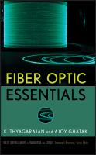

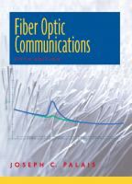
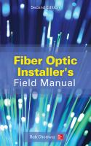
Sources: Citations .. (Cont.)
Books from Calgary Public Library: For Project Research
Fiber Optic Essentials by Thyagarajan, K.
Book, 2007
                The Undersea Network by Starosielski, Nicole
                Book, 2015
Fiber Optic Communications by Palais, Joseph C.
Book, 2005
                Fiber Optic Installer's Field Manual by Chomycz, Bob
                Book, 2015 Second edition
‘24/7 Sunlight’ by Param Panchal (Feb 2026)

Slide 36


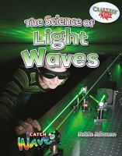
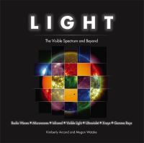
Sources: Citations .. (Cont.)
Books from Calgary Public Library: For Project Research
Light- The Extraordinary Energy That Illuminates Our World by Wade, Jess
Book, 2025
                Light by Amson-Bradshaw, Georgia
Book, 2018
The Science of Light Waves by Johnson, Robin
Book, 2017
                Light - The Visible Spectrum and Beyond by Arcand, Kimberly K.
                Book, 2015
‘24/7 Sunlight’ by Param Panchal (Feb 2026)

Slide 37
Thank you
‘24/7 Sunlight’ by Param Panchal (Feb 2026)

